Slide 1
About Staple Breeze
Apparel logo Design Brief by Kader Bah

Slide 2
Project scope
Create font that will be used on clothes (most pieces will have no logo or a very minimal logo).
Stylized word and font for
Staple Breeze
Minimal logo (black words over white background/white words over black background)

Slide 3
About Staple Breeze
Lifestyle brand focused on comfort/ minimalism/quality (jeans, jackets, t shirts, hoodies, etc).

Slide 4
Brand details
Brand colors
https://color.adobe.com/My%20Color%20Theme-color-theme-18515156

Slide 5
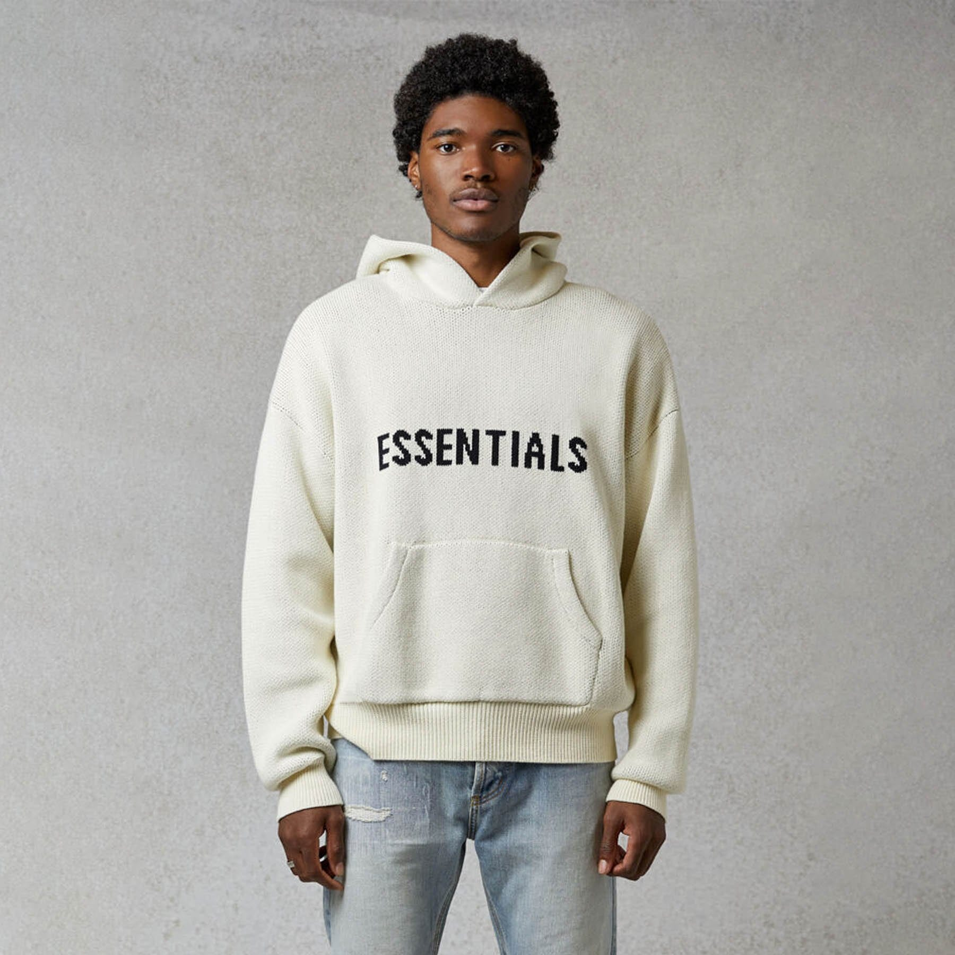
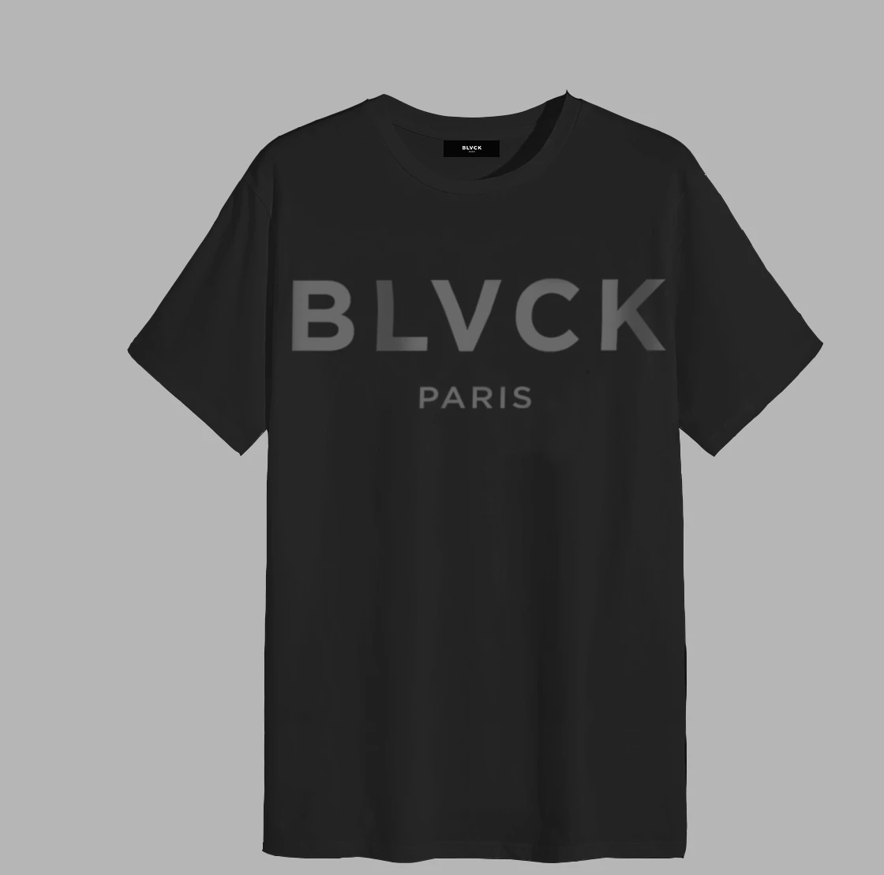
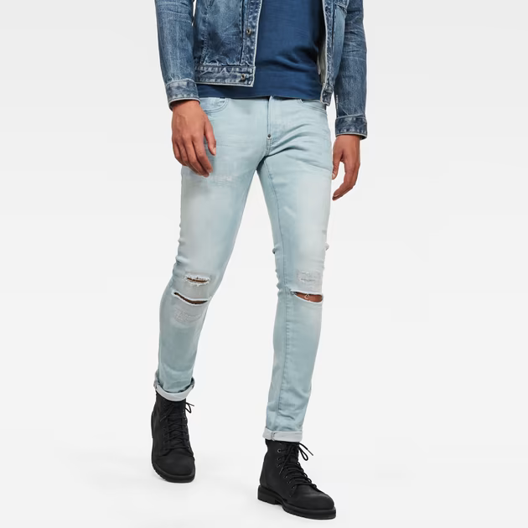
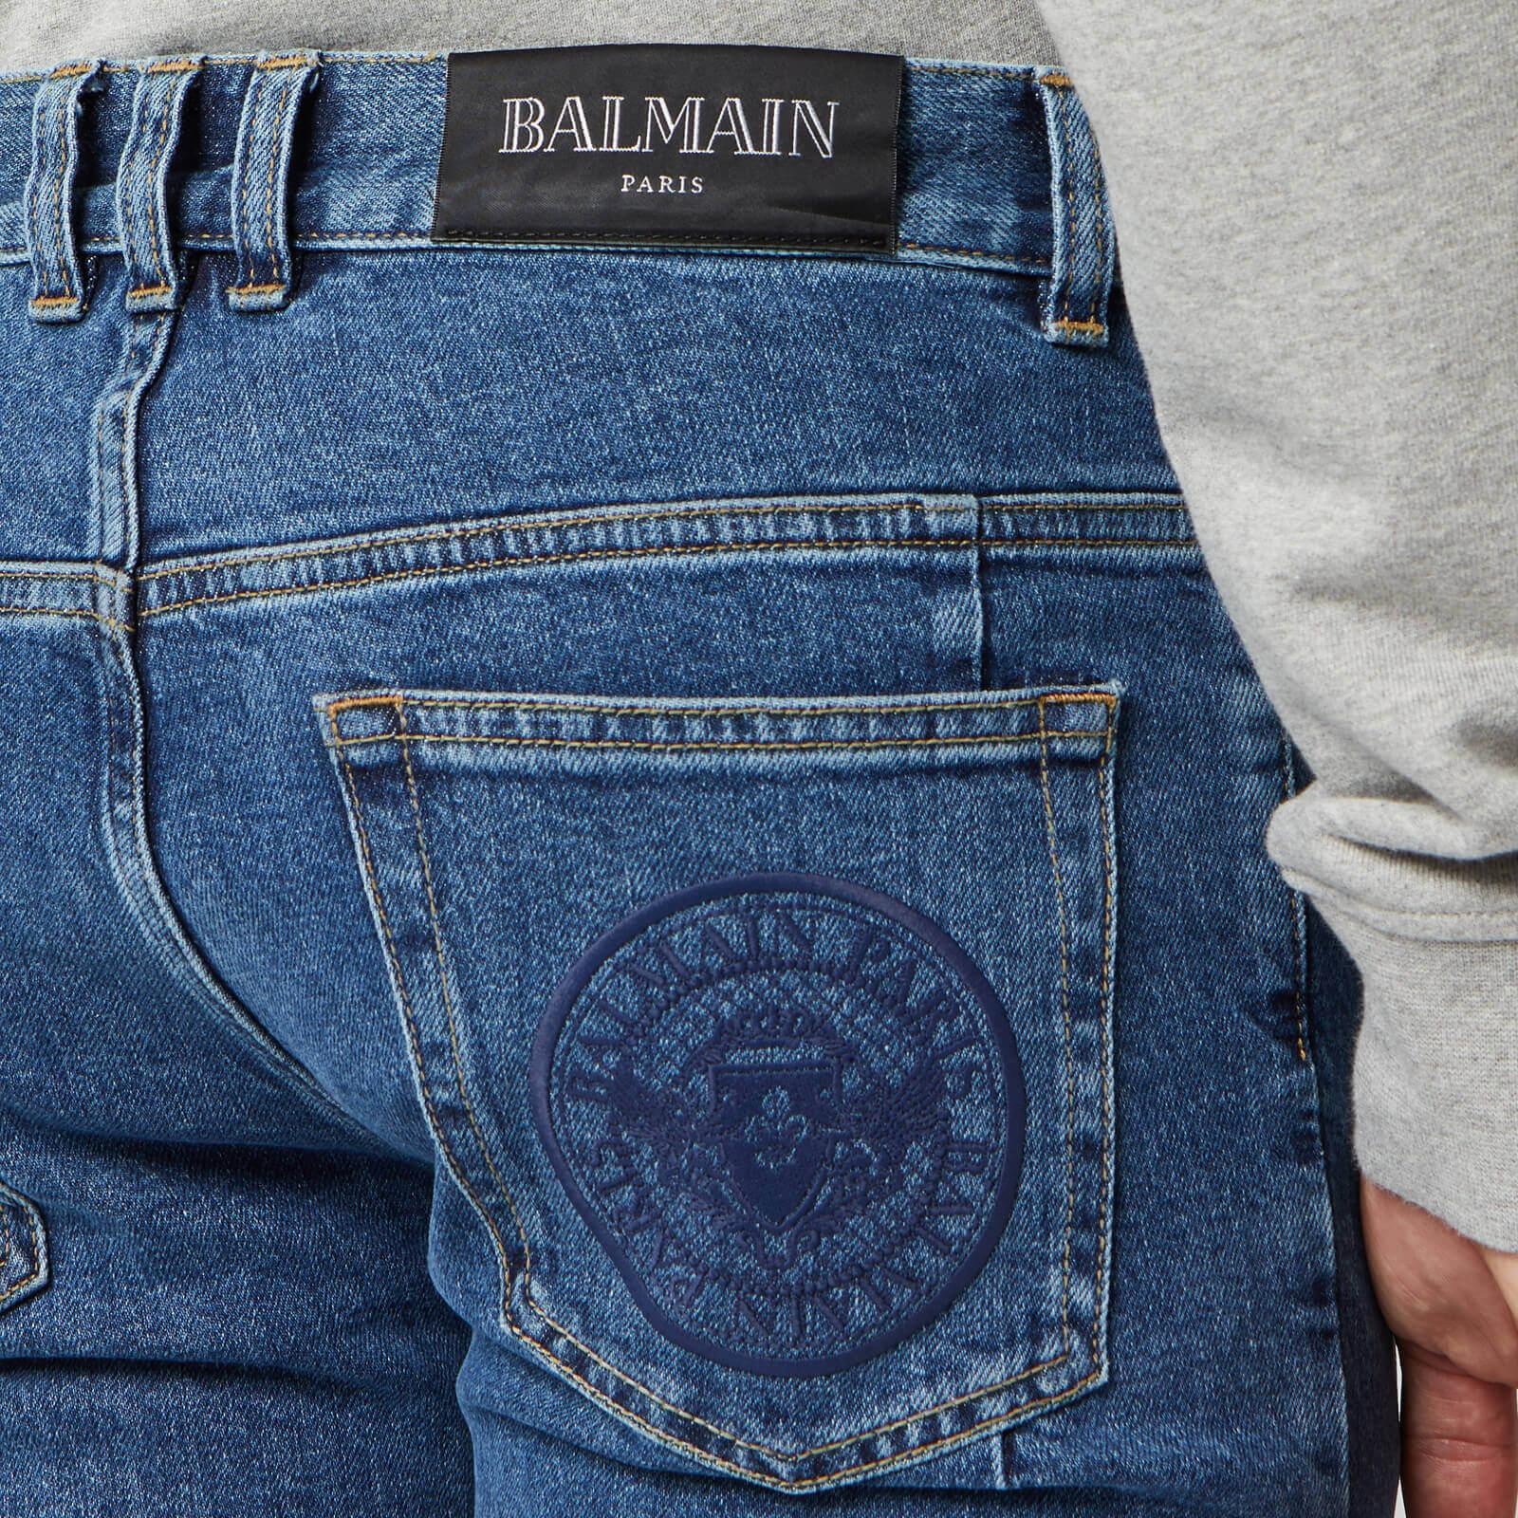
Safe directions to follow

Slide 6
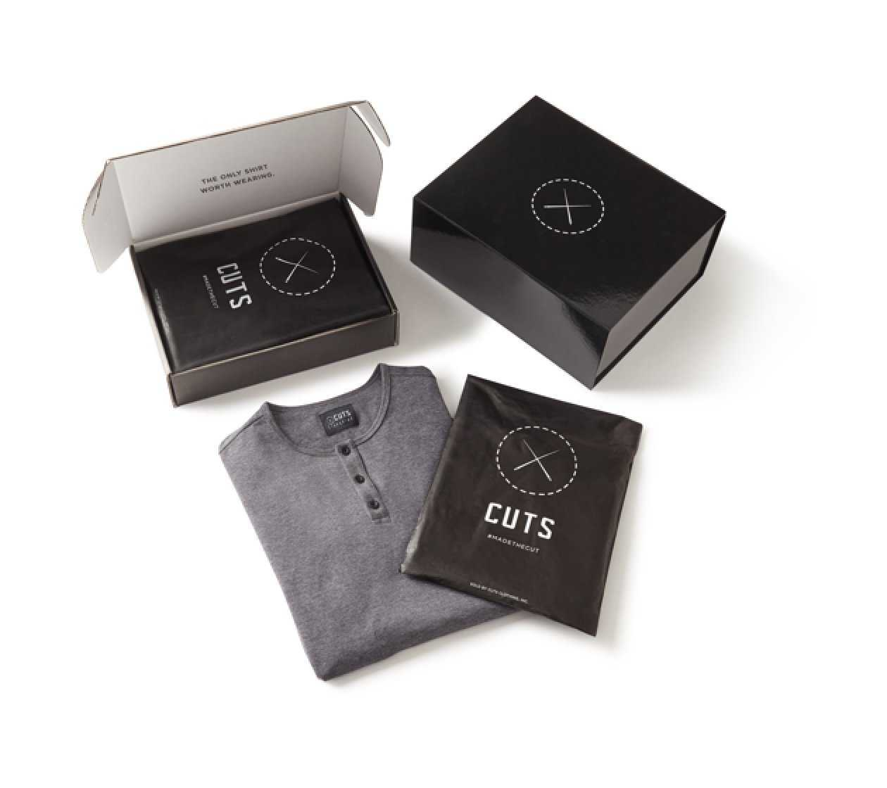
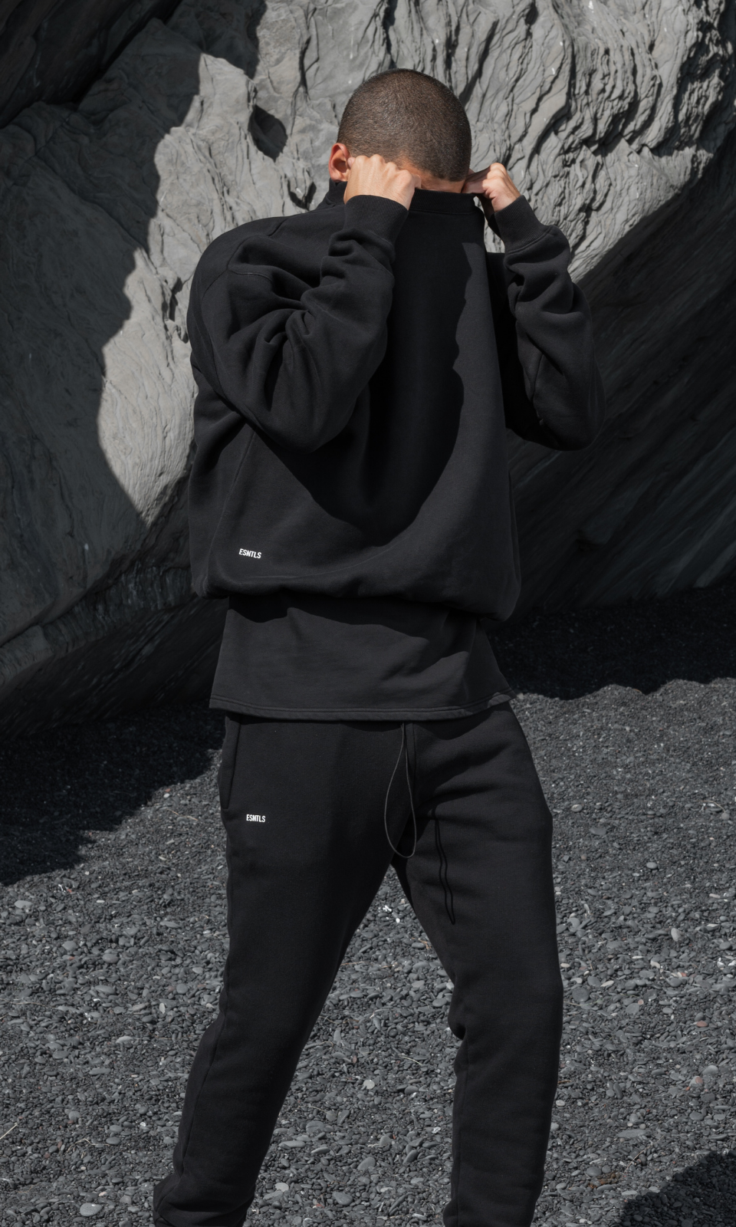
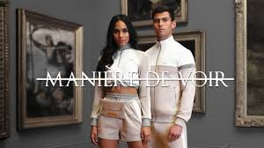
Some brands we are inspired by
Cuts clothing
Manière de voir
ESNTLS

