Slide 1
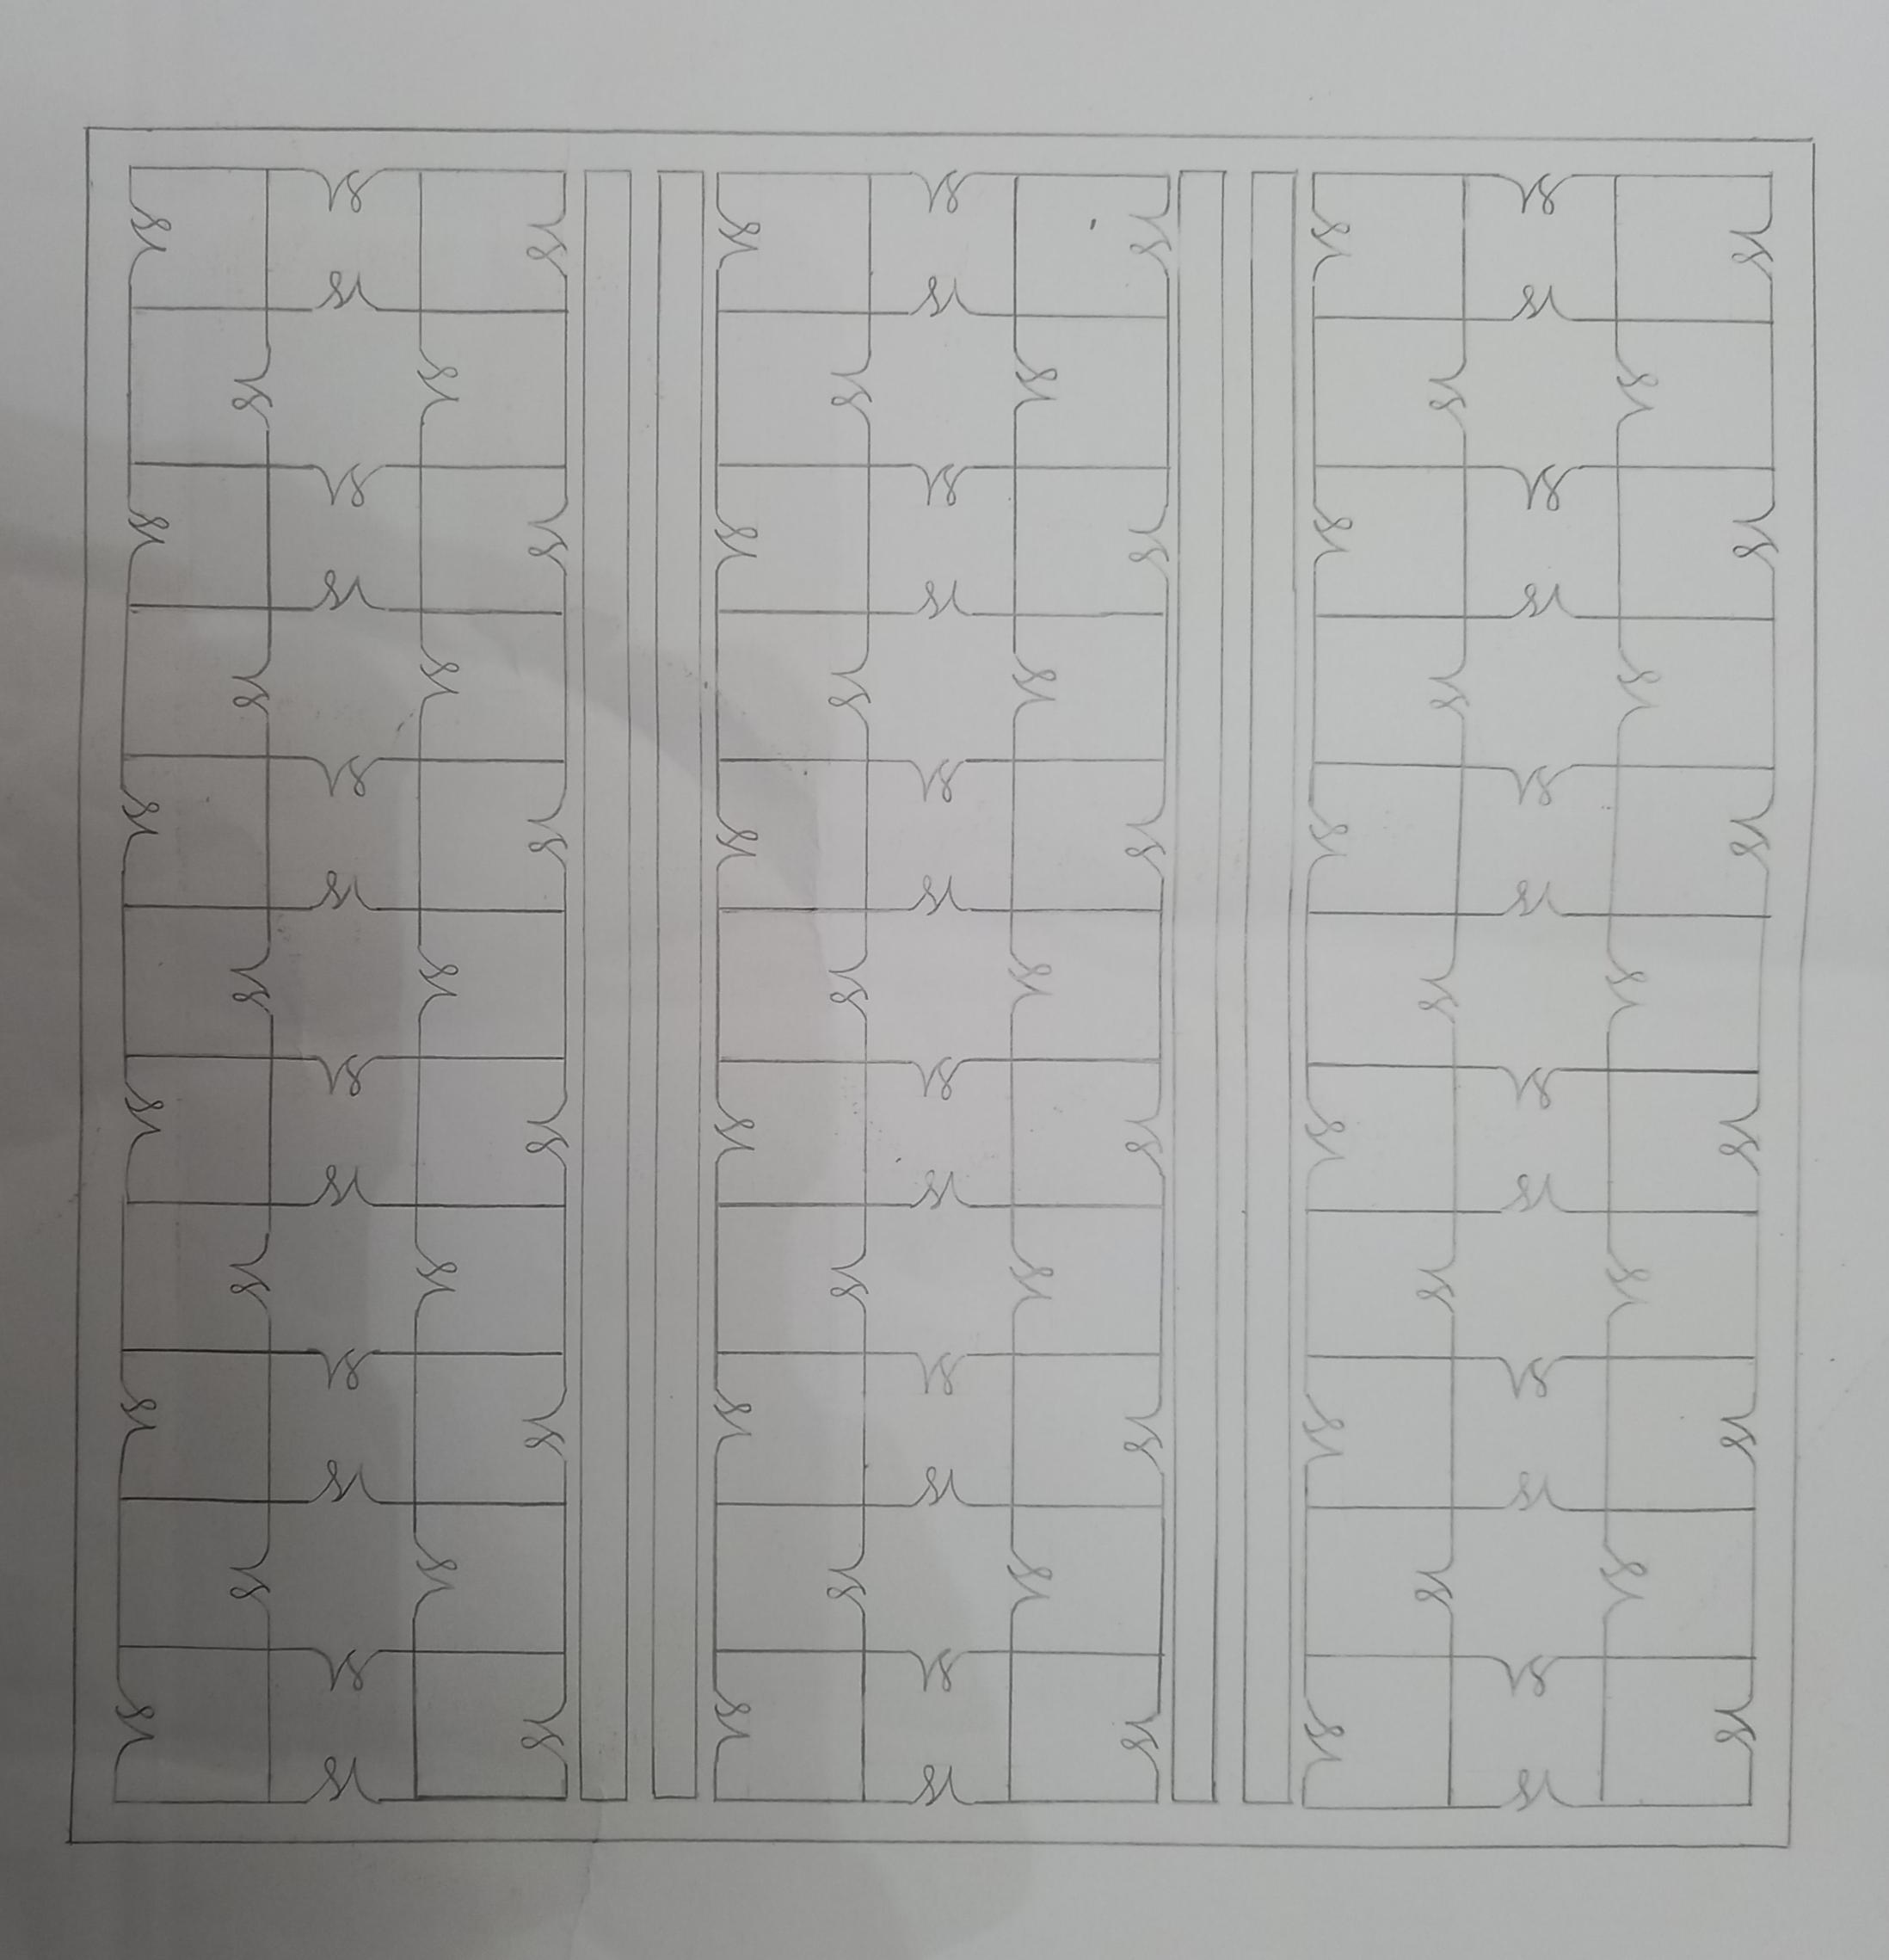
Black Square back ground
4 rectangles a bright grey
SM lines I’d like to be white and thick
Make sure it’s thick enough to see the letters from a decent distance
Unlike the one I’ve provided due to using a pencil
The S must have a loop in it
The length of the s should be the length of the M (half of the M)
Excuse the crinkles in the paper that does need to be incorporated.

Slide 2
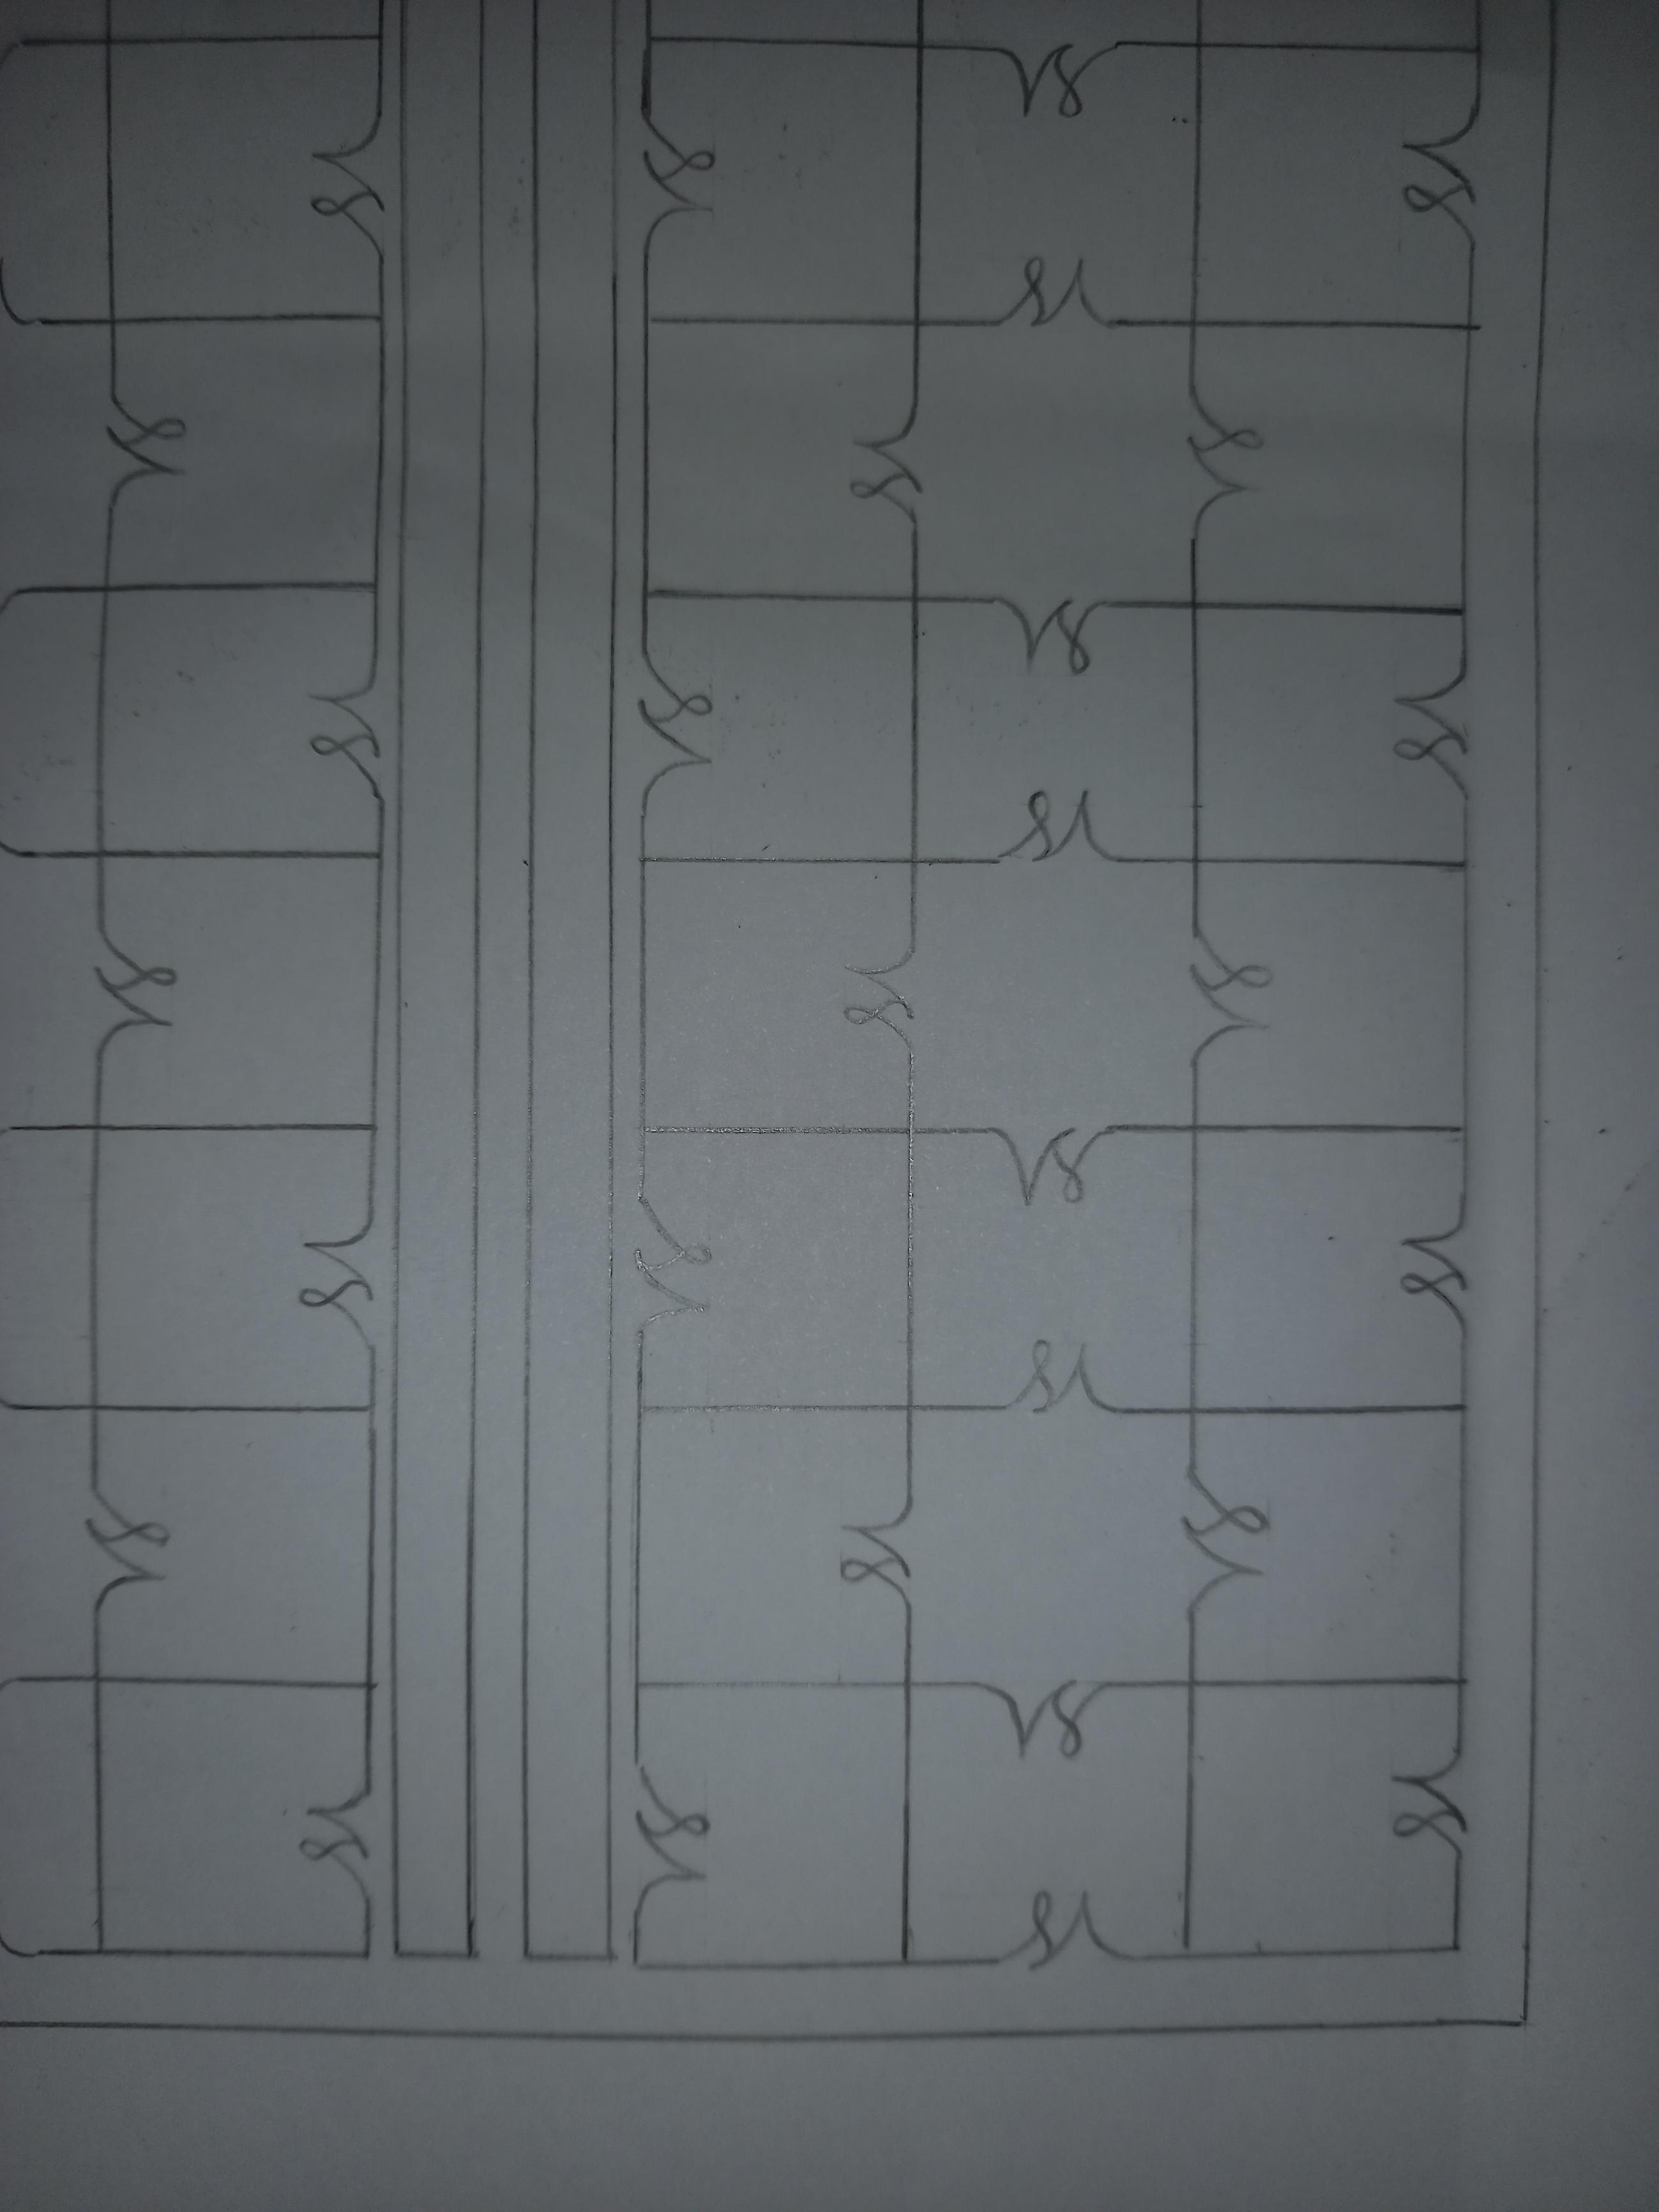
Here is a close up of the design for better understanding.

