Slide 1
SUPPORTING INFORMATION FOR DESIGNERS:
These slides will need to be in the presentation and should be completely reworked in line with the proposed designs
SLIDE 2: the title is ‘Typical project deal structure’ this is a key slide and needs to be attractively presented
SLIDE 4 customize again completely as you see fit, this is just to indicate the information that needs to be communicated in an attractive manner (we are NOT wed to the chequerboard, colours etc and do not want to condition your creativity)
SLIDE 5: reorganize / adapt as you see fit, we just need to highlight the fact that we were selected by international competition for support by the www.icfa.lu
SLIDE 6 (projects) Pictures of projects will be customized to the projects but the structure needs to be standardized as you see best

Slide 2
Typical project deal structure
Client
(fleet owner/operator)
Bank / Other
(vehicle lease)
EPC
(design/construct)
Project SPV
Equipment Supplier
Operations & Maintenance
Investors
(equity & debt)
Project Developer
Opex
Capex
Investment
Service fee ($/km)

Slide 3






Impact Measurement and Reporting
Vai Capital is committed to sound risk management, responsible operations and to furthering the Paris Objectives and SDGs. Private placements will incorporate impact metrics as appropriate. Managed funds will operate a Measuring, Reporting and Verifying (MRV) system for the climate and sustainable development impact of individual projects and on a portfolio level.
Fund investment processes will be certified for alignment with the UN Sustainable development goals
Impact indicators will be established and reported on for projects and portfolios of future funds

Slide 4

Vision The full sustainable electrification of road vehicle transport globally. | Mission To deliver climate mitigation, health and other SDG impacts at scale, through electrification of commercial vehicle fleets. | Impact and returns We aim to generate attractive financial returns, as well as environmental, social and economic impact, with a primary focus on climate mitigation health and cities.
Providing project finance We are looking to deploy capital to vehicle electrification projects in the form of equity and/or debt. | Arranging Private Placement Vai Capital arranges private investment in vehicle electrification projects. We offer financial advisory and impact management services. | Building dedicated funds We will deliver a series of investment strategies, primarily in developing markets, and establish and advise distinct investment funds to deliver them. Vai Capital will advise an Authorised Investment Fund Manager (AIFM) in Luxembourg.
Unlocking growth We expect to unlock global fast-growing and scalable markets for investment in electric vehicles and their charging infrastructure, contributing to delivery of the Paris Agreement. | Established track record In renewable energy infrastructure (30% IRR), EV and energy efficiency project development, fund conception, structuring, marketing and management. | Selected for support Selected for support by the International Climate Finance Accelerator Luxembourg.

Slide 5
Supported by ICFA
www.icfa.lu
“We support innovation and high impact investment strategies to grow tomorrow’s climate finance leaders.”

Slide 6

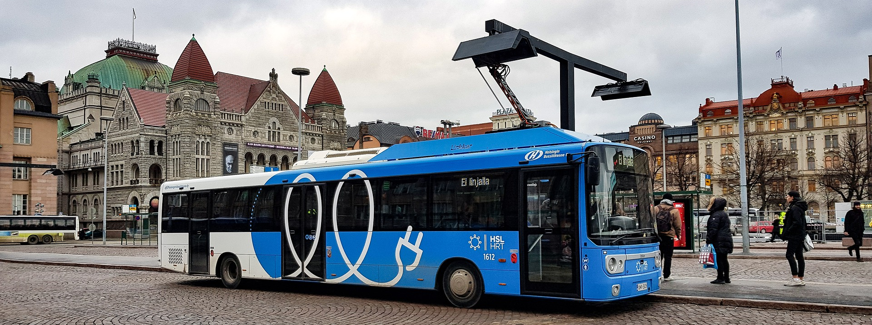
Pipeline project Example (Europe)
Client | A European Municipality | Ticket size | US $xx M (estimate)
Vehicles | XXX electric buses XXX electric cars XXX electric refuse collection trucks | Emissions reduction | 39,700t CO₂ 25.8t NOx 18.3t PM2.5
Charging CAPEX | US $XXXM (estimate) | Project scaling potential | Additional XXX buses

