Slide 1

Brief Logo – Automation & Efficiency Lab’

Slide 2

Who we are ?
Losam Agency, marketing agency specializing in the creation and animation of communities.
Losam Agency created “Automation & Efficiency Lab’” for the company Abbyy, the first think tank dedicated to “intelligent” automation of documents processing to improve efficiency and operational excellence of organizations.
The “Automation & Efficiency Lab’” is :
1 founding committee composed of 6/8 leaders which will define the themes of the different meetings
5 meetings a year (1 dinner + 4 breakfasts meetings)

Slide 3

c
Who is Abbyy ?
ABBYY empowers organizations to gain a complete understanding of their business processes and the content that fuels them with its Digital Intelligence platform. ABBYY technologies are used by more than 5,000 companies, including many of the Fortune 500, and is recognized for its leadership in Intelligent Document Processing (IDP) and Process Discovery & Mining for driving significant impact where it matters most: customer experience, effectiveness, profitability, and competitive advantage. ABBYY is a global company with offices in 14 countries.

Slide 4
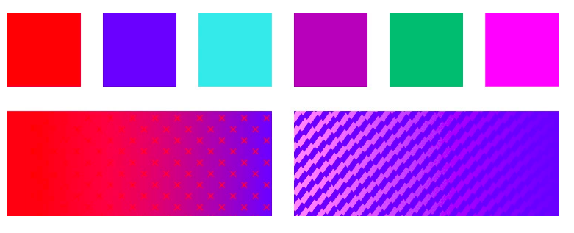
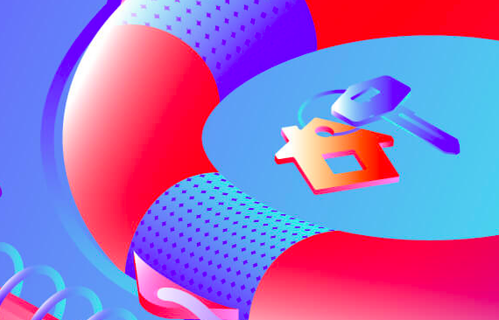
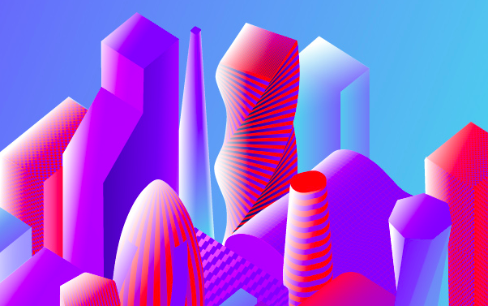
Abbyy - Brand Guidelines
See document enclosed for more details and visit https://www.abbyy.com/company/media-and-brand-center/

Slide 5
Automation & Efficiency Lab’
Target :
Decision-makers in charge of continuous improvement and operational excellence, particularly within Shared Services Centers, Centers of Excellence and Service Centers.
Positioning :
The Lab brings together decision-makers in charge of continuous improvement and operational excellence, particularly within Shared Services Centers, Centers of Excellence and Service Centers. The objective is the sharing and co-creation of best practices in automation, particularly documents processing, to improve the efficiency of organizations.
Baseline :
« The first think tank dedicated to “intelligent” automation of documents processing to improve efficiency and operational excellence of organizations. »

Slide 6
Brief
What : Creating a logo
Logo text : Automation & Efficiency Lab’
Elegant
Fun
Traditionnal
Personal
Feminine
Colored
Low end
Bold
Serious
Modern
Professional
Masculine
Black & White
High-end
v
v
v
v
v

Slide 7

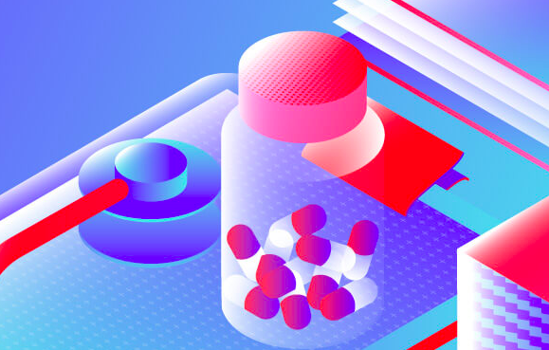

c
DNA of Abbyy
https://www.abbyy.com/company/media-and-brand-center/

Slide 8

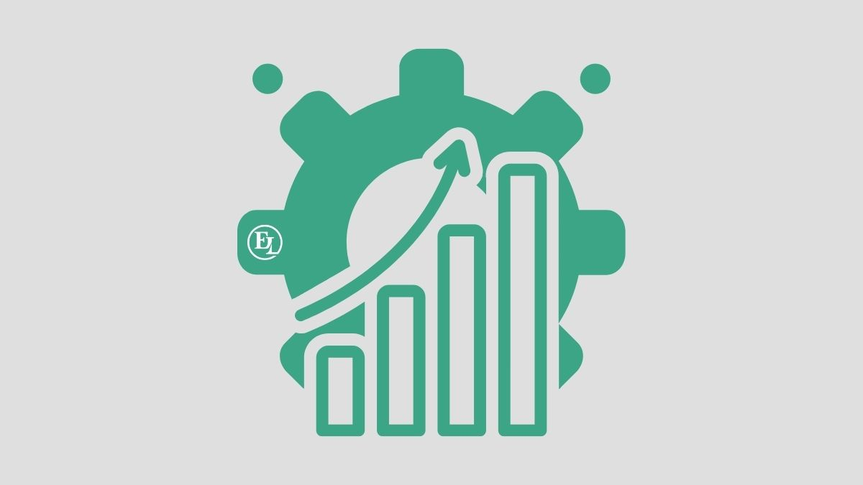

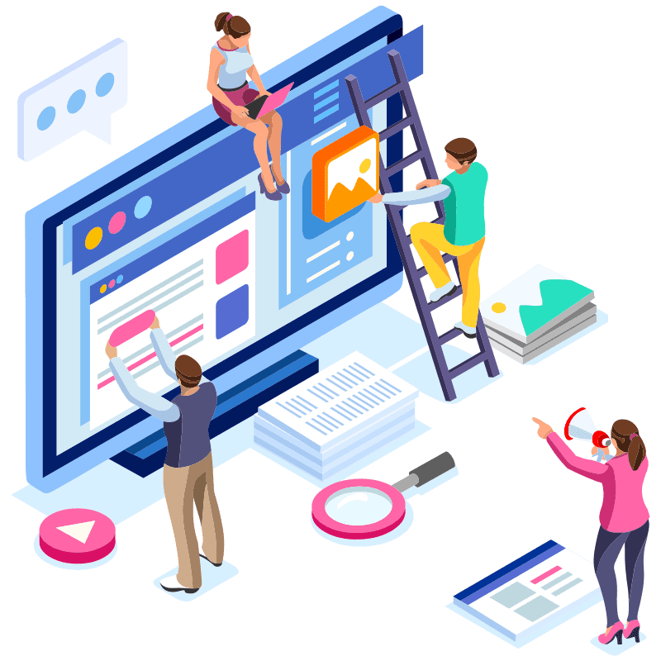
Inspirations

