Slide 1
Client & Data Centric Lab’
Sujet
Brief Logo

Slide 2
Who we are ?
Losam Agency is a BtoB marketing agency specialized in the creation and animation of CxOs communities.
Losam Agency created “Client and Data Centric Lab’” for ClaraVista, the first think-tank dedicated to CRM and Data Marketing leaders.
What is “Client and Data Centric Lab’” ?
1 founding committee composed of 6/8 leaders which will define the themes of the different meetings.
5 meetings a year (1 dinners + 4 breakfasts meeting).

Slide 3
Who is ClaraVista ?
At ClaraVista we have been developing our marketing expertise for over 15 years in various industries (luxury, retail, cosmetics, media & telco, B2B...) and internationally.
We build tailor-made delivery teams gifted with a genuine ability to manage projects – from strategy to operations.
Our motto is to create "Augmented Intelligence"​ – symbiosis of artificial and human intelligences for a successful customer experience. We guide our clients to leverage their talents and their data capital, by combining ambition and pragmatism.

Slide 4
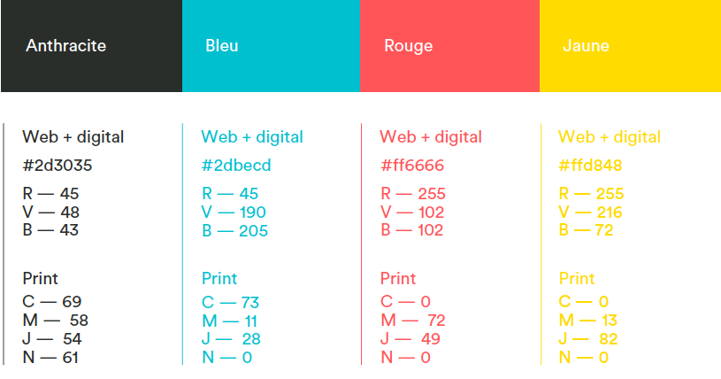
ClaraVista - Brand Guidelines / Do
Abstract and sleek designs are priviliged with a data or new tech scope.
Four Colors:

Slide 5
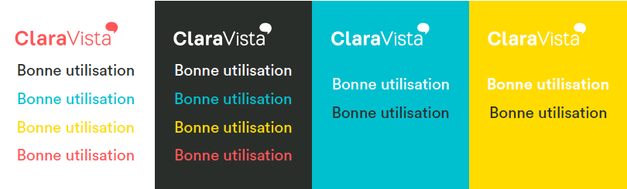
ClaraVista – Brand Guidelines / Do
Combinations:
On a white bottom, the red color is privileged.

Slide 6


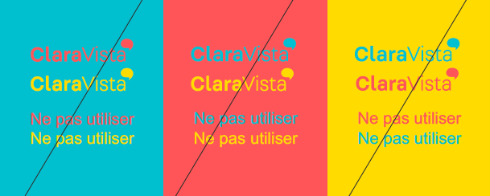
ClaraVista – Brand Guidelines / Don’t
Avoid complex images and bright colors
This should not be used by itlsef, but only above « ClaraVista »:
Impossible combinations examples:

Slide 7


Brief
What : Creating a logo
Sector : Marketing, Data
Font: CIRCULAR STD
Logo text :Client & Data Centric Lab’
Elegant
Fun
Traditional
Personal
Feminine
Colored
Low-end
Audacious
Serious
Modern
Professional
Masculine
White & Black
High-end
v
v
v
v
v

Slide 8
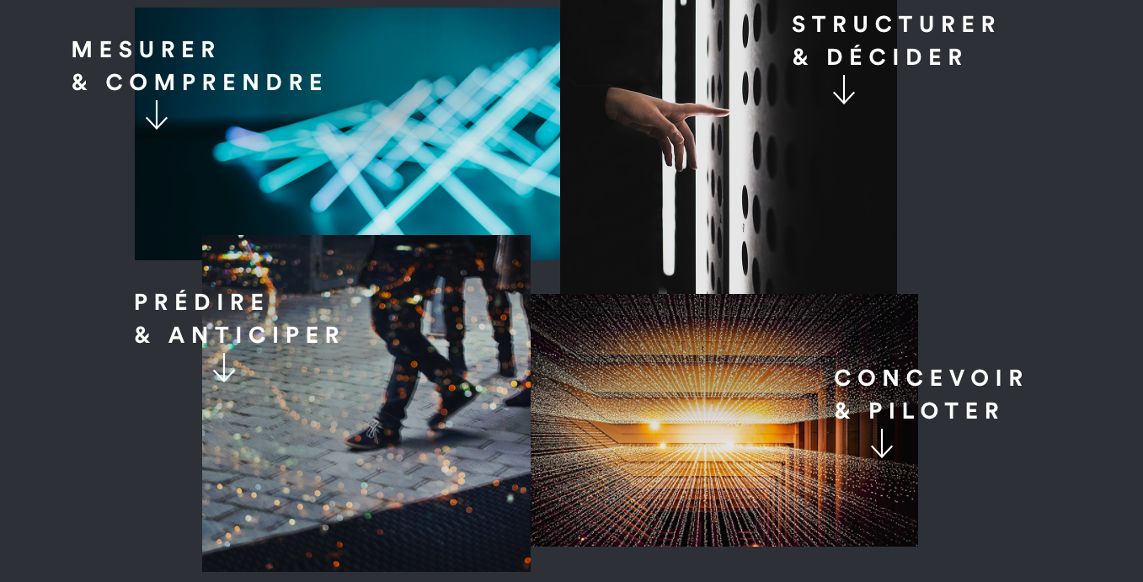
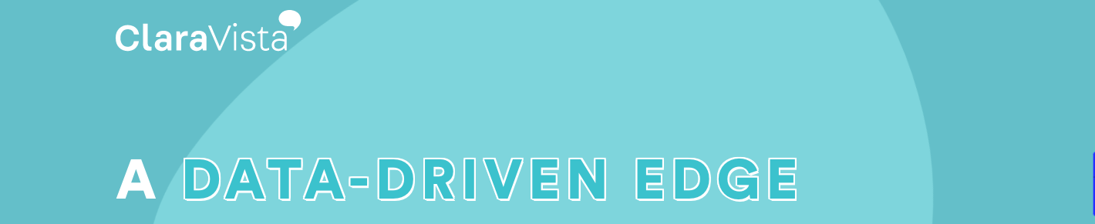
DNA of ClaraVista

