Slide 1
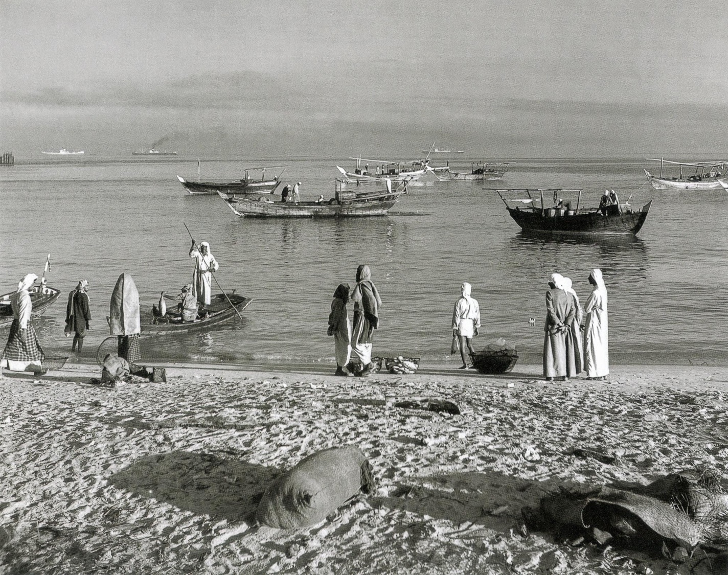
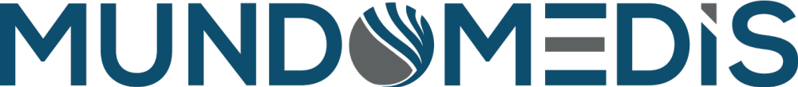
Home page top image

Slide 2
Homepage
Home page top content
Mundomedis (logo) | Incubator | Accelerator | UAE Distribution | References | Contact Us
Mundomedis is a global incubator for start-up and early-stage medical device companies and serves as a growth accelerator for more advanced medical device companies.
Located in Dubai Silicon Oasis, a fully integrated technology park with the aim to foster technology and entrepreneurship, Mundomedis provides active operational support to medical device companies through the expertise of highly experienced and well-connected industry veterans.
These veterans serve as mentors, interim-managers or as freelance consultants, enabling medical device companies to outsource key operational functions, lowering monthly operating expenses and minimizing operational risks. Along with the operational support Mundomedis provides, we utilize our global network of strategic partners, distributors, manufacturers and healthcare providers to:
Raise Capital
Assist and drive M&A strategies
Develop global sales and marketing strategies
Build and expand distribution channels
Source suppliers and assist in outsourcing production
Support in Regulatory Affairs
Mundomedis helps your business minimize operational risk, operate more cost-effective, grow faster and increase profitability.

Slide 3
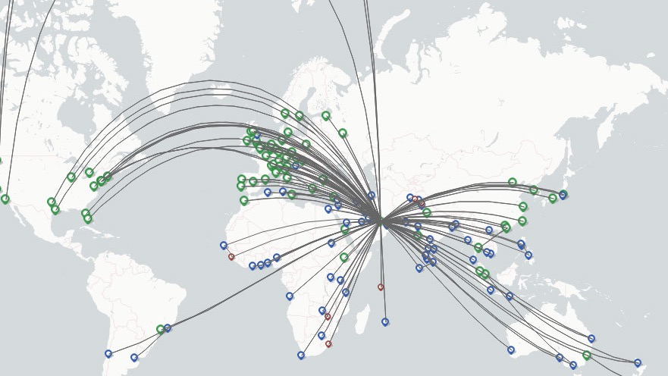
Located in Dubai – Covering the world
Home page bottom
The story of Dubai - from a small fishing village of palm frond huts to the most modern city in the world.
In a matter of 20 years Dubai has shown the world what ambition, vision and leadership, coupled with determination to overcome the odds, can achieve.
The story of Dubai symbolizes the ambition of many corporations and leaders around the globe.
We are proud to call Dubai our home for the past 20 years, having witnessed the most dynamic phase of that growth.
The Dubai story has inspired the founding of Mundomedis. A globally connected company, driven by passionate medical device industry experts, aiming for the exceptional and never the average.
Connecting the global medical device world, helping young and established medical device companies to accelerate. Always with the goal to become the best - as impossible as it might seem.
Dubai has shown the world – It is not impossible!

Slide 4
Global Medical Device Incubator
Incubator page top
Mundomedis serves as an incubator for start-up and early-stage medical device companies. The most recent COVID pandemic has shown that permanent workspaces have lost their importance. Many global technology incubators are focused on providing office space and a geographically, centralized ecosystem of industry specific companies. However, today’s world of global connectivity offers the opportunity for a much farther-reaching technology ecosystem than the location of one office and technology park can ever offer.
Start-up companies do not necessarily require office space. Access to funding, business mentoring, cost effective outsourcing of key operational components, the ability to access markets faster and more effective are key considerations for medical device companies to join our Mundomedis incubator ecosystem.
Founded and operated by highly experienced medical device industry veterans, we provide vital support to start-up and early-stage medical device companies:

Slide 5
Incubator page bottom
Fund Raising
Creation of investor deck, including teaser, presentation, financial model etc
Global Market Access
We help create and actively execute “go to market” strategies
Supply Chain & Manufacturing
We have a global network of component suppliers and outsourced manufacturers, which can assist in fast tracking the process to commercialization and assure cost effective production
Quality & Regulatory Affairs
Through our cooperation with Arazy Group we are able to provide global support for Quality & Regulatory Affairs
Active investor engagement with our constantly growing Investor Network
Supporting in valuationand investor negotiations
Through our Regional Directors and our large network of medical device distributors we are able to accelerate global market access and revenue growth
Through the global medical device registration platform LICENSALE regulatory affairs in over 125 countries can be easily controlled

Slide 6
Growth Accelerator
Accelerator page
Managing growth is one of the most difficult tasks any company leader has to manage. Growth needs investment and often requires entering new markets. New markets mean new entry barriers, a new competitive landscape, new customer demands…
The value proposition that works well in a home market may not be valued the same in a different country. This may be due to the way healthcare systems operate or requirements of technology and expertise may be different. Having achieved revenue growth in a home market and having build performing sales channels may not be a matter of “copy and paste” entering new markets.
Especially for smaller and mid-sized companies building a direct sales force in multiple foreign markets may not be the right approach. Typically, global expansion is achieved by building a network of global distributors. This is often a lengthy trial and error process. Finding the right distributor and being able to build the necessary relationship and provide the right support to justify time and money spent to build up international markets, is one of the most difficult challenges and often the point where companies get stuck in their growth mode and growth starts slowing down, rather than accelerating.
Our Mundomedis medical device industry veterans have successfully built global distribution networks for a variety of medical devices and companies. From the USA, to Latin America, Europe, Middle East and Africa and Asia Pacific, Mundomedis has direct representatives present in these regional markets. We are quickly able to connect innovative medical device companies with excellent distributors.
Mundomedis shortens your time to identify global distributors
Mundomedis supports in contract negotiations, market evaluations and commercial terms
Mundomedis accelerates your time to generate revenue
Mundomedis accelerate your growth
Mundomedis minimize risk
Mundomedis reduces your market entry cost
Create a graphic to make this more visually appealing

Slide 7
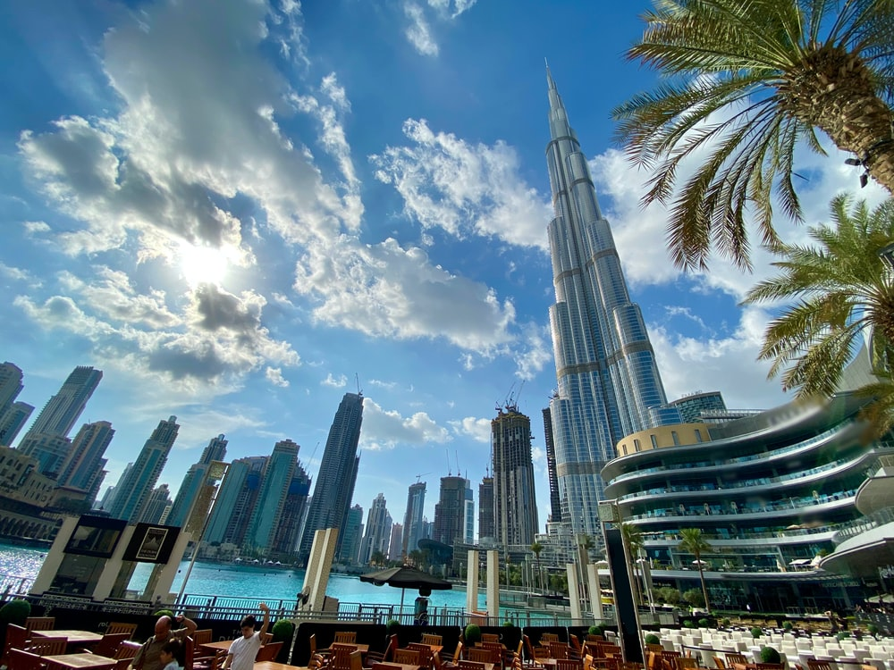
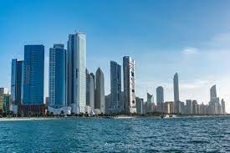
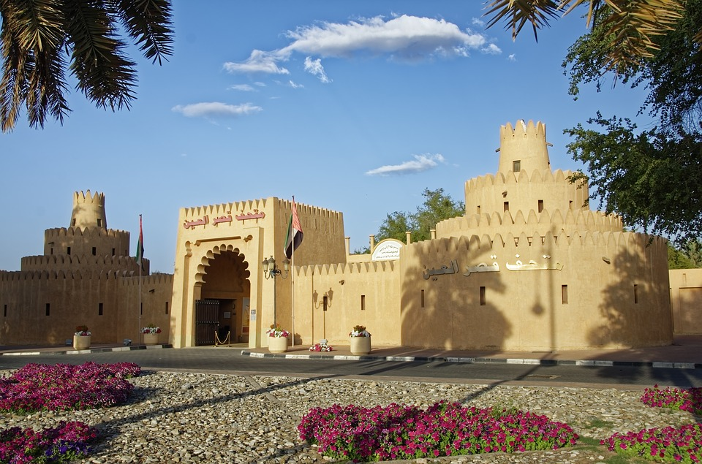
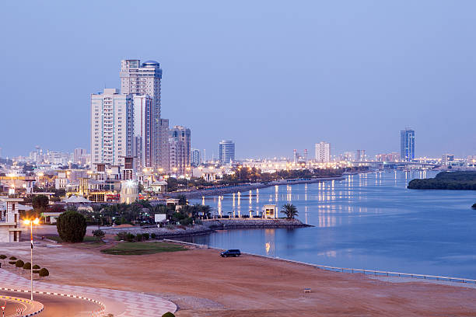
UAE Medical Device Distribution
UAE Distribution page top
Mundomedis distributes medical devices through a direct sales force in the United Arab Emirates. Our focus is the promotion of our portfolio companies, introducing highly innovative medical devices into the UAE healthcare market. This sales channel provides a footprint for our portfolio companies in the Middle East, a $ 30 Billion market for medical devices. Our sales force is specialized in introducing and selling novel medical devices and understands the hard work and time necessary to introduce an innovation to medical practitioners. We cover the key areas of the United Arab Emirates with dedicated regional sales managers.
DUBAI & SHARJAH
ABU DHABI
AL AIN
NORTHERN EMIRATES

Slide 8
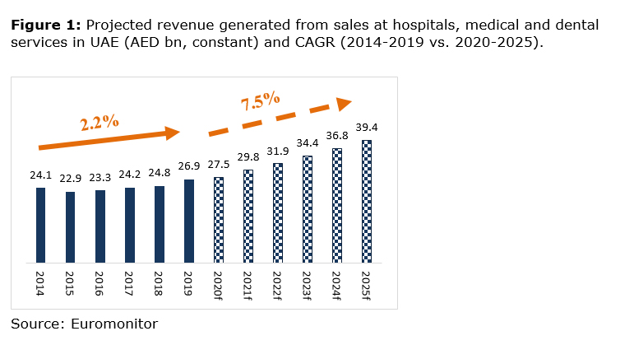
UAE Medical Device Market
UAE Distribution page bottom
With rising initiatives by the government, the UAE Healthcare market is witnessing astonishing growth. The UAE government is extensively expanding and upgrading its healthcare system to develop a strong world-class healthcare infrastructure. The government is also encouraging private sector participation to upgrade the existing infrastructure and match the quality of services offered in developed countries.
Further, the UAE Government is liberalizing policies to attract foreign investments, in order to improvise the healthcare standard and boost the healthcare industry. The healthcare market of the UAE is expected to grow at a CAGR of around 10% in the next years.

Slide 9
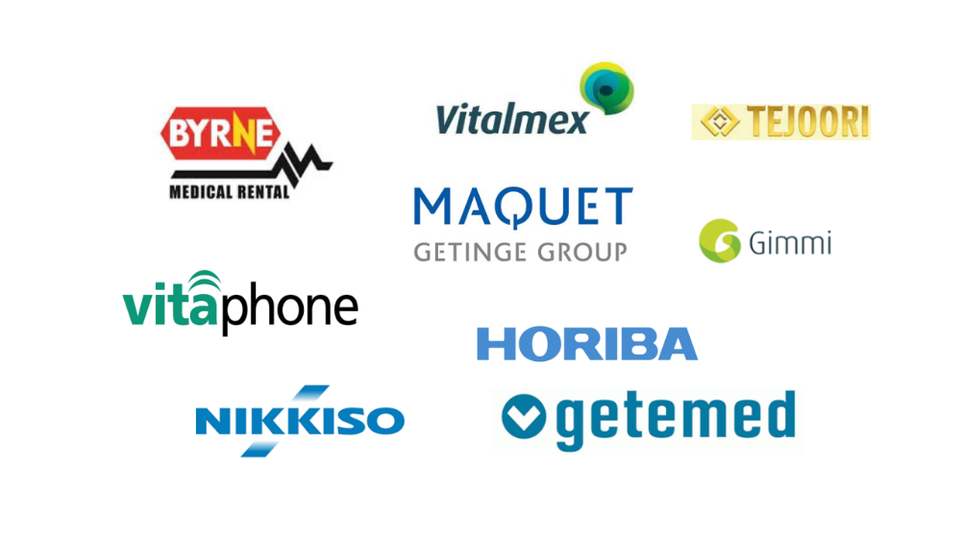
References

Slide 10
Contact us

