Slide 1
LOGOS WITH REQUIRED TEXT.
Please submit two logos each with the different text outlined below
Logo 1
Logo 2
HEADQUARTERS & HEADQUARTERS COMPANY
U.S. ARMY GARRISON FORT POLK
HEADHUNTERS
HHC U.S. ARMY GARRISON
JRTC AND FORT POLK
HEADHUNTERS

Slide 2


Current Logo (Left) // Distinctive Unit Insignia (Right)
Note: We are NOT attached to the design on left and completely open to newer things. Looking for new logo/image and creativity desired.

Slide 3
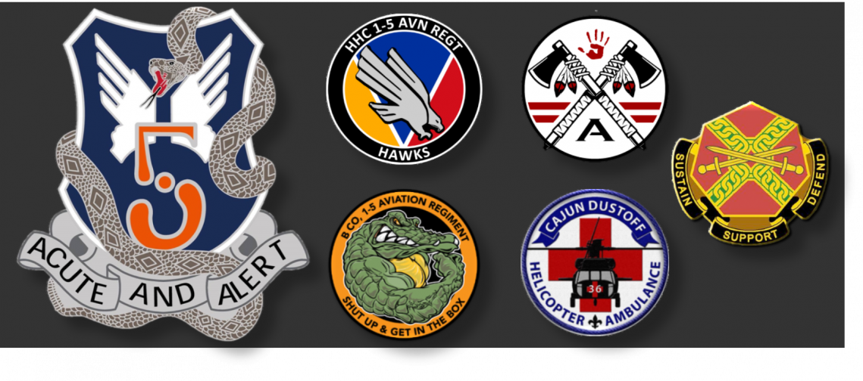
Battalion (Higher HQ) insignia on left.
Sister Company Logos middle two columns.
We don’t want anything resembling their logos. However, tying in with themes of the state of Louisiana are welcome (snakes, gators, Native American).

