Slide 1
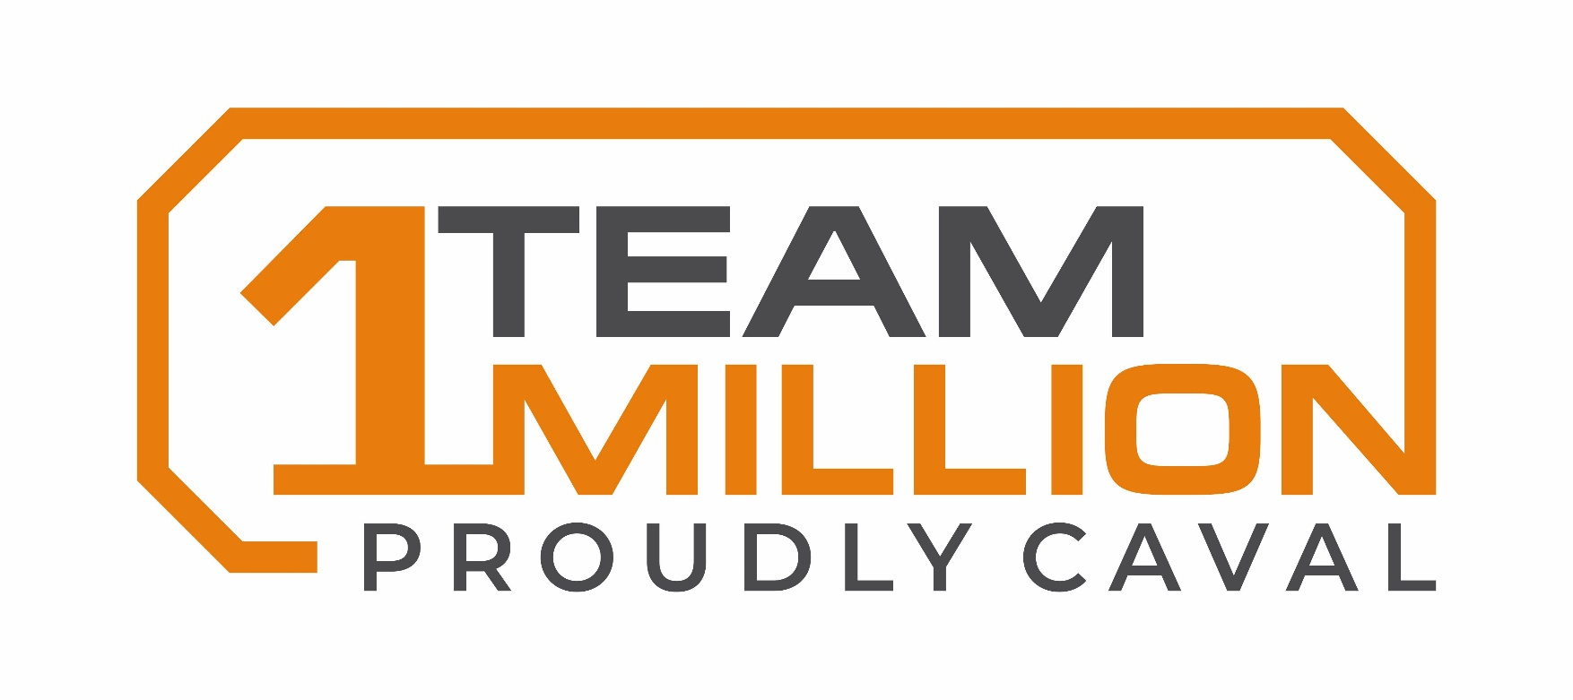
Vision & Mission
Caval Ridge: Proudly Pursuing Perfection
Vision
Mission

Slide 2
Strategic intent: FY22 VISION
“Caval Ridge: Proudly Pursuing Perfection”
“Caval Ridge” means:
  This is us: our identity, our people, our performance and our culture.
  We aspire for this brand to be associated with safe, reliable and of the highest quality products to our customers.
“Proudly Pursuing” means:
  We aspire for all employees to be proud that they work at Caval. We do respect that to achieve this we need to earn it.
  This status of being proud doesn’t rest just with our people, it extends to our stakeholders, our customers and those who we support to build a better world
  Our pursuit refers to our journey; one where we intend to learn and adapt to be better than before.
“Perfection” means:
  Perfection touches on every aspect of our operations; our social value, our people, our operating performance, our quality and our relationships with our stakeholders
  Our standards are well defined and delivered constantly by our systems, processes and people
  We deliver results for our customer and respect them to the highest degree
  We have diverse and inclusive teams who are empowered to take ownership and make decisions to improve the sustainability of our business

Slide 3
Strategic intent: FY22 MISSION
“1 Team, 1 Million, Proudly Caval”
“1 Team” means:
  We work safely and effectively together across the complex
  We provide context and engage in open and honest communication with our teams
  Our teams are empowered to continuously improve and implement initiatives
  We develop and upskill our people to support team outcomes
  We leverage and integrate functional support
  We genuinely help each other above all else
  We utilize the BOS practices to improve every part of our business
“1 Million” means:
  Pursue operating perfection with 0% waste
  We will safely deliver >1 million t/mth
  Everyone knows our performance against target, how they contribute to Caval’s success and what is needed to close the gap
  We are being proactive not reactive to situations
  Our operating discipline and standards across safety, volume and cost are well understood and setting a high standard
  We have world class performance of assets (8000hrs for CHPP and 6000hrs for trucks)
“Proudly Caval” means:
  People can bring 100% of themselves to work and are empowered to contribute
  Our people are proud to be a part of Caval, they take ownership in results for their area and the site as a whole
  Our pride stems from the results we achieve and the respect we demonstrate for each other
  We have reduced our TRIF, delivered on commitments to inclusion, diversity, supported our community and are having a positive impact on building a better world

