Slide 1
Personal Instruction
$35 for tandem lesson (2:1)/Half-HR
$50 for private lesson/Half-HR
$150 to train 4+ players/1-Hour

Slide 2
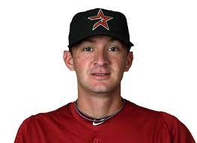
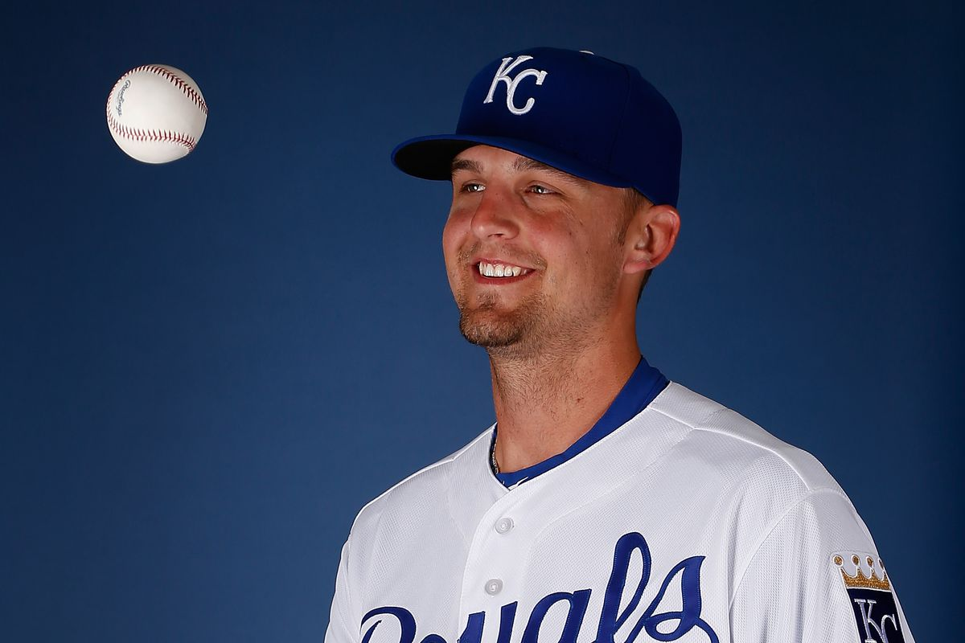
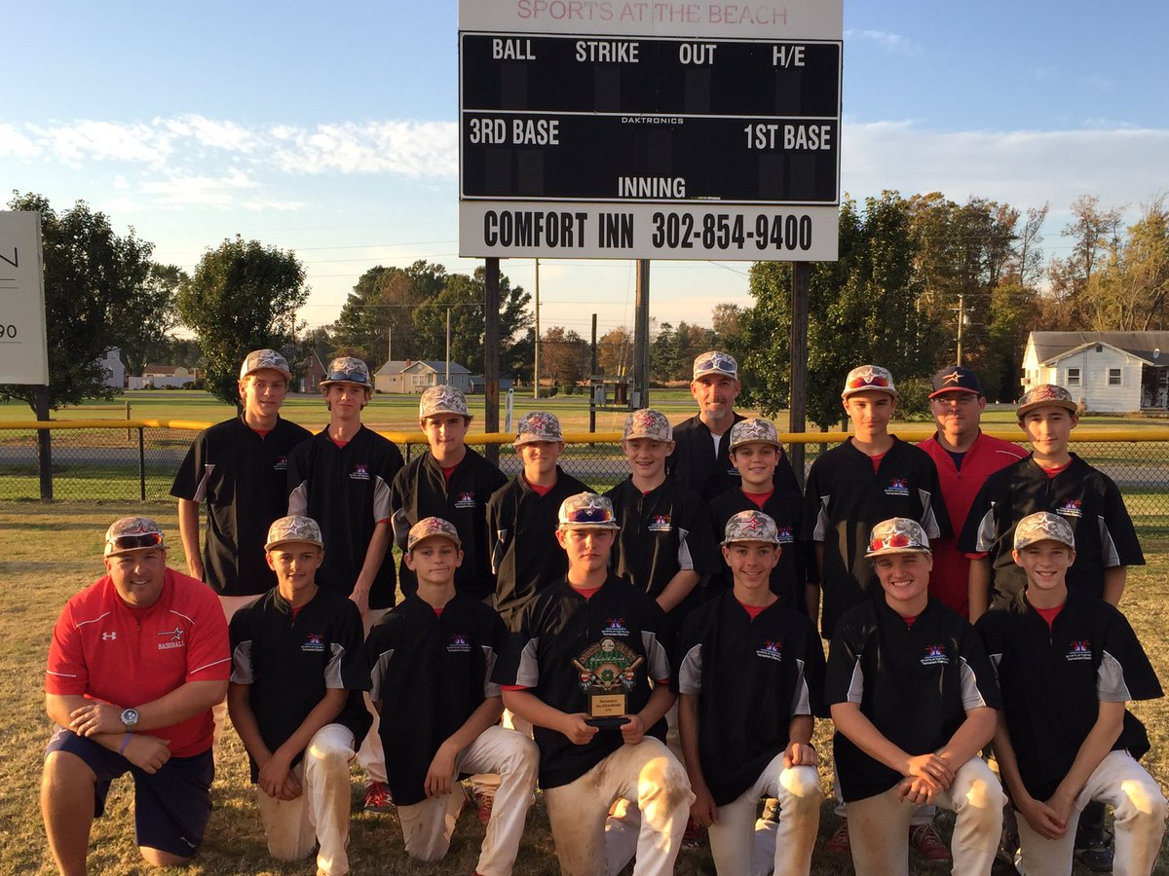
Private Instuction
Douglas Arguello – Former
Pro Pitcher MiLB (Rangers & Astros)
Christian Binford – Former Pro
Pitcher MiLB (Royals, Orioles, Detroit)
Mike Huller; former Pro Pitcher MiLB
(Giants) – Pitching & Hitting Instructor

Slide 3
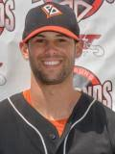
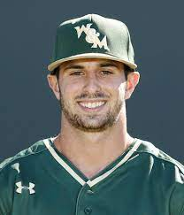
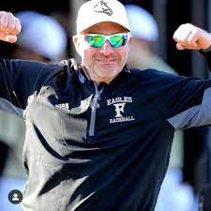
Private Instruction
Ryder Miconi –Hitting
Played professionally after
College in the Independent League
on the West Coach
Kyle Wrighte – Infield & Hitting
Current College Coach; Former
College Shortstop
Glen Caroline – Catching & Hitting
Current HS Coach & 16u
Showcase Coach

Slide 4
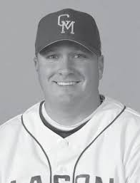
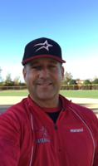
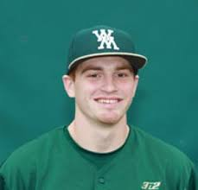
Lessons
Andy Devitt –Hitting & Pitching
Former College Coach & Current
High School
Zach Newell– Hitting & Defense
Former College Player & former HS Coach
Kevin Sisk– Hitting & Infield
Former College & former Pro Player
Current 16u Showcase Coach

Slide 5
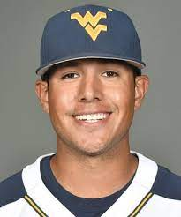
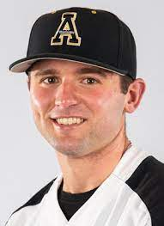
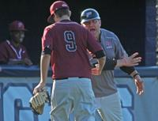
Jacob Garcia –Catching & Hitting
Current college coach; works Rip City’s
Camps
Paul Koch– Hitting & Catching
Former College Coach &
HS Head Coach
Ryan Smoot– Catching & Hitting
Current College Coach & former player

Slide 6
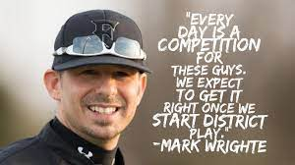
Mark Wrighte – Hitting & Defense
Current HS Head Coach and
15u Showcase Coach
Gurjot Singh – Hitting & Infield
Former College Player & Current HS Coach

