Slide 1

MOBILE MARKETING MADE EASY

Slide 2
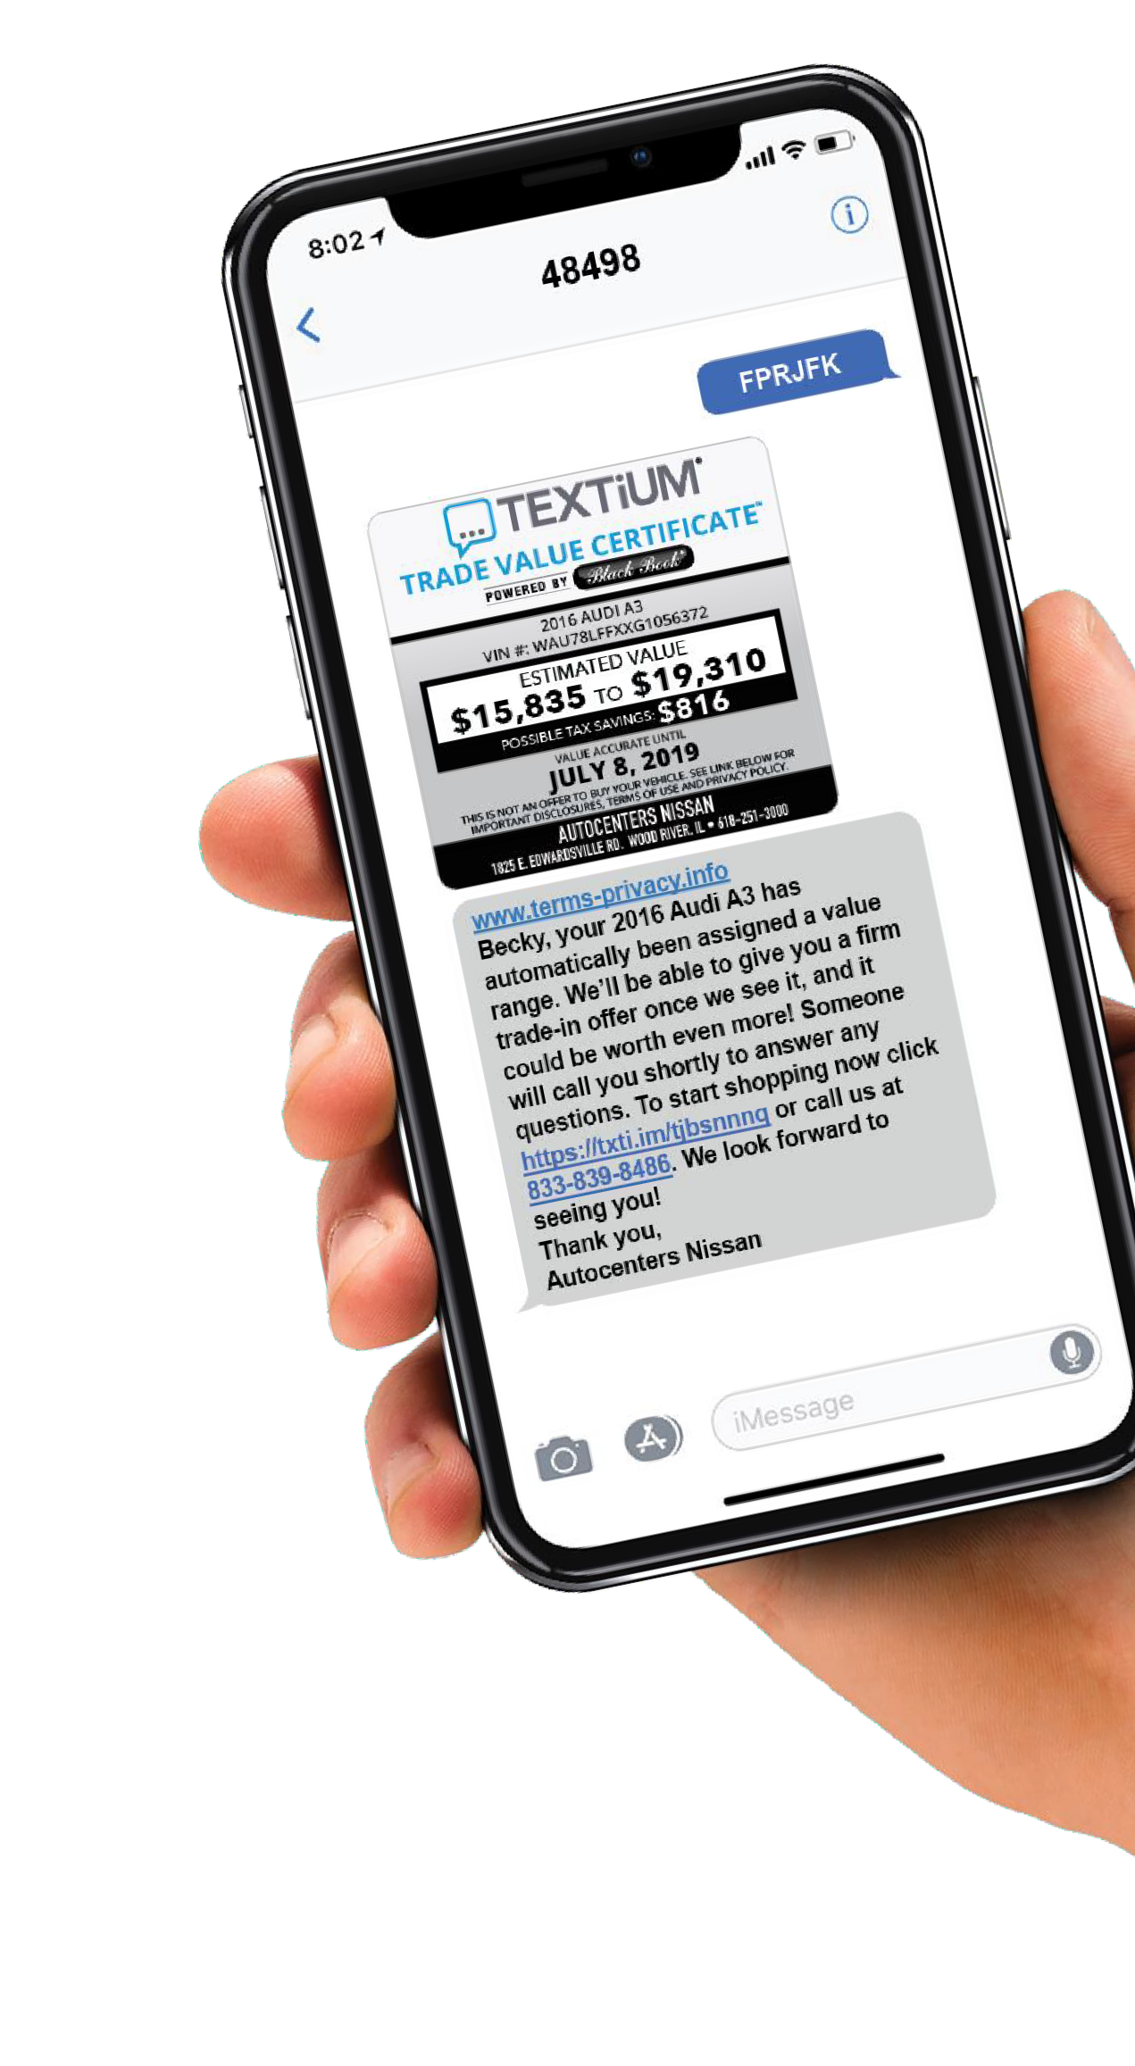

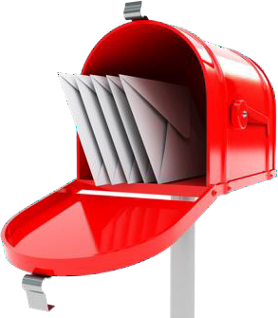
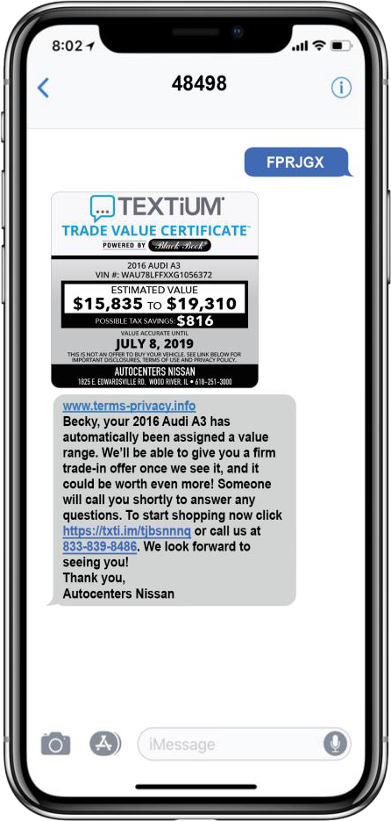
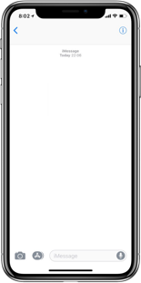


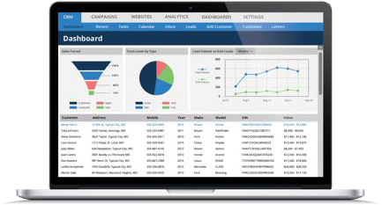

TEXTiUM offers THE MOST INNOVATIVE
Direct Mail in the industry!
IT’S TANGIBLE – IT’S TARGETED – IT’S TRACKABLE
DIRECT MAIL HAS AN UPGRADE!
TEXTiUM’s revolutionary technology ties Direct Mail in with the digital age using the number one method of communication:
BENEFITS INCLUDE:
MORE PRECISE TRACKABILITY • ELEVATED RESPONSE • EMPIRICAL RESULTS
HOW IT WORKS
FPRJGX
iHeart Direct Mail uses proven artwork and targeted data to generate interest
Customers text their unique PIN printed on the mail piece
TEXTiUM instantly responds with a personalized offer including links to website and a tracking phone number
Dealer instantly receives the lead and mobile number in the CRM in real time
BDC can follow-up with
customer immediately

Slide 3

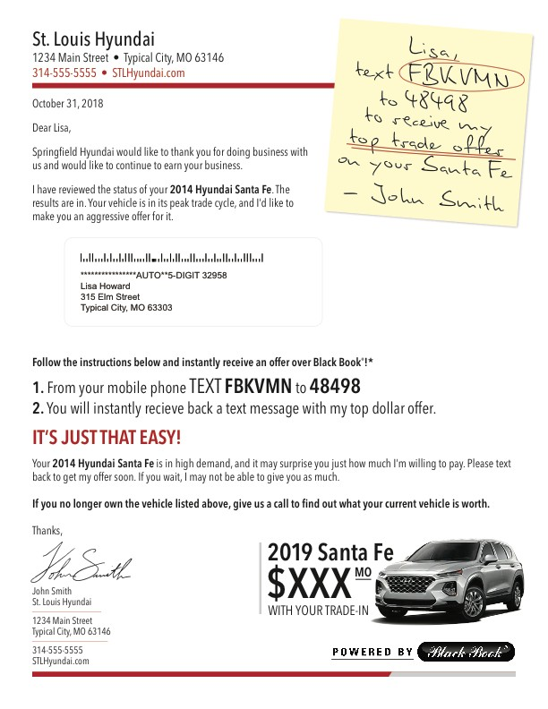
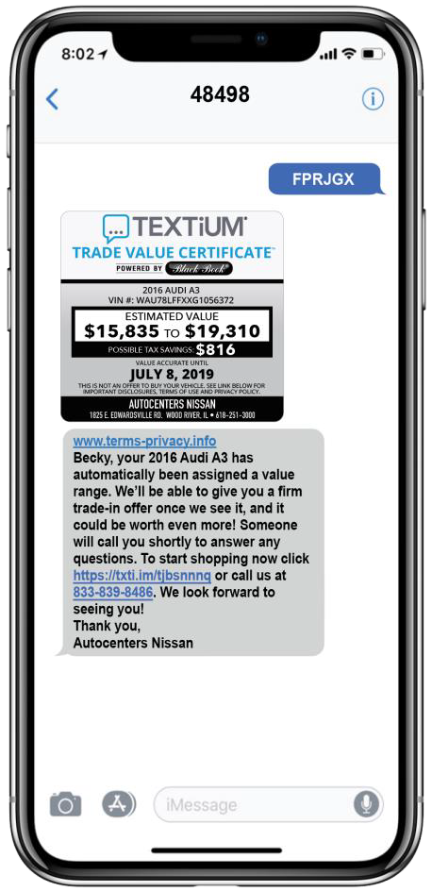



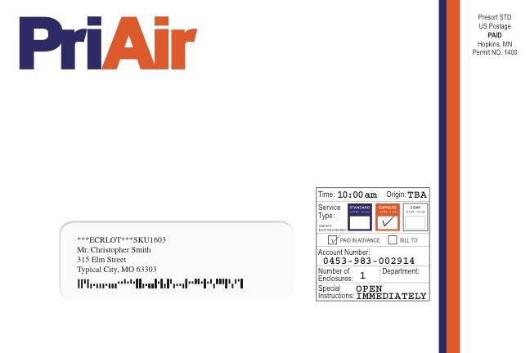

PRIAIR POST-IT
BUYBACK
TRY IT NOW!
Text FPRJGX to 48498
Target Audience: Sent to a combination of your sales and service database and conquest owners. We can filter by make, purchase/service date, and model year.
Text Response: Consumers can TEXT to receive a Black Book® Certificate on their vehicle, plus two additional vehicles!

Slide 4

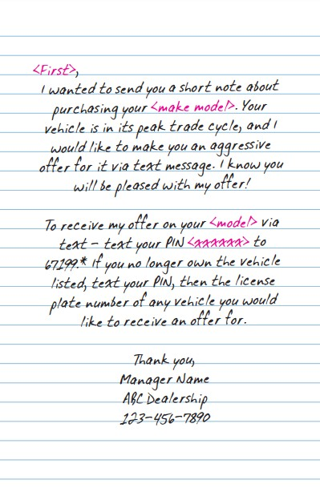

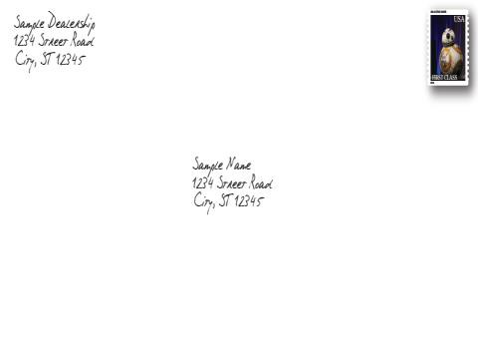
HANDWRITTEN
BUYBACK
TRY IT NOW!
Text FPRJGX to 48498
Target Audience: Sent to a combination of your sales and service database and conquest owners. We can filter by make, purchase/service date, and model year.
Text Response: Consumers can TEXT to receive a Black Book® Certificate on their vehicle, plus two additional vehicles!

Slide 5





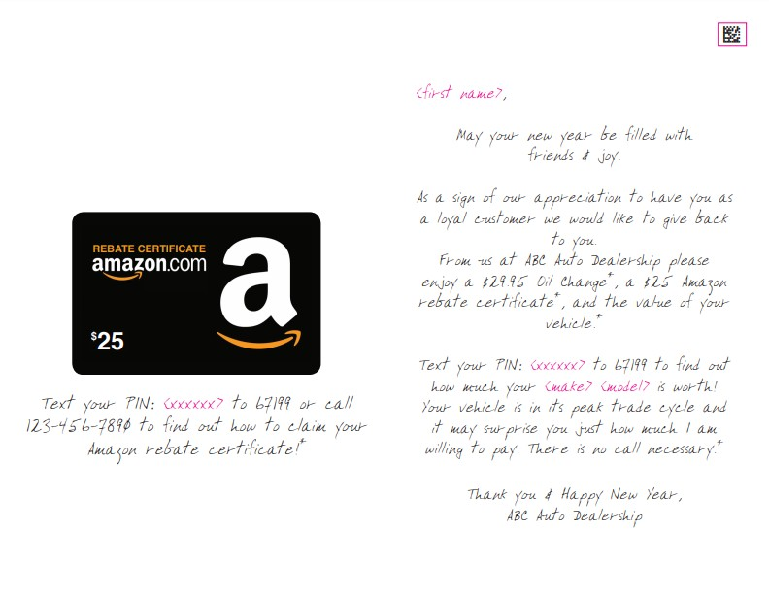
THANK YOU
DATABASE CARD
TRY IT NOW!
Text FPRJFX to 48498
Target Audience: Sent to a combination of your sales and service database and conquest owners. We can filter by make, purchase/service date, and model year.
Text Response: Consumers can TEXT to redeem an Amazon Rebate Certificate and to receive a Black Book® Certificate on their vehicle, plus two additional vehicles!

Slide 6
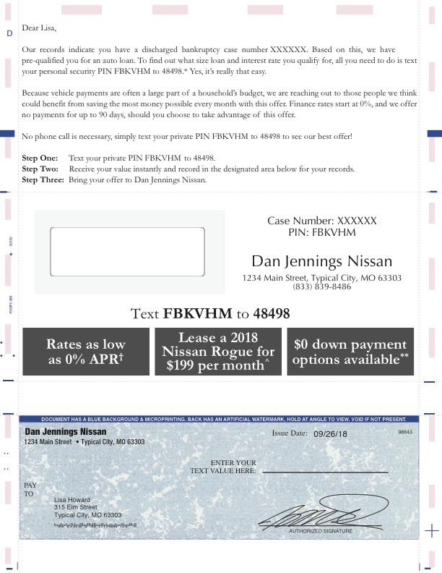
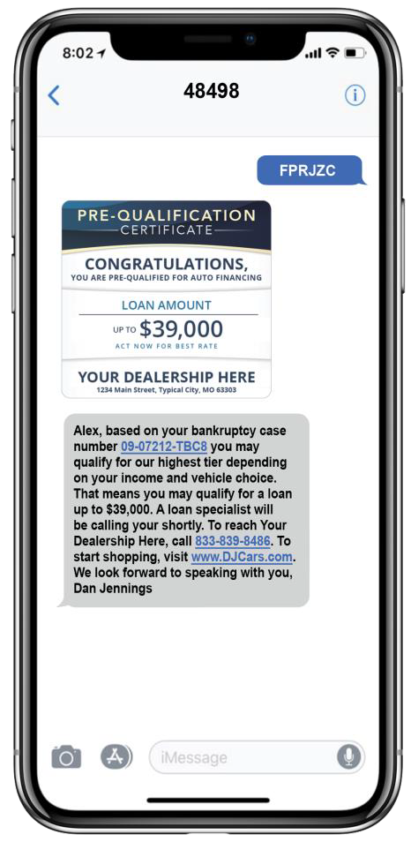

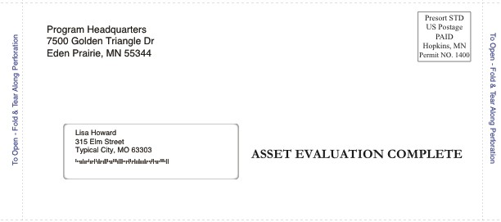
BANKRUPTCY
SNAP PACK
TRY IT NOW!
Text FPRJZC to 48498
Target Audience: Courthouse bankruptcy public records with up to a 10-year history of discharges!
Text Response: We highlight their discharged date and case number. Consumers can text to find out how much they are pre-qualified for!

Slide 7

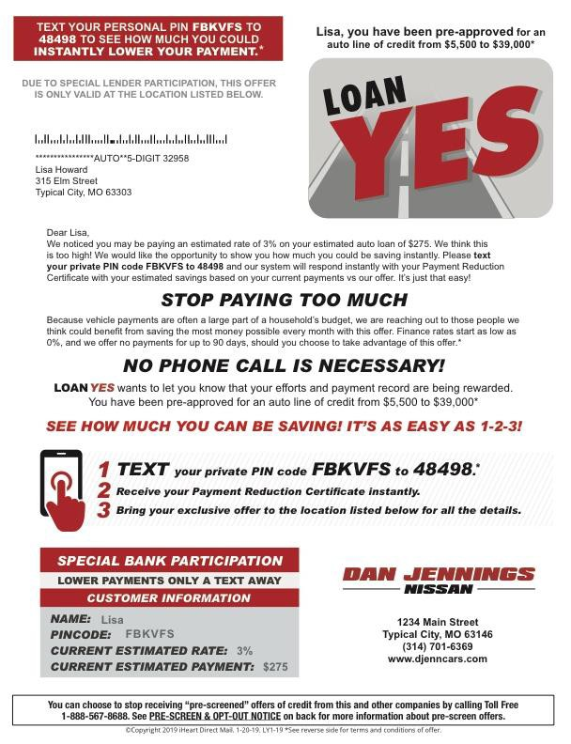
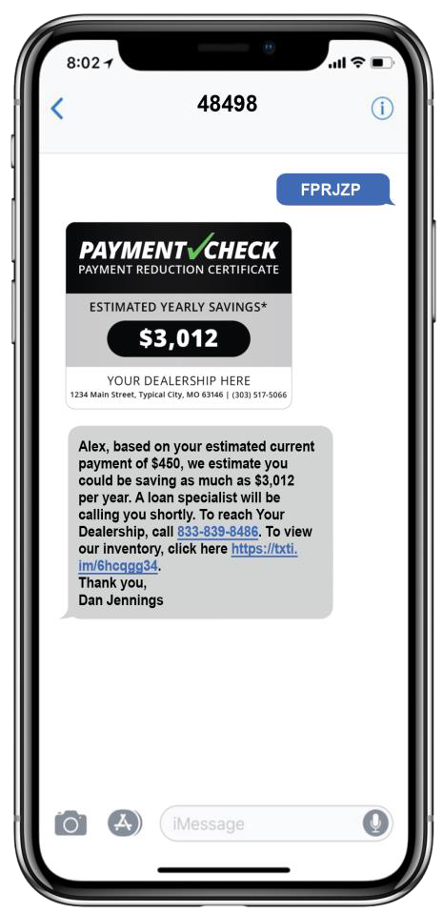


LOAN YES
CREDIT LETTER
TRY IT NOW!
Text FPRJZP to 48498
Target Audience: Equifax credit list with specific credit scores, current payments, and current rates. Example: 520-620 Score, current payment over $250, and current rate over 6%
Text Response: Personalized annual savings. Example: $450 (current payment) - $199 (lease special) = $251 (monthly difference) x 12 =
$3,012 ANNUAL SAVINGS

Slide 8

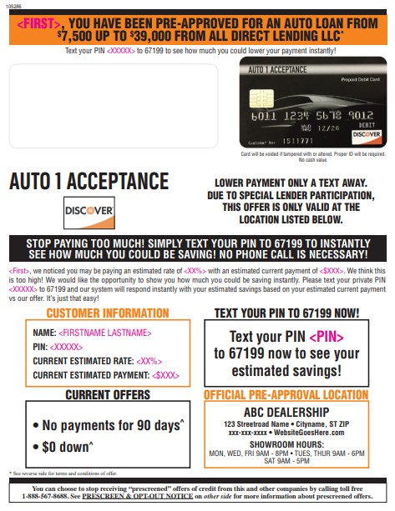

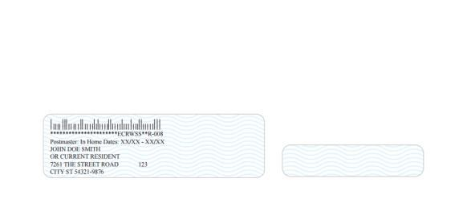

DISCOVER
CREDIT LETTER
TRY IT NOW!
Text FPRJZP to 48498
Target Audience: Equifax credit list with specific credit scores, current payments, and current rates. Example: 520-620 Score, current payment over $250, and current rate over 6%
Text Response: Personalized annual savings. Example: $450 (current payment) - $199 (lease special) = $251 (monthly difference) x 12 =
$3,012 ANNUAL SAVINGS

Slide 9



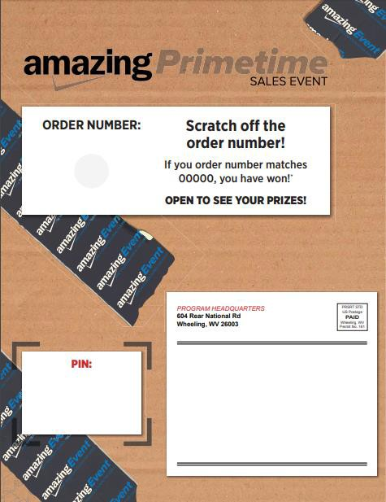

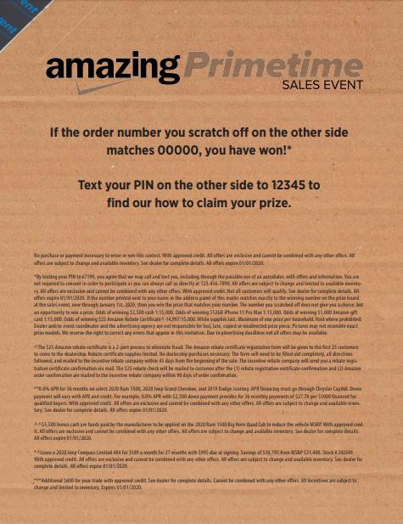
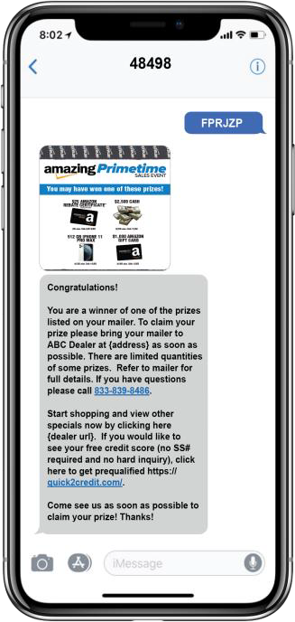
AMAZING
PRIMETIME
MAGAZINE
TRY IT NOW!
Text FPRJBW to 48498
Target Audience: Sent to targeted zip codes with an income filter!
Text Response: Consumers can text to find out how to claim a prize

Slide 10


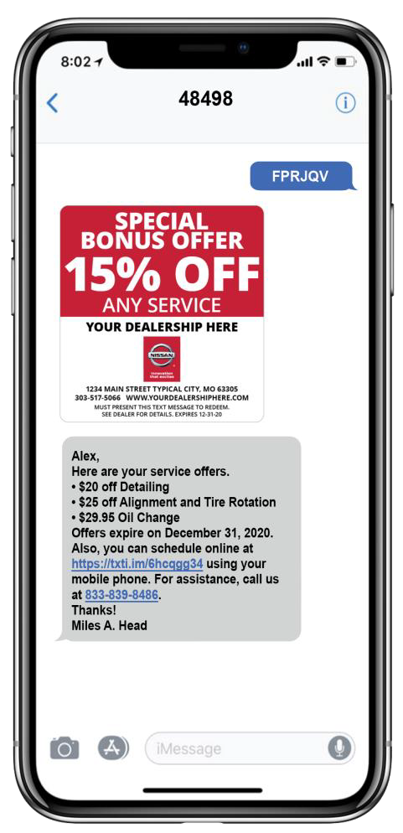


SERVICE
POSTCARD
TRY IT NOW!
Text FPRJQV to 48498
Target Audience: Sent to a combination of your sales and service database and conquest owners. We can filter by make, purchase/service date, and model year.
Text Response: Consumers can TEXT to receive service offers directly to their phone!

Slide 11

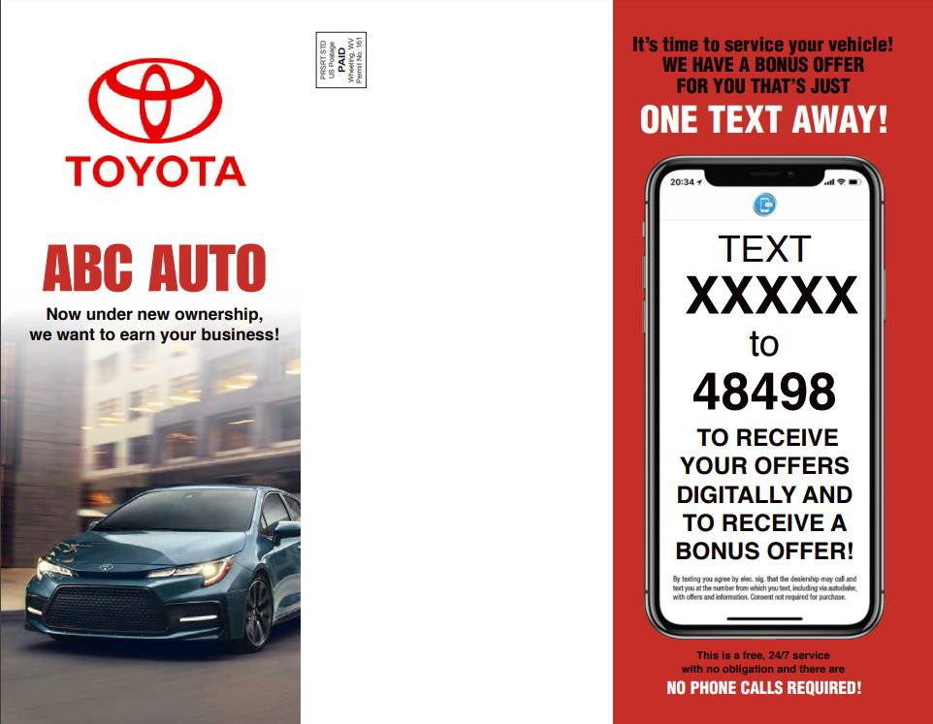
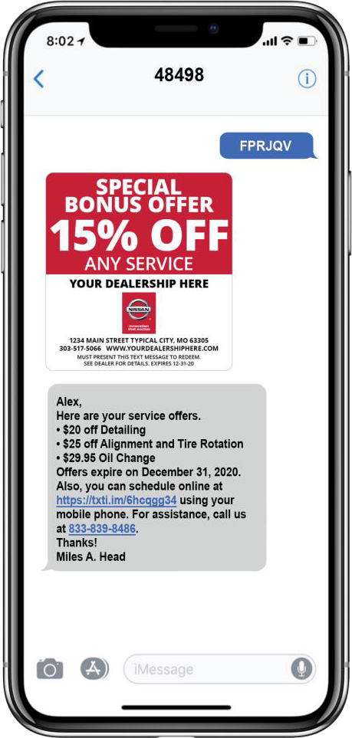

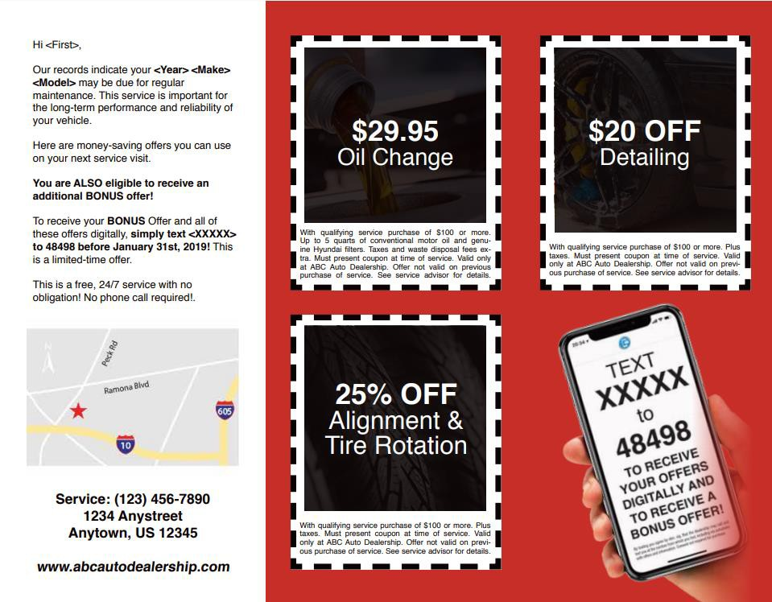
SERVICE
TRI-FOLD MAILER
TRY IT NOW!
Text FPRJQV to 48498
Target Audience: Sent to a combination of your sales and service database and conquest owners. We can filter by make, purchase/service date, and model year.
Text Response: Consumers can TEXT to receive service offers directly to their phone!

Slide 12


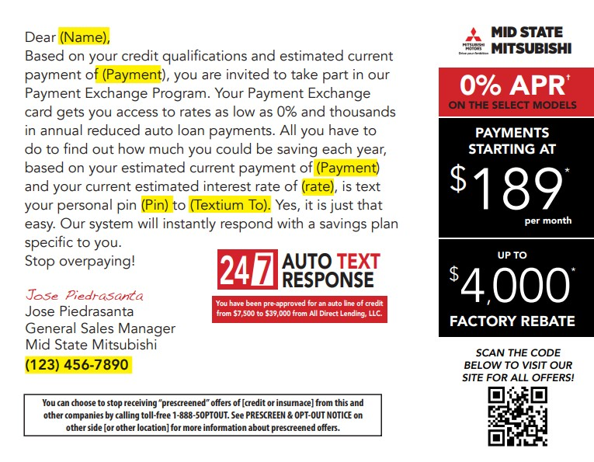
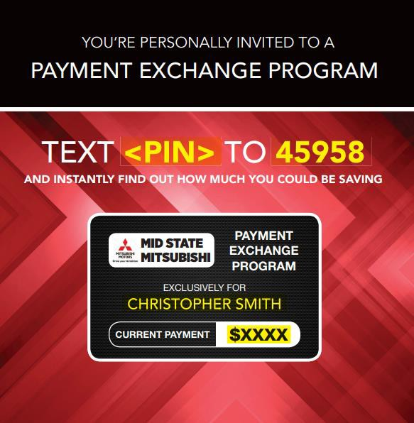


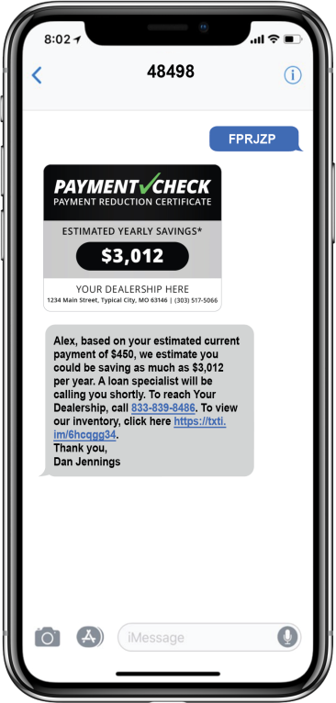

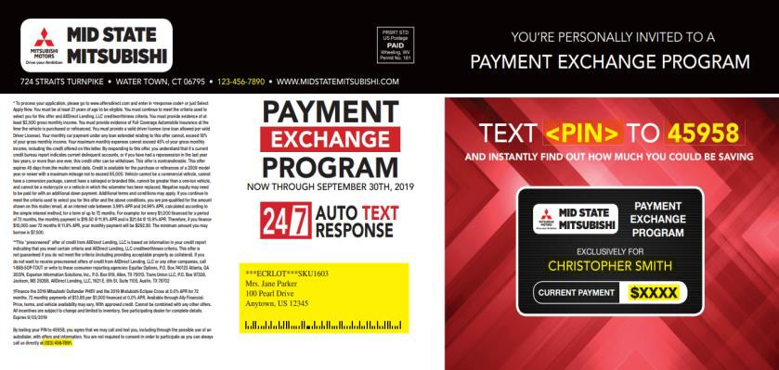

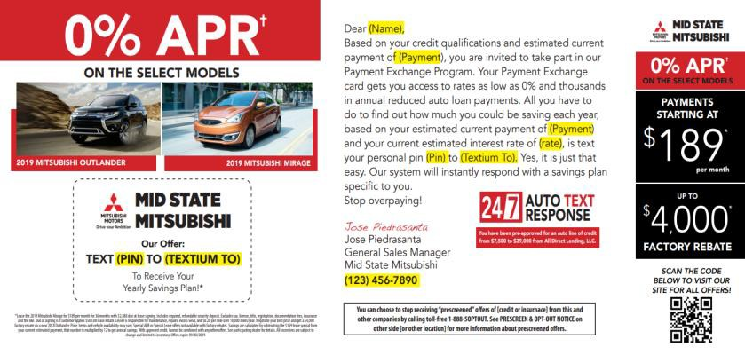
PAYMENT
TRY IT NOW!
Text FPRJZP to 48498
EXCHANGE PRIME CREDIT
MAILER
Target Audience: Equifax credit list with specific credit scores, current payments, and current rates. Example: 520-620 Score, current payment over $250, and current rate over 6%
Text Response: Personalized annual savings. Example: $450 (current payment) - $199 (lease special) = $251 (monthly difference) x 12 =
$3,012 ANNUAL SAVINGS

Slide 13

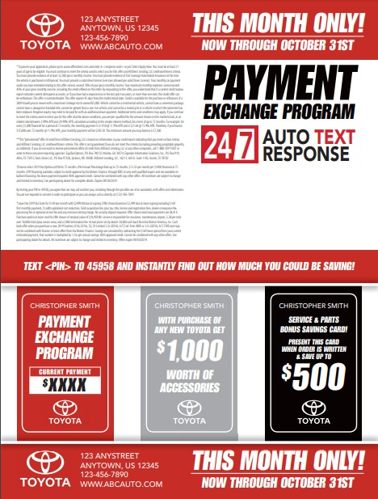




3- CARD PAYMENT
EXCHANGE
PRIME CREDIT
MAILER
Target Audience: Equifax credit list with specific credit scores, current payments, and current rates. Example: 520-620 Score, current payment over $250, and current rate over 6%
Text Response: Personalized annual savings. Example: $450 (current payment) - $199 (lease special) = $251 (monthly difference) x 12 =
$3,012 ANNUAL SAVINGS
TRY IT NOW!
Text FPRJZP to 48498

