Slide 1





© Copyright 2020. All images and ideas expressed in this document are Copyrighted material and the product of Textium, LLC.
_{PATENT PENDING.} ANOTHER MOBILE MARKETING INNOVATION FROM

Slide 2
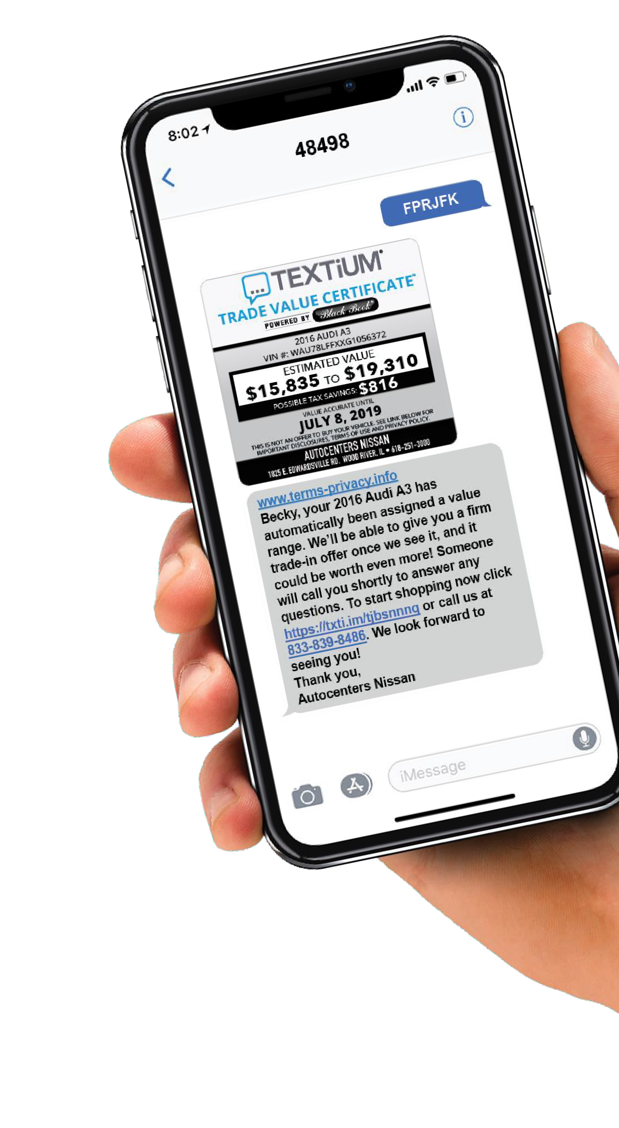


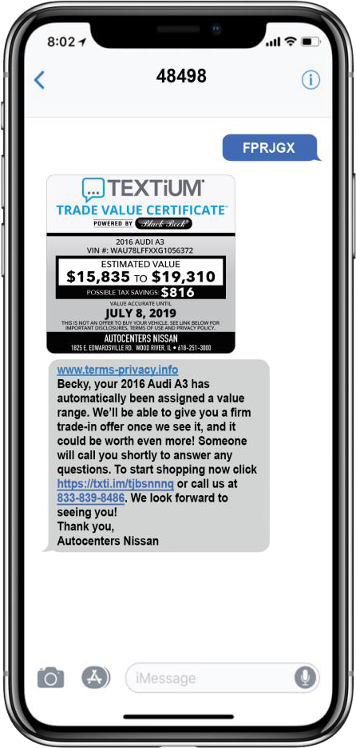
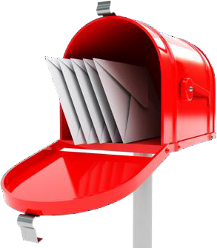
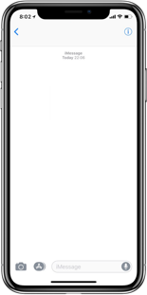


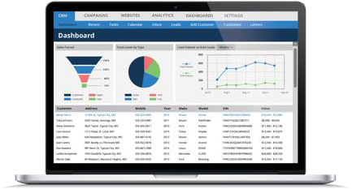
TEXTiUM offers THE MOST INNOVATIVE
Database Email in the industry!
EMAIL HAS AN UPGRADE!
TEXTiUM’s revolutionary technology ties Email in with the mobile age using the number one method of communication:
BENEFITS INCLUDE:
MORE PRECISE TRACKABILITY • ELEVATED RESPONSE • EMPIRICAL RESULTS
HOW IT WORKS
FPRJGX
Proven artwork to generate interest
Customers text their unique PIN on the email
TEXTiUM instantly responds with a personalized offer including links to website and a tracking phone number
Dealer instantly receives the lead and mobile number in the CRM in real time
BDC can follow-up with
customer immediately

Slide 3
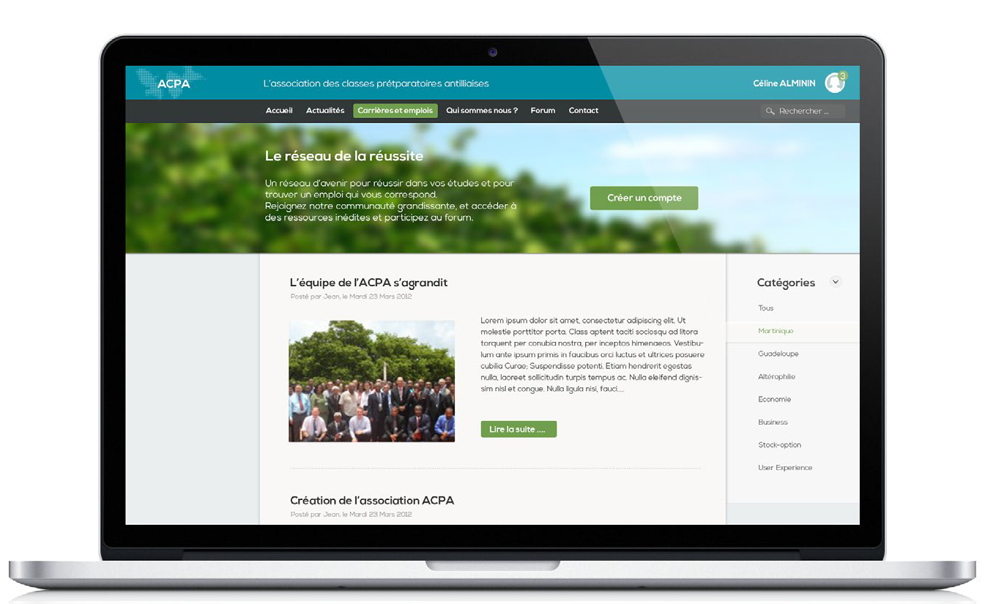
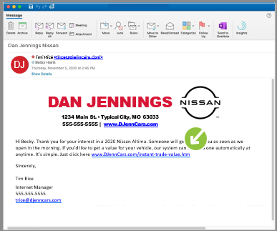
All buy back oriented emails will include variable text pins so that consumers can gain the value of their trade instantly. Consumers can the check the value of up to 2 additional vehicles using the VIN or license plate number. All leads are sent direct to your CRM.
MO

Slide 4
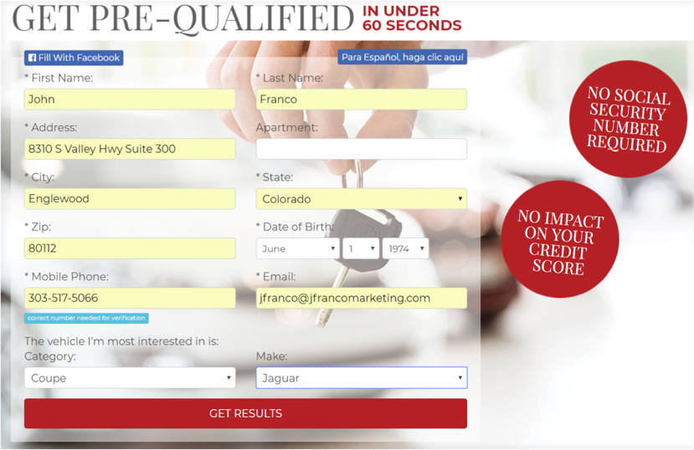


Quick2Credit short form application will pop-up when email links are clicked delivering the highest possible quality lead to your CRM.
The applicant is prompted to provide basic contact information along with the make and vehicle category they are most interested in.
This application does not require a SS# and does not count as a hard inquiry.
MO
Triggered email, text, and direct mail follow up.

Slide 5
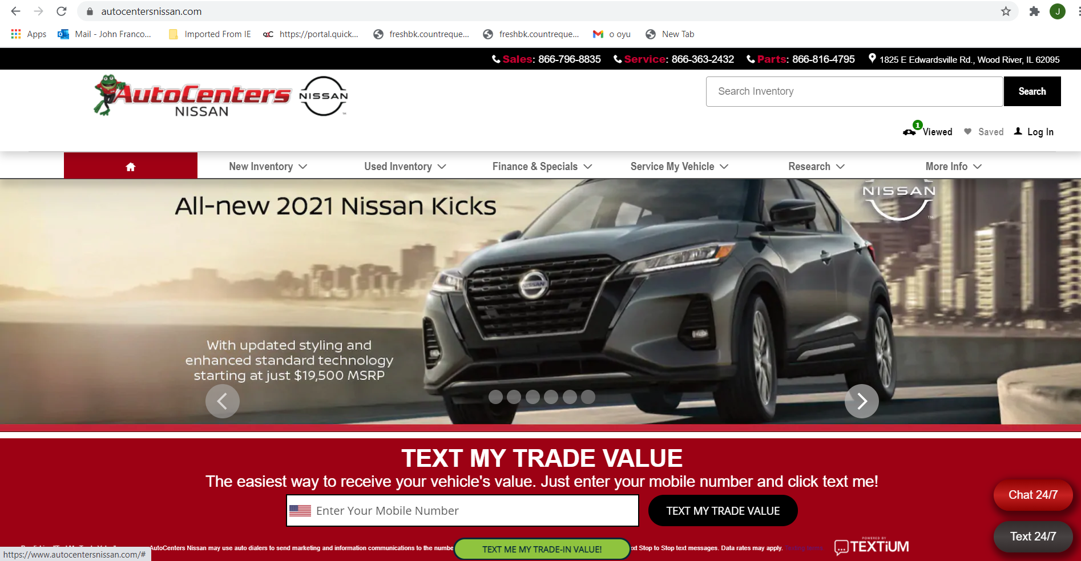
MO

Slide 6
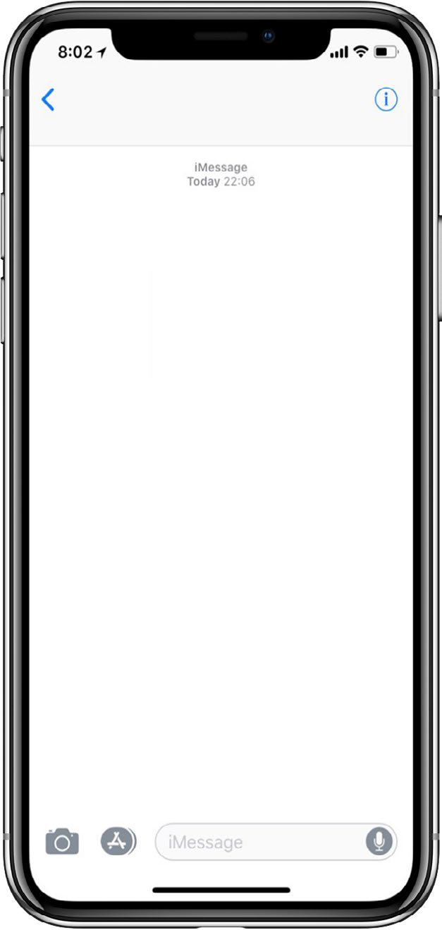




Increased sales volume with Automated Cadence follow-up from Qucik2Credit and MURL.
Your BDC may forget about leads, but Quick2Credit/MURL never does
Quick2Credit/MURL verifies that each interested shopper is contacted, converted, and sold Hot notifications identify anxious buyers and instantly notifies the dealer’s CRM
NOTE
Day 20/45, if customer answers “Yes, I’m still interested”, a HOT Notification is sent to the dealer’s CRM
DAY 3
DAY 10
DAY 20
DAY 45
+1 (833) 839-8486
+1 (833) 839-8486
+1 (833) 839-8486
+1 (833) 839-8486
Becky, has someone from Dan Jennings Nissan contacted you about your estimated trade-in value? If you could please reply with: Yes or No
Becky, have you had a chance to visit Dan jennings Nissan yet? If you could please reply with: Yes or No
Becky, have you purchased a vehicle yet? If you could
please let us know by replying with: Yes or No
Becky, have you purchased a vehicle yet? If you could
please let us know by replying with: Yes or No
Yes
No
No
Yes
Thank you for letting us know. Below are a couple quick links to shop and call us. Have a great day. Click for our website DJennCars.com.
We hope you’re able to visit soon. We’re here to help.
Please call us if
you have any questions or need directions. Click for our website DJennCars.com.
Are you still interested in purchasing? Reply with Yes or No
Did you purchase from Dan Jennings Nissan?
Yes
Yes
Click to call us 833-839-8486.
Click to call us 833-839-8486.
Thank you for letting us know. We are here to assist you whenever you’re ready. Click for our website DJennCars.com.
Click to call us 833-839-8486.
Thank you for your business. Please don’t hesitate to call us if you need anything.
833-839-8486.
Dan Jennings Nissan
Dan Jennings Nissan
Customer Assurance, Powered by TEXTiUM®
Customer Assurance, Powered by TEXTiUM®
Dan Jennings Nissan
Dan Jennings Nissan
Customer Assurance, Powered by TEXTiUM®
Customer Assurance, Powered by TEXTiUM®

Slide 7
RESULTS
The focus of our emails to get consumers to text to get the value of their trade or get them to the pre-qualify with Q2Credit delivering unmatched lead quality directly to your CRM.
Emails Sent: 2,277
Open Rate: 24.4
Opens: 540
Text Leads Delivered to CRM: 27
Tracked URL Link Clicks: 22
Direct Clicks To Dealer: 14
Total Engagement: 63
MO
DEMO
Click here

Slide 8
What do you get?
Your Unique iFramed Quick2Script
Quickstart Welcome Kit
Triggered Follow Up And Text Cadence
200 leads a month ($2.50 per after 200)
Free use in any supporting marketing you do
Unlimited support
What does it cost?
FREE
for first 30 days
No hassle. Cancel at any time
$495
set-up fee
$795
per month

