Slide 1



Sell more cars without spending a penny more on marketing.
© Copyright 2020. All images and ideas expressed in this document are Copyrighted material and the product of Textium, LLC.
_{PATENT PENDING.} ANOTHER MOBILE MARKETING INNOVATION FROM

Slide 2


MOTIVATING FACTORS
As online shopping increases websites must have tools to convert that traffic into high quality exclusive leads.
To achieve high conversations ratios there must be an equitable exchange of accurate data between shopper and dealer. Consumers don’t want to give up any part of their SS number online, but they do want to know where they stand as the financial part of a vehicle purchase is always top of mind
Leads must be sent and easily reportable inside the dealers current CRM vs requiring the use of a third- party tool.
Triggered follow including email, direct mail, and text cadence to assist dealer with conversions.

Slide 3
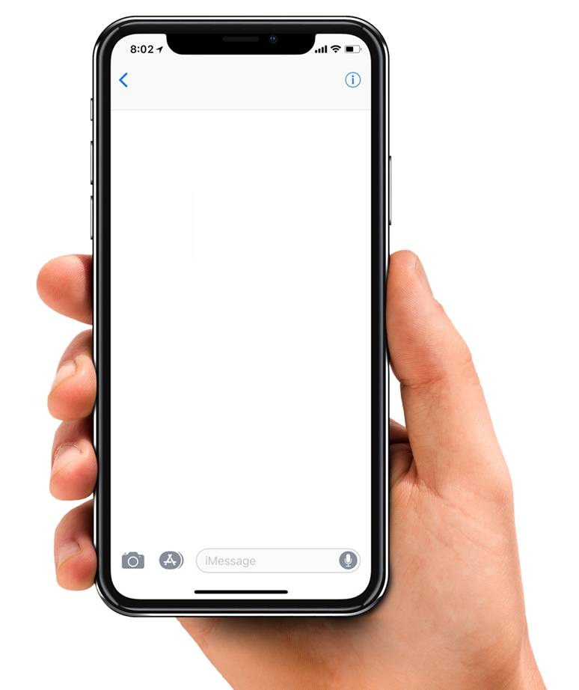
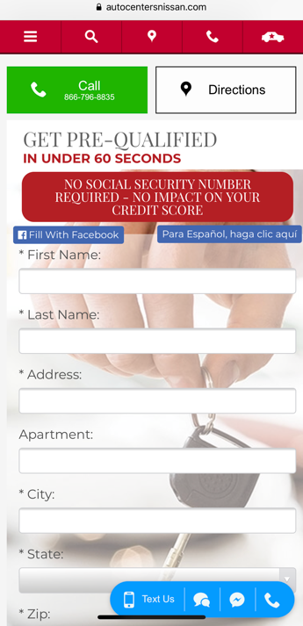
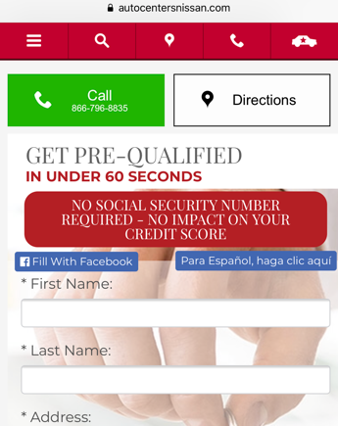




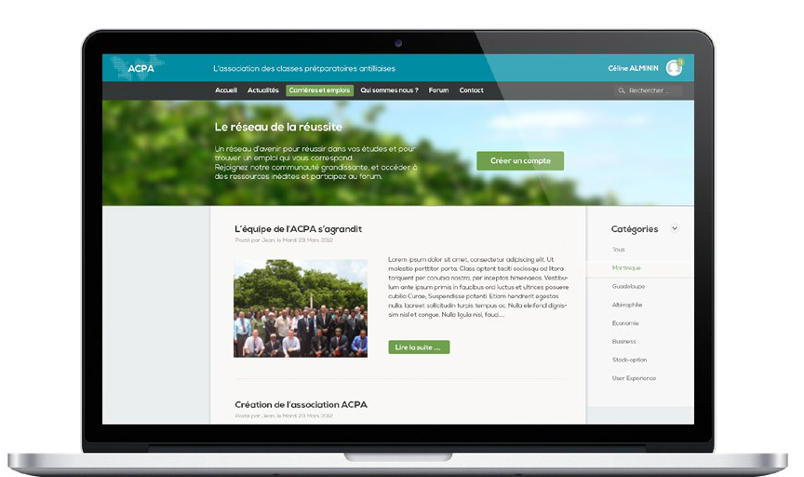





The first step in digital retailing, website lead conversion with extensive follow-up.
IT’S EASY: Plugs into all in-house and outsourced agency marketing efforts
IT’S AUTOMATED: Qucik2Credit URL takes over. Shopper interaction is automatically generated
1
Quick2Credit is iFramed into the dealer's website and the link can be copied and pasted into any digital channel
2
In-market shoppers click a strategically located banner and short form application will pop requiring basic data.
3
Real-time leads and hot notifications with name, credit pre-qualification, request vehicle make and category, and mobile number with email address are sent to the dealer CRM instantly.
Quick2credit/DEALER.COM
TRADE VALUE CERTIFICATE
CRM CAMPAIGNS WEBSITES ANALYTICS DASHBOARDS SETTINGS
Dashboard Recent Tasks Calendar Inbox Leads Add Customer Customers Letters
Dashboard
Sales Funnel
Total Leads by Type
Lead Volume vs Sold Leads Weekly
17673
800
11071
600
Total Volume
400
Sold Volume
200
4872
CRM LEAD
1761
0
Jul 22 Aug 5 Aug 19 Sep 2
Sep 16
Customers Appts
Contacted Sold
Active Sold
Recent Leads
Time of Arrival
Source of Lead First Name
Bad Lost
Last Name Mobile # Contactd (Y/N) Appointment ( Y/N)
9/10 3:00p
TEXTiUM
John Q.
Public (314) 989 - 9888 N N
9/10 3:00p
TEXTiUM
Jack
Jones (314) 456 - 2281 Y Y
9/10 3:00p
TEXTiUM
Tim
Smith
(314) 798 - 6640
Y N
Y Y
9/10 2:58p
TEXTiUM
Jane
Banks
(314) 895 - 1221
Y Y
N N
9/10 2:58p
TEXTiUM
Lisa
Wilson
(314) 223 - 7643
9/10 2:57p
TEXTiUM
Greg
Thompson
(314) 985 - 9832
Y N
Y N
9/10 2:57p
TEXTiUM
Thomas
Williams
(314) 681 - 7621
9/10 2:57p
TEXTiUM
Cindy
Becker
(314) 636 - 8787
Y Y
N Y
9/10 2:57p
TEXTiUM
Dan
O’Riely
(314) 900 - 2213
.com
Website
9/10 2:56p
TEXTiUM
Margret
Jennings
(314) 838 - 3802
Email

Slide 4

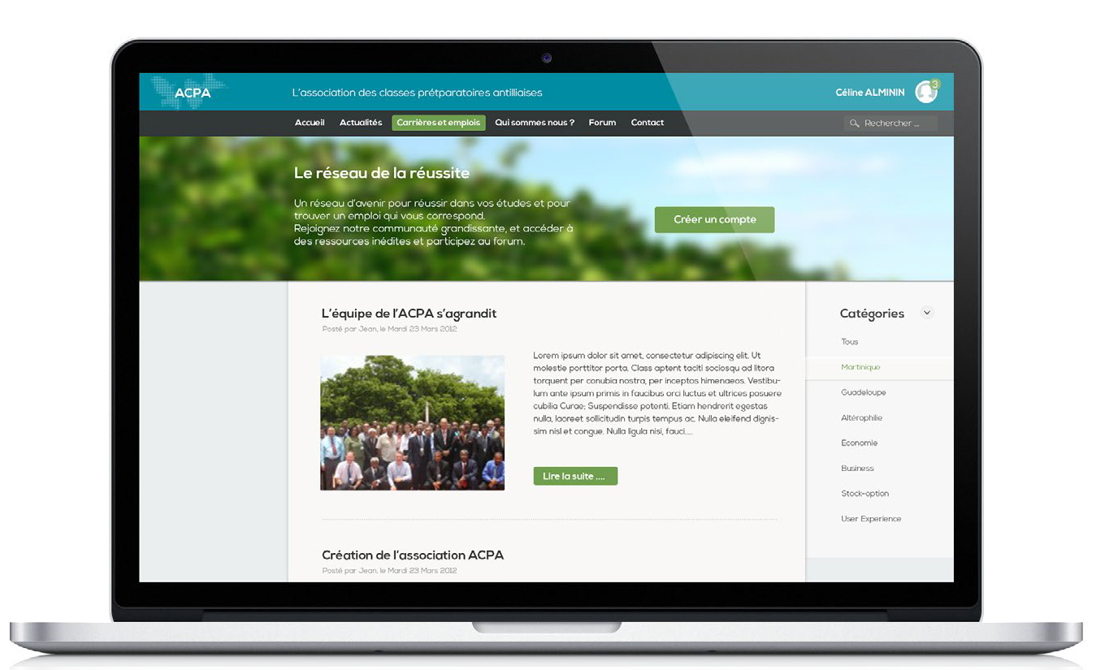
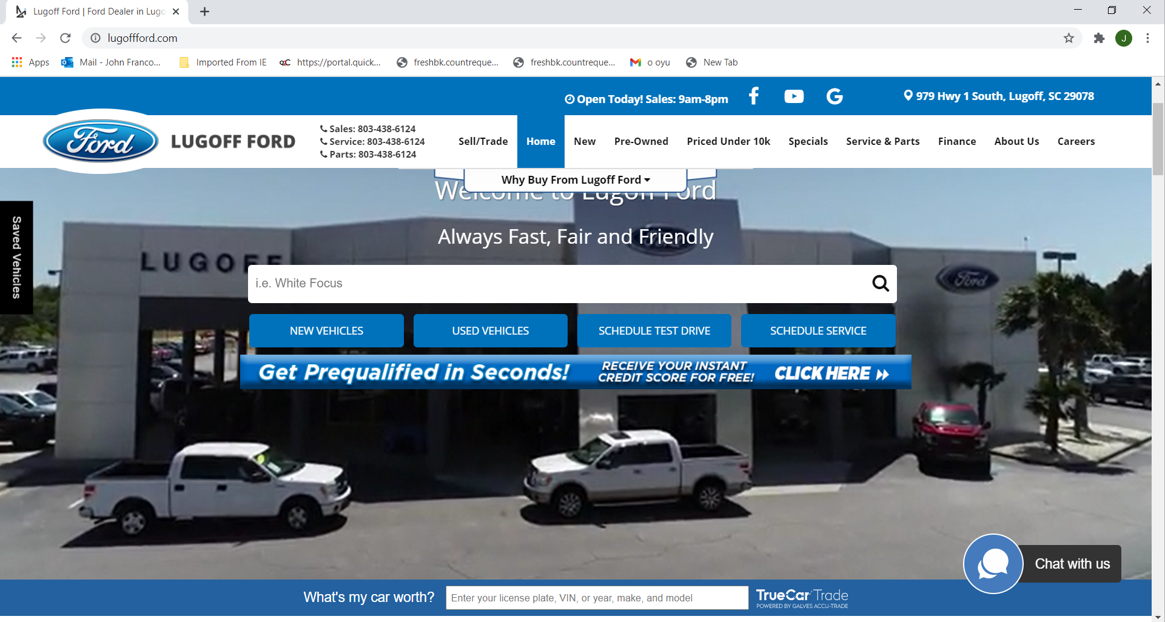
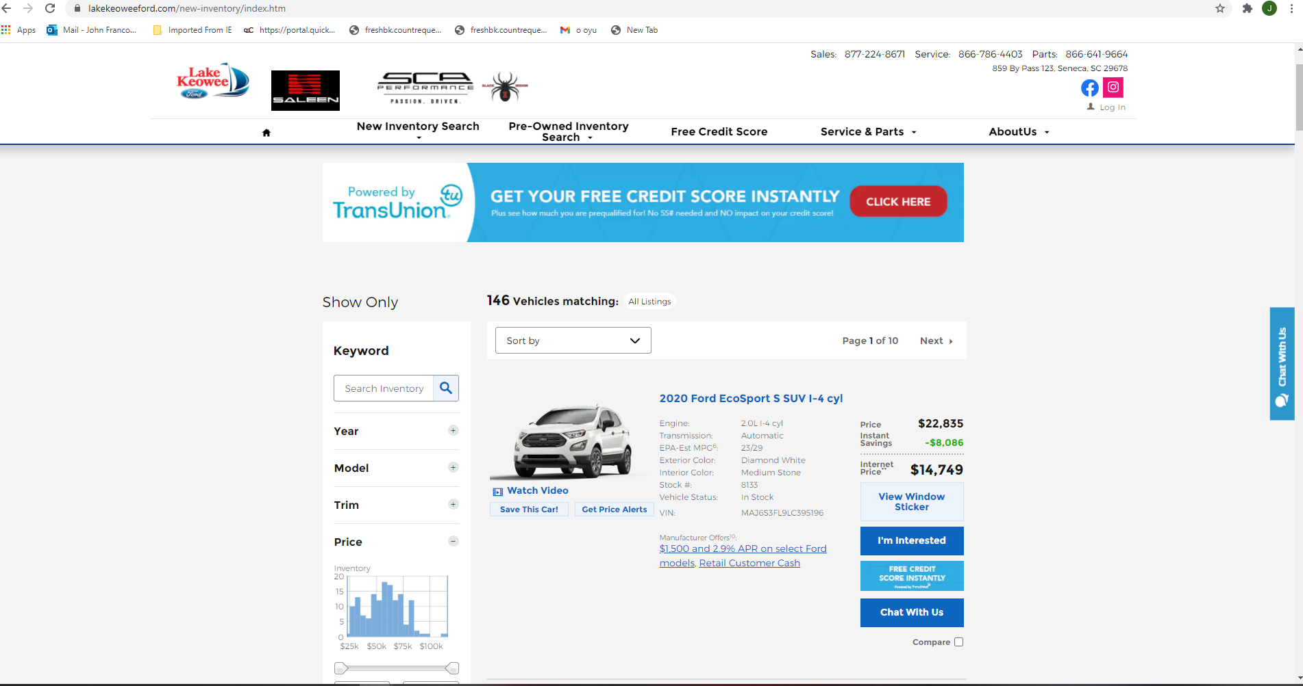
Quick2Credit starts with strategically placed banners to boost website lead quantity and quality.
Nothing for you to do. The Quick2Credit team works with your website provider to set up program
Offer instant accurate Pre-Qualification to shoppers
Free auto credit score
Shoppers never leave your website
Home Page Above Fold
VDP And SRP Pages

Slide 5
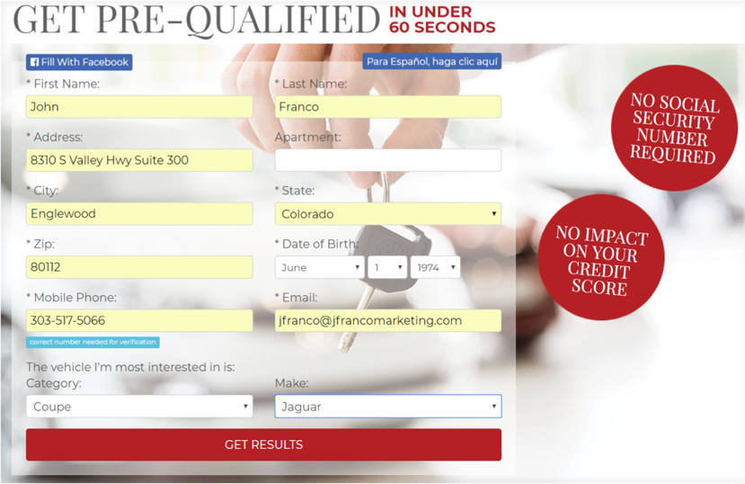

Immediately after one of our banners is clicked the Quick2Credit short form application will pop-up.
The applicant is prompted to provide basic contact information along with the make and vehicle category they are most interested in.
This application does not require a SS# and does not count as a hard inquiry.
MO

Slide 6
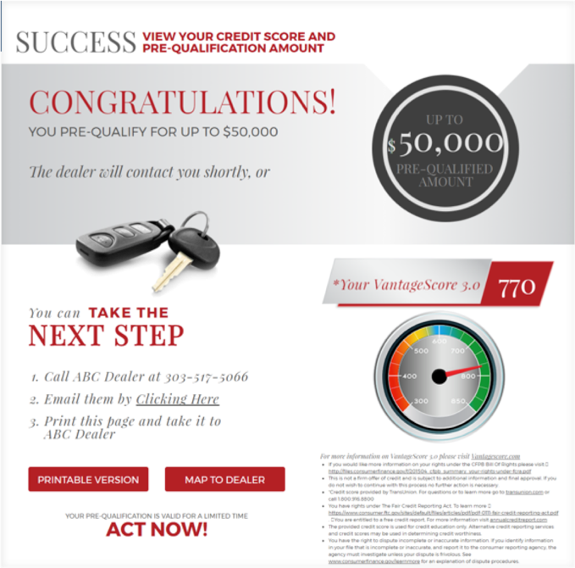
Instantly Quick2Creidt will communicate with TransUnion and deliver the client their credit score and pre-qualification base on the dealers 8 tiers.
The applicant is prompted to either print their prequalification or communicate directly with the dealer via email or tracking phone number.
This applicate may also get turn by turn directions via Google maps if this was done on a mobile device.
MO

Slide 7
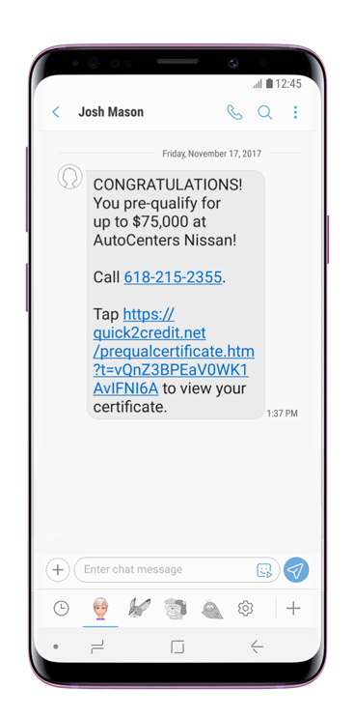
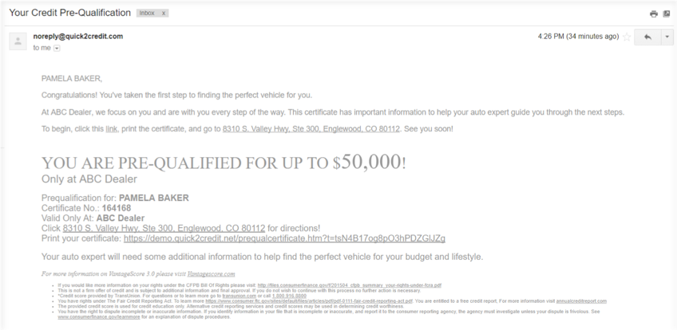
Once Quick2Creidt issues the prequalification triggered follow will occur automatically. In the form of Email and Text.
Triggered Text
Instant Q2C Pre-Qual
Triggered Email
MO

Slide 8
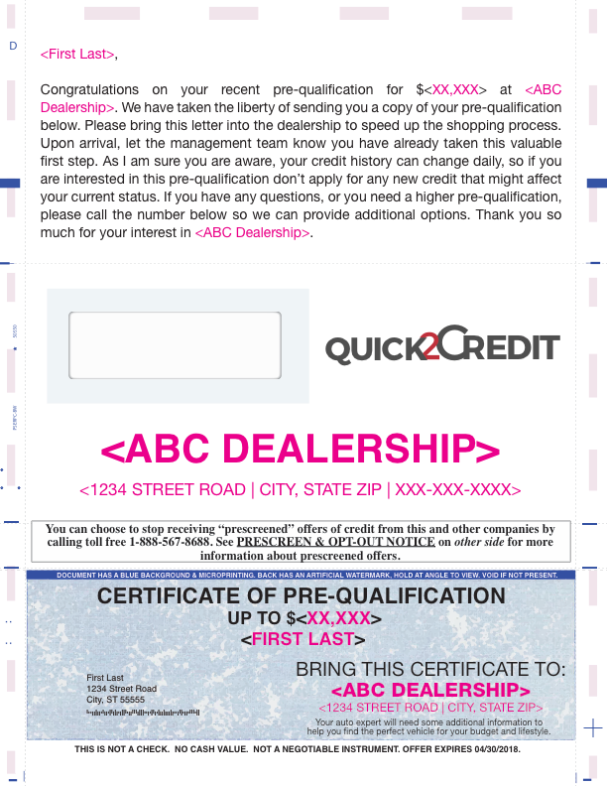
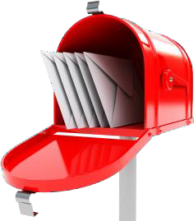
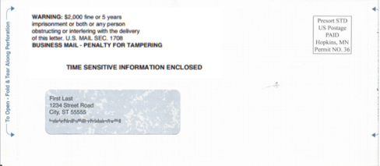
In addition, Quick2Creidts triggered follow up will include direct marketing for those consumers that prefer offers that are tangible
MO

Slide 9
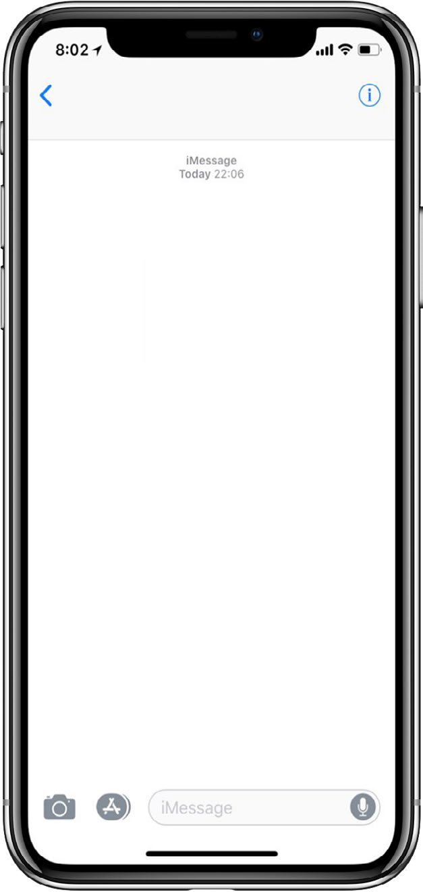




Increased sales volume with Automated Cadence follow-up.
Your BDC may forget about leads, but Quick2Credit never does
Quick2Credit verifies that each interested shopper is contacted, converted, and sold Hot notifications identify anxious buyers and instantly notifies the dealer’s CRM
NOTE
Day 20/45, if customer answers “Yes, I’m still interested”, a HOT Notification is sent to the dealer’s CRM
DAY 3
DAY 10
DAY 20
DAY 45
+1 (833) 839-8486
+1 (833) 839-8486
+1 (833) 839-8486
+1 (833) 839-8486
Becky, has someone from Dan Jennings Nissan contacted you about your estimated trade-in value? If you could please reply with: Yes or No
Becky, have you had a chance to visit Dan jennings Nissan yet? If you could please reply with: Yes or No
Becky, have you purchased a vehicle yet? If you could
please let us know by replying with: Yes or No
Becky, have you purchased a vehicle yet? If you could
please let us know by replying with: Yes or No
Yes
No
No
Yes
Thank you for letting us know. Below are a couple quick links to shop and call us. Have a great day. Click for our website DJennCars.com.
We hope you’re able to visit soon. We’re here to help.
Please call us if
you have any questions or need directions. Click for our website DJennCars.com.
Are you still interested in purchasing? Reply with Yes or No
Did you purchase from Dan Jennings Nissan?
Yes
Yes
Click to call us 833-839-8486.
Click to call us 833-839-8486.
Thank you for letting us know. We are here to assist you whenever you’re ready. Click for our website DJennCars.com.
Click to call us 833-839-8486.
Thank you for your business. Please don’t hesitate to call us if you need anything.
833-839-8486.
Dan Jennings Nissan
Dan Jennings Nissan
Customer Assurance, Powered by TEXTiUM®
Customer Assurance, Powered by TEXTiUM®
Dan Jennings Nissan
Dan Jennings Nissan
Customer Assurance, Powered by TEXTiUM®
Customer Assurance, Powered by TEXTiUM®

Slide 10
RESULTS
The Average Dealer Received $2.52 MILLION DOLLARS In Pre-Qualified Leads In December
Florida Toyota Dealer Received $6,720,000 MILLION In One Month
MO
Illinois Nissan Dealer Received $78,580,000 MILLION In Pre-Qualified Leads In 2020
DEMO
Missouri Independent Dealer Received 392 LEADS In One Month
Click here
J Franco Designed Credit Cite Received 8,327 LEADS Valued At $181,695,00 In 2020

Slide 11
What do you get?
Your Unique iFramed Quick2Script
Quickstart Welcome Kit
Triggered Follow Up And Text Cadence
200 leads a month ($2.50 per after 200)
Free use in any supporting marketing you do
Unlimited support
What does it cost?
FREE
for first 30 days
No hassle. Cancel at any time
$495
set-up fee
$795
per month

Slide 12
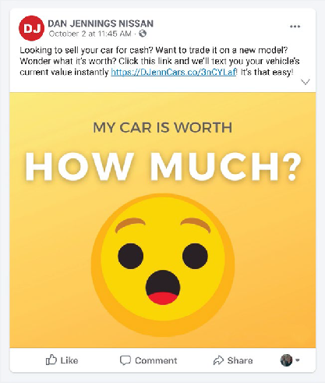
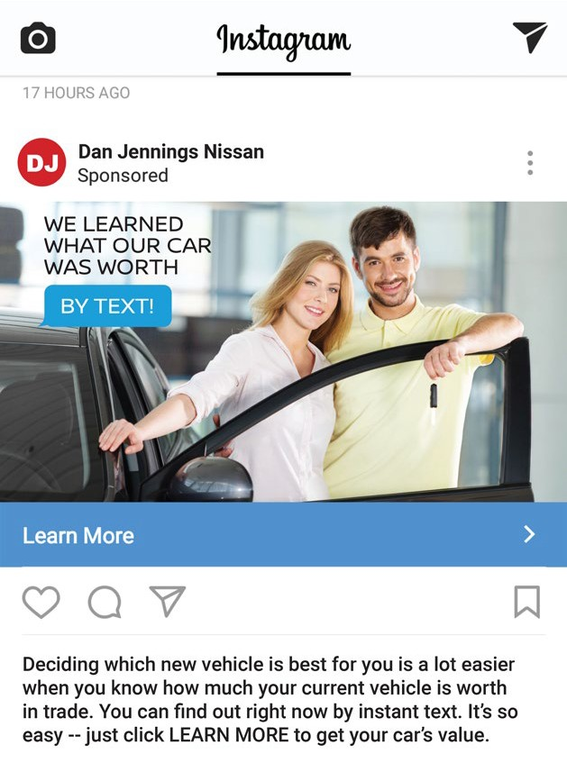
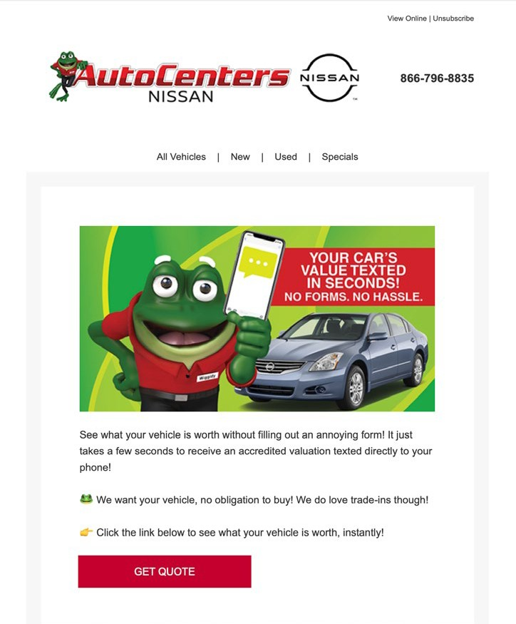

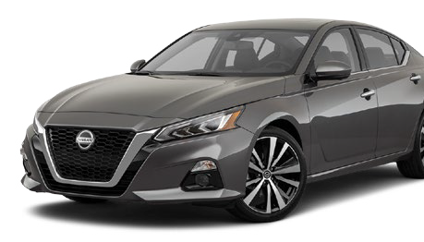

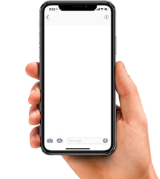
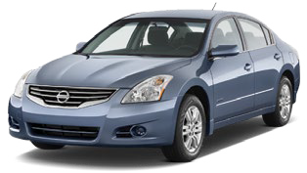
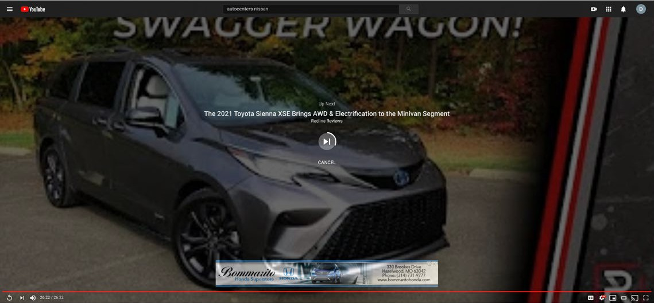
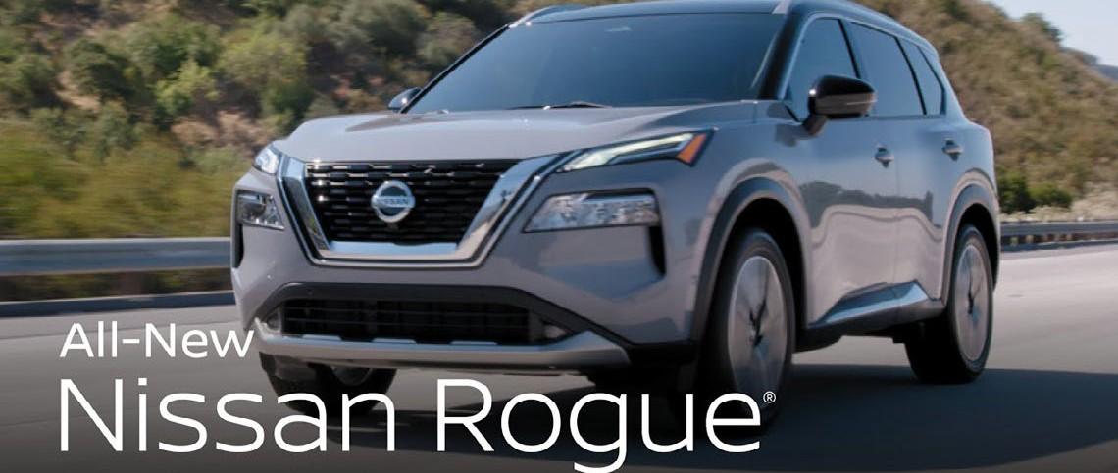
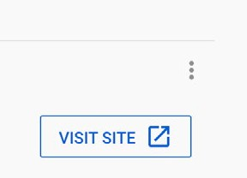

Digital marketing examples.
Plug Qucik2Credit URL into any current social media posts or paid ads
Facebook ad
Instagram post
Google web ad
Dealership blog
DAN JENNINGS NISSAN’S
BUY-BACK
EVENT!
WE’LL PAY TOP- DOLLAR FOR YOUR TRADE
DAN JENNINGS
I Qualify For
We learned how much we cold buy upfront
SEE YOUR CREDITSCORE NOW!
Thinking about a new car?
Wonder what your trade-
in is worth? WE’LL
TEXT IT
TO YOUR MOBILE PHONE
CLICK HERE
1234 Main Street Typical City, MO DJENNCARS.COM
See what your vehicle is worth without filling out an annoying, time-
consuming form. Click below and have your vehicle’s up-to-date value texted to your mobile phone!
Takes just seconds.
Free service with no obligation to buy.
PPC ads
You Tube
Ad Preview http://DJennCars.com/instant-trade-value.htm
Get A Trade Value Before Your Buy | Dan Jennings Nissan
Ad www.DJennCars.com
Click now and we will instantly and automatically text you your vehicle’s upfront trade value. Dan Jennings Nissan makes it hassle free!
Dan Jennings Nissan - We want to buy your vehicle - See what it’s worth!
See what your car is worth in seconds with an instant trade value by text! Click below for your value
www.DJennCars.com/instant-trade-value.htm
DAN JENNINGS NISSAN WILL
VALUE YOUR CAR BY TEXT!
CLICK FOR YOURS

Slide 13


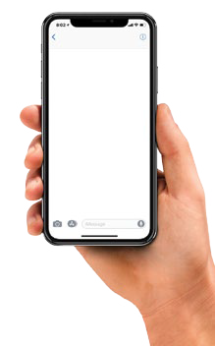
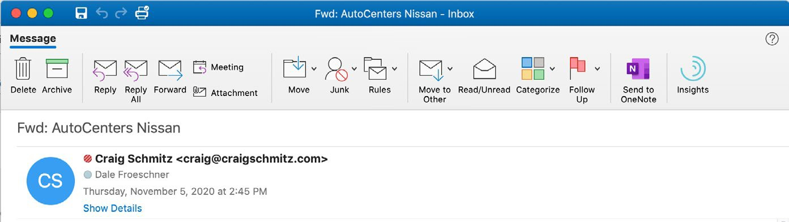
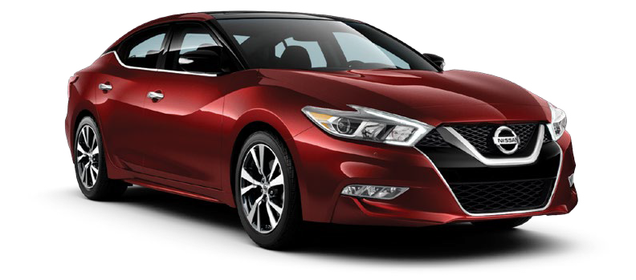

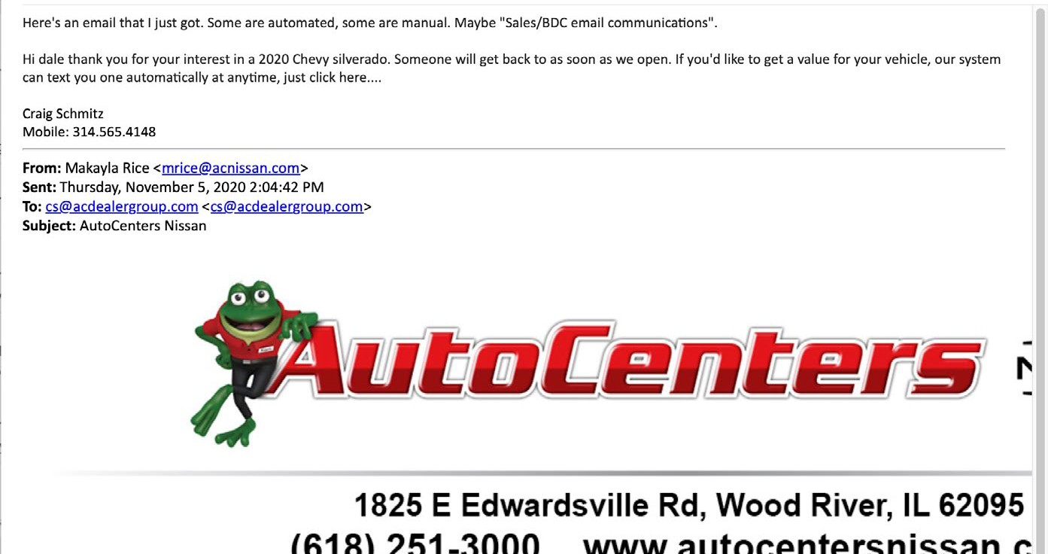



Email marketing examples.
Email campaigns
Plug Quick2Credit URL into all internal and outsourced email marketing Move interested shoppers to a streamlined experience
Instantly drop them onto your website to start shopping
Quick2Credit Automation continues to follow-up to generate more sales and leads
CRM autoresponder and BDC emails
DAN JENNINGS NISSAN
BUY BACK
SALE EVENT
We need pre-owned vehicles and
WE WANT TO BUY YOURS!
Find out what it’s worth right now on your mobile
WE’LL TEXT YOU YOUR VEHICLE’S VALUE
phone. Click below for your instant, automatic trade value text. No phone call required.
CLICK FOR TRADE VALUE
Dan Jennings Nissan
DJ
Tim Rice <trice@djenncars.com>
Becky Harris
2020 NISSAN MAXIMA
$399/mth*
SHOP NOW
Just $1,999 down cash or trade
BIG DISCOUNTS
on NEW Nissans & pre-owned vehicles!
DAN JENNINGS
1234 Main St. • Typical City, MO 63033 555-555-5555 | www.DJennCars.com
Hi Becky. Thank you for your interest in a 2020 Nissan Altima. Someone will get back to you as soon as we open in the morning. If you’d like to get a value for your vehicle, our system can text you one automatically at anytime. It’s simple. Just click here www.DJennCars.com/instant-trade-value.htm
Sincerely, Tim Rice
Internet Manager 555-555-5555
trice@djenncars.com
Special financing offers for a
LIMITED TIME ONLY!
150 NEW
60 SECOND
NISSANS
CREDIT
AVALABLE
Special Red Tag prices on each one!
Save thousands before month end.
CLICK NOW
APPROVAL
Get pre-approved before you shop!
No Social Security # needed. No impact on your credit score.
CLICK NOW
Limited time event - sale ends July 31, 2020
DAN JENNINGS
1234 Main St. • Typical City, MO 63033 833-839-8486 | www.DJennCars.com

Slide 14

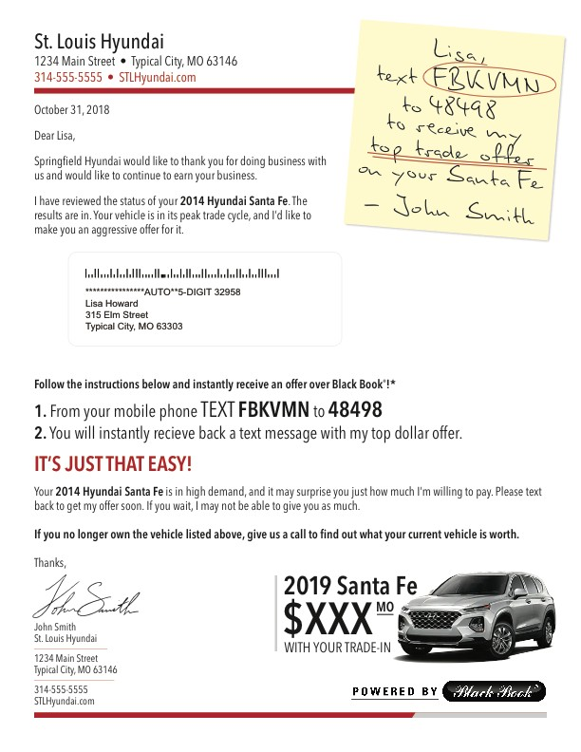
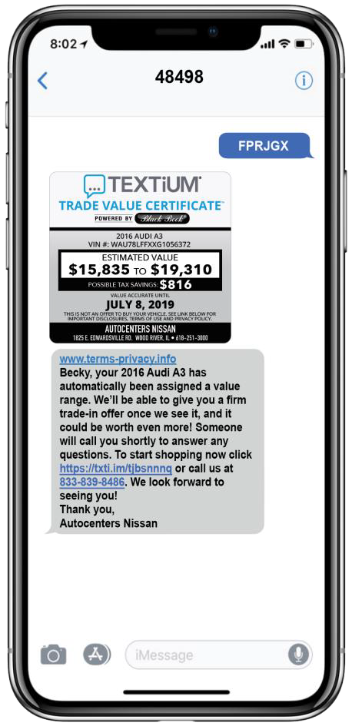



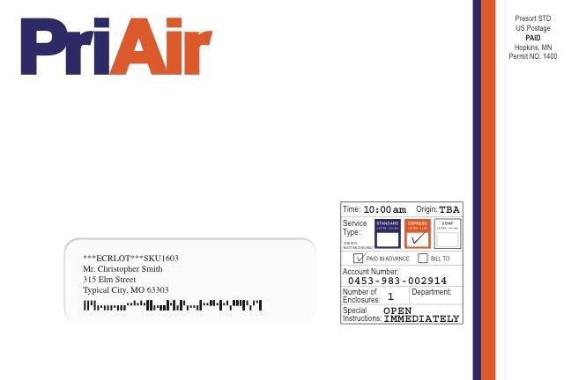
PRIAIR POST-IT
BUYBACK
TRY IT NOW!
Text FPRJGX to 48498
Target Audience: Sent to a combination of your sales and service database and conquest owners. We can filter by make, purchase/service date, and model year.
Text Response: Consumers can TEXT to receive a Black Book® Certificate on their vehicle, plus two additional vehicles!

