Slide 1
Flyer
Brand logo design
Competitor analysis

Slide 2


Quest
Audio advice
Notes:
Logo: a simple compass.
Message: the app helps you find your way.

Slide 3

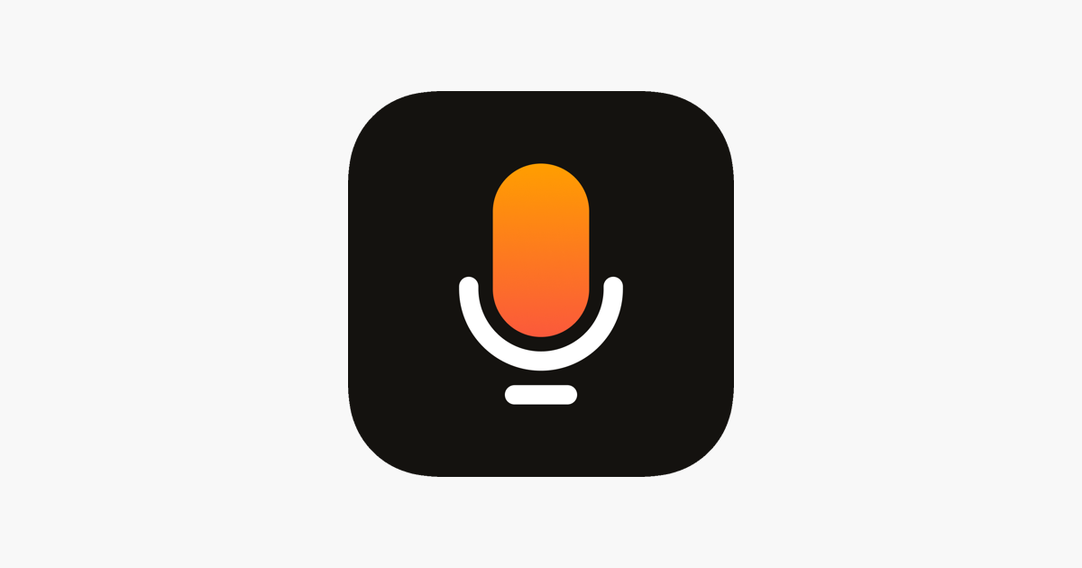

Stereo
Speak freely
Notes:
Logo: a speaker.
Message: the power of speech is yours.

Slide 4


Yac
Eliminate meetings with voice messages
Notes:
Logo: a black slant.
Message: don’t be the black slant, be the rising white.

Slide 5
How to succeed with this app
Dos
Don’ts
Be simple
  What does this mean? The logo should be “clean” – think Nike, or Yac
Be creative
Follow the style set here
  use rounded corners
  minimalist design
  no more than 2 - 4 elements in the logo
Tell a story with one image
Don’t be too straightforward in your thought process
  What does this mean? Tell me a complex story (plenty of thought behind it) with a simple logo. It should not, for example, just be a random image of a mic.
Don’t use too many elements

Slide 6
Good luck!

