Slide 1
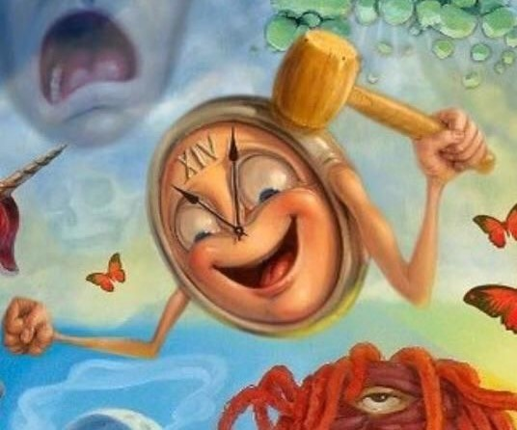
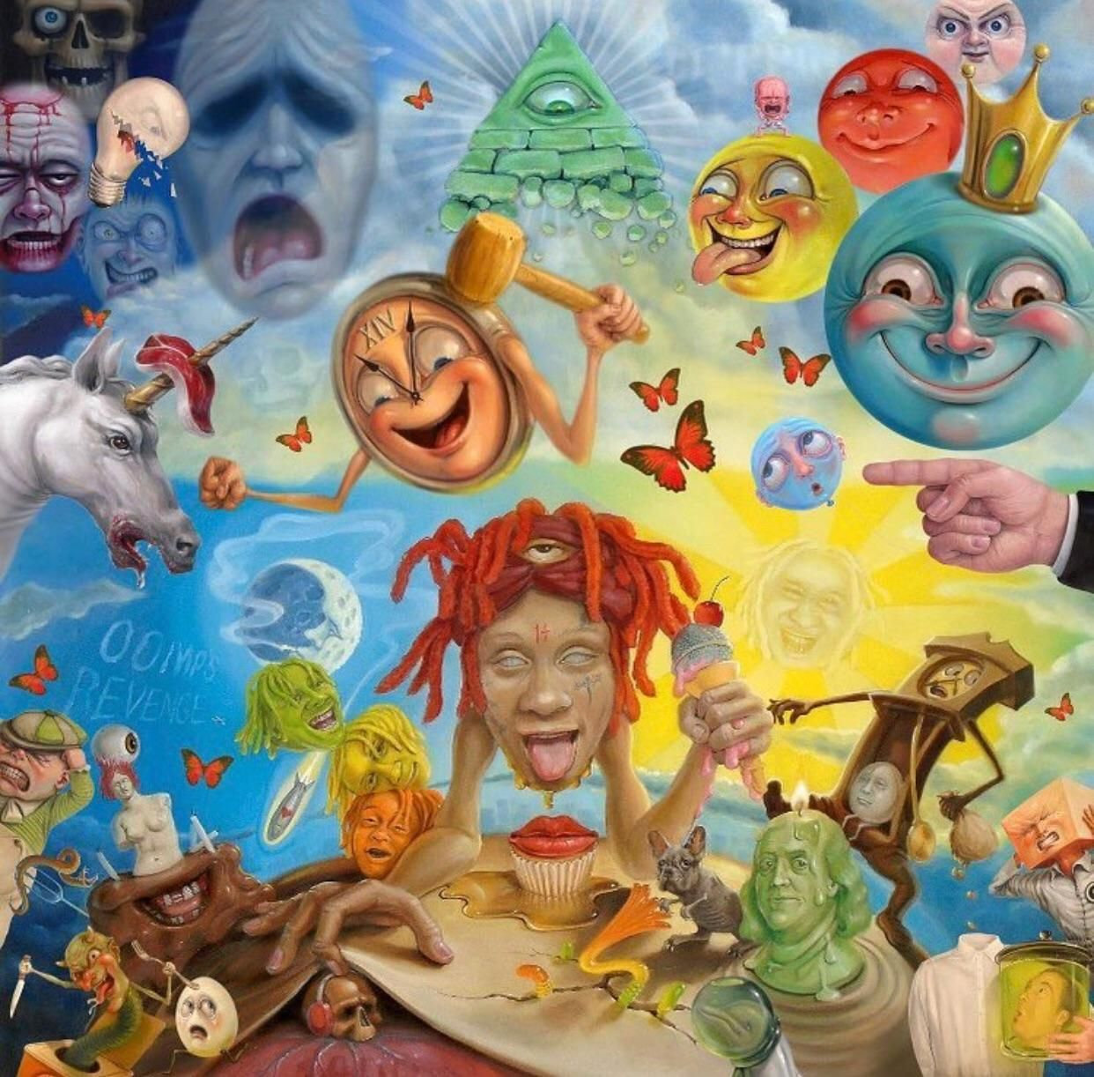
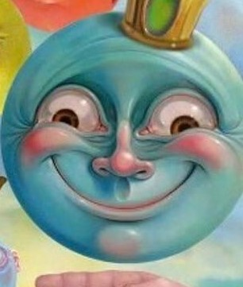
I want the artwork to be similar to these two images which were painted by the Windsor Surreal Painter (Stephen Gibbs). I feel like the “Surreal” art style would make the shirt pop more. I also like the glossy/realistic cartoon effect the artwork has as well.

Slide 2
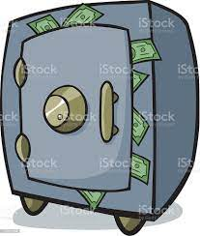
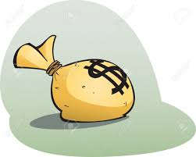
The idea for the artwork that I had in mind was an image of a buff armed safe that is holding up the money bag aggressively in front of its face with a menacing look and a open mouth filled with K9 like teeth. The money bag will have a look of utter shock/fear on its face looking at the safe. The safe will be looking like it is about to devour the money bag.

Slide 3

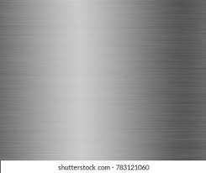
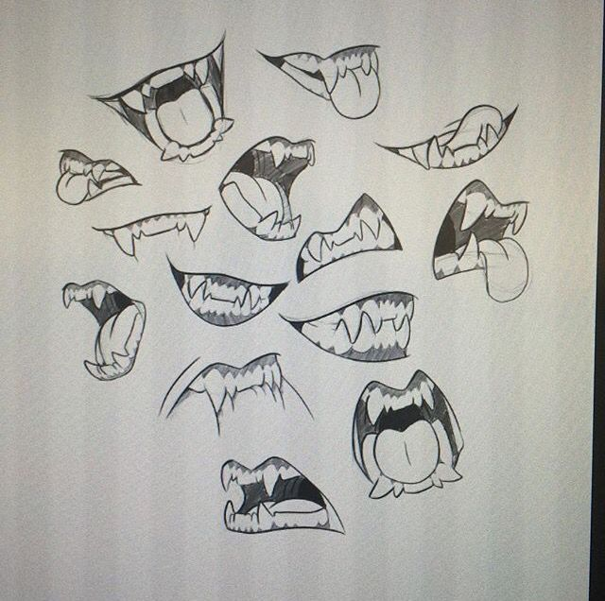

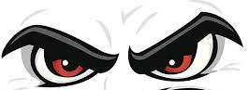
The safe will have buff arms with defined muscles.
I want the color of the safe to be a metallic grey color with a sheen to it.
I want the safe to have K9 like teeth. The pose of the mouth has to insinuate anger or hungry look as if it can't wait to consume the money bag.
The safe will be grabbing the money bag tightly with its left hand holding the bag to its open mouth.
I want the eyes of the safe to be sinister/menacing looking as it stares down the money bag.
The Safe should have money busting from its seam as if it’s filled with money.
The mouth of the Safe should also be below the wheel fly which is basically the nose.
(These are all just examples of what the image will be; the artwork itself should be in the “Surreal” art style)

Slide 4

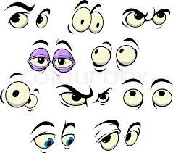
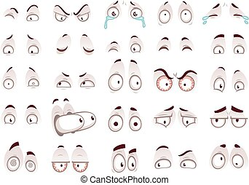
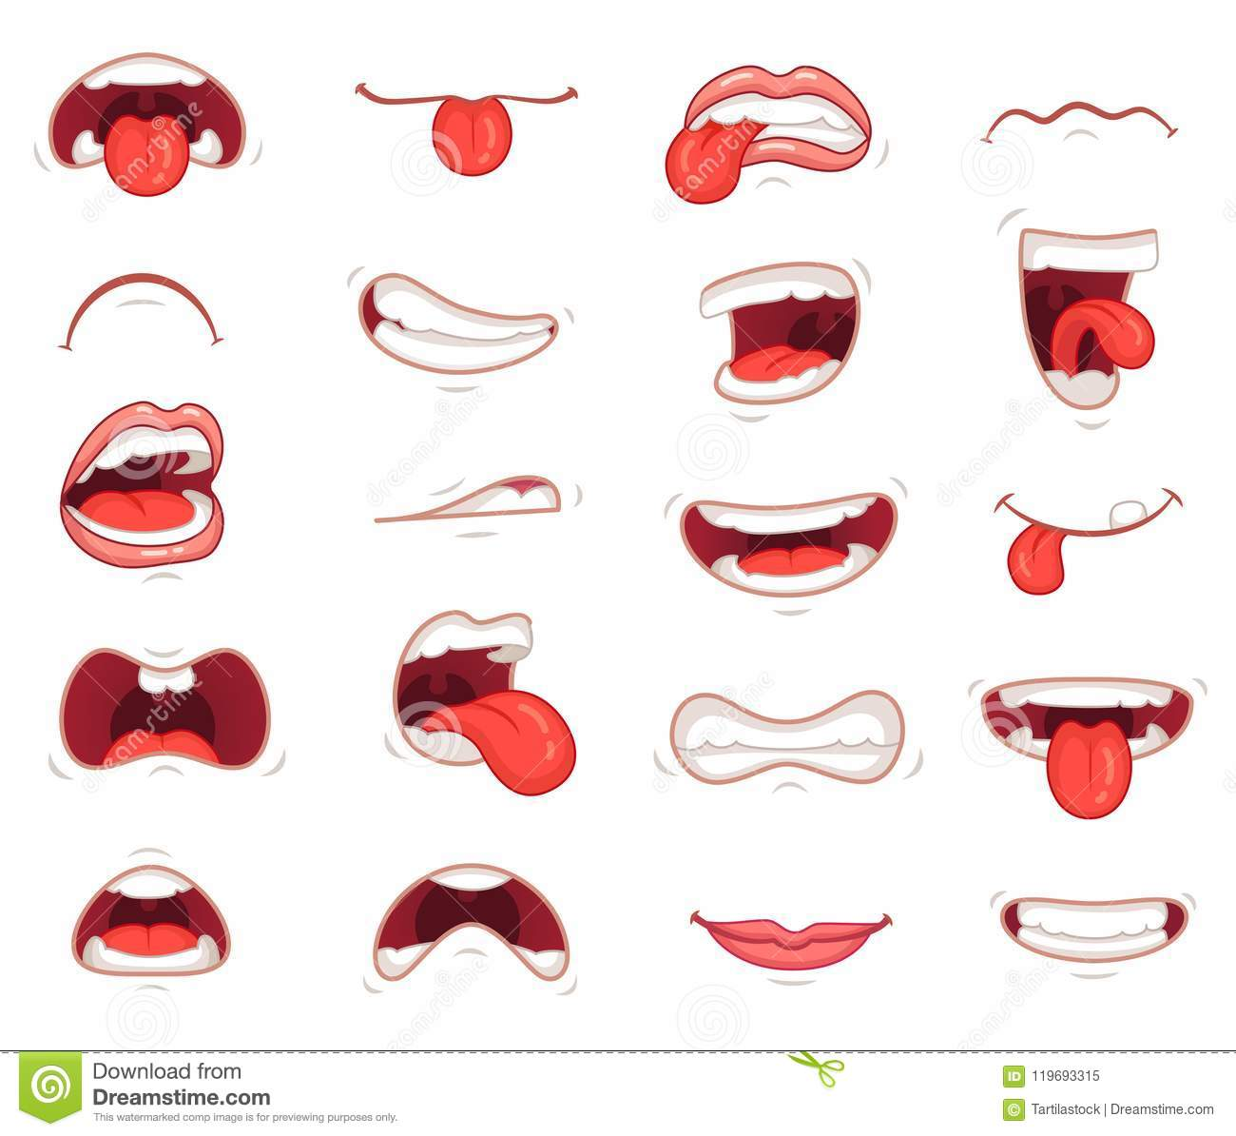
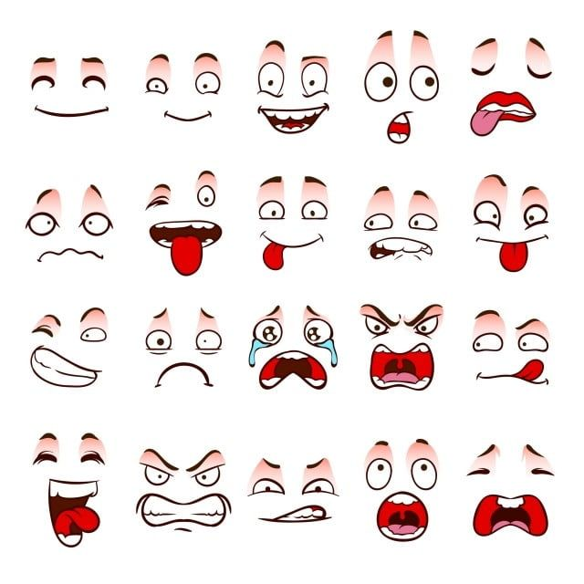
I want the money bag to be a tan color with a green dollar sign in the middle of it acting as the nose of the money bag.
The money bag will have a very frightened expression on its face with its eyes popping out of the sockets and sweat dripping down from its forehead.
I want the Money Bags mouth to be open giving off a shocked/scared vibe as well.
(These are all just examples of what I want the image to be; the artwork itself should be in the “Surreal” art style)

Slide 5

The Safe should take up a good majority of the T Shirt.
I want the artwork to have a faded ring affect around the Safe grabbing the money bag. The faded ring around the Safe and money bag should start off black like the shirt than fade in closer to the artwork itself.
I want the artwork to be in the center of the shirt.

