Slide 1
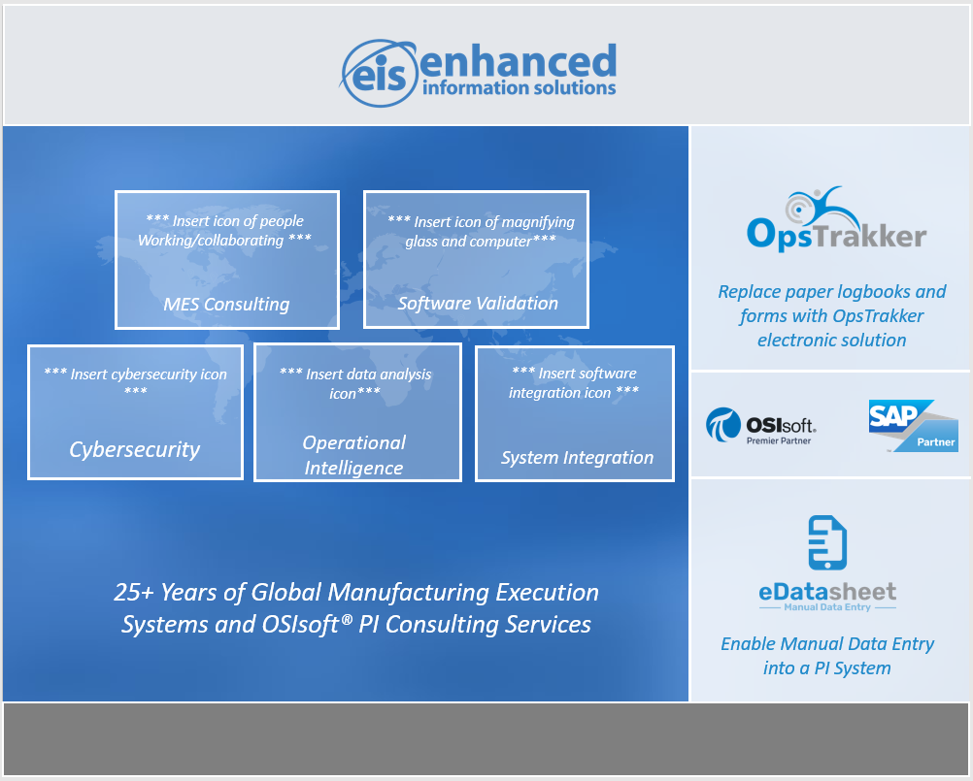
We would like the trade show banner to include the elements on the image to the left.
The banner may be organized in any way which you believe looks best, using the colors consistent with our logos and website (eisinc.com & opstrakker.com)
The most important aspects to highlight are:
Company Logo
“25+ Years of Global Manufacturing Execution Systems and OSIsoft PI Consulting Services
Services:
MES Consulting
Software Validation
Cyber security
Operational Intelligence
System Integration
Product Logos:
OpsTrakker
eDatasheet

Slide 2
Please choose or create icons to
represent each of the services within
the bubbles.
All bubbles must be the same size as
one another
Please visit eisinc.com to explore
additional information
They must have a modern and clean
look

Slide 3


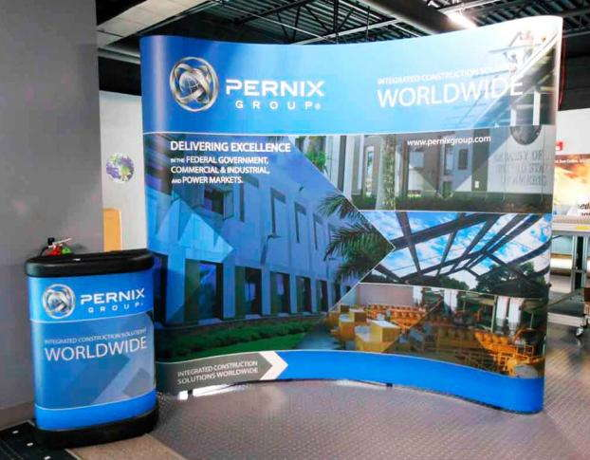

Banners we like (also attached to design brief)

Slide 4











25+ Years of Global Manufacturing Execution Systems and OSIsoft® PI Consulting Services
*** Insert icon of people
Working/collaborating ***
*** Insert icon of people
Working/collaborating ***
MES Consulting
Software Validation
Replace paper logbooks and forms with OpsTrakker Electronic Solution
*** Insert icon of people
Working/collaborating ***
*** Insert icon of people
Working/collaborating ***
Cybersecurity
System Integration
*** Insert icon of people
Working/collaborating ***
Enable Manual Data Entry into a PI System
Operational Intelligence

Slide 5


25+ Years of Global MES and OSIsoft® PI Consulting Services
Replace paper logbooks and forms with OpsTrakker electronic solution
*** Insert icon of people
Working/collaborating ***
*** Insert icon of magnifying
glass and computer***
MES Consulting
Software Validation
*** Insert cybersecurity icon ***
*** Insert data analysis icon***
*** Insert software
integration icon ***
Enable Manual Data Entry into a PI System
Cybersecurity
Operational
Intelligence
System Integration

Slide 6








*** Insert icon of people
Working/collaborating ***
*** Insert icon of magnifying
glass and computer***
MES Consulting
Software Validation
Replace paper logbooks and forms with OpsTrakker electronic solution
*** Insert cybersecurity icon ***
*** Insert data analysis icon***
*** Insert software
integration icon ***
Cybersecurity
Operational
Intelligence
System Integration
25+ Years of Global Manufacturing Execution Systems and OSIsoft® PI Consulting Services
Enable Manual Data Entry into a PI System

