Slide 1











The innovative solution
for Hospitality, Television, Movie and Wi-Fi Services

Slide 2


Contents
 Executive Summary
 Introducing LSP
 Offering
 Pricing
 LSP Finance


LSP Technology Summary

Slide 3


Executive Summary
This corporate profile is intended to give a comprehensive overview of Lifestyle Panel
business operations.
Lifestylepanel is made up of several key business arms. There are Hospital & Aged Care Centres, Hotels & Mining Camps for guest services including WiFi, Movies on demand and content management and finance solutions for equipment acquisition and deployment for early adoption of the latest technologies.
Our strength is through our continued evolution and improvement of services via close relationships with our customers.

Slide 4


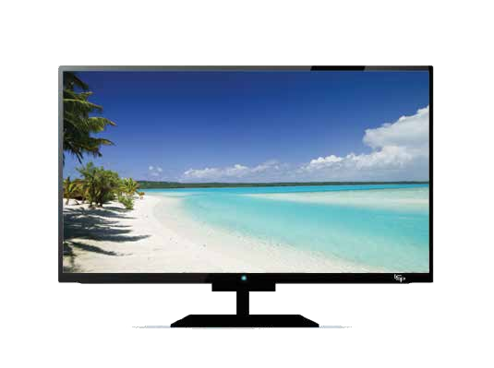
Our Vision
To be the Hospital & Aged Care
Centres, Hotel & Mining Camp’s First Choice for guest services, through dynamic and elastic integration

Slide 5

Introducing LSP
A better way to
Inter-connect to your guests.

Slide 6

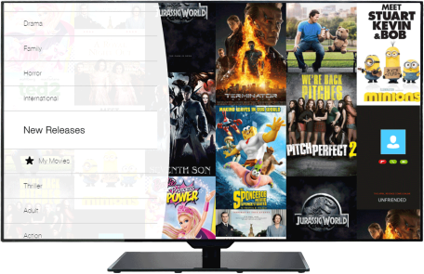
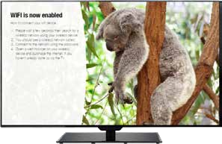
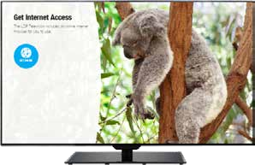
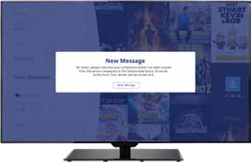

Offering
In Room Wi-Fi
Offer In Room Wi-Fi to your guests with guaranteed coverage (no dead spots). Highly secure – each guest has a unique password – and multiple devic- es can access at one time. This can be delivered through the existing infrastructure
Internet Browser
The built in internet browser allows guests to surf the web on your TV.
Movies on Demand
A curated and comprehensive genre-driven movie catalogue. Guests can watch movies in HD quality and are able to pause, fast forward & rewind. All files are stored locally so usage doesn’t affect the hotel’s external bandwidth, and an unlimited number of users can view the same content simultaneously.
LSP can update movie catalogue remotely.
Guest Messaging
The messaging feature allows the site to broadcast a message to guests. Messages to just one room, all rooms, or a selection of rooms. It’s a great way for each site to promote ad-hoc information.

Slide 7
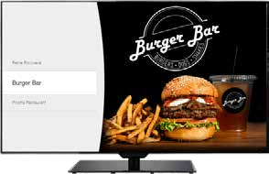
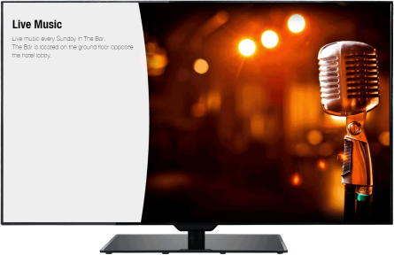
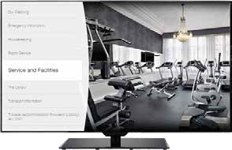
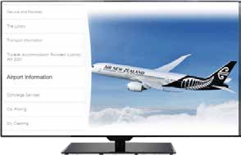
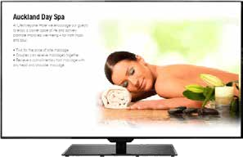
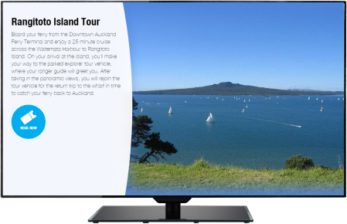
Offering
Restaurants & Dining
The Dining feature allows the site to showcase restaurants and cafes with menus.
Event Calendar
The Event Calendar feature allows you to keep guests informed of what events are happening at each site and in the local area.
Things to do
The Things to Do feature allows each site to promote guest facilities, for example, pool, gym, spa, sauna and kids club or activities. Having this information readily available in a visual format helps to increase satisfaction.
Digital Compendium
This is the home for all the information from the old printed compendium, which means content can be easily changed using the simple content management system.
Special Offers
The Specials feature allows guests to view what spe- cial deals or offers running across various site facilities.
Local Attractions
This feature allows the sites to promote places and busi- nesses around the local area to guests and
potentially even sell advertising space

Slide 8
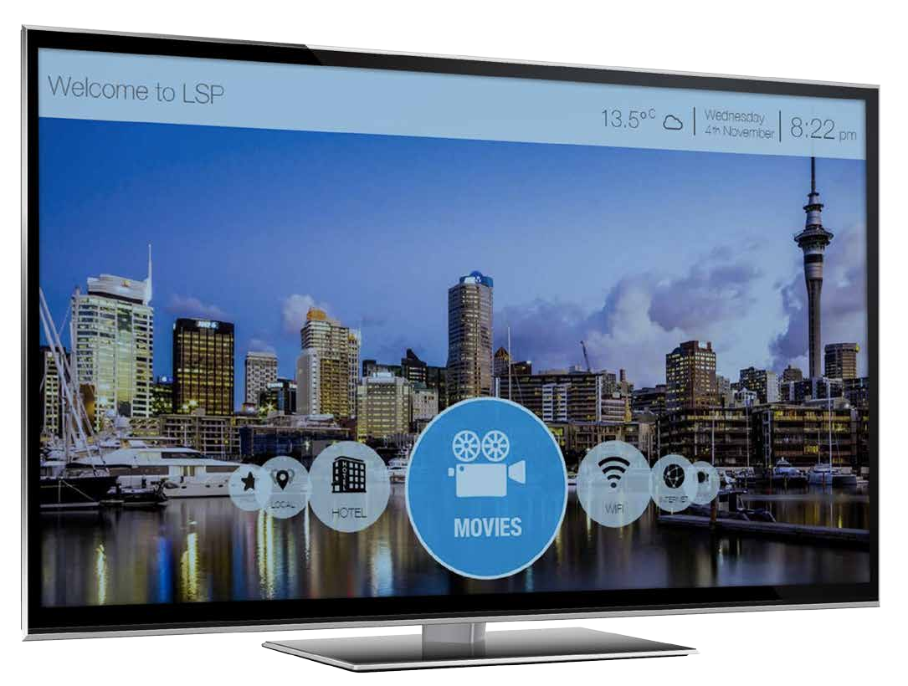


Connecting your guests to their world!

Slide 10




Enjoy our comprehensive movie library

Slide 11


Lifestyle Panel Advantages
 Leverage off existing infrastructure & cabling
 One-Stop Shop and Single Invoice
 Delivering Movies-on-Demand, WiFi, Games, Meal Plans, Hospital Information
 Speed to install, Minimal Disruption for site and patients
 Partnership development Opportunities creating new revenue opportunities
 Advertising
 Medical history and records
 Nurse rounding and recording
 Reporting

Slide 12



Hospital & Aged Care Centre Pricing
What’s Included:
Site Compendium Movies
TV - Free to air Wifi
The Ultimate guest engagement
Internet
Apps
One Invoice
Games

Slide 13

Hospital & Aged Care retains all revenues under a fixed fee for movies on demand and WiFi.
Hospital & Aged Care has complete flexibility in how the services are retailed to guests.
New Release
All Other Movies
Giveaways & Incentives

Slide 14


Delivering dependable
Wi-Fi into each guest room!
Guests can connect simultaneously to multiple devices.
No costly data cabling!
We get your information, services, promotions and entertainment to the guest when and where it matters.
Private and secure network.
We provide the connection between the hotelier and the traveling guests to things important to them.
Lifestyle panel can be connect to non-essential power

Slide 15



Real-time updates and information on your screen
Guest Messaging
Weather Information
Accounts
Clinical Records
Site Compendium

Slide 16


Equipment
Lifestyle Panel Mini to integrate with existing TV
Remote control and wireless keyboard with touch pad

Slide 17

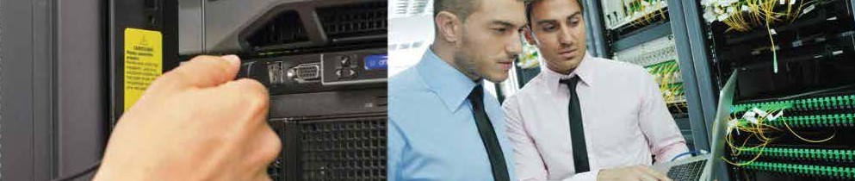
PMS Interfacing
Integration is available with most PMS systems or we can provide a stand-alone system control console.
Content Management
 Channel line up
 Each individual site may manage their own information.
 Head office may change information as required.
 Specials may be provided on-line in real time.

Slide 18


LifeStyle Panel Technology
 LSP Infrastructure also improves existing
free to air and cable TV quality
 Key advantages – Cost, reliability, features and scalability
 Site Property Management integration and reward programs developed
 Encrypted secured WiFi and internet facilities
*To provide effective WiFi and content throughout an existing site is a fraction via LSP
An increase in the level of data usage and changes to technology has resulted in a derogation of service to customers of both WiFi and Content.
 LSP delivers services across all infrastructure methods primarily existing Coaxial cabling through our LSP enterprise EoC masters & software removing the need to upgrade existing telecommunications infrastructure

Slide 19
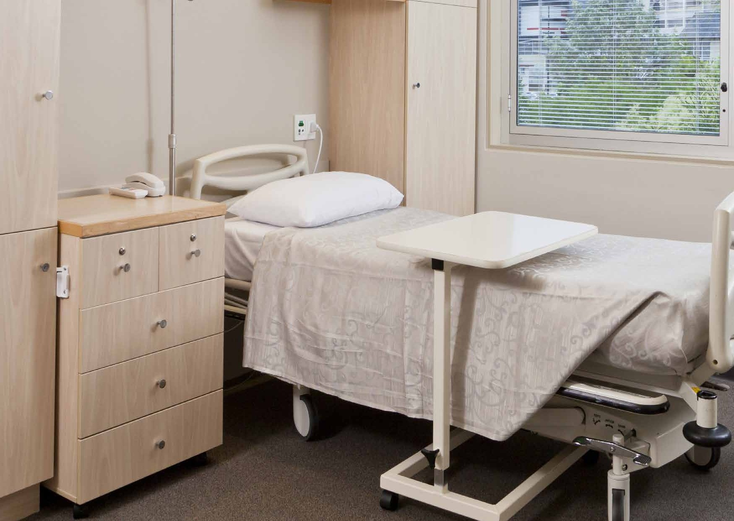

Infrastructure Room Cost
LSP 15%
The Market 85%

Slide 20









Lifestyle Panel Finance
LSP Finance was established last year for the provision of equipment without capital outlay for small, medium and large Hospitals & Aged Care Centres,
Hotels & Mining Camps
finance

Slide 21

Lifestyle Panel Finance Benefits
100% FULLY TAX DEDUCTIBLE PAYMENTS
UNIFORMITY OF ROOM STANDARDS
EASY MONTHLY PAYMENTS
FULLY WARRANTED FF&E FOR THE TERM OF THE AGREEMENT
INCREASED NIGHTLY ROOM RATE
NO END OF TERM RESIDUAL PAYMENTS

Slide 22
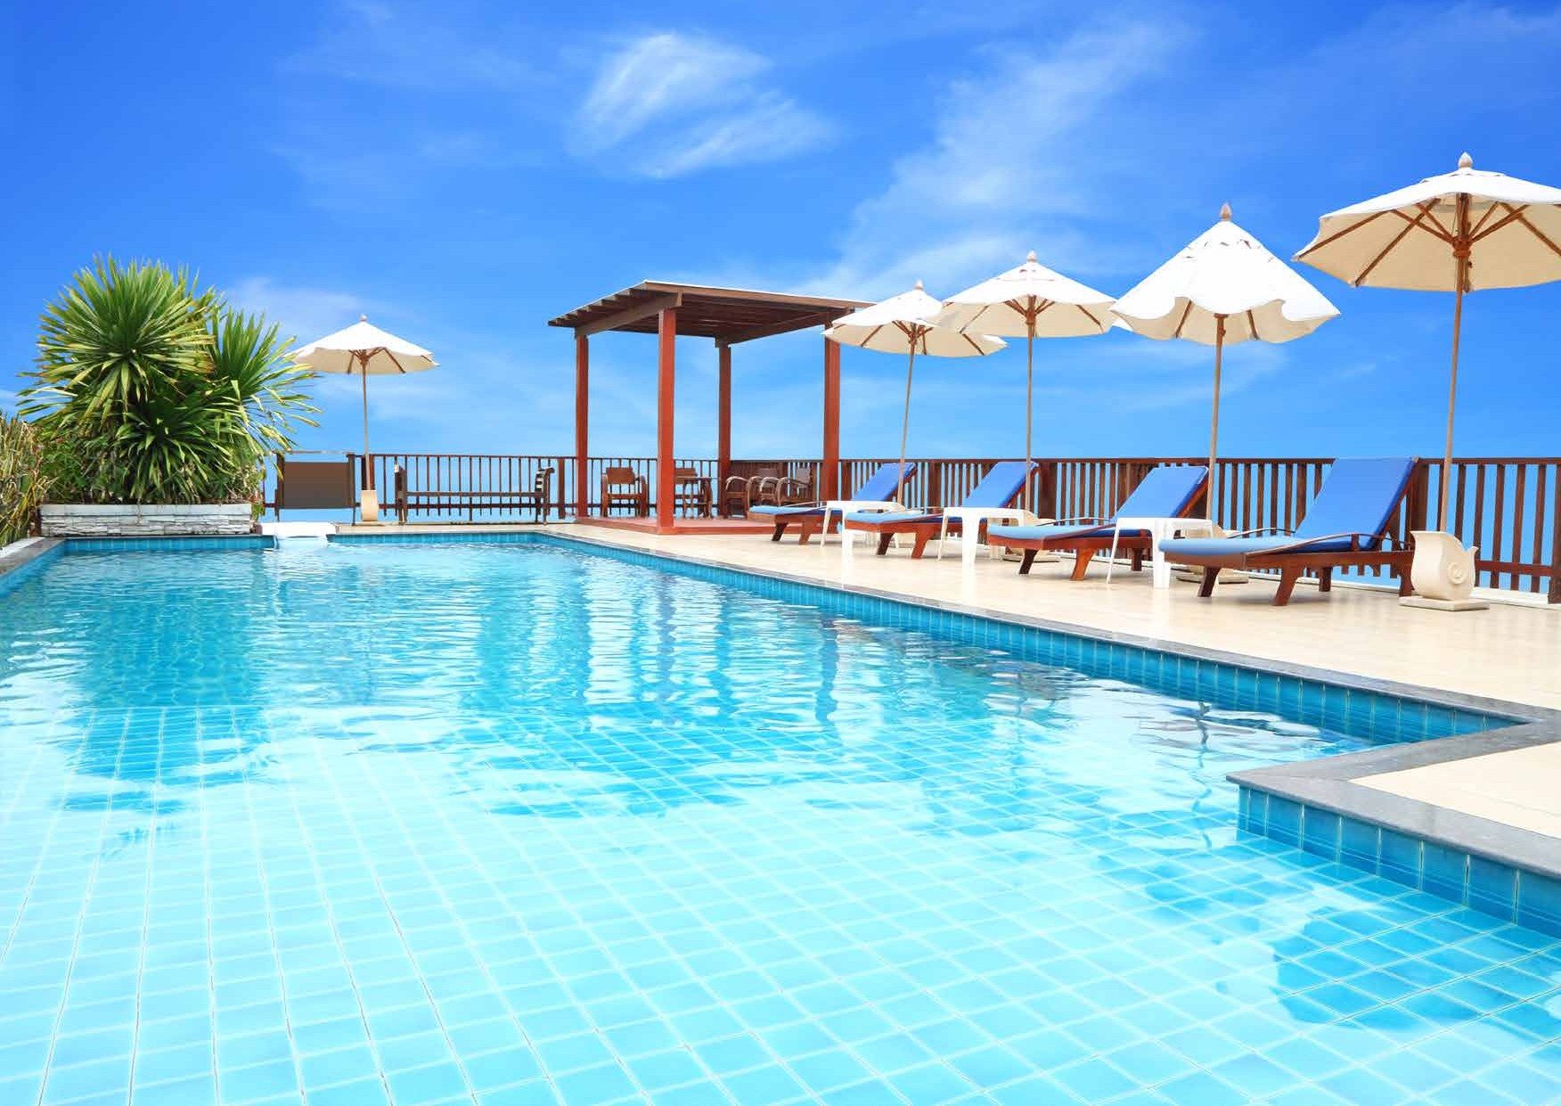

Summary
We invite you to arrange a site survey today with our friendly team to review your Hospital & Aged Care for a complete proposal for the provision of LSP’s guest services.
At LSP we`re extremely proud of the our alliance with Major Hotel Resort Groups and excited about the future development of our services.
Ben Westaway
President & Managing Director

