Slide 1


COMPANY
PROFILE

Slide 2
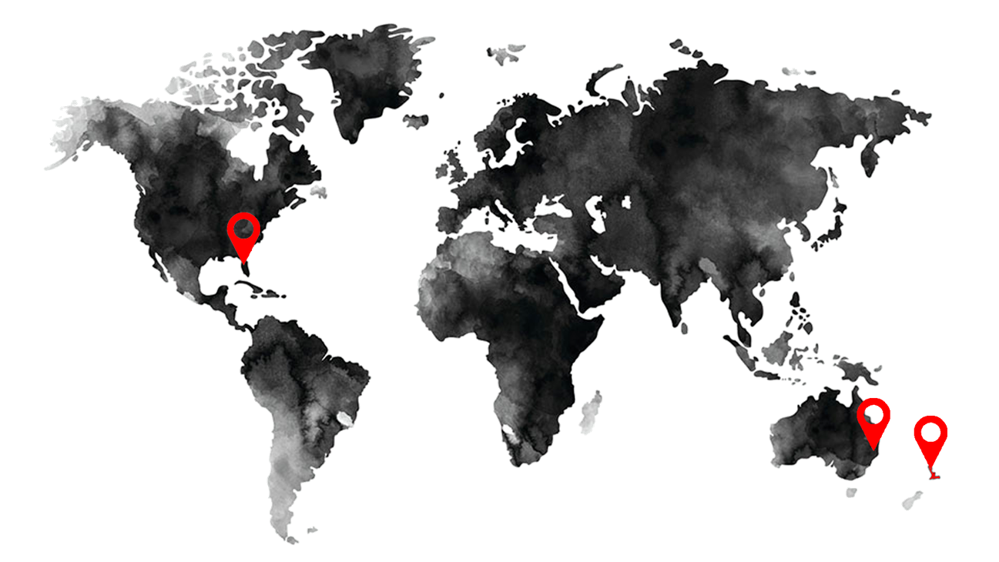
COMPANY OVERVIEW
Lifestylepanel Pty Ltd is a non-listed public company that provides IoT solutions, technical services, entertainment and communication to hotels, healthcare, aged care, mining camps and education facilities.
LSP operates offices in Australia, New Zealand and the United States of America.

Slide 3

PROFILE
With extensive industry experience and over 10,000 endpoints across Australia, New Zealand, Fiji, Indonesia, Singapore and United States of America – Lifestylepanel (LSP) is able to bring together the best outcomes for your facility.
LSP was founded in 2008 to capitalize on the anticipated growth in on-demand Wi-Fi, Information and Content for Hotels.
VISION
To be the first choice and solution provider through dynamic and flexible integration platforms, extending to hospitals, aged care facilities, student, regional and remote accommodation facilities, and mining camps.

Slide 4
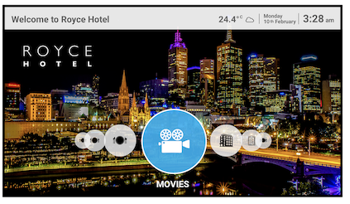
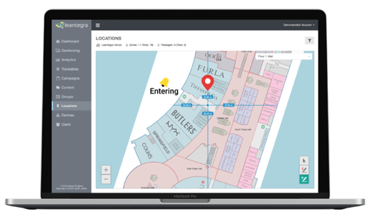

PRODUCTS & SERVICES
Lifestylepanel aligns and partners with Tier 1 manufacturers to design and develop specialised software for various market segments.
Wi-Fi Management
Customised User Interfaces
IPTV & Digital Head Ends
Smart TV Networks
Content Management
Movie Content
Food & Beverage Ordering
Digital Compendiums
Casting
LSPTRAK – real-time staff & asset tracking
LSPCARE – healthcare interfaces
Digital Signage
Property Management System Integration

Slide 5
CLIENT PORTFOLIO

Slide 6
PARTNERSHIPS

Slide 7

www.lifestylepanel.com
SALES & SERVICE
info@lifestylepanel.com
Australia
77 Logistics Place
Larapinta QLD 4110
+61 (7) 3164 1100
United States of America
2295 S. Hiawassee Road, Suite 306
Orlando, Florida, 32835
+1 951-660-1967

