Slide 1

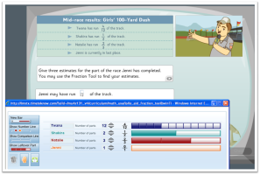



Evolution of Digital Instructional Tools
Next Gen
Digital Teaching
Platforms
2012
2010
Print→ Digital
In-class Computing
2000
Electronic Whiteboards
1985
Computer Labs

Slide 2
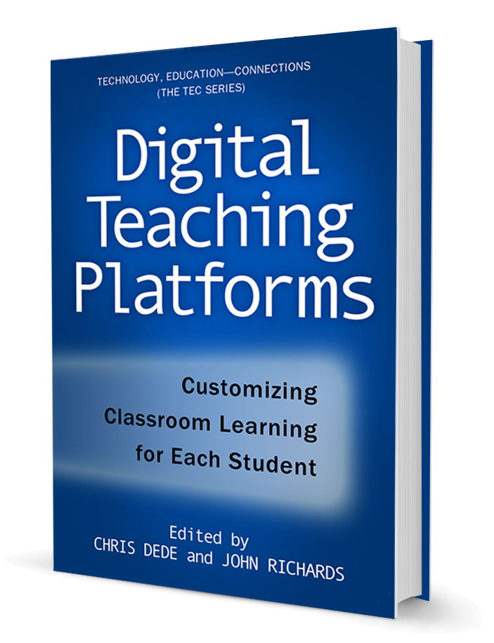
The Digital Teaching Platform contains a comprehensive curriculum of guided learning sequences that include applet activities, multimedia presentations, practice exercises, and activities. Before class the teacher uses planning tools to prepare; during class he uses multimedia to introduce a topic, an math tool to explore a mathematics concept, and practice exercises. After class, the teacher can review each student’s progress, trends in the class performance, and begin the process for planning tomorrow’s lessons.
The platform provides powerful tools to the teacher for planning and managing lessons, customizing instruction to individuals, and providing quick feedback on all activities. It facilitates the management of groups of students without losing focus on individuals. It frees up the teacher for small group work and individual tutoring. In these ways, the platform respects the role of schools in today’s society by teaching to standards and preparing students for high-stakes tests.
At the same time, the T2K Digital Teaching Platform deploys a social constructivist pedagogy and provides tools and content to build on that approach. It features open-ended explorations, student collaboration, shared work, and group discussion. In this way the platform goes beyond the standards and engages students in their learning, preparing them in a deep way for their place in a technology-rich society.

Slide 3
Traditional LMS Instructional Loop
Content
Management
Assessment
Grade
Book
SIS

Slide 4
Traditional LMS
Skinnerian Teaching Machines—ILS’s
“Teacher Proof” Technology
Closed Curriculum
Fixed Map from Assessment to Curriculum
Lab or Back of the Room
One student only

Slide 5


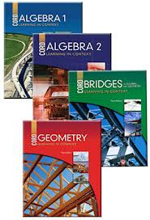

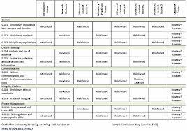

Where is the Locus of Control?
Traditional LMS
Teacher
Technology
Curriculum
Student

Slide 6
Teacher-Centered
Traditional LMS
Teacher
Technology
Curriculum
Student

Slide 7
Curriculum-Centered
Traditional LMS
Teacher
Technology
Curriculum
Student

Slide 8
Student-Centered
Traditional LMS
Teacher
Technology
Curriculum
Student

Slide 9

Technology-Centered
Traditional LMS
Teacher
Technology
Curriculum
Student

Slide 10

Digital Teaching Platform—Instructional Loops
Teacher
Course
Syllabus
Content
Management
Assessment
Grade
Book
SIS

Slide 11
Digital Teaching Platform—Instructional Loop
Designed for Classroom Use
  Real Time Classroom Management
Teacher-Centric
  Scaffolds Teachers
Open Curriculum—Flexible, Teacher-Modifiable
Lesson Planning Tools
Individual, Group, and Whole Class Curricula
Collaborative, Project Centered
Adaptive Assessment Loop for Personalized Instruction

Slide 12
Where is the Locus of Control?
DT Platform
Teacher
Technology
Curriculum
Student

Slide 13
Teacher-Centered
DT Platform
Teacher
Technology
Curriculum
Student

Slide 14
Student-Centered
DT Platform
Teacher
Technology
Curriculum
Student

Slide 15
Instructional Delivery Scan
21st Century School Environment | Course Platform LMS | Course Delivery LMS | Digital Teaching Platform | Text book | e-book
Interactive Digital Environment |  |  | 
Virtual Courses |  | 
Teacher Administration Tools |  |  |  |  | 
Student Administration Tools |  |  |  |  | 
Course Authoring Tools |  |  | 
Curriculum Content |  |  |  |  | 
Assessment Content |  |  |  |  | 
Classroom Support |  |  |  | 
Pedagogical Support |  |  |  |  | 

