Slide 1
2021 Icon Set - Competition
Cameron Jones
27/07/2021

Slide 2



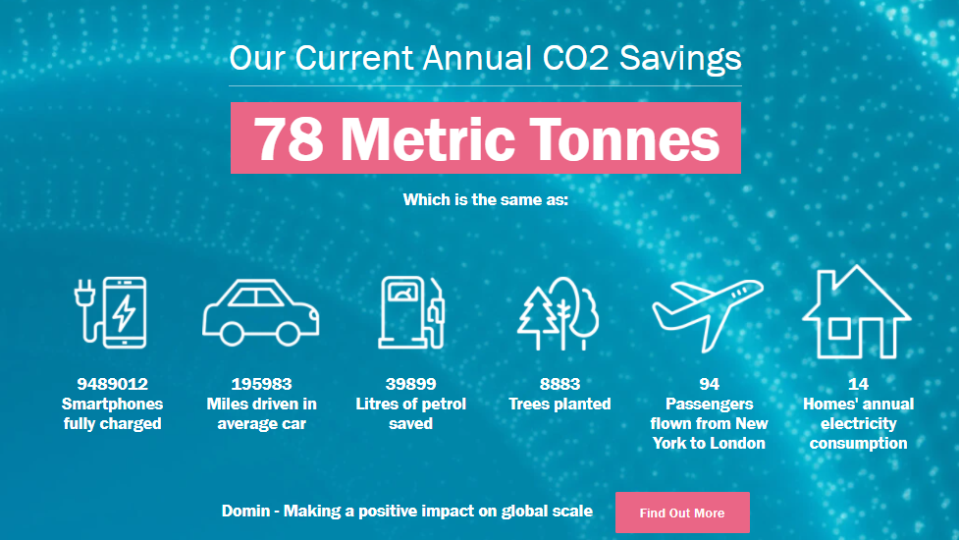
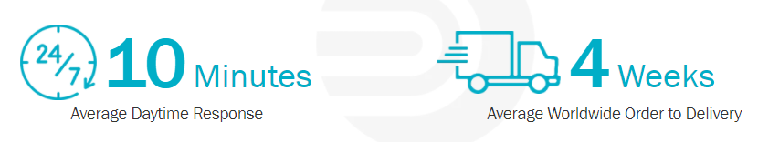
Current Domin Icons

Slide 3
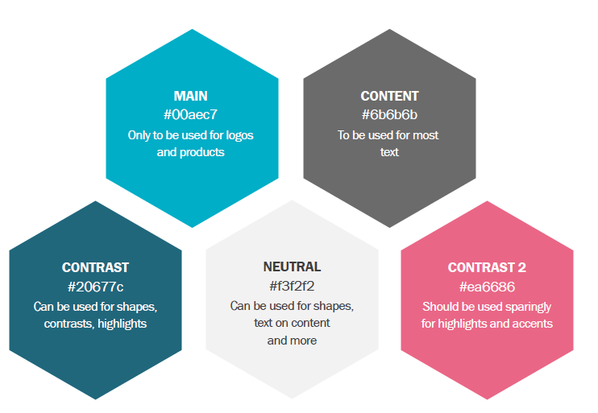
Colour Scheme

Slide 4
Desired Icon List
Sustainability
eCommerce
Business Essentials
Strategy and Management
Social Media
Technology
Industry sectors:

Slide 5
Sustainability
Tree
Aeroplane
House
Electricity
Oil/ Petrol
Car
Sapling
Globe
Wind Turbine
Thermometer
Recycling
Trash Can
Charging
Battery
Factory

Slide 6
eCommerce
Online Store
Shopping Cart
Shopping Basket
Customer Support
Packaging
Delivery
Gifts
Payment
Reminders
Recommendations
Product Review
Social Sharing
QR Code Scan
Quote
Help
Forwards
Backwards
Up
Down
Currency (£, $, €, ¥)

Slide 7
Business Essentials
Contact Name
Phone
Location
Address
E-Mail
Website
Domin
Internet
Copyright

Slide 8
Strategy and Management
Quality
Goals
Process
Solution
Brainstorming
Checklist
Organisation
Analysis
Policy
Inspection
Production
Workflow
Search
Scales
Presentation
Laptop
Deadline
Time
Sending
Survey
Sales

Slide 9
Social Media
LinkedIn
Facebook
Online Chat
Wifi
Blog Post
Video
Twitter
YouTube

Slide 10
Technology
Gear
Spanner
Design
Mechanics
Electronics
Development
Knowledge
Simulations
Flow Rate
Performance
Lifespan
Weight
Size
Power
Leakage
Vibration
Frequency
Connector
Digitalisation
Additive Manufacturing
3D Printer
Machining
CNC
Factory
Automation

Slide 11
Industry Sectors
Aerospace
Automotive
Die Casting
Animatronics
Injection Moulding
Systems
Testing
Robotics
Railway
Timber
Simulation
Hydraulic Press
Hydraulics

