Slide 1
Popstars Logo Design
Branding and Mood Board

Slide 2
Branding
Lifestyle
  *Clean Eating*
  Fitness /Active lifestyle
  Healthy & fresh
  Quick
  Nostalgic – 80’s push pop
  Upscale lifestyle
Demographics
  Women
    Healthy moms / Busy Moms
    Health-conscious women who are on-the-go
  Clean Eating
    Fitness-focused (men and women)
    Yoga / Eastern philosophy / whole body health
    Long-term wellness – Real food

Slide 3
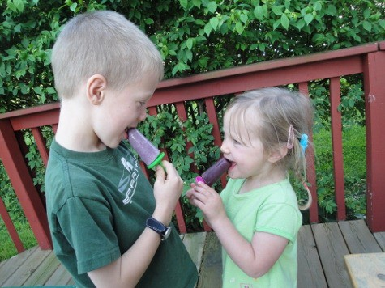

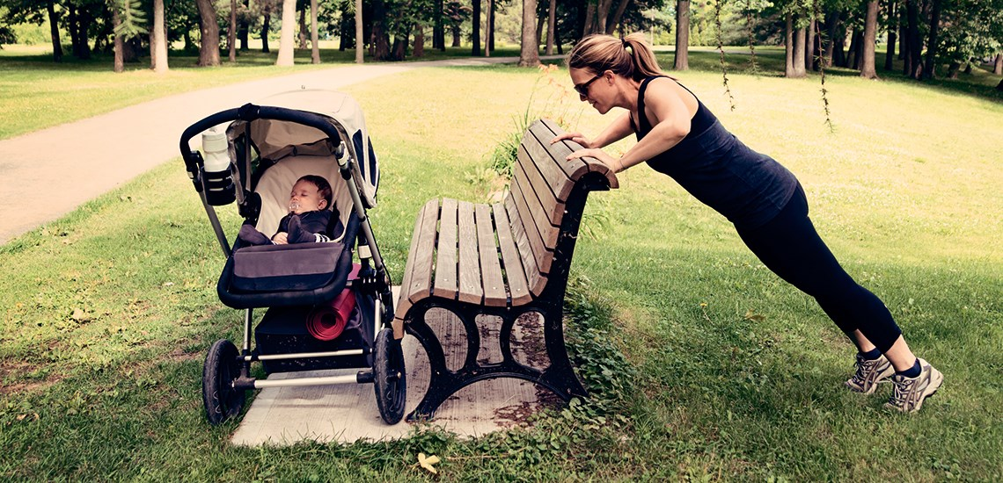

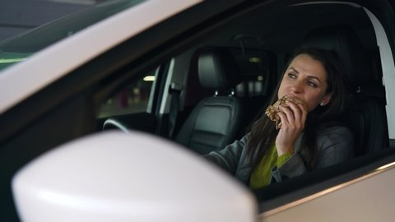
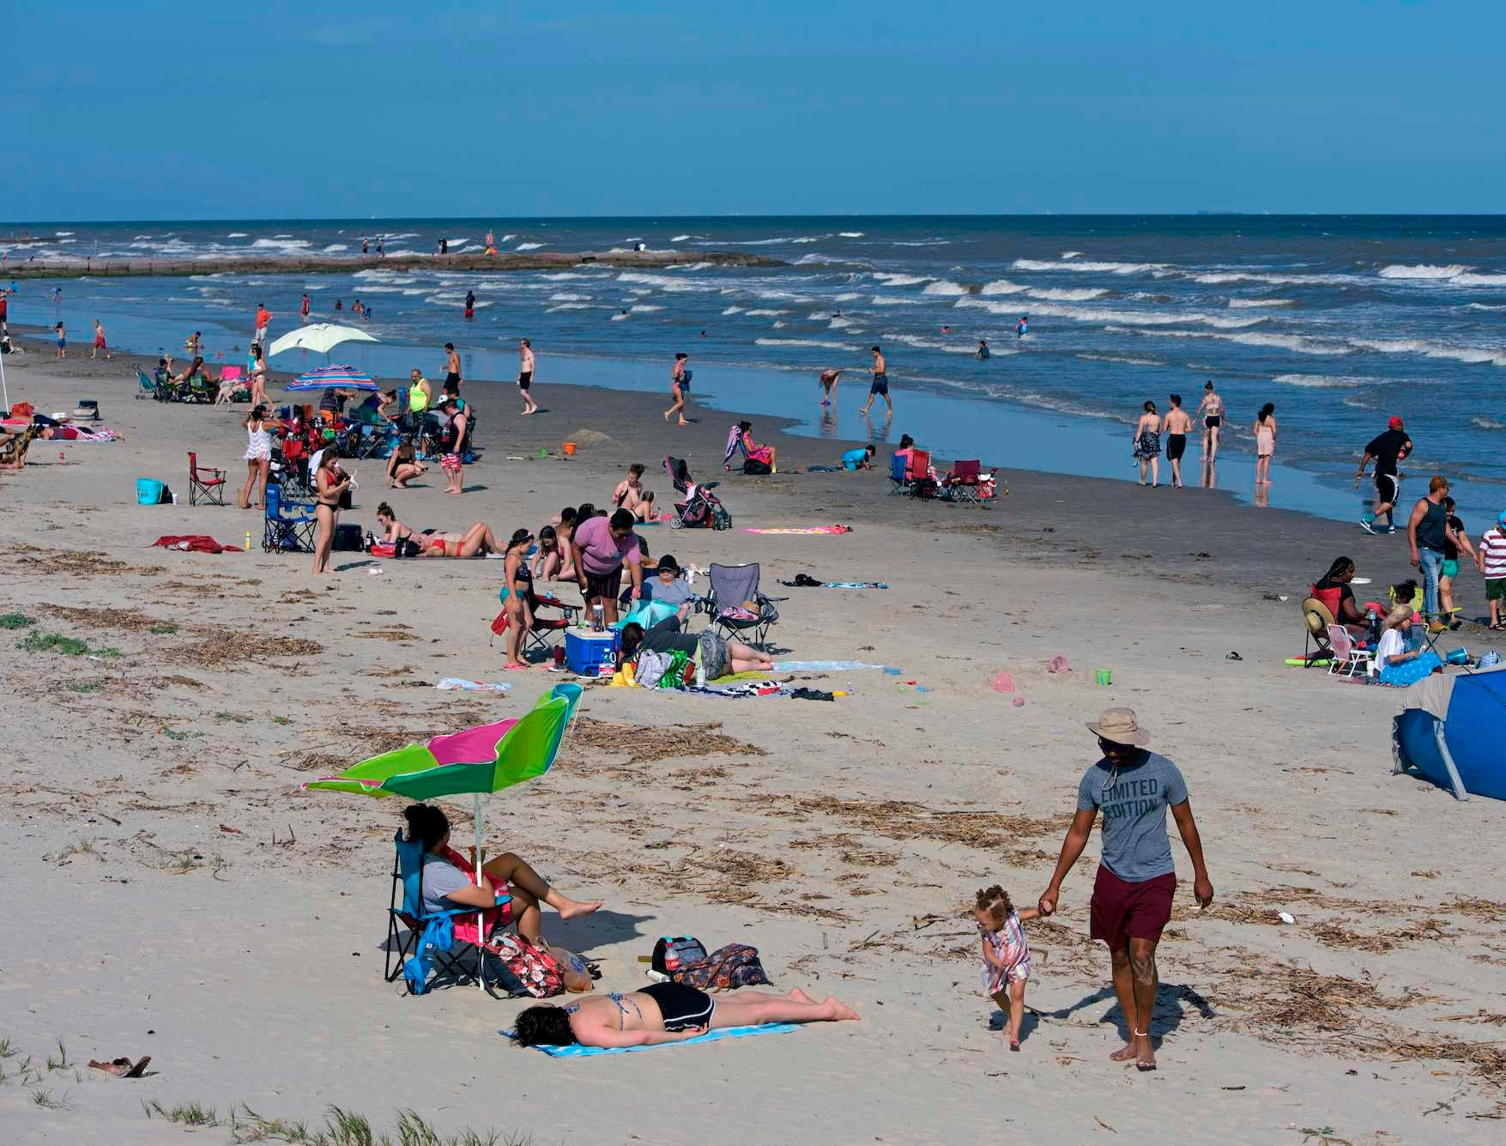


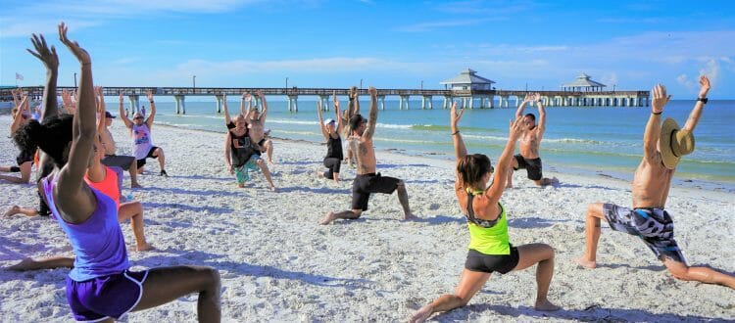
Mood Board
Good for kids
Healthy Mamas (Busy Moms)
Clean eating/ Upscale / Yoga & Fitness

