Slide 1
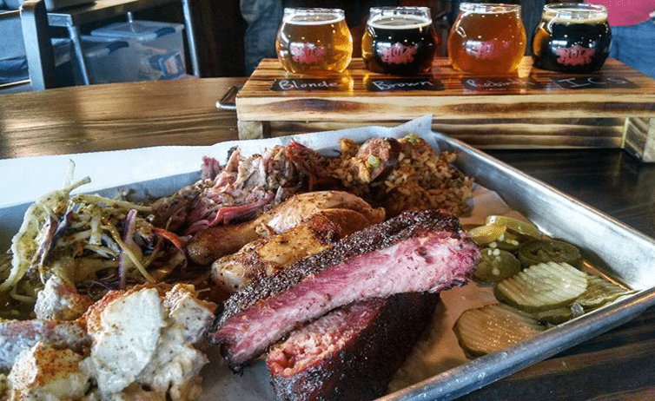
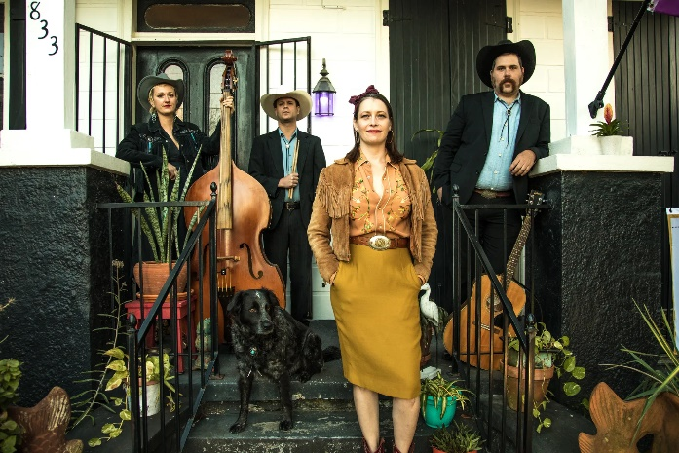
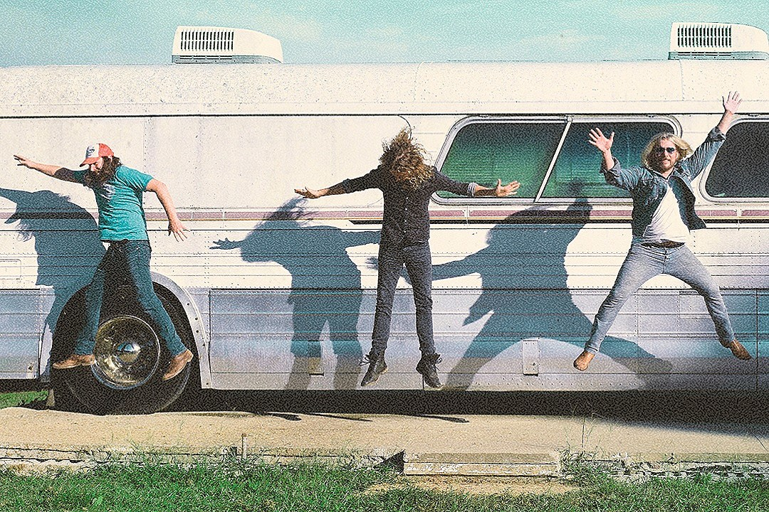
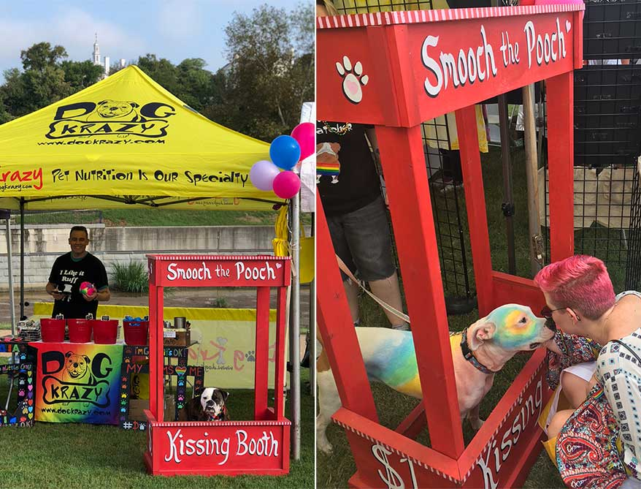
Americana Festival – Saturday, Sept 5th & 6th – 11am-8pm
Entertainment
11:30am-1pm – Tanglers Jam Session
1:30pm-3pm – Tipsy Chicks
3:30pm-5pm – Grayson Capps
5:30pm-7pm – Gal Holiday & the Honky
Tonk Revue
11:30am-1pm – Tanglers Jam Session
1:30pm-3pm – Lilli Lewis Bluegrass Debut
3:30pm-5pm – Honey Island Swamp
Country Breakdown
5:30pm-7pm – Texas Hill
Activities
Art Market (30 vendors – 12pm-6pm)
Yard Games
Face Painting
Food Vendors
Fete au Fete
BBQ
Big O Popsicles
Gourmet Popcorn
Spun Fun
Beneficiary
LASPCA Presence/Tent
Doggie Photobooth
% of dog can toys donated back to LASPCA

Slide 2

Festival Name Ideas
Festival Americana - similar to Festival Acadiana
Americana FestivALE
Jammin’ Jubilee
Summer Send Off – perhaps we can work in DAT’SUMA/suma/summer?

Slide 3
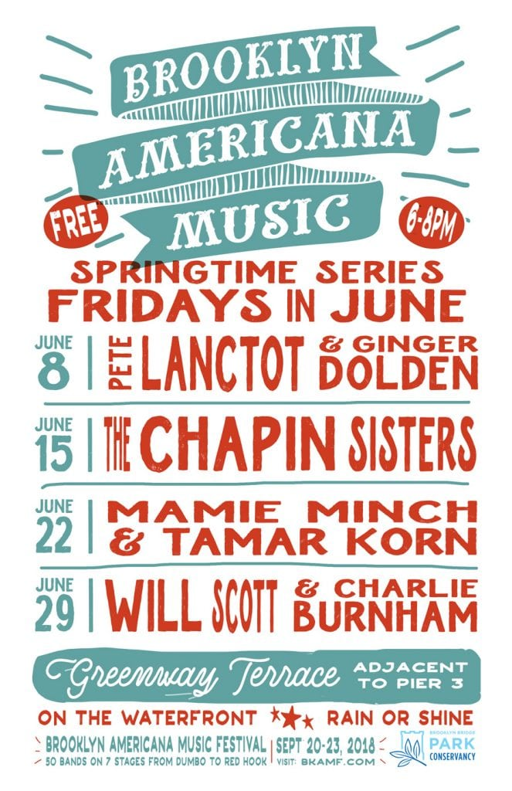

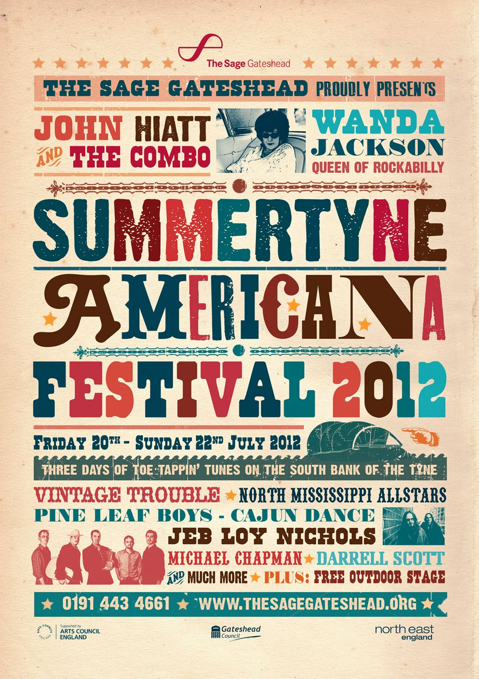
Graphic Styles – Letterpress Style/Red, White, Blue

Slide 4
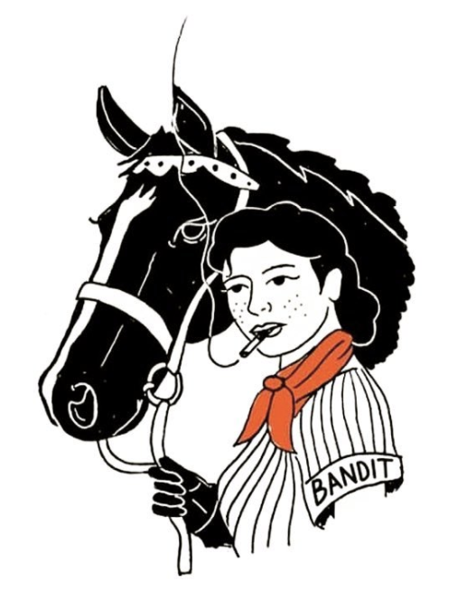

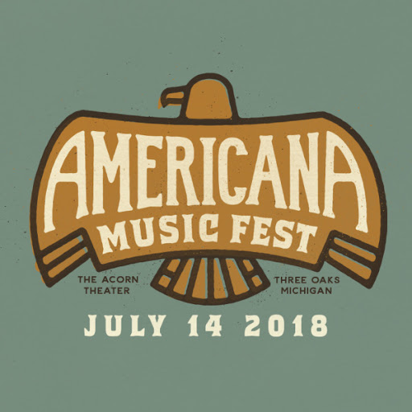
Graphic Styles – Americana Tattoo Style
Tattoo Sketch Example
Local Logo Example
Possible Festival Example

Slide 5
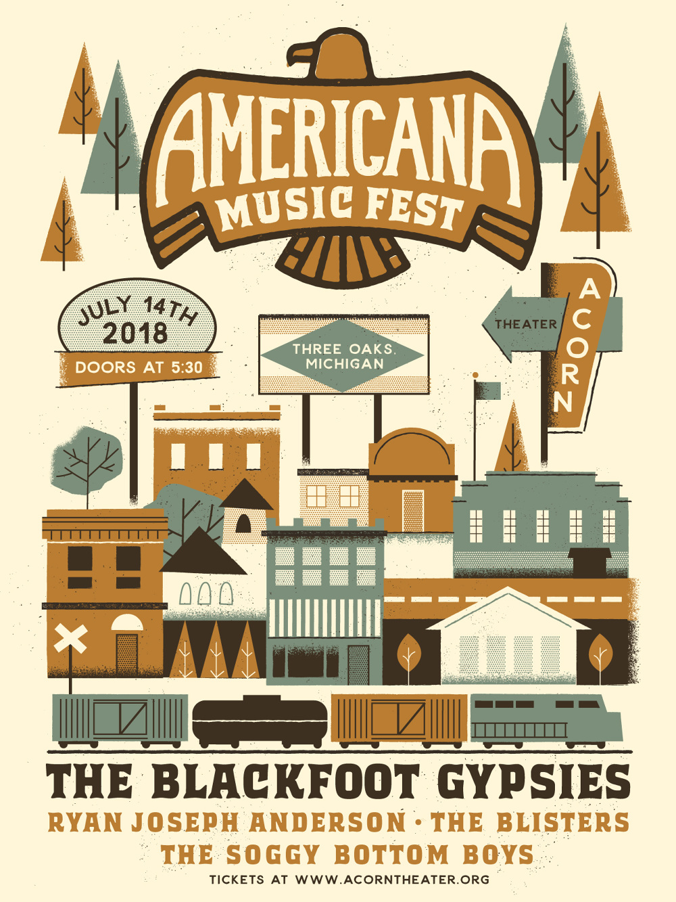
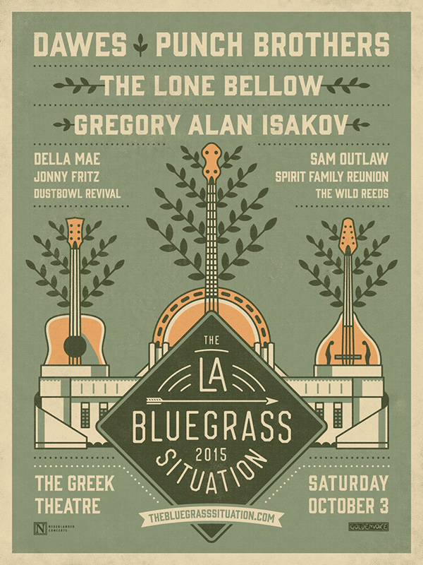

Graphic Styles – Americana Tattoo Style – State Flag Idea
Poster Example
Graphic Hierarchy Example

Slide 6
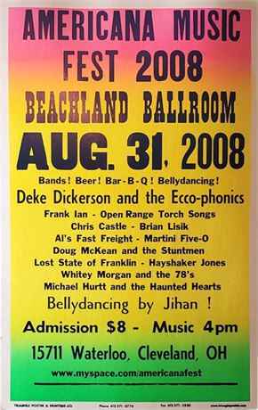
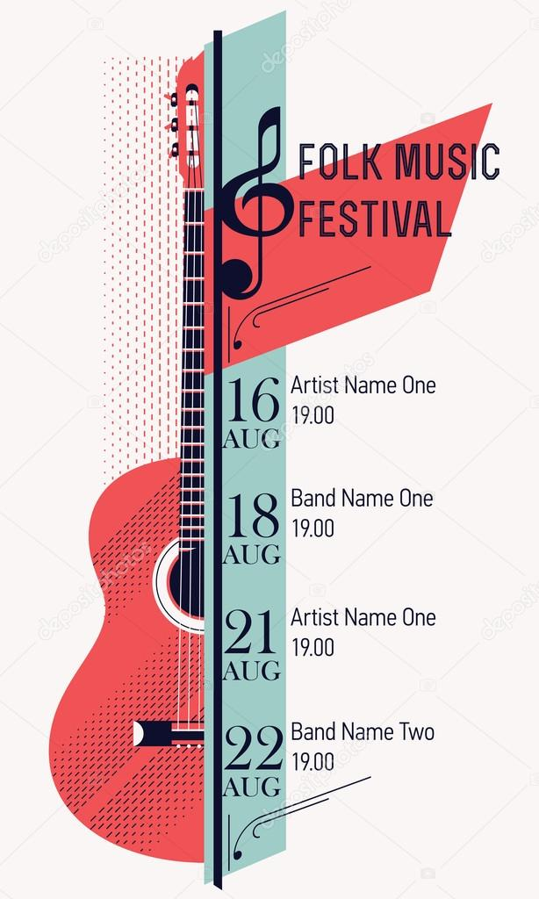
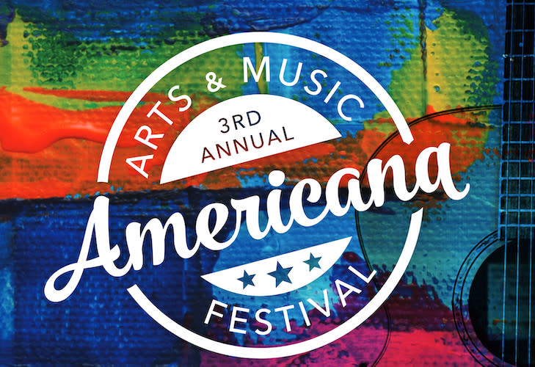
Graphic Styles – “Colorful”/Other

