Slide 1

Company Logo & Colors
Proprietary and Confidential - Erbi Biosystems 2021

Slide 2
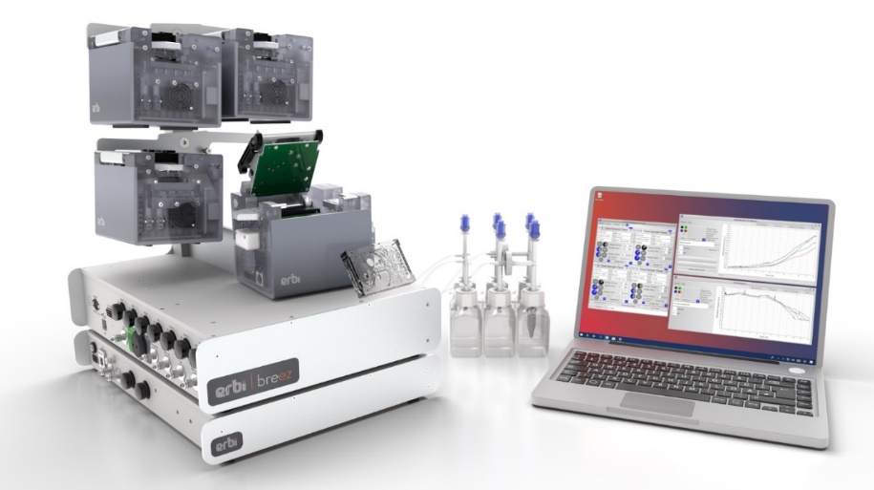
“The system is sooo much easier to use than a bioreactor."
“More runs were made in the 2-3 months we used the system than we could ever hope to achieve in our reactor lab over an entire year.”
"This is the only PD expansion system that does perfusion.”
“Reliable, and definitely quick to set up and get running. Cheaper to run. Can get more data faster.”
Erbi Breez: 2mL Automated Perfusion Cell Culture System
Proprietary and Confidential - Erbi Biosystems 2021

Slide 3
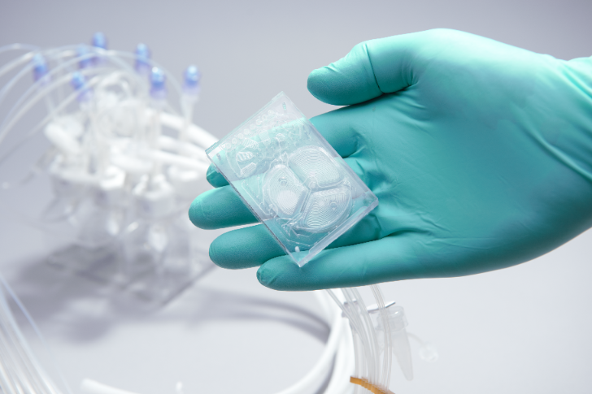
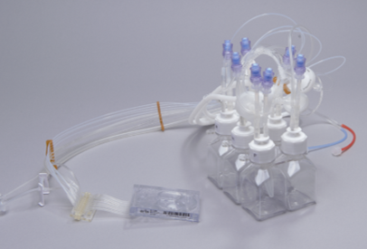
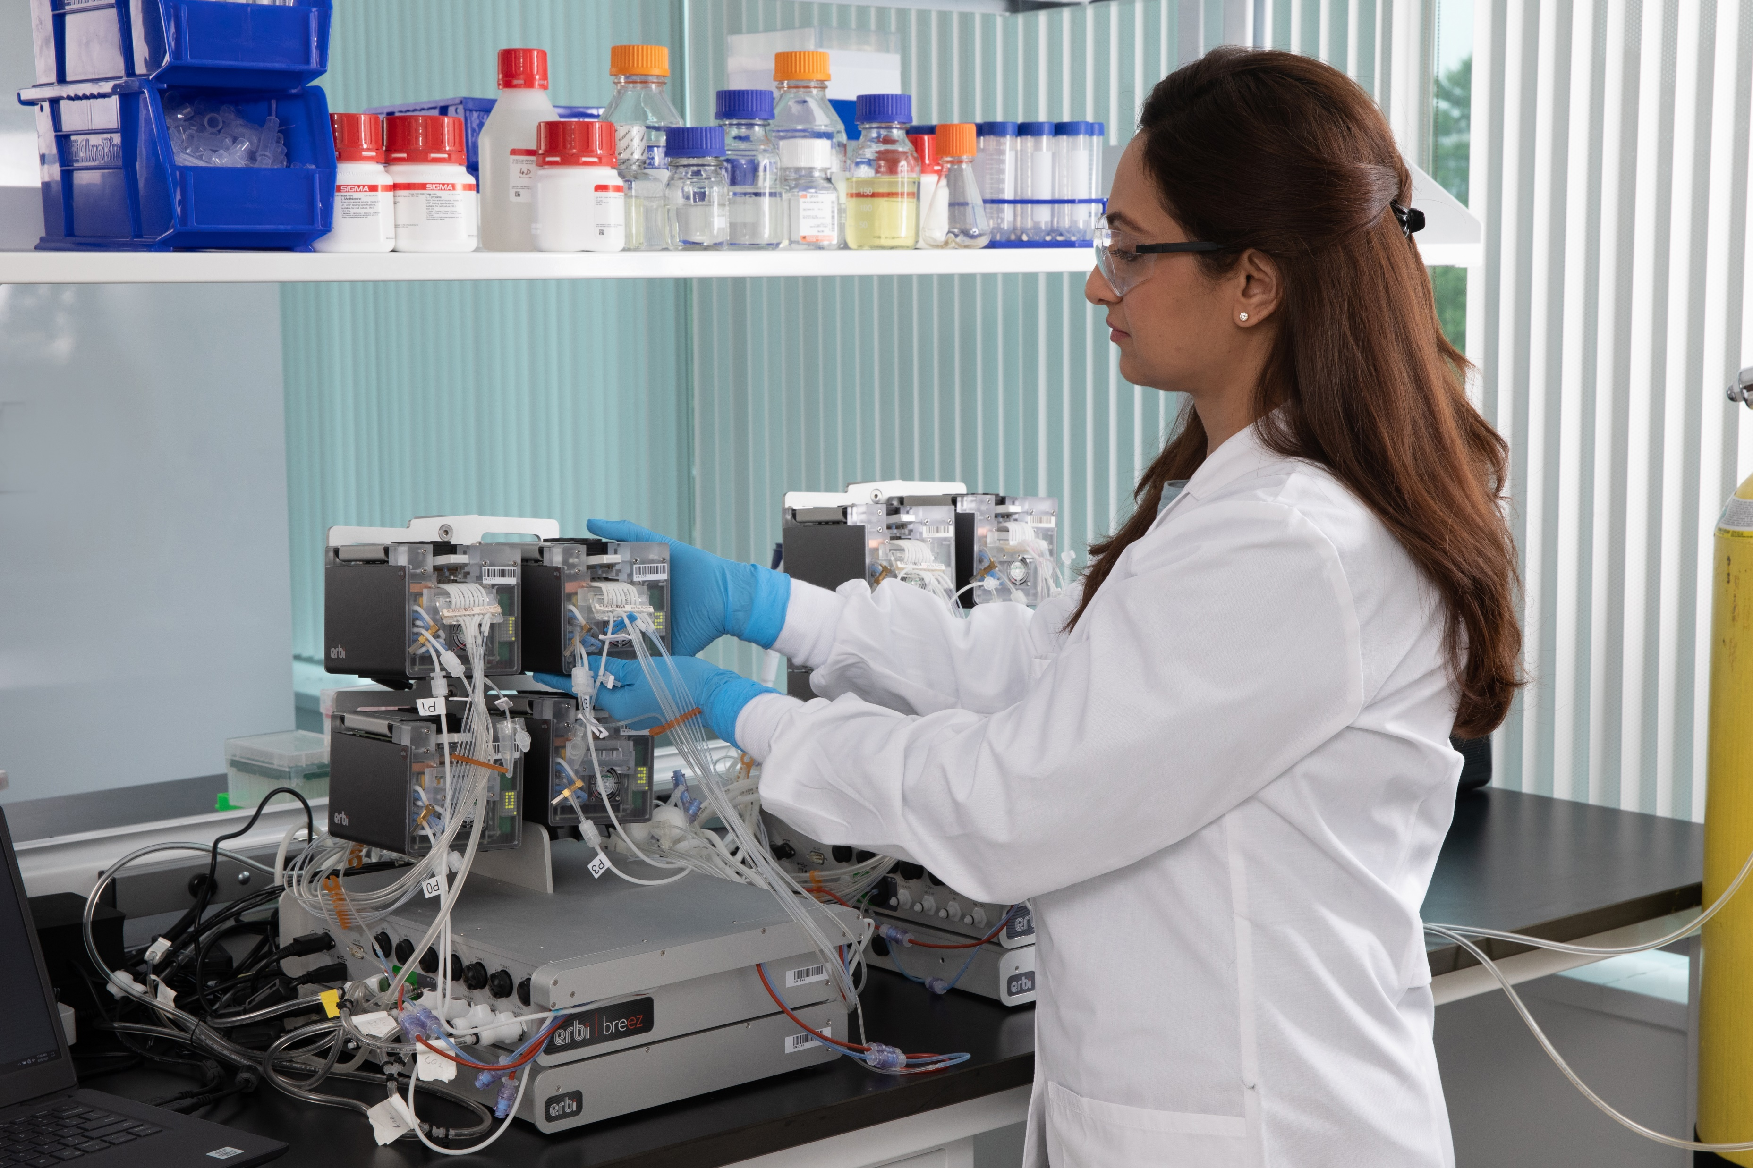
High Performance Automated True PerfusionTM Microbioreactors

Slide 4

Enhance Workflows
Late clone selection
Cell line development
Media Optimization
PD & Characterization
CHO, T cells, Pichia, E. coli, HEK 293, Sp/2
Maximize Workspace
Quick set up, run & take down
Eliminate probes, clunky accessories & their management
Shrink your reactor & support areas by 90%
Improve Throughput
More knowledge created / person
Much reduced OPEX/CAPEX cost
Accelerate your intensification and continuous bioprocess timelines
Proprietary and Confidential - Erbi Biosystems 2021

