Slide 1


COMPANY
PROFILE
Because Results Matter
Notes:
https://pixabay.com/photos/person-man-male-business-tablet-731479/

Slide 2
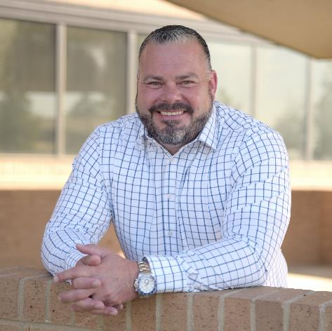
A Message From Our CEO
Premier Healthcare logistics provider. Deliver high-quality, accessible, care to improve patient outcome and better their lives.
Wes Struebing
Logistics Titans - CEO
Clients look to us when they have had it with missing shipping deadlines, are frustrated with order management issues and can’t pinpoint the exact location of their goods while having to deal with logistics organizations that seem to operate in reactive mode or don’t seem to react at all.
We help our clients become masters of knowing exactly where their goods are while making certain budgets are met, and we make it all easy and easy to prove. We firmly believe that results matter, and we look forward to obtaining superior results for you.
Notes:
https://unsplash.com/photos/pAtA8xe_iVM

Slide 3

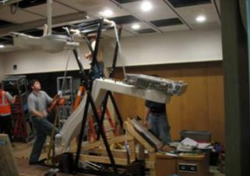
How We Play…
We don’t subscribe to a typical vision or mission instead we focus on how we play
Frontline first, because customers are first.
We highly value our frontline teams because knowledge and experience to take care of our customers with reliably they can count on.
Results matter. Count on us to deliver.
We are wired to perform. We take ownership for doing our part. Are proactive vs reactive, Agility to adjust to Changes.
We are bold, Think big and Make a difference.
We have a fearless mindset. We are here to challenge the status Quo. We take the right calculated risks to improve productivity.
Play to WIN and have fun.
We are here to win and have fun along the way.
Do it the right way.
Safety number one Priority. Deploy Responsible Sustainable solutions. We collaboratively partner within Ecosystem to earn the trust of our every day, Improving quality and driving out cost.
Notes:
https://pixabay.com/photos/office-business-colleagues-meeting-1209640/

Slide 4
Transportation planning
Transportation execution
Post shipment management
What We Do
We design, implement, manage and continuously improve custom logistics programs for our healthcare customers
Carrier
3PL
Forwarder
Asset Based Specialized Carrier
Technology Driven 3PL
High Touch
Freight Forwarder
U.S.’s Largest Specialized Carrier both truckload and LTL
250 Project Warehouse locations in the U.S. and Canada (JIT & JIC solutions)
Massive final mile delivery network
Specialized Experienced Trained Healthcare crews
Innovative supply chain solutions
Value focused freight solutions
Real time visibly and solutions
Award-winning customer service
Data analytics and telematics solutions
Responsible and reliable service
Creative and configurable solutions
Flexible and consistent
Notes:
Combine carrier and slide 5 into single slide
Combine 3PL and slid 6 & 7 into single slide

Slide 5

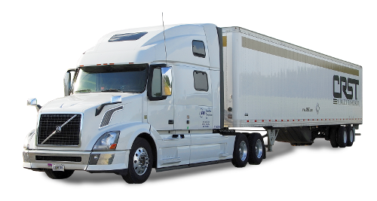
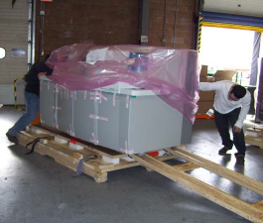
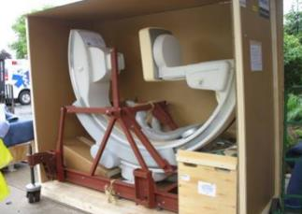


Transportation Equipment
This is the largest and best specialized transportation fleet and supply chain services organization in North America
53’ Air-ride Padded Van Trailer
Extensive Equipment Compliment
  Liftgates
  E-tracks for secure strapping
  Teams
Straight Trucks
Truckload and Less-than-Truckload Service
Satellite and GPS Tracking
Custom Equipment and Tools Based on Customer Requirements

Slide 6
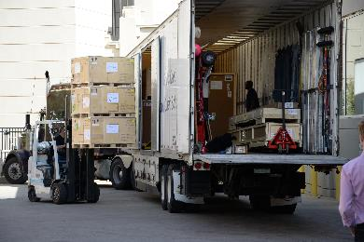
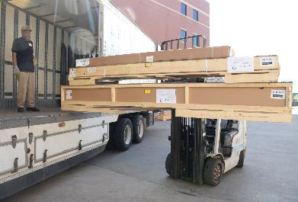
MEDICAL EQUIPMENT CAPABILITIES
  Coordinated deliveries to meet Installers on-site
  Full Service for TL & LTL
    Pad-wrap, Inside Load & Deliver
  CPM (Customer Product Management)
    Warehousing, Inventory Management (Short term and Long term)
  Final Mile Deliveries from DC’s to Site
    Pad wrap, Trained Crews for: Inside, Unpack, Set into place, Debris removal, skilled Labor
  Value-added Logistics
      In Hospital move, De-Install, Light assembly, additional Labor, specialized moving equipment; unpack on-site or at warehouse
55 DISTRIBUTION CENTERS PROVIDE FINAL MILE SUPPORT

Slide 7
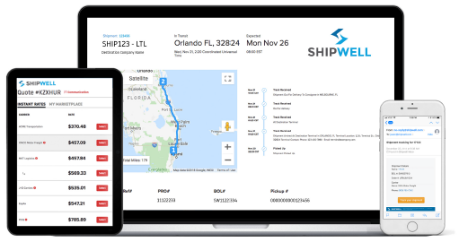

Our TMS Technology
The industry’s best TMS technology highly customized by Logistics Titans
Automated shipment tracking and data share in real-time
Employs AI, API, EDI and machine learning technology
1
4
Customizable alerts and notifications
2
5
Client specific work instructions and data share
Clear timelines of activity at every step
3
6
Access for clients, carriers and team members via iOS or Android mobile app
Notes:
https://unsplash.com/photos/c_GmwfHBDzk
https://pixabay.com/photos/young-girl-teenager-drawing-pretty-2143037/
https://pixabay.com/photos/gangster-tough-per-gang-attitude-539993/

Slide 8
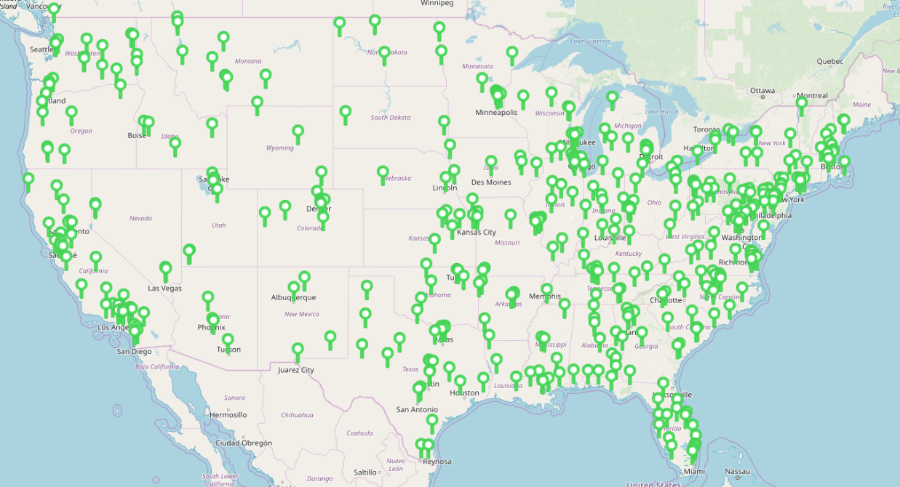
Our Project Warehouse Network
This largest variable use specialized warehouse network in North America
Locations
More than 250 locations in the US and Canada
Systems
Common asset management system in most locations
Several Solutions
A series of complex supply chain
Variable Cost
Only pay for exactly what you use
Challenging Products
Managing large, delicate products requiring special handling
Quality Focus
97.73% Free from overage, shortage or damage
Notes:
We need to target this slide toward the customer

Slide 9


Innovation to achieve best-in-class, delivering peak performance
Further drive performance and innovation culture
Build strategic relationships
We put your best people on the account
We share concepts where ”WE” need to improve
You share your ideas with Logistics Titans
COURAGE FOR INNOVATION and CHANGE
    Drive out waste and share the benefits (Design 4 Logistics
    Continous Improvement / lean thinking
    Rapid test new concept and Ideas
    Gemba evauation
    Automation for high volume

Slide 10
Transportation Management functional building blocks
Flexible, automated, plug & play
Strategic
Draft fix font and spacing
Shipping instructions and documentation
Control tower 24/7 support
Standard planning
(forward)
Visibility, shipment monitoring
System & Solution planning
(backward)
Mile stone Tracking
Continuous improvement
(root cause analysis)
Optimization / order consolidation (carrier, load, route mode)
Exception management
pro-active
TM Business Analytics
Pre-Call Confirmation
Exception notification (handling)
Carrier KPI reporting
Transportation planning
Transportation execution
Post shipment management
Operational
Legend:
automate
Out-source
Partnership
In-source

Slide 11
The Logistics Titans Difference
This is how we drive superior customer results
Quality Focused: Damage Prevention, On-Time, Fulfilling Each Unique Delivery Requirement
Technology Supporting Customised Solutions and Realtime Visibility
Customized Asset Based Solution Specializing in Difficult and Sensitive Goods Management
Safety Focused for Product, Delivery Crews, & the Public
Superior, Experienced “High Touch” Single POC Customer Service Team

Slide 12

Thank You
Notes:
https://pixabay.com/photos/computer-apple-business-workplace-1185569/

