Slide 1
About ADG (Australian Doctor Group) & Logo Brief
Brand Vision:
  ADG is a SaaS enterprise that enables and empowers the medical and pharmaceutical community to come together to provide better informed and more effective healthcare solutions to help Australians live healthier, longer lives.
Objective of the brief:
  Australia's leading medical publisher needs a new logo to support its transformation into a digitally enabled two-sided information platform
  Key deliverables of the new logo design:
  The logo design should position ADG as a SaaS based technology business and therefore follow many of the established elements of that industry.
  The logo should include ‘Image icon’ + ‘Company name’
  The icon should represent ‘connection’ – of bringing the pharmaceutical industry and medical profession together
  Primary colours are green and black

Slide 2
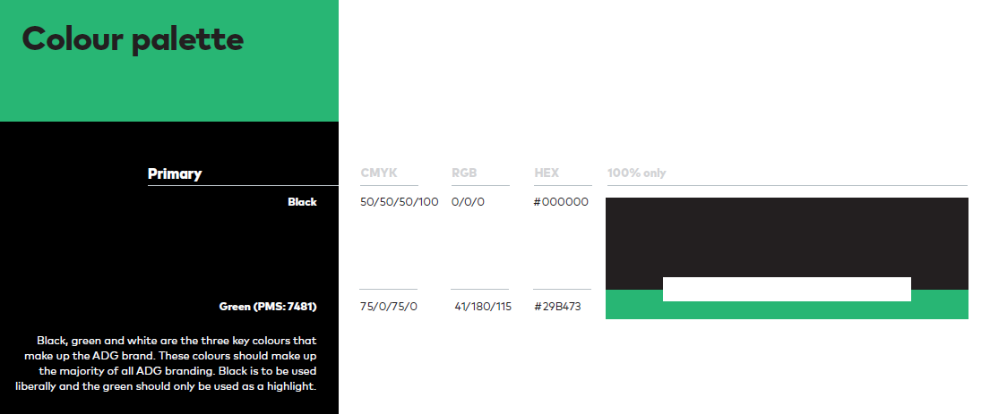
ADG Brand Colours – Green & Black
There is scope to use different versions of green based on design recommendations.

Slide 3

ADG – New Logo Components
Ideal final logo design elements
Image icon + Company name
Image icon – What should it represent?
Preference:
Connection – of bringing the pharmaceutical industry and medical profession together
Alternate option:
Medical information – we provide the latest news and clinical information for doctors to stay informed
Company name
Preference:
Explore all lower or upper case (cannot be mixed case)
adg OR ADG
Alternate option:
Australian Doctor Group can also be used long with the shortened adg name

Slide 4

ADG – New Logo Inspiration : SaaS Industry
Image icon + Company name

