Slide 1

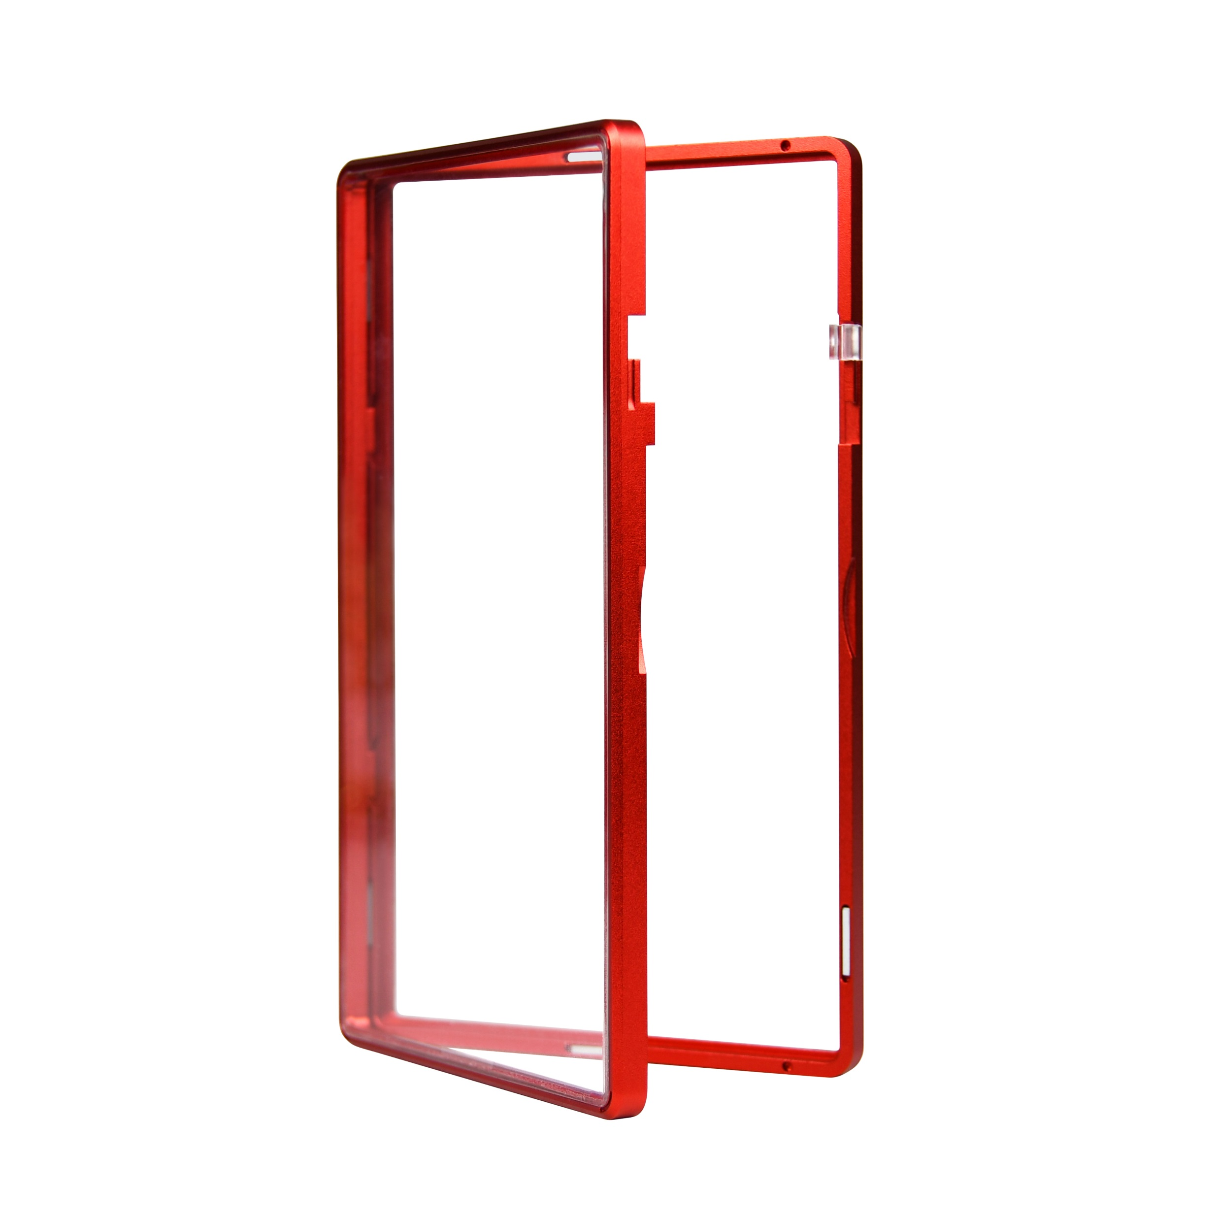
MAGENTIC PROTECTIVE
SLAB CASE
Protect Your Slabs In Style
Example Of A Box I like
SIMPLE, CLEAN, LUXURIOUS
Box Colors – White Packaging
Gold Text / Logo Embossed
FULL PRODUCT IMAGE LAYERED OVER SOME COOL TEXTURE THAT MATCHES PRODUCT COLOR (COMES IN RED, GOLD, BLACK)
BOTTOM SHOW PRODUCT ICONS

Slide 2
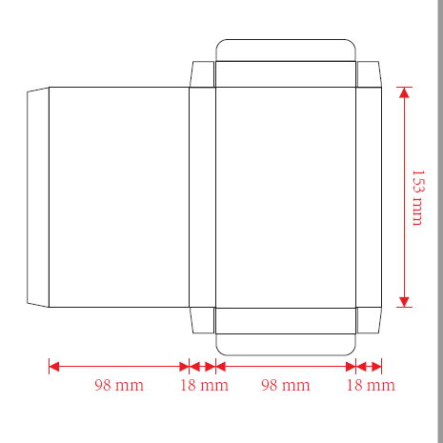
Please Add Logo & Company Name
Please create a cool image (product photo) to showcase on front of the box. The product comes in RED, BLACK, AND GOLD
3. Please leave a compatibility icon (MADE FOR (PSA) (5.22mm) ) (Slide 7)
4. Add Slogan: “Protect Your Slabs In Style” – This needs to be bold and stand out in the front
5. Custom designed icons by you found on slide 6
6. Please create a unique skin for the package – (reference skin ideas)

Slide 3
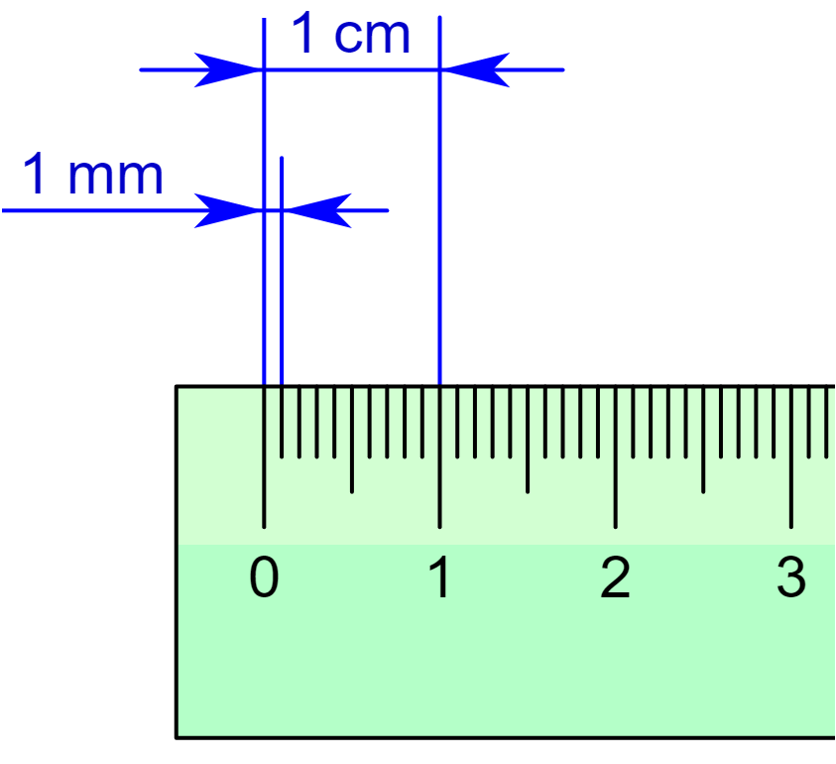
Add
Please Leave A Section For Instruction & Legal Disclaimer – Add temporary text for now
Add
Please add logo / company name / slogan
Add
Please Add A Fake QR Code for them to follow up on social media
Add
Please Add a bar code
Add
Please leave a section for company name, phone, and website. Make fake number and use www.slabmags.com
Add
Please add a thickness meter for people who do not know if the case is compatible “Measurement Meter”

Slide 4
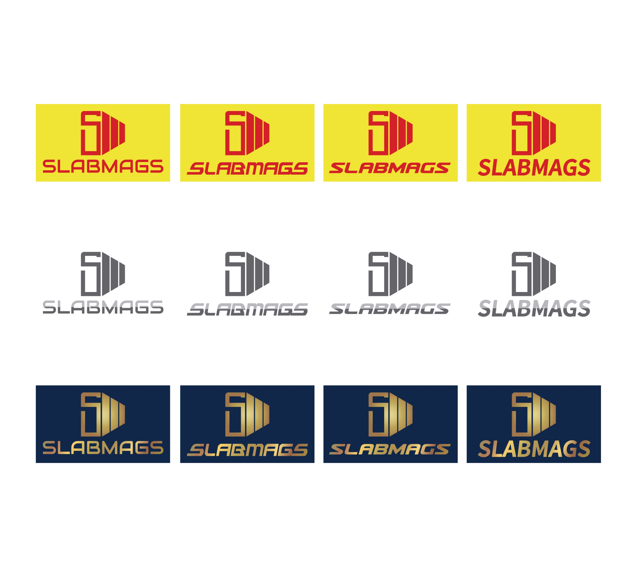
LOGO & NAME

Slide 5
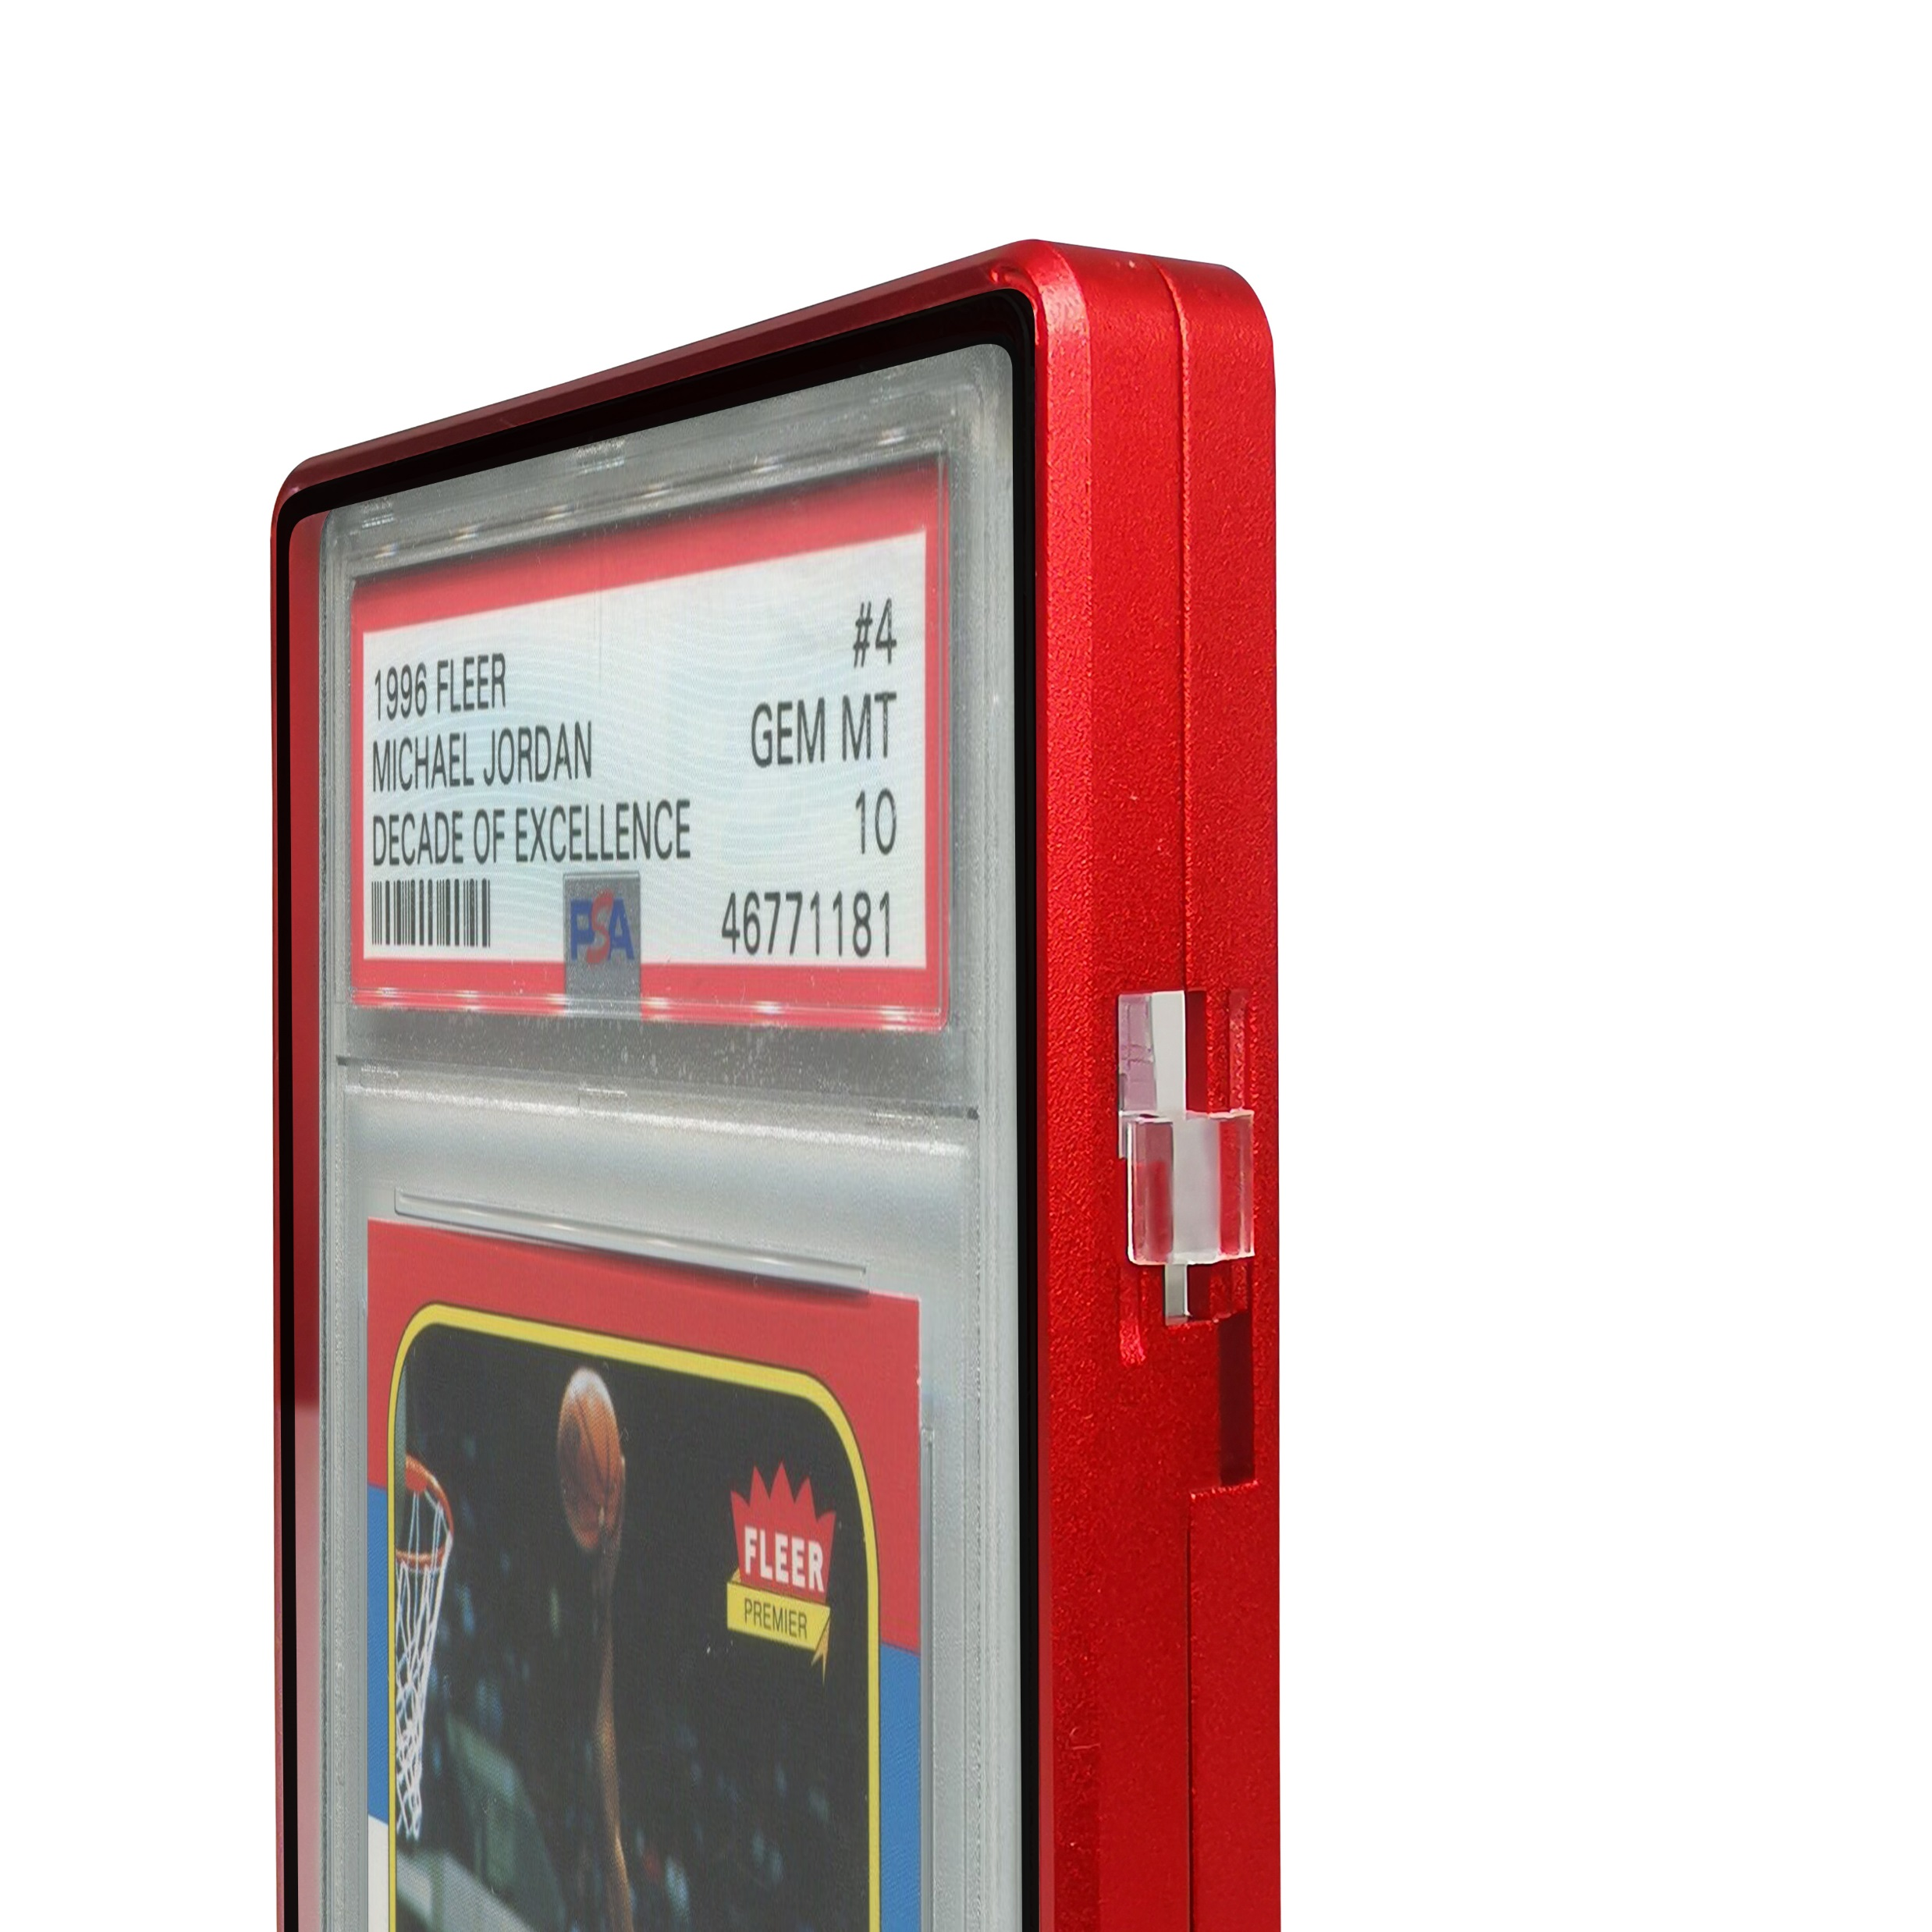
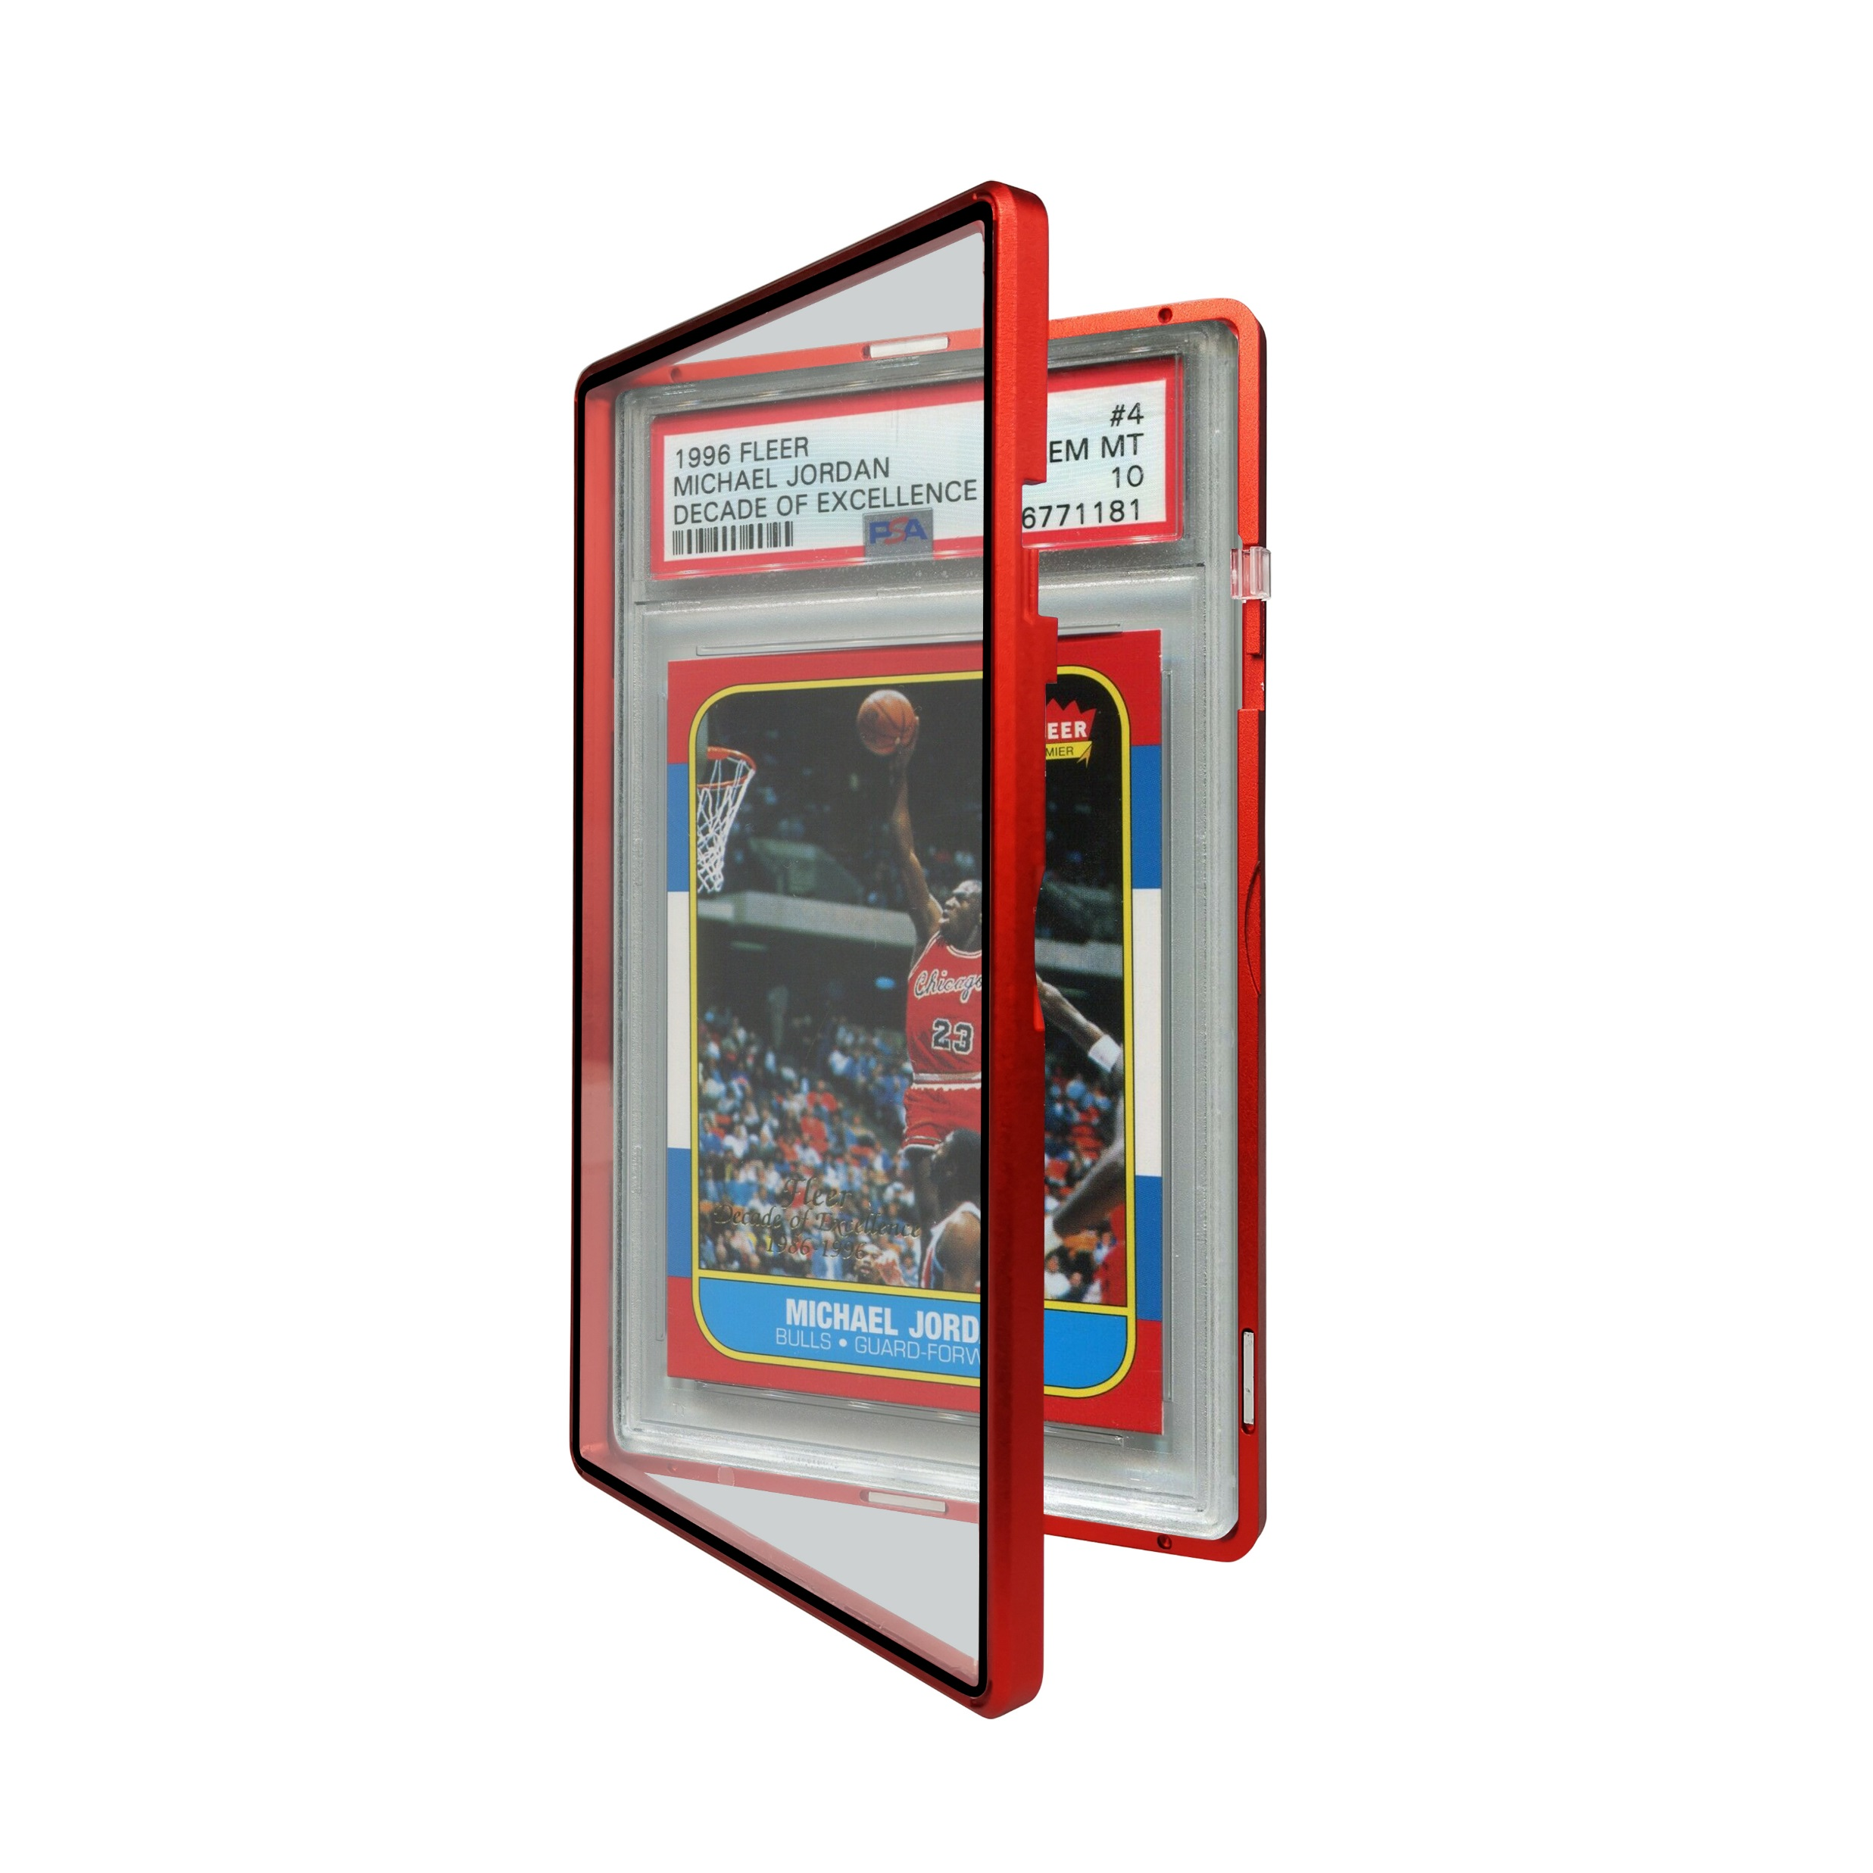
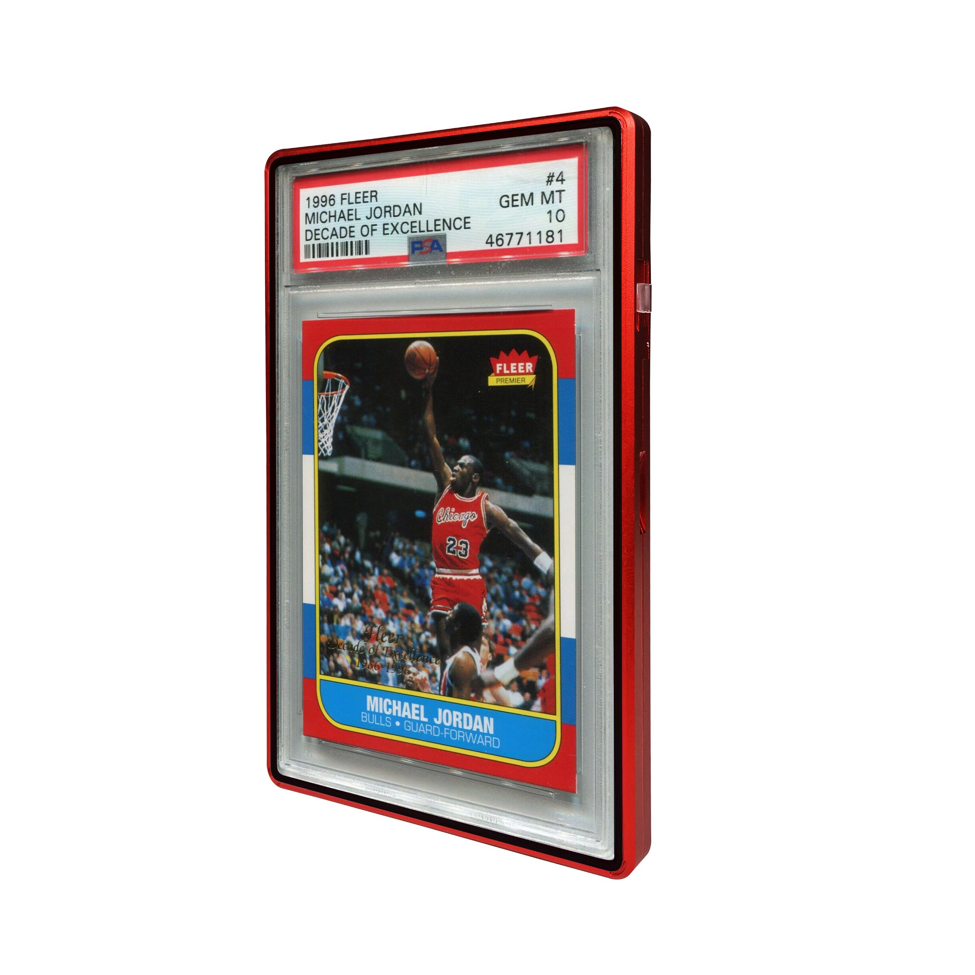
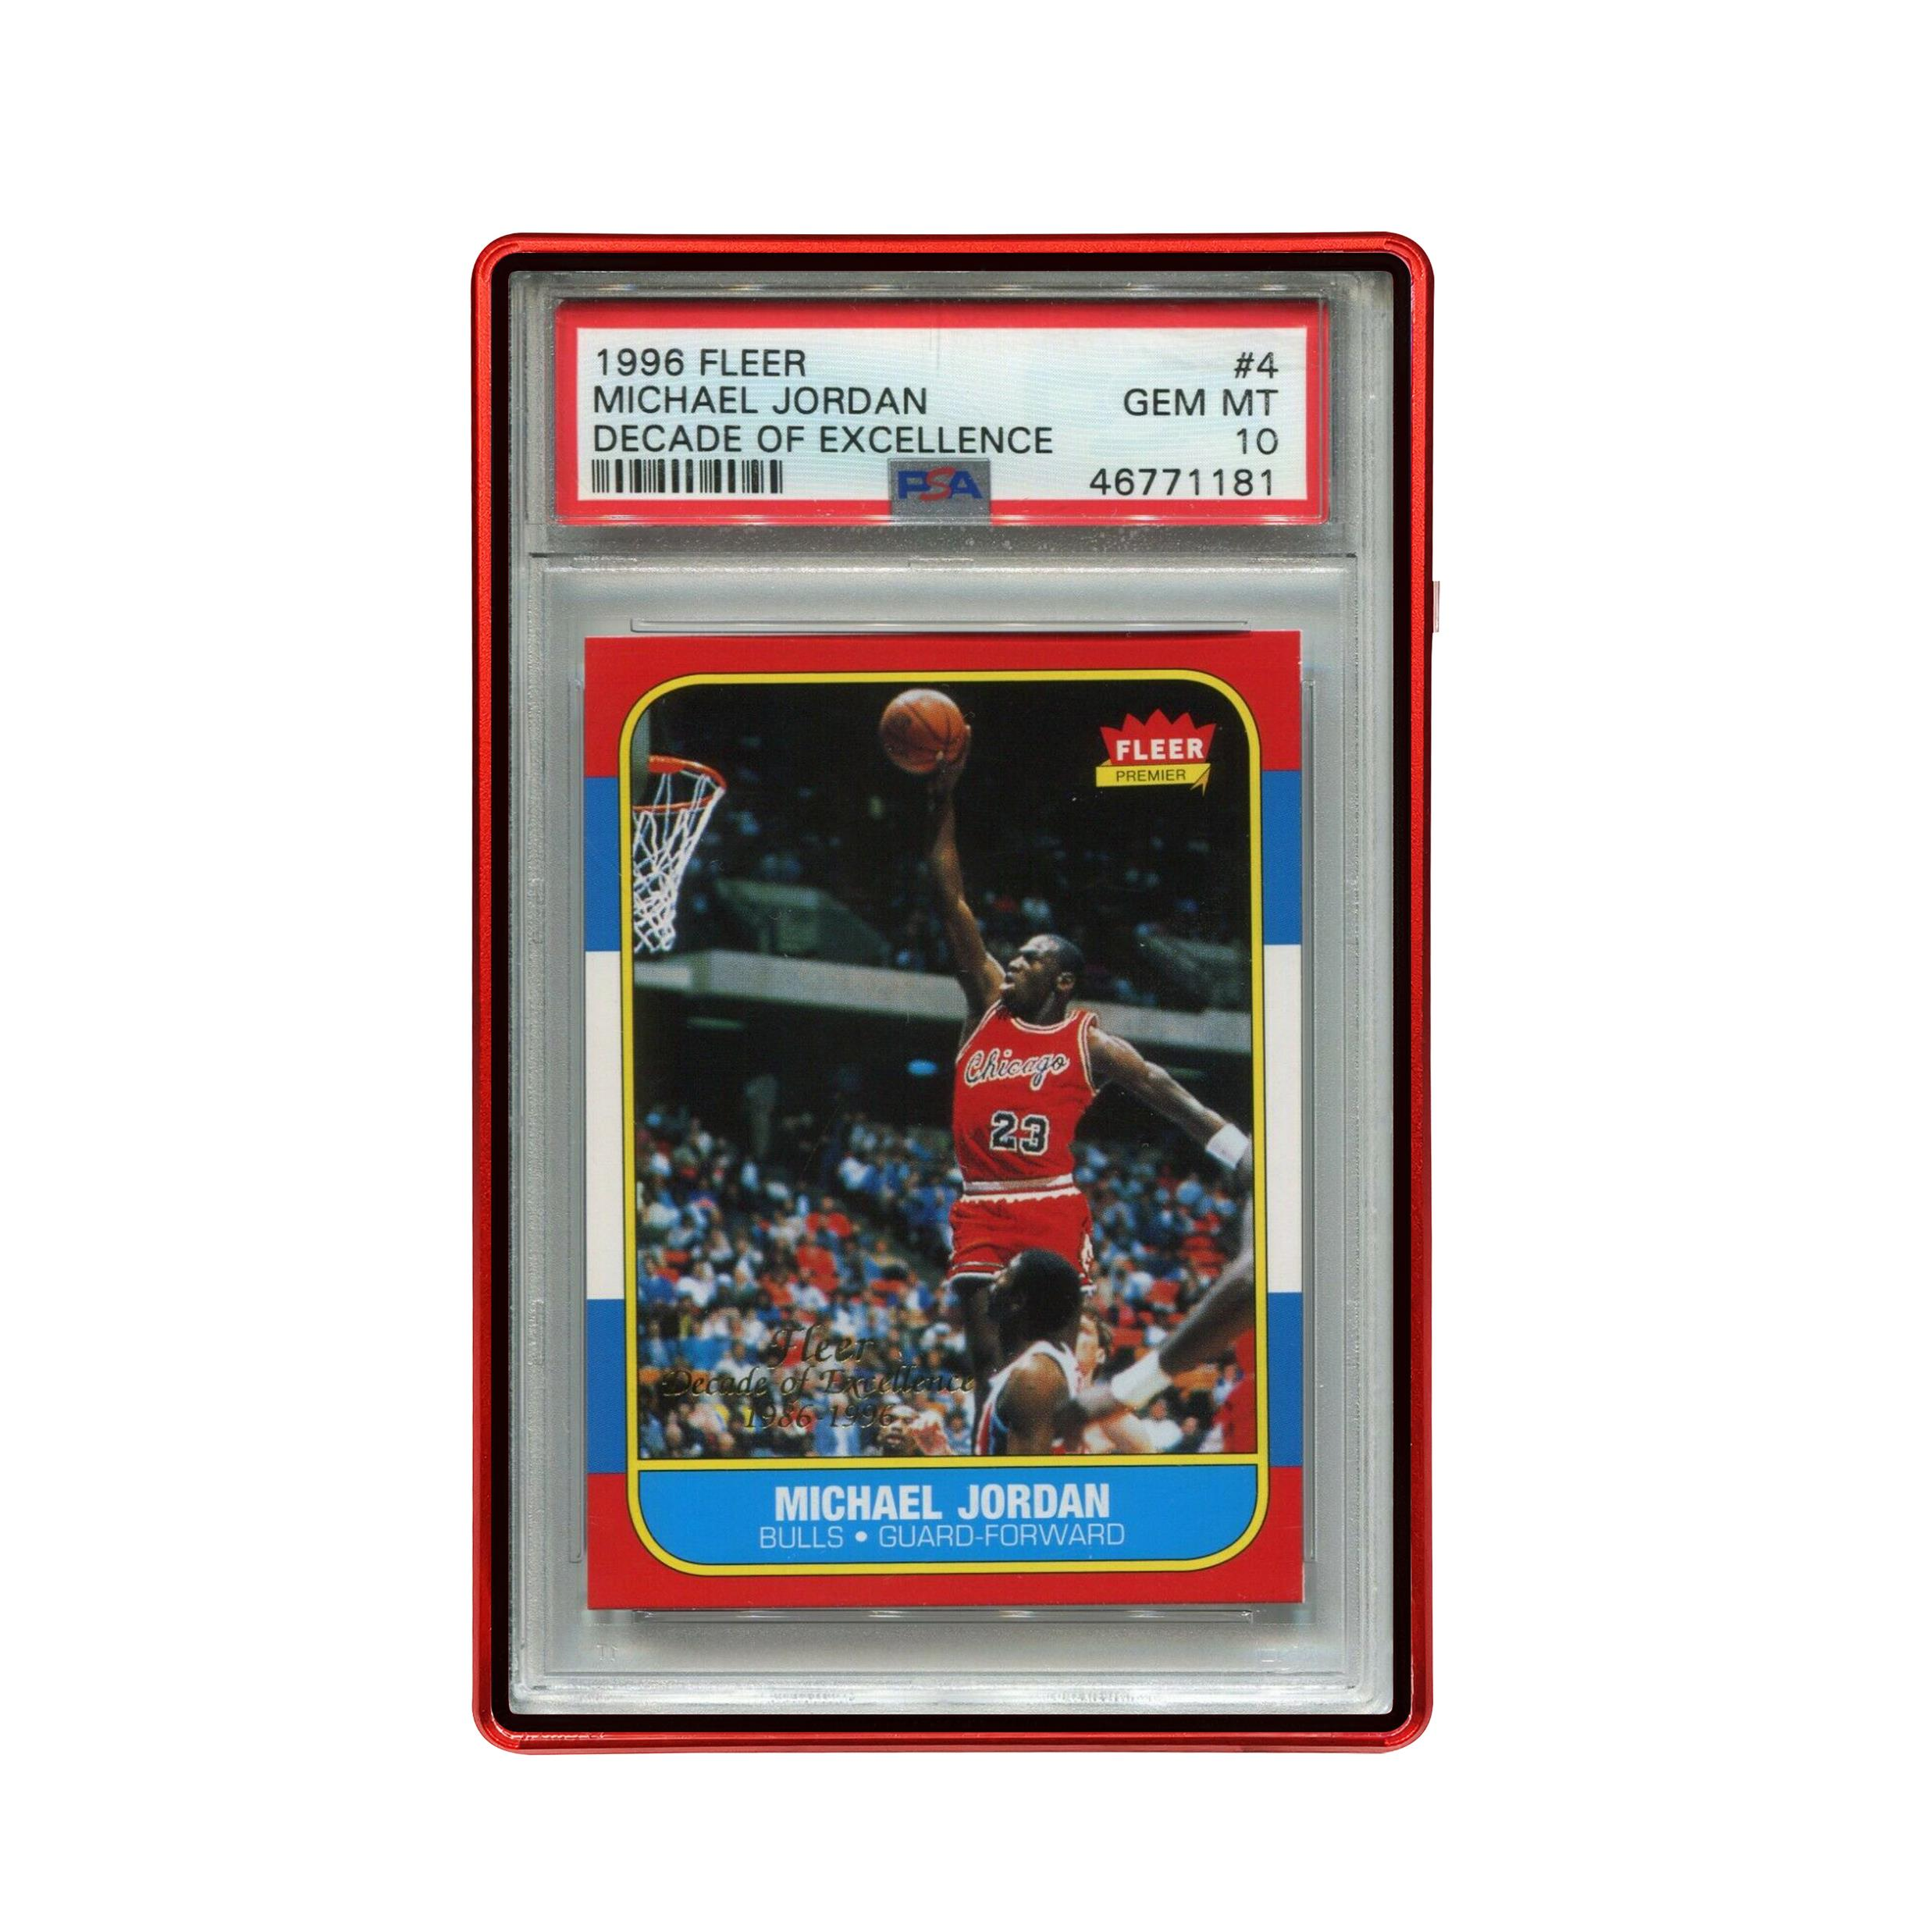
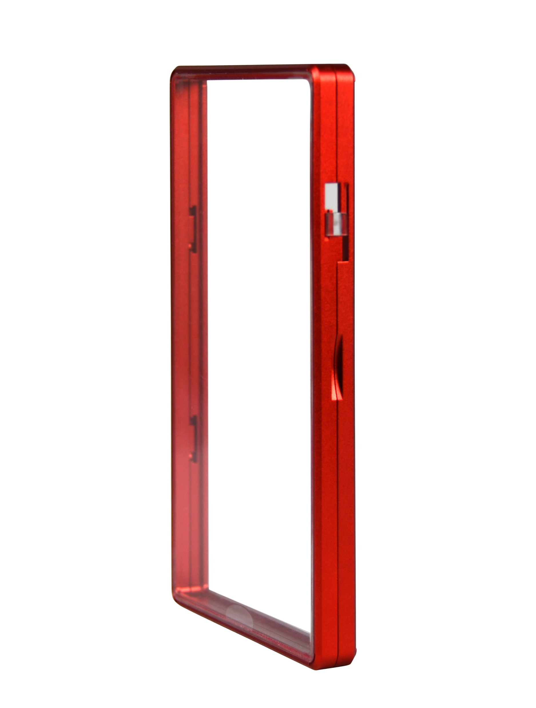
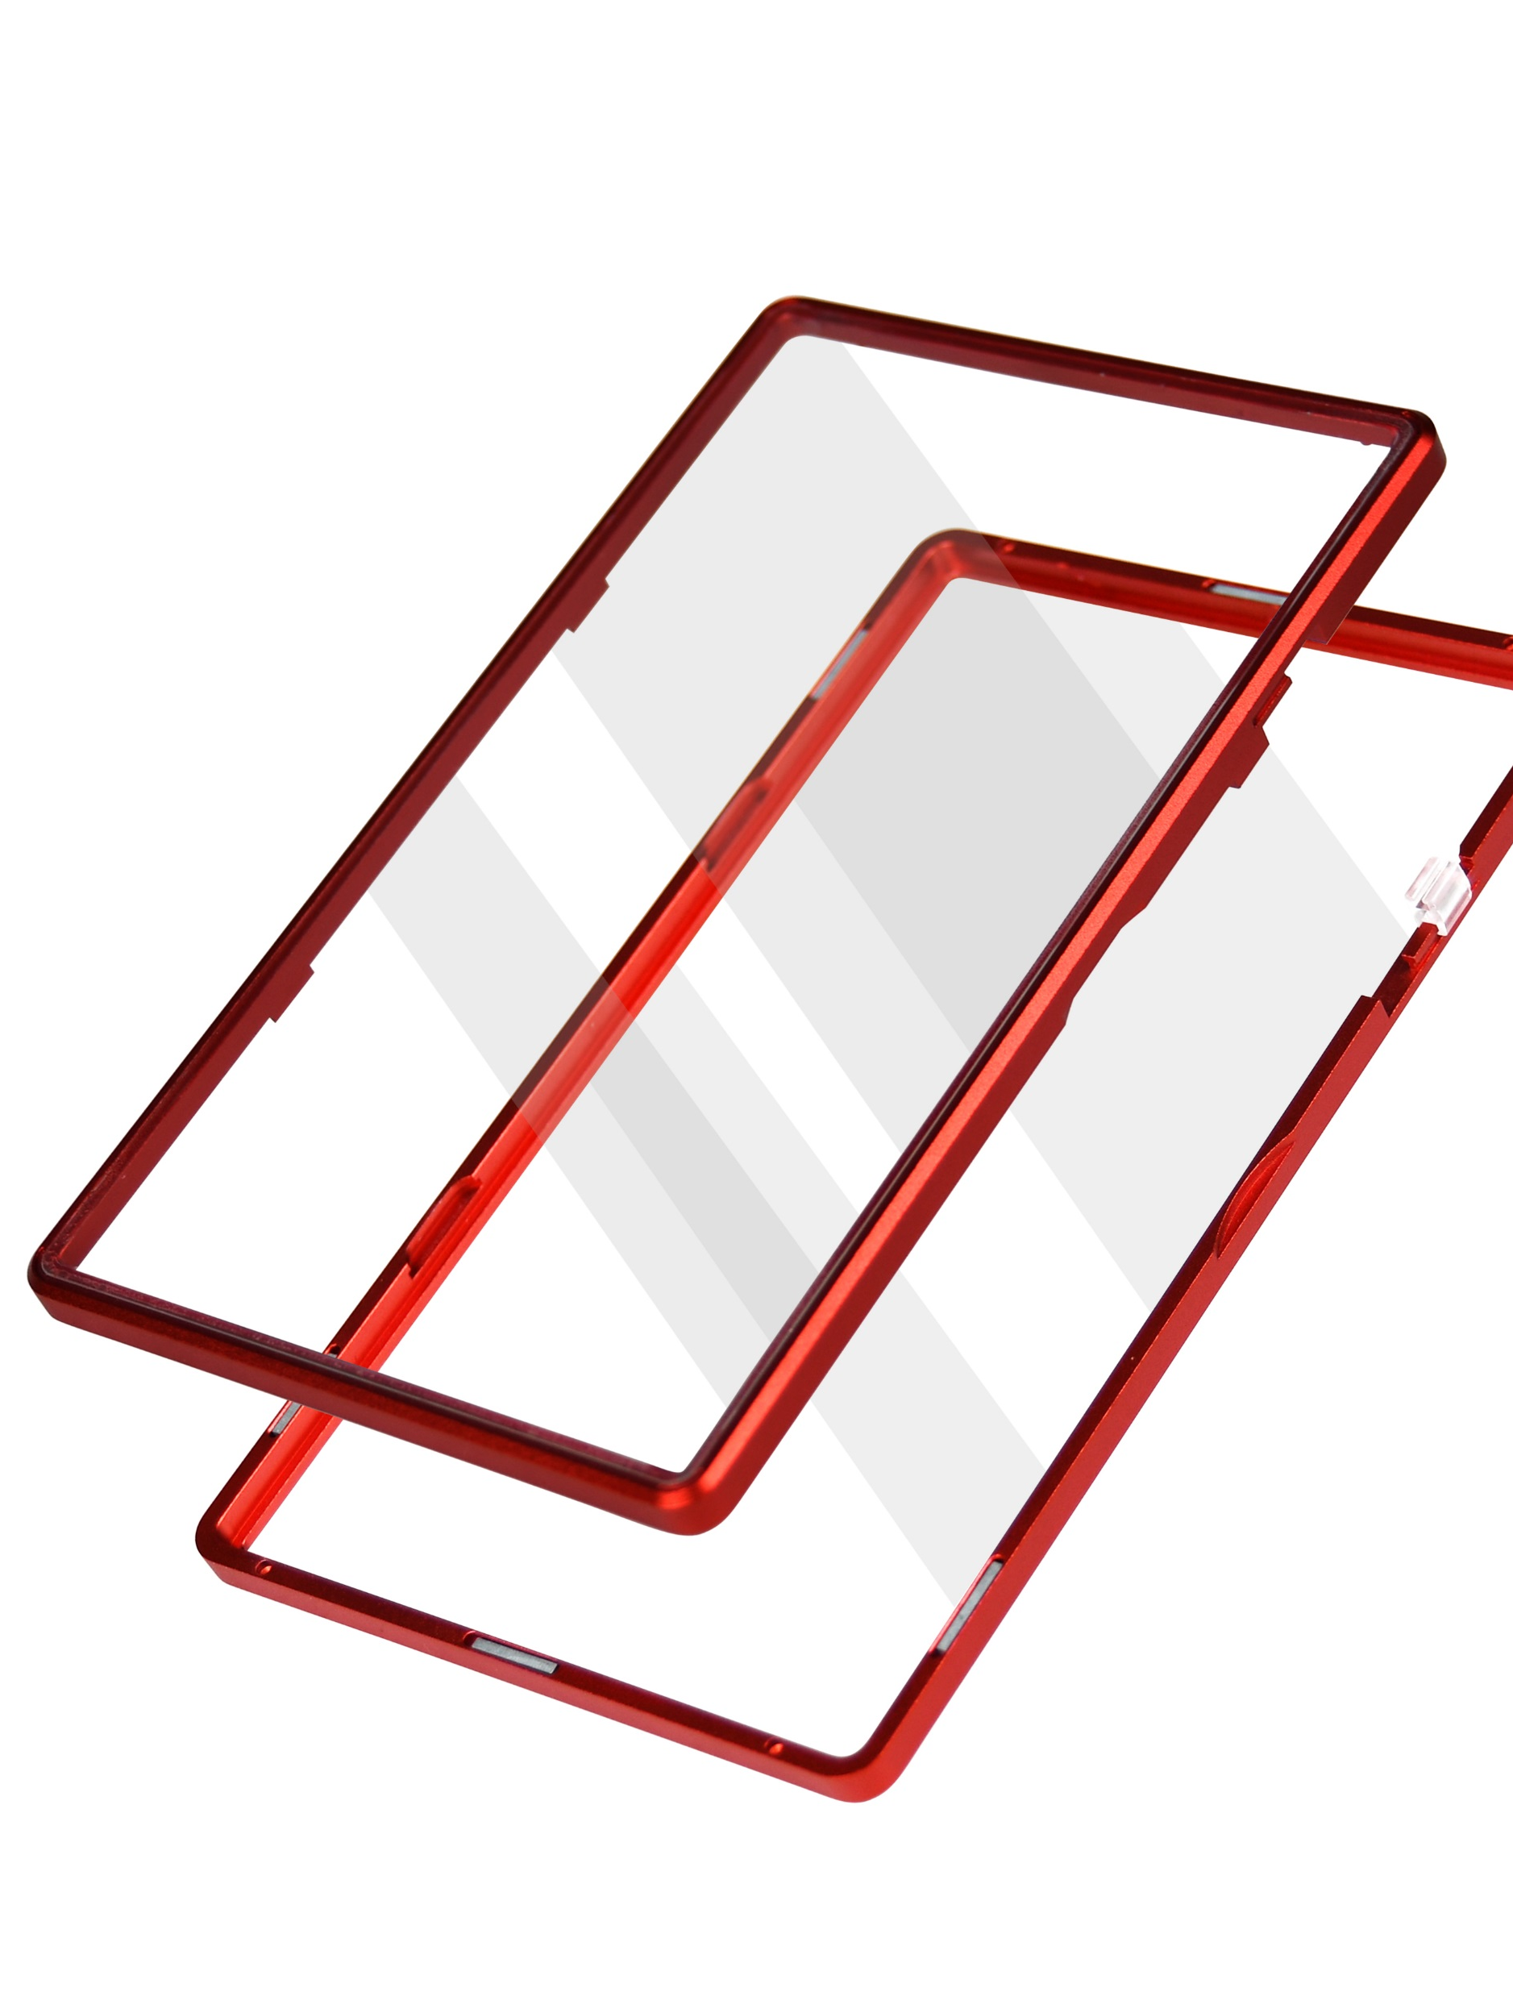
Product Photo

Slide 6
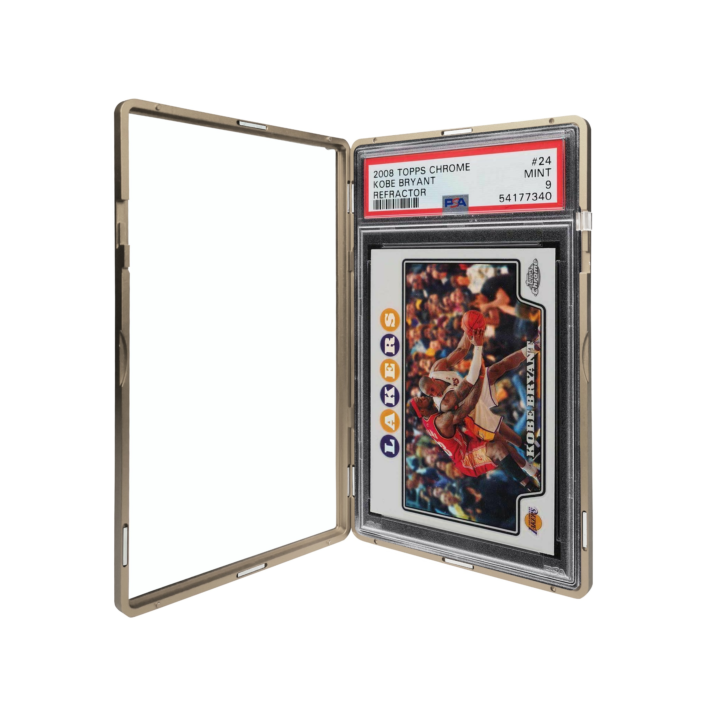
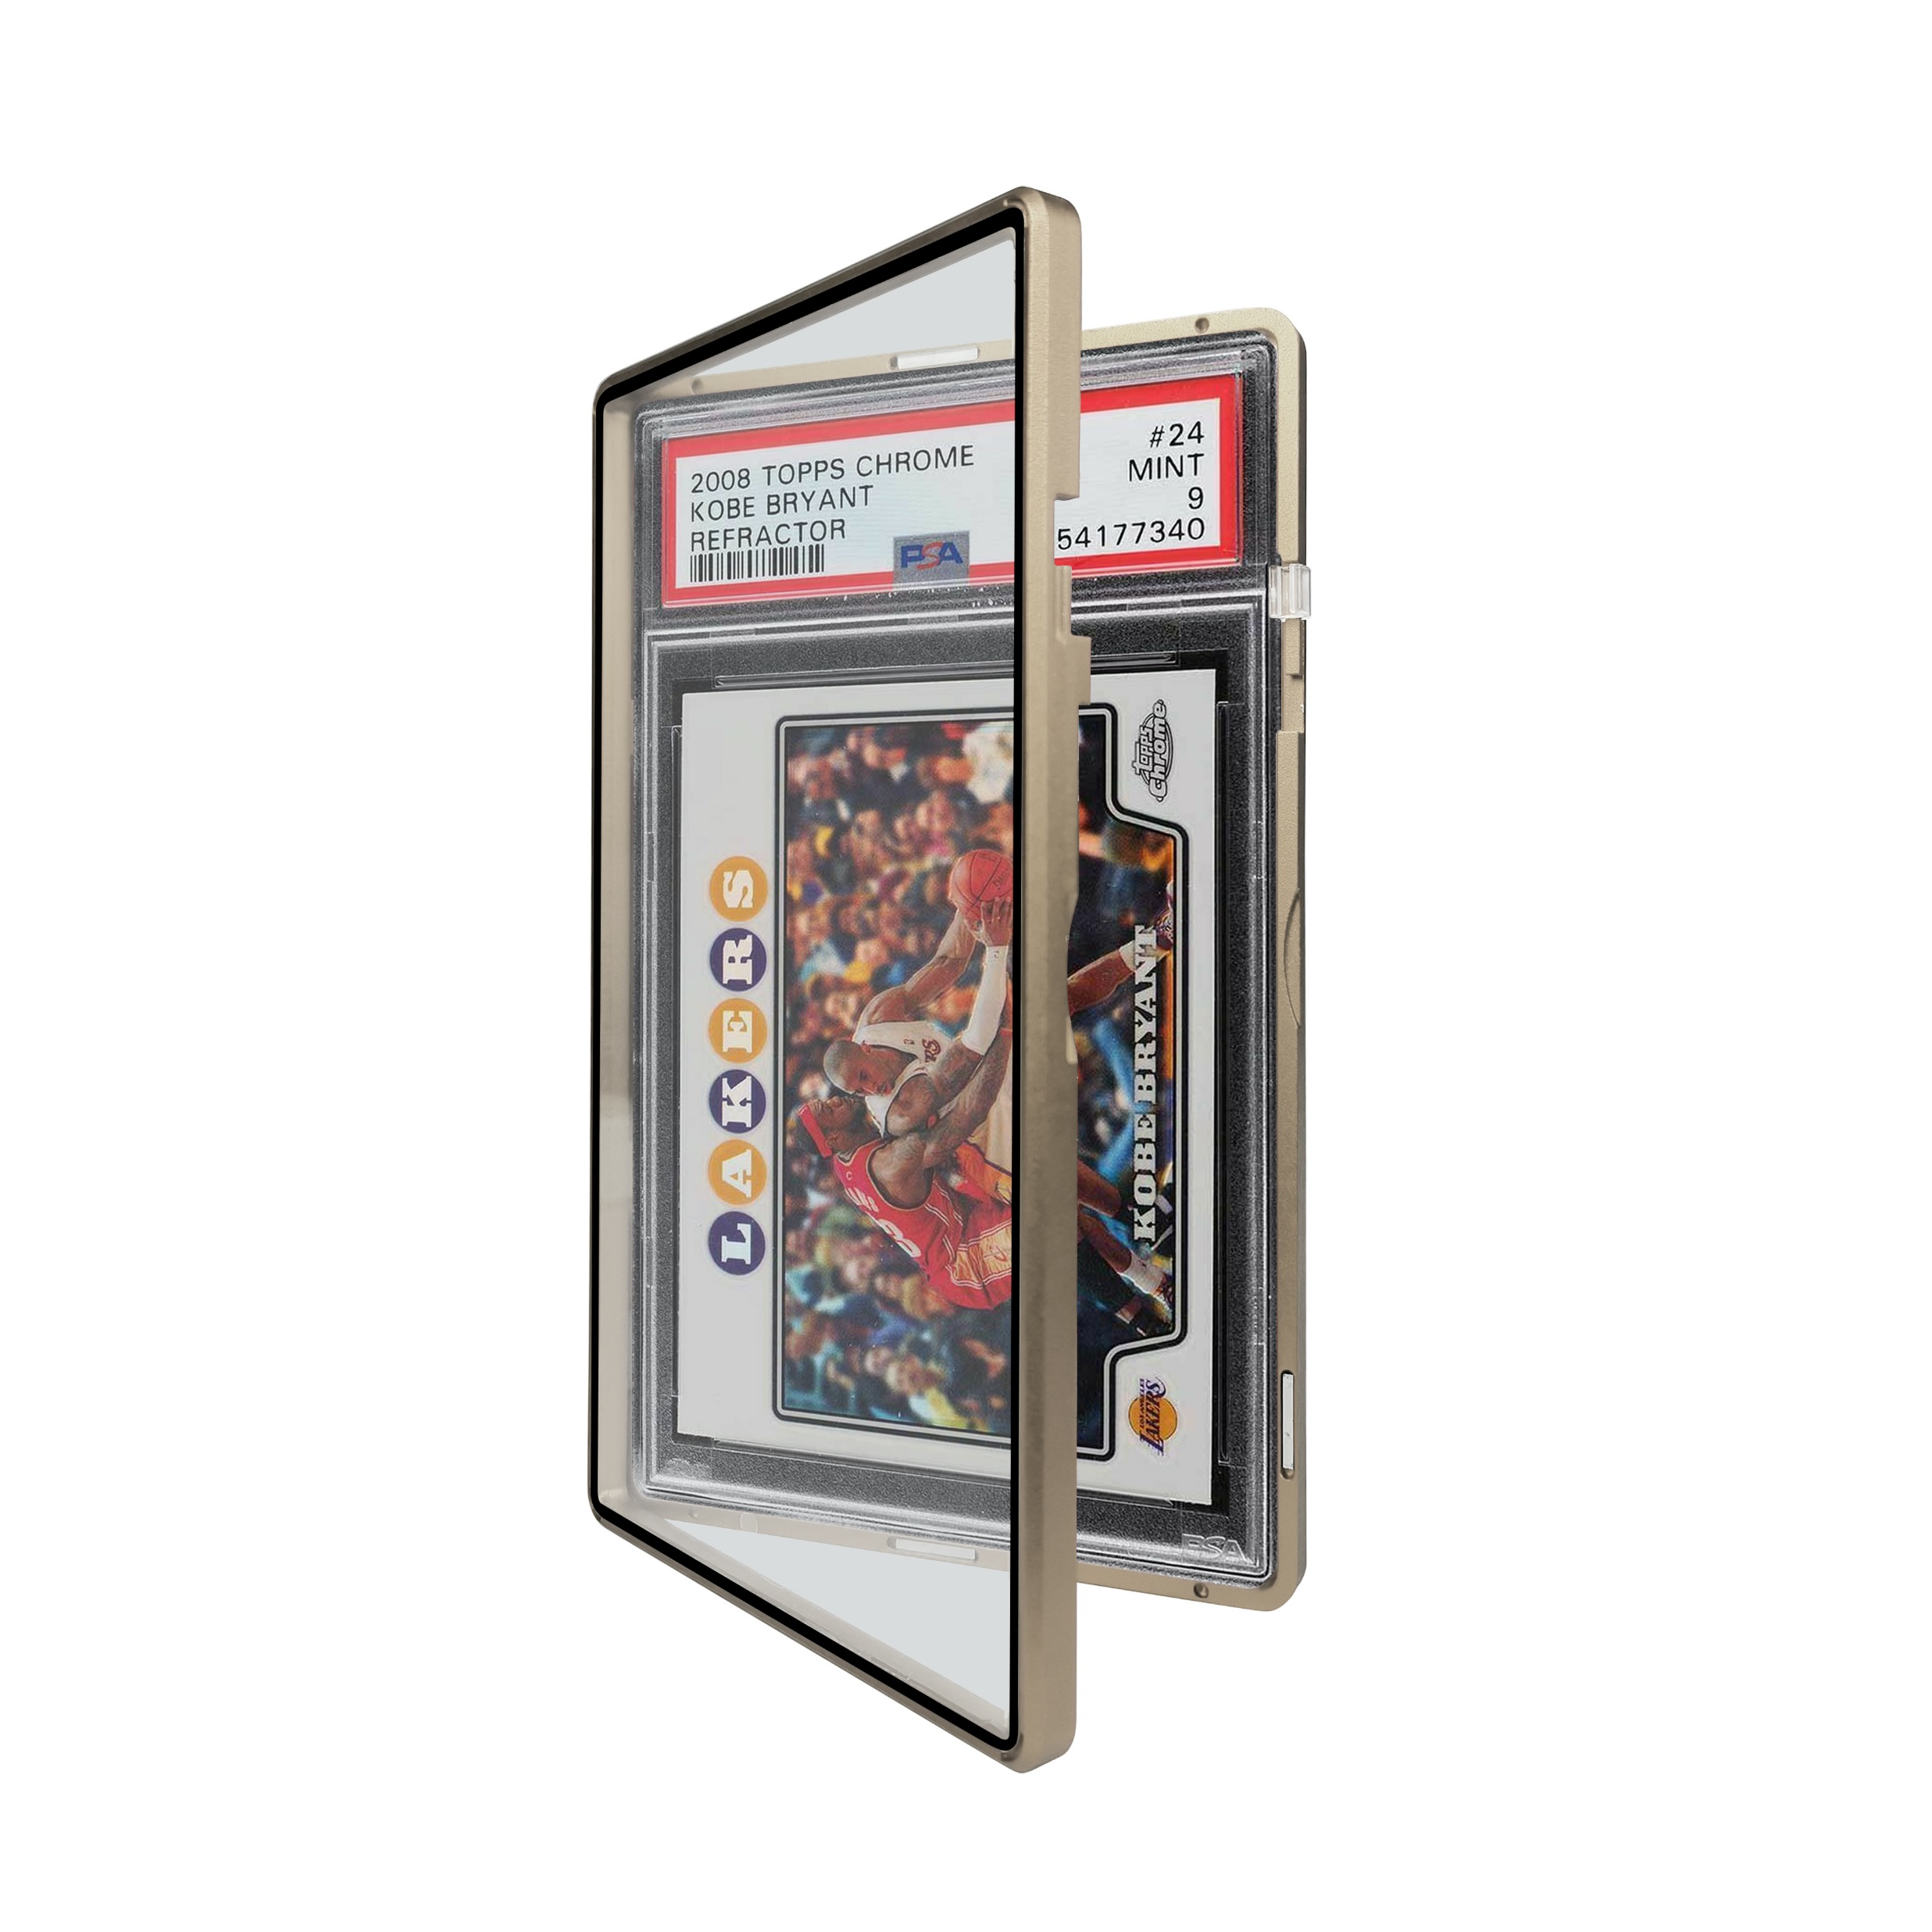
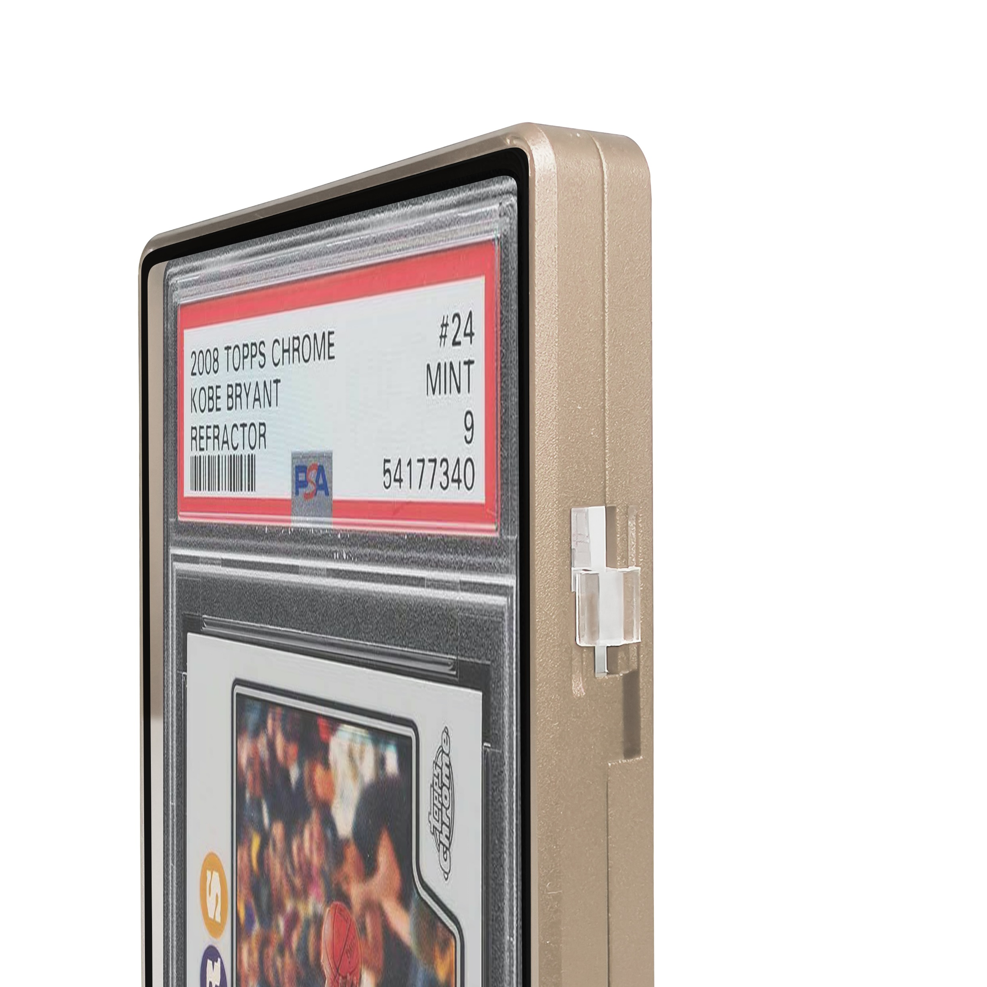
GOLD

Slide 7
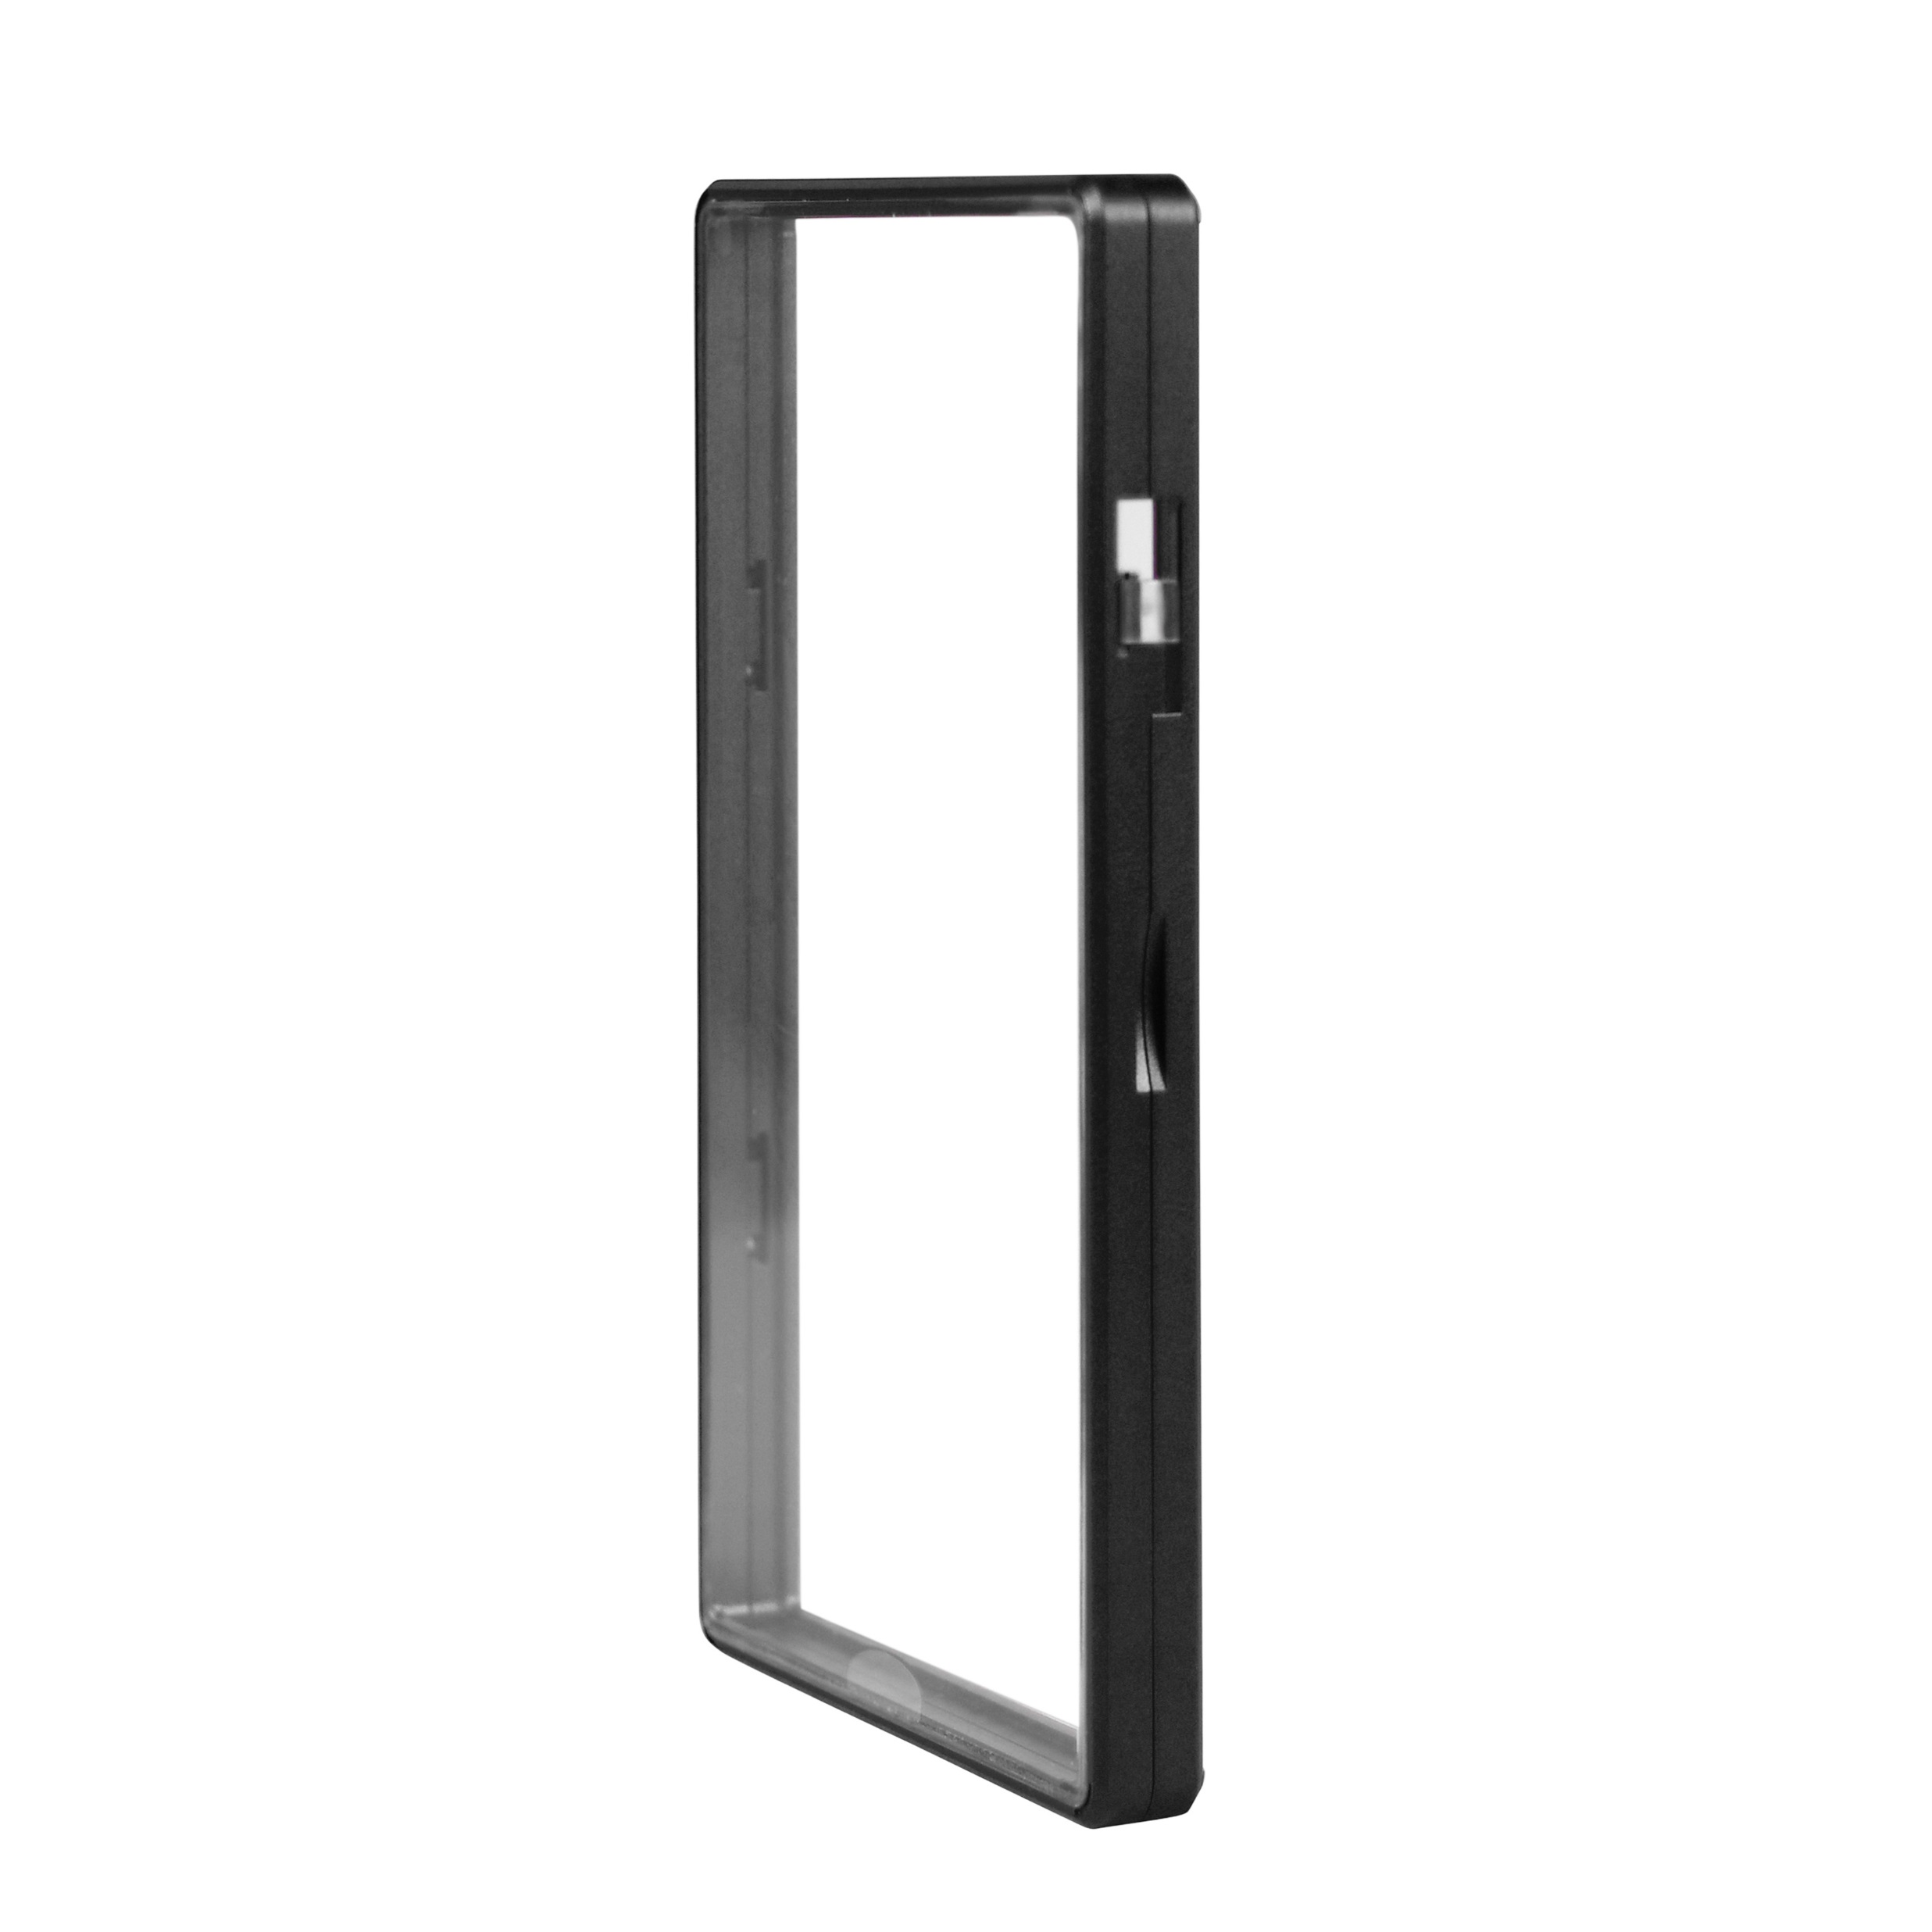
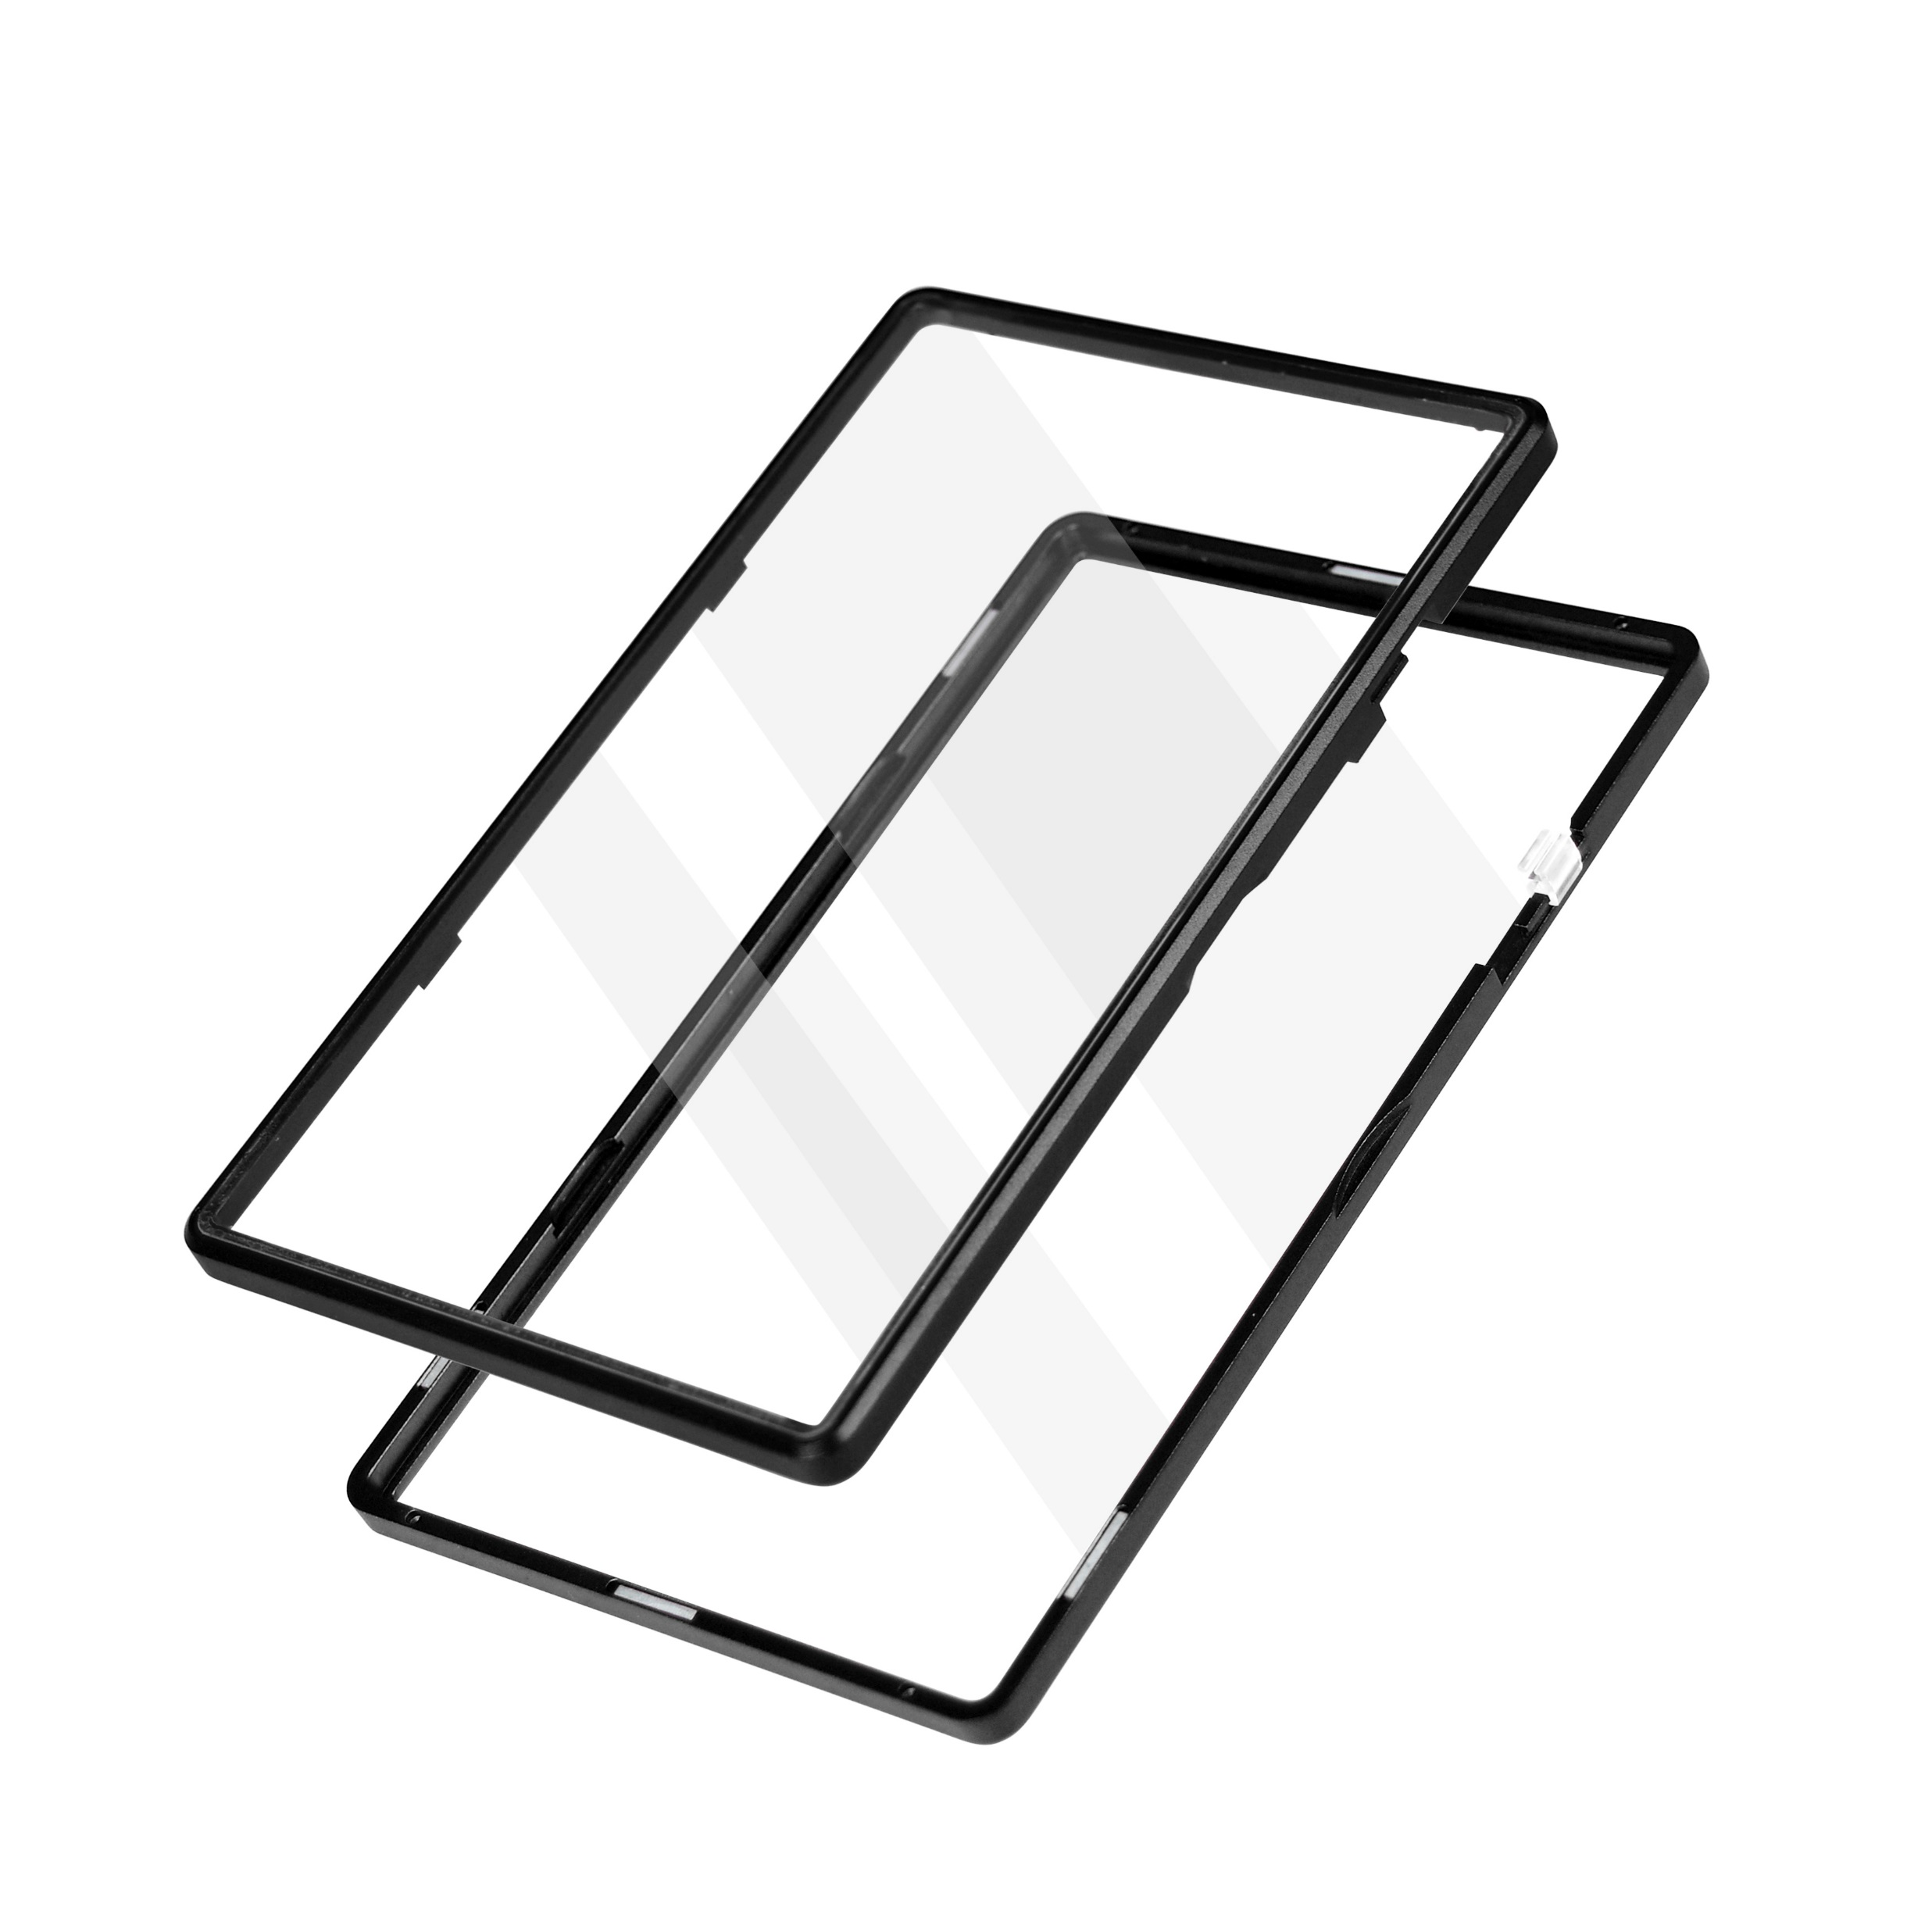
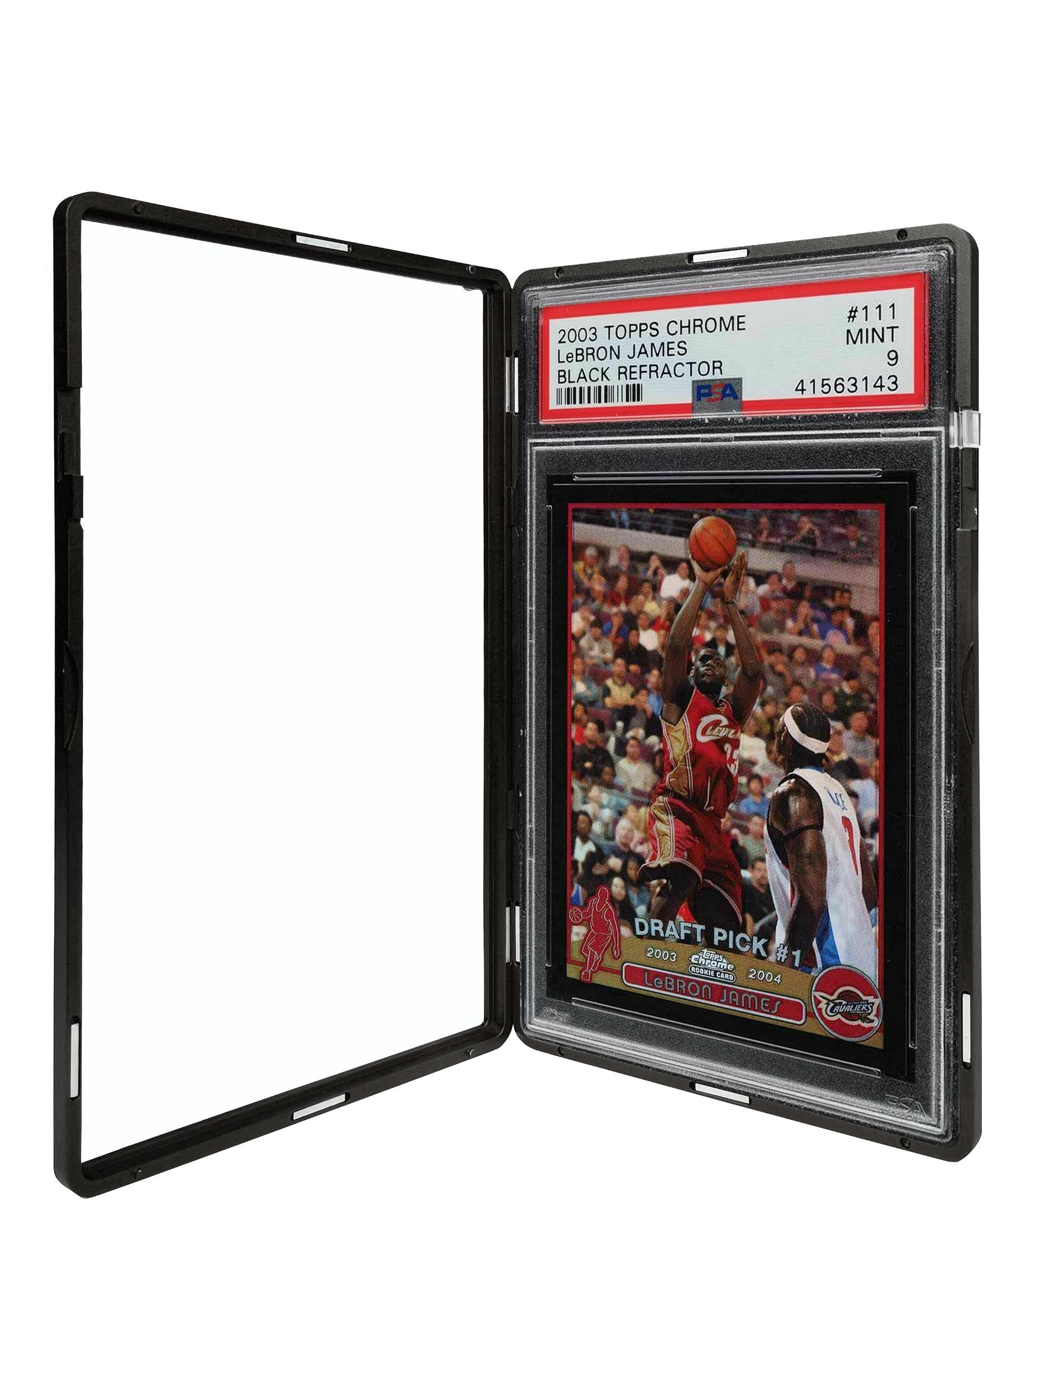
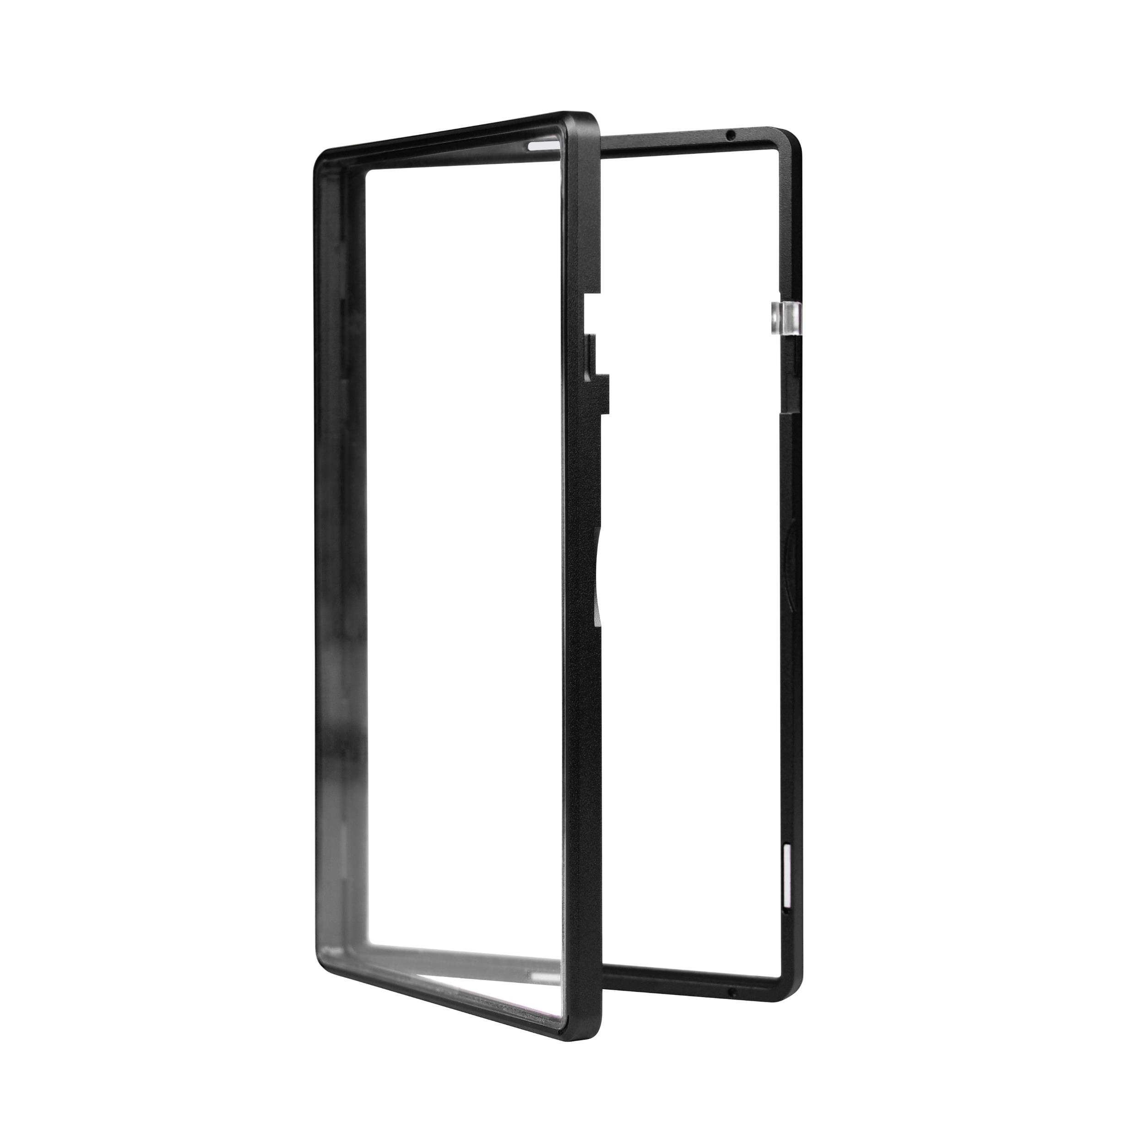
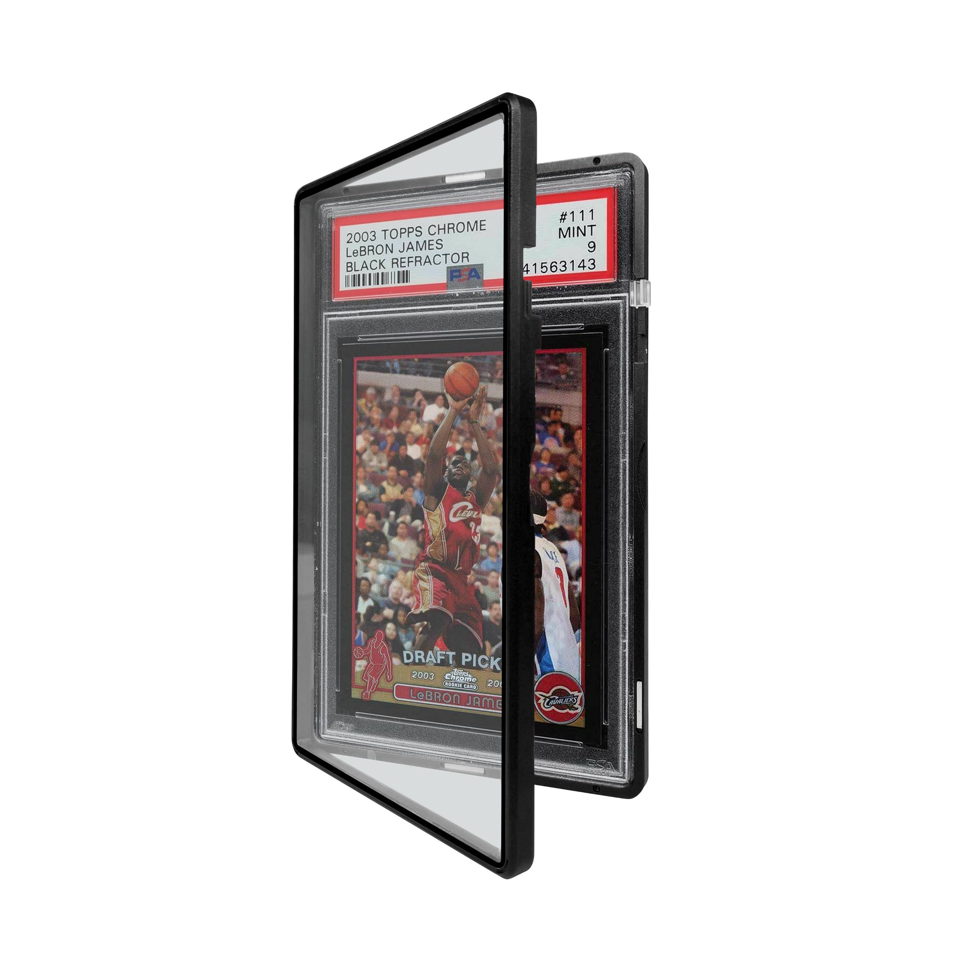
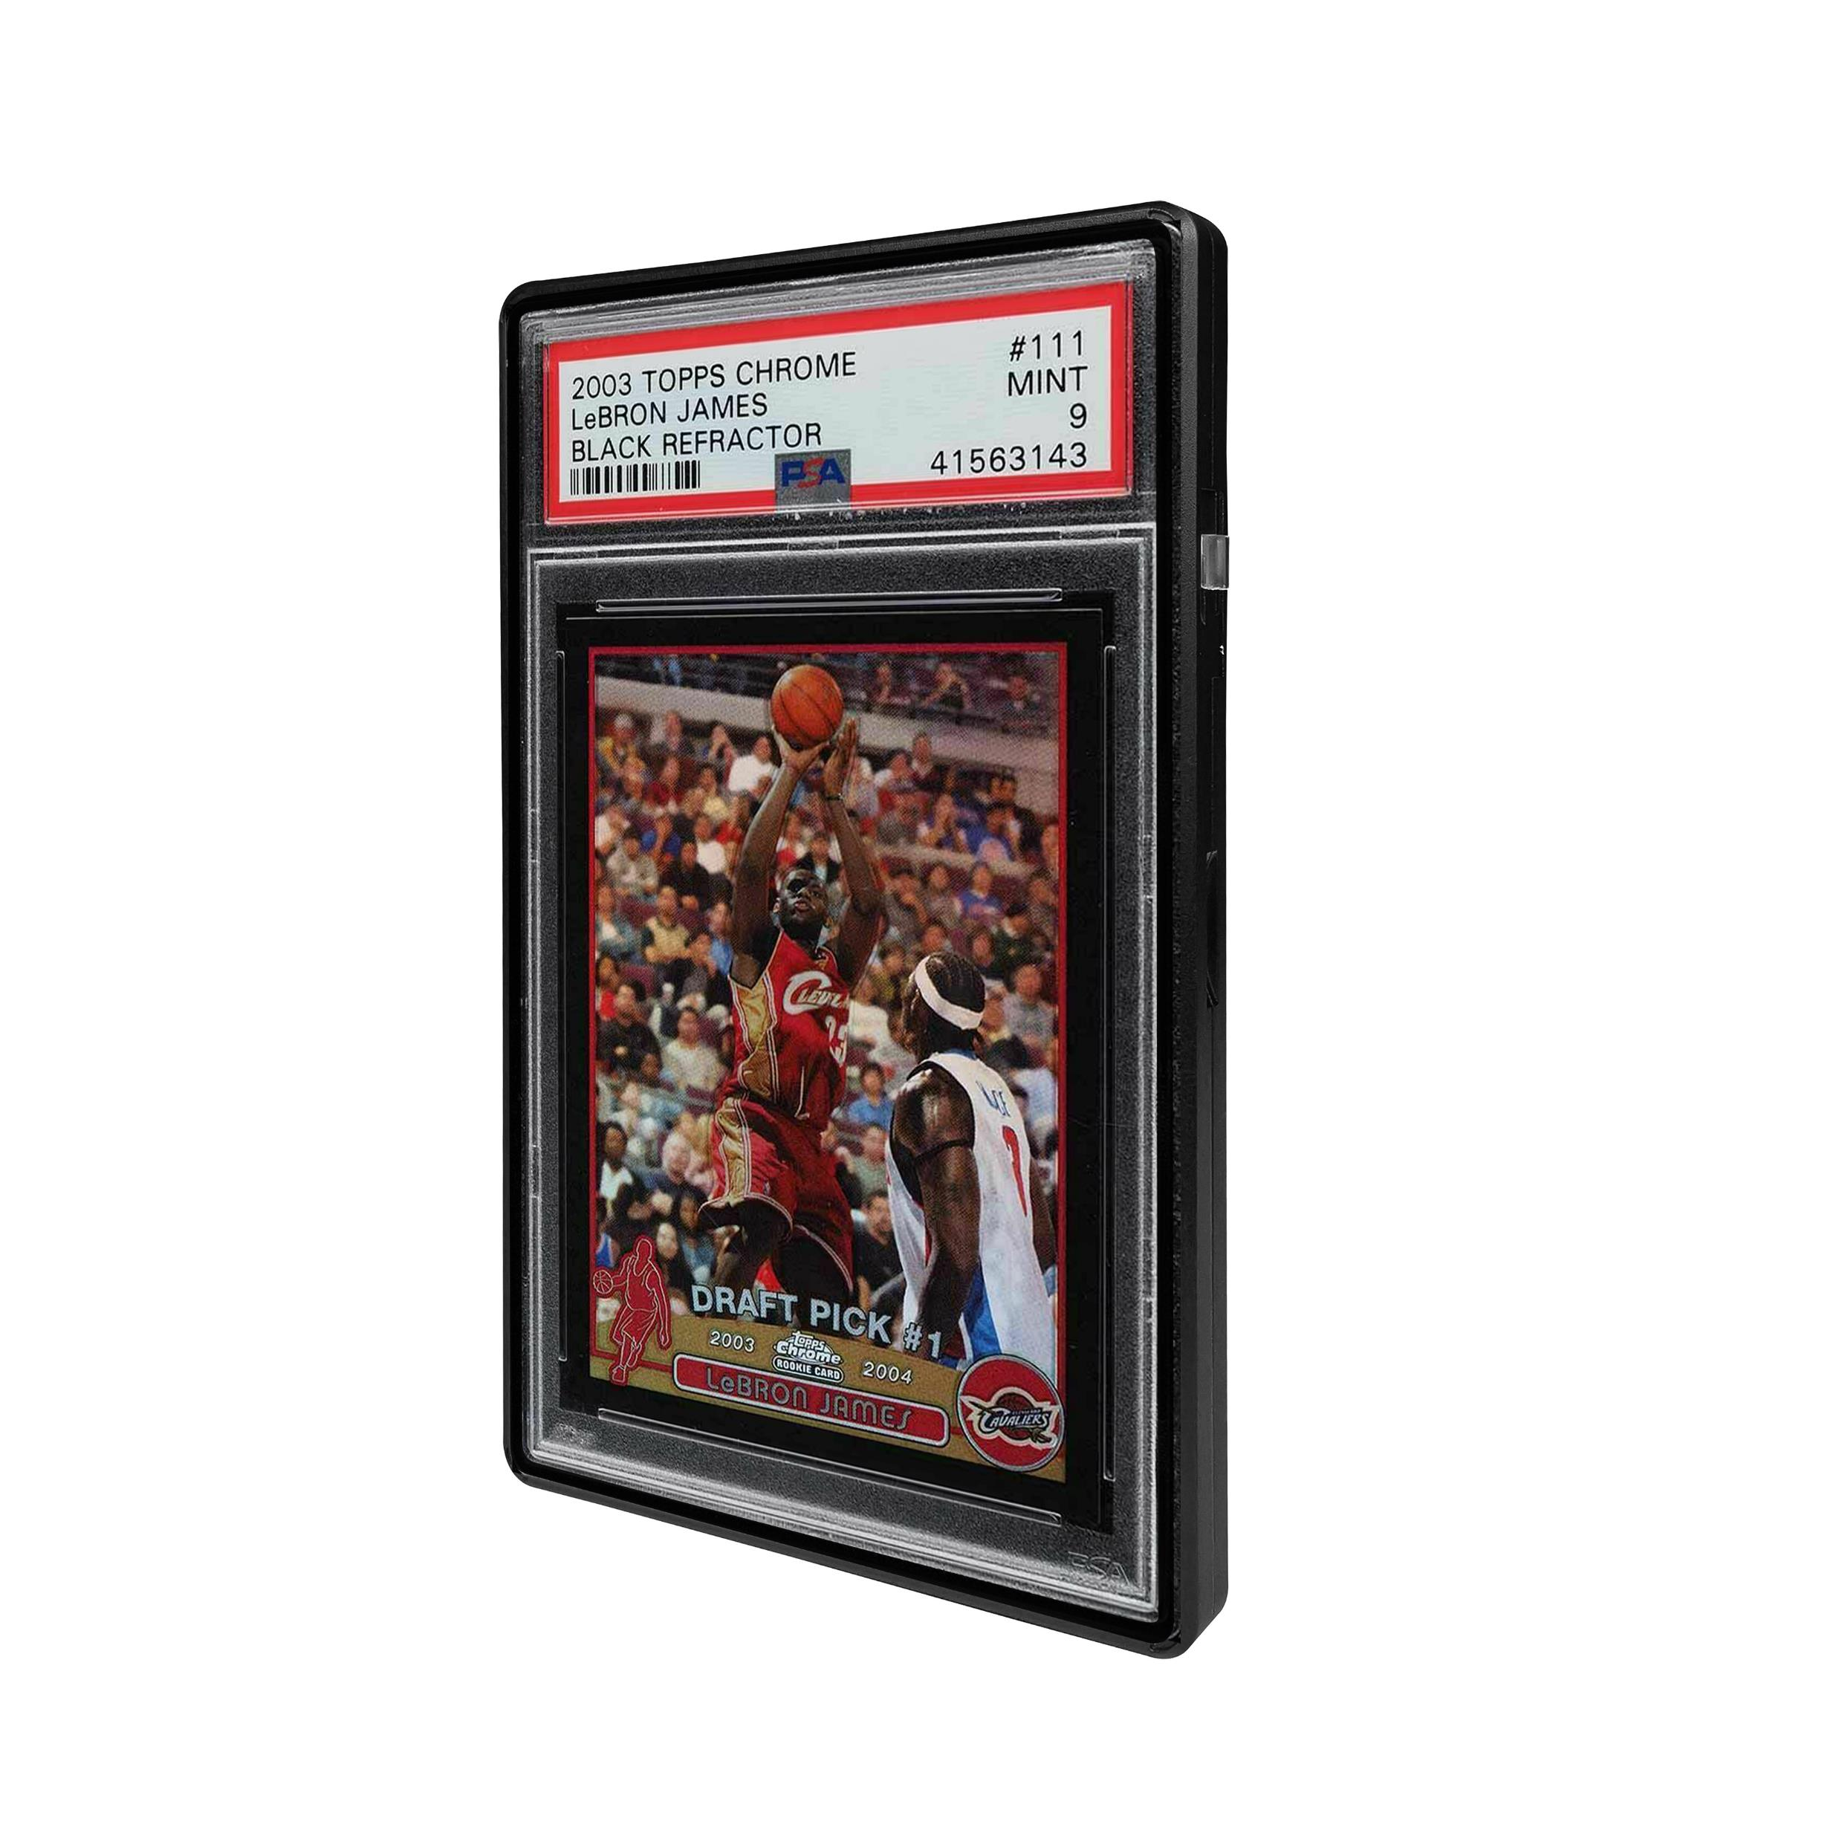
Black

Slide 8
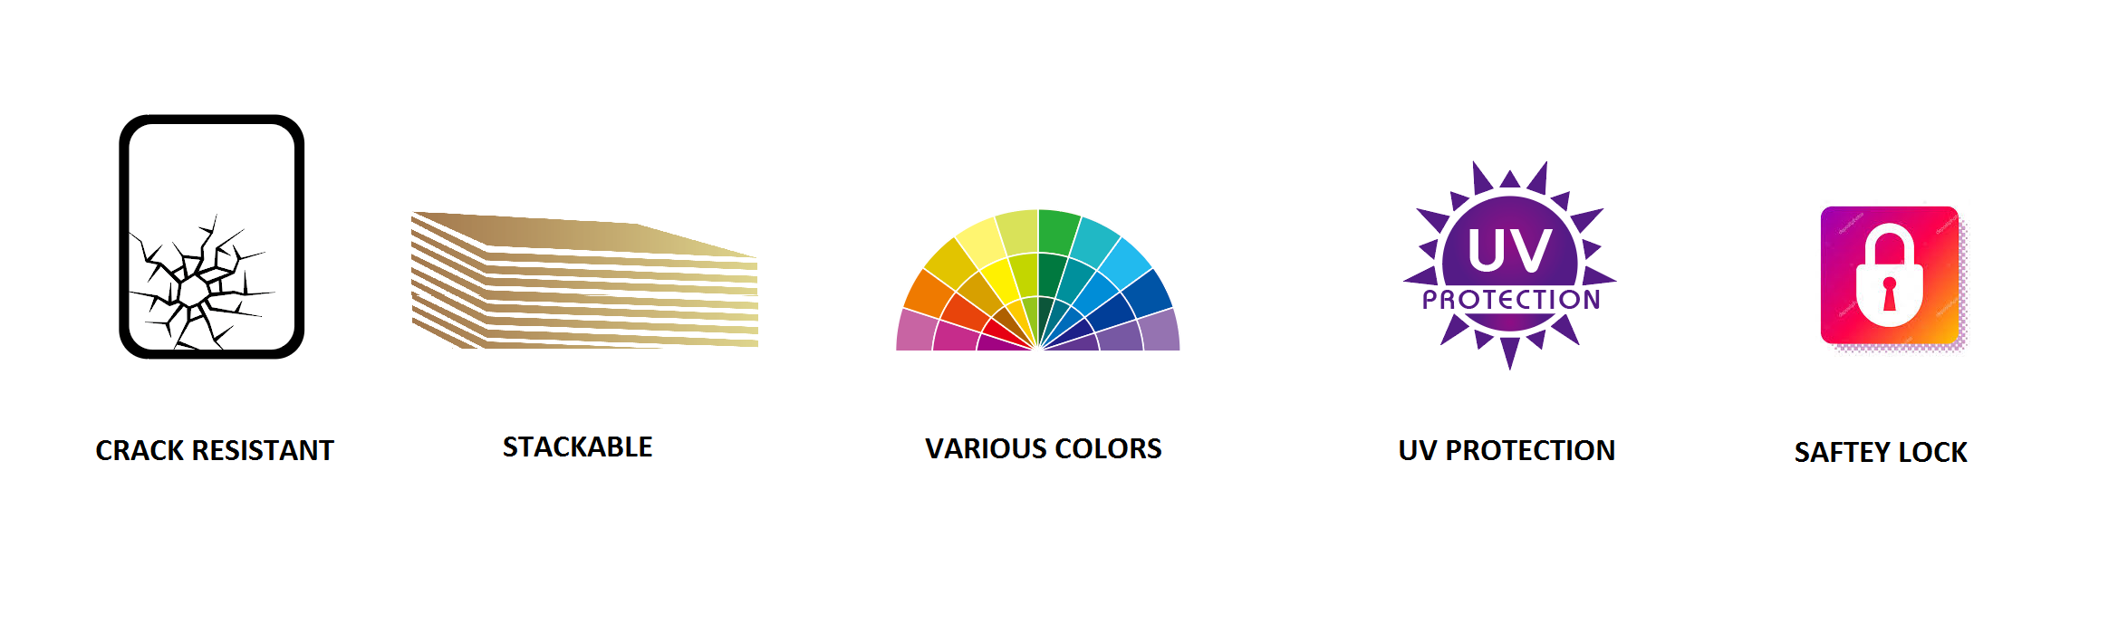
ICONS
PLEASE CREATE NEW ICONS THAT MATCH THEME OF PACKAGING – WITH NO COPYRIGHT ISSUES

Slide 9
Compatibility ICONS
MADE FOR
PSA
(6.0mm)

