Slide 1
04/27/2021
Graphics Library
Website graphics archive for PPT use
Christopher Schouten, Marketing Director

Slide 2













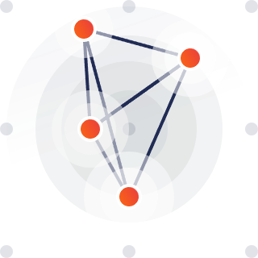


Data
Device
Actions
Build & Deliver
Cloud Backend & App
Decisions
Commands
Assess
Discrete Secure Element/Pico SE
Certify
Design
End-to-End
Connect

Slide 3








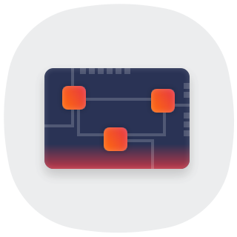


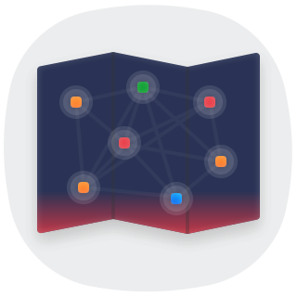









IoT Services
Kudelski IoT keySTREAM
IoT Solutions (end-to-end)
Hardware Design
Asset Tracking
Global Coverage
IoT Ecosystem
Software Design
Integrated Secure Element
PKA
Integrate
Integrity

Slide 4
















Multi-Connectivity
NFC
Secure Authorizations
Manage
Root of Trust
Strategic
Multi-Sensor
Passive Solution
Manufacture
Secure & Manage
Testing
Passive Keyless Access
Network
User Privacy

Slide 5












3 different points
Train
User to User Authorization
5-year Battery Life
Control
Trust
Integrity
Lifecycle
Update

Slide 6

www.kudelski-iot.com
Presenter Name, Presenter E-Mail Address

Slide 7
Orange
Keep corner radius to a small and constant amount
Limit use of gradient to keySTREAM or other limited elements on the page.
Generally, Red is not used unless it is to indicate threat, risk, danger.
Keep corner radius to a small and constant amount
Light Blue
Shadow: 90% opacity
Size: 102%
Blur: 5pt
Dark Blue
Gradient
Dark Gray
Gray background work well to group things (white boxes with their blue title box) together
You will need a few arrows and common icons.
For technical diagrams, please use these guidelines and elements and copy/paste them into your slides.

Slide 8


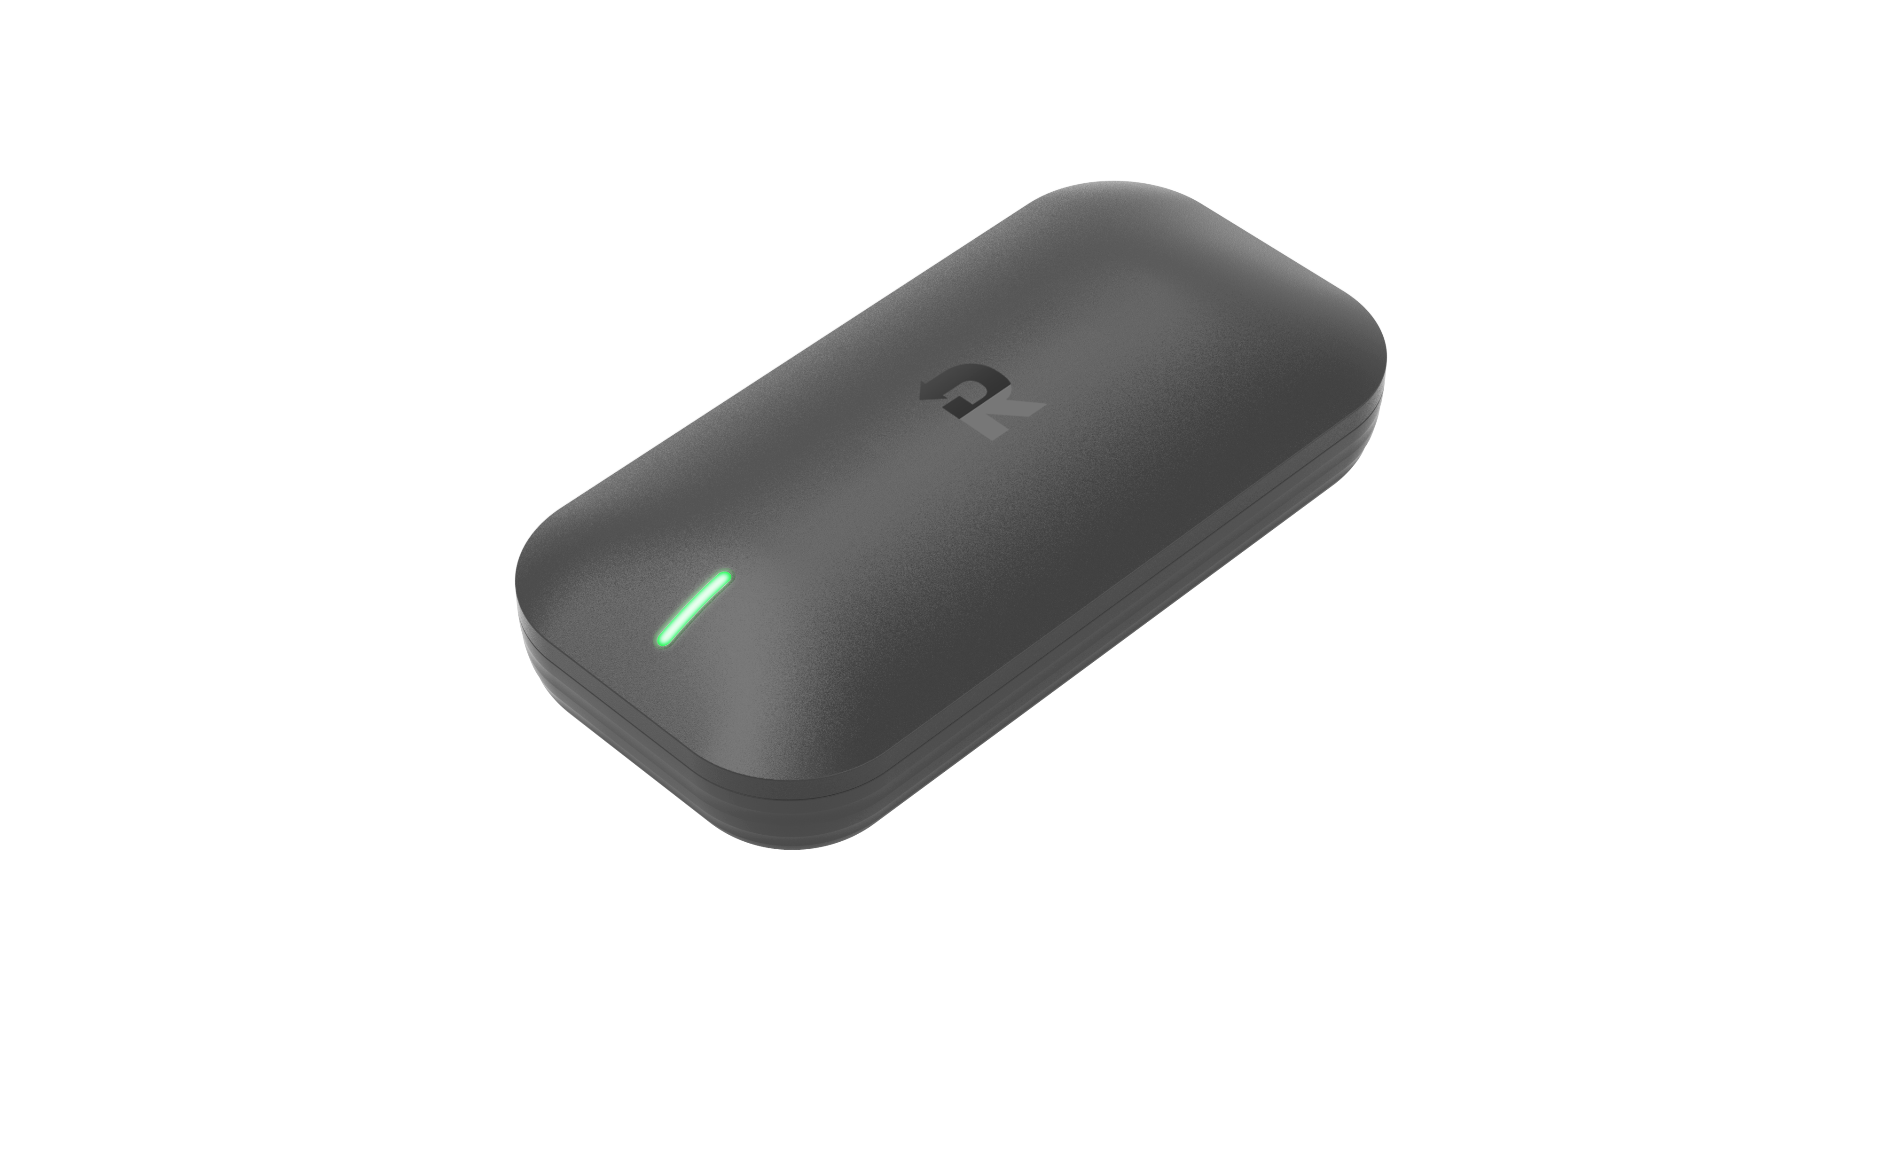
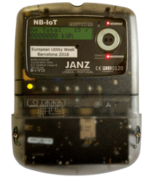
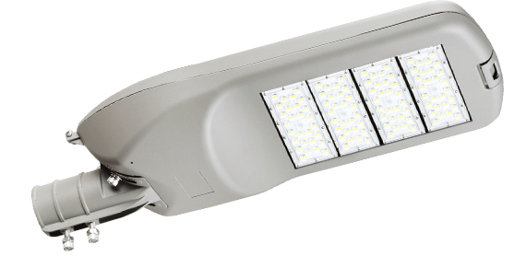

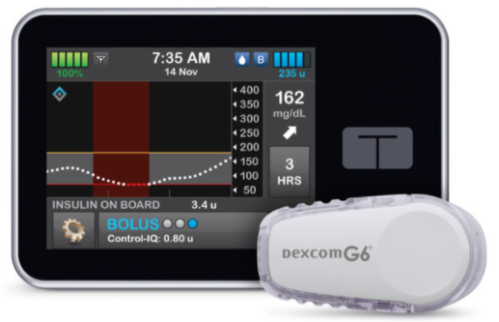







YOUR IoT DEVICE
YOUR CLOUD
Secured Data
Your Device Applications
Your IoT Applications
…
keySTREAM SERVER
Security Management
Root of Trust
Secure
Client
Library
Your IoT Platform
Automotive
keySTREAM SECURITY CLIENT
Medical
Smart Building(s)
Industrial
Smart Cities
Notes:
Get designer advice on cleaning up
Look for optimal logos

