Slide 1

Brief Logo - S&OP Impact Lab’

Slide 2

Who we are ?
Losam Agency, marketing agency specializing in the creation and animation of communities.
Losam Agency created “S&OP Impact Lab’” for the company Board, the first think tank dedicated to S&OP managers and directors best practices and its impact on business performance.
The “S&OP Impact Lab’” is :
1 founding committee composed of 6/8 leaders which will define the themes of the different meetings
5 meetings a year (1 dinner + 4 breakfasts meeting)

Slide 3

c
Who is Board ?
Board is the #1 decision-making platform. Founded in 1994, Board International has enabled people from more than 3,000 companies worldwide to have a transformative impact on their business by rapidly deploying Business Intelligence, Corporate Performance Management, and Predictive Analytics applications on a single unified platform.
Board allows companies to intuitively play and create with data to produce a single, accurate, and complete view of business information, gain actionable insights, and achieve full control of performance across the entire organization.

Slide 4
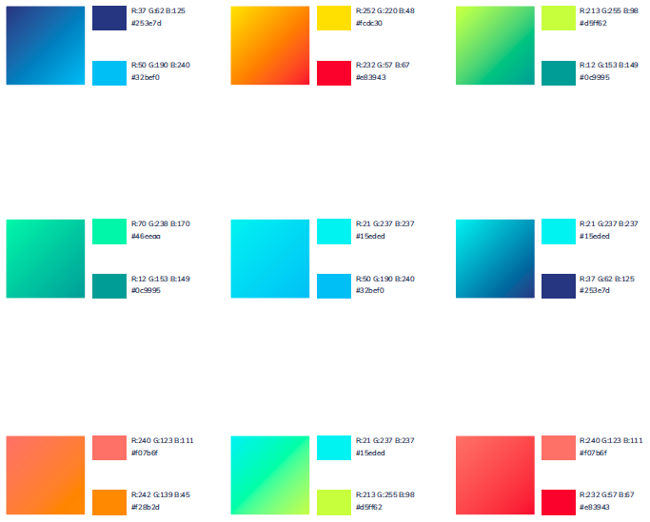
Board - Brand Guidelines
Primary color « Blue reflects our heritage, and symbolizes trust, reliability and digital technology. »
Neutrals colors can support our primary color when necessary.
Only the use of gradients present here is allowed.
Secondary colors to support the primary color

Slide 5
S&OP Impact Lab’
Target :
S&OP directors/managers/leaders of CAC 40 and SBF 120 companies
Directors of supply chain of CAC 40 and SBF 120 companies
Positioning :
The S&OP Impact Lab’ is a confidential Think Tank, launched by Board. It brings together decision-makers in charge of S&OP and aims to promote sharing of best practices for the strategic management of organizations and their performance.
Baseline :
« The first think tank dedicated to S&OP managers best practices and its impact on business performance. »

Slide 6
Brief
What : Creating a logo
Sector : Supply Chain, Operations
Logo text : S&OP Impact Lab’
Elegant
Fun
Traditionnal
Personal
Feminine
Colored
Low end
Bold
Serious
Modern
Professional
Masculine
Black & White
High-end
v
v
v
v
v

Slide 7
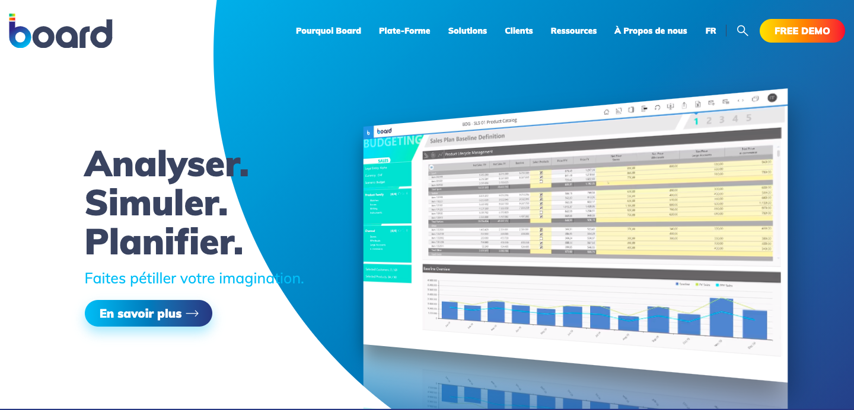
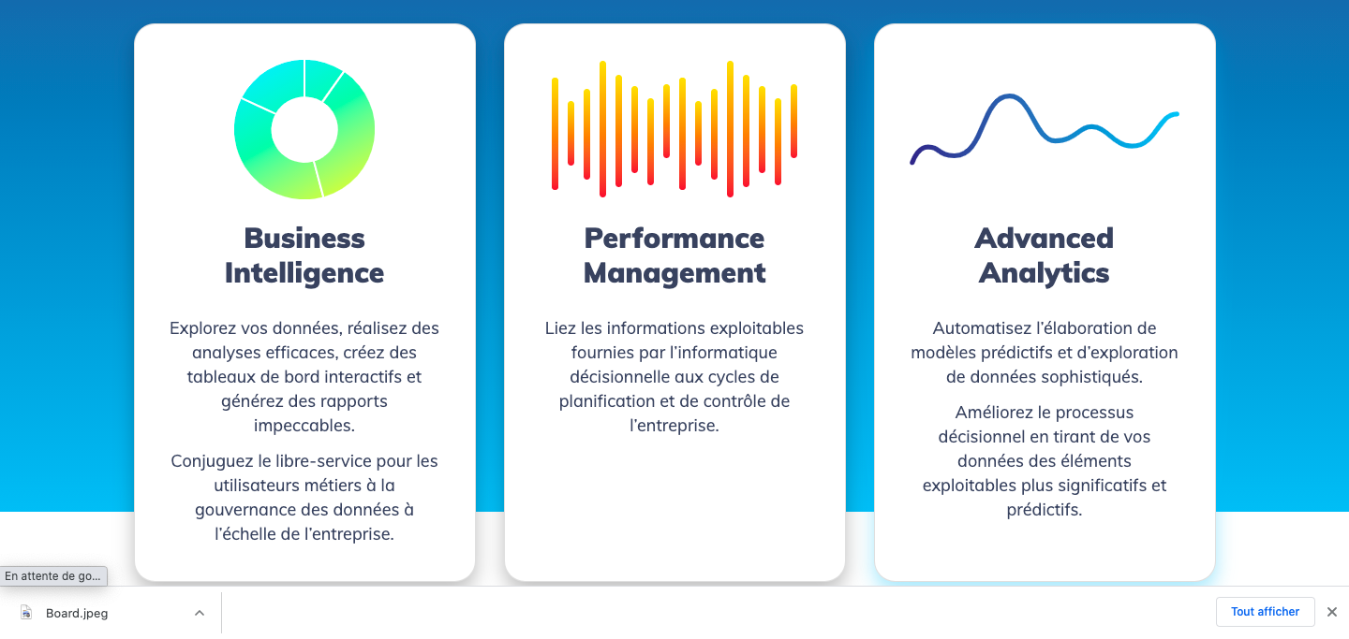
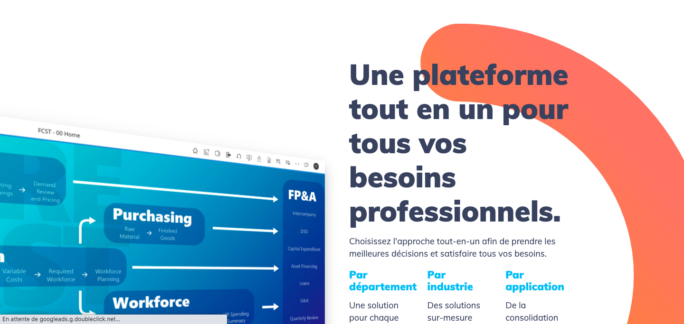
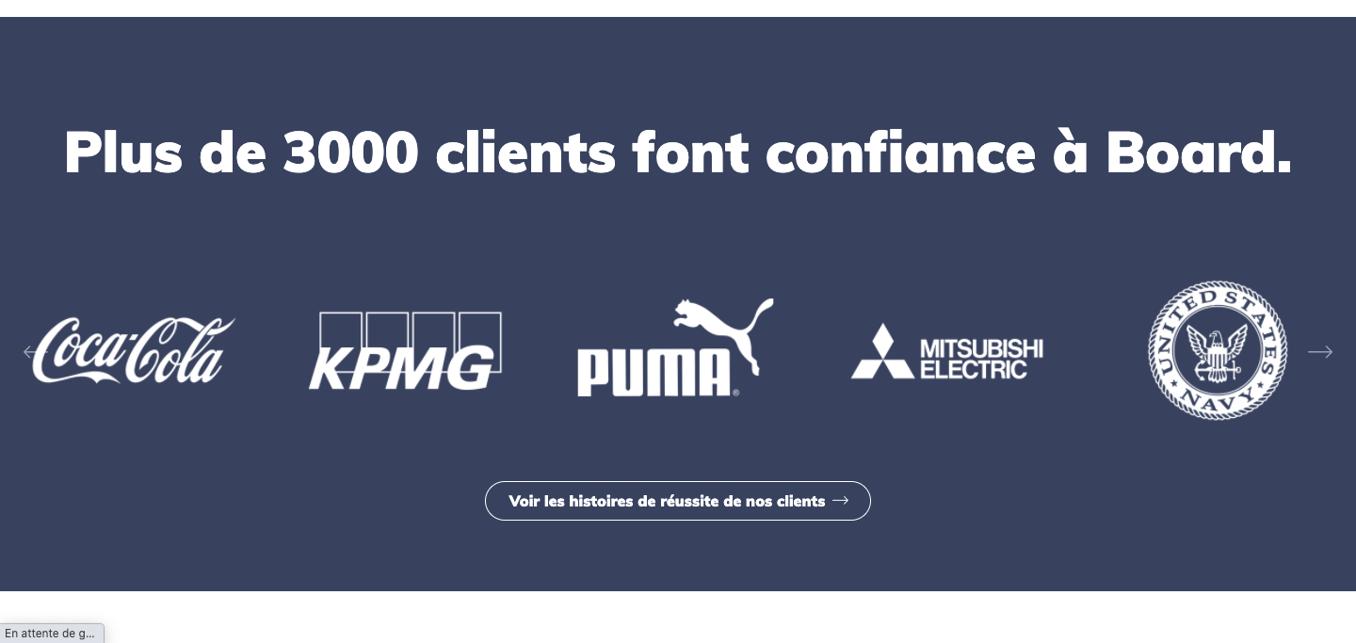
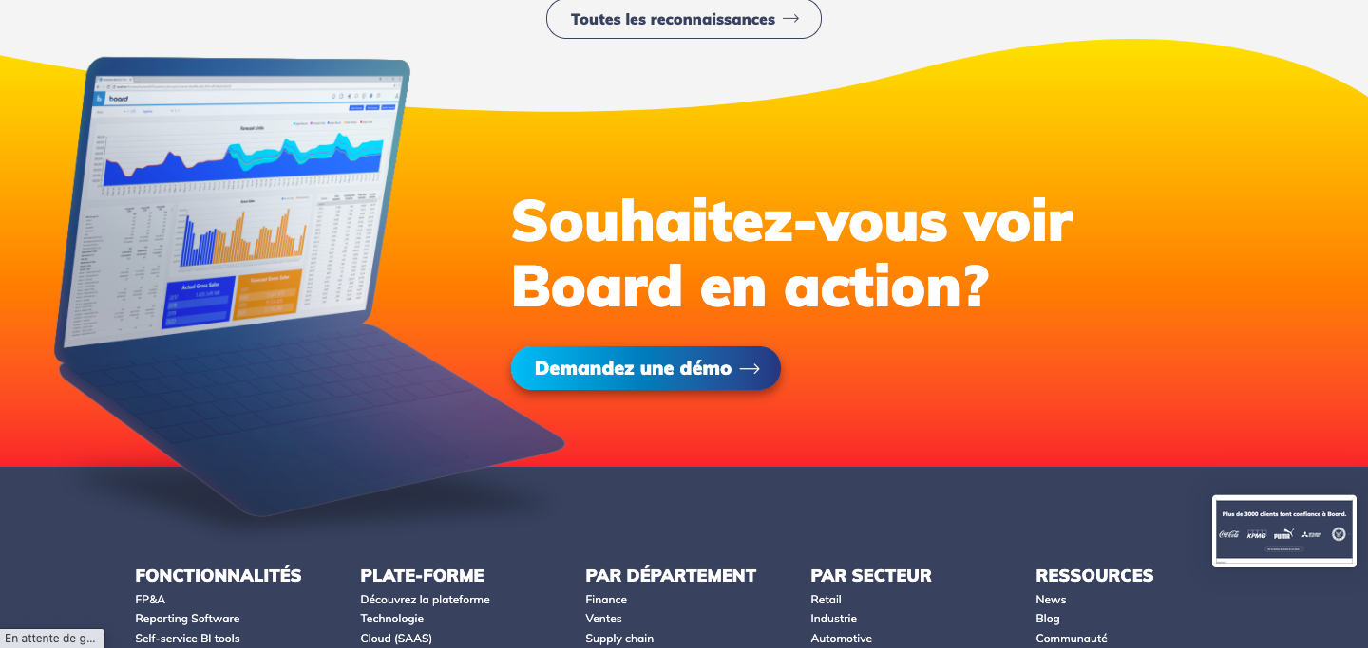
c
DNA of Board

Slide 8





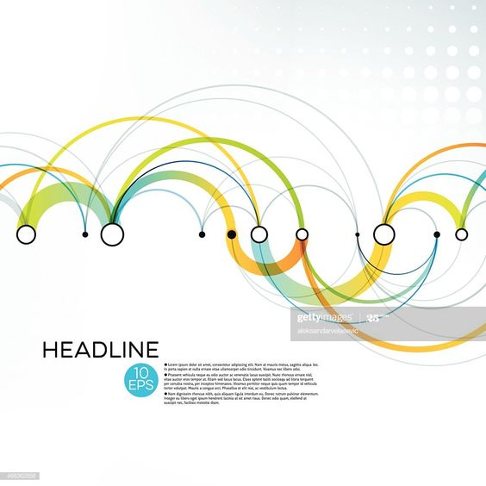


Inspirations
Use of the gradient colors for « S&OP » in the title of the think tank

