Slide 1
A Platform for Monitoring and Prediction of Social Impact and Acceptability of Modern Border Control Technology
This project has received funding from the European Union’s Horizon 2020 research and innovation
programme under grant agreement no 883075.

Slide 2



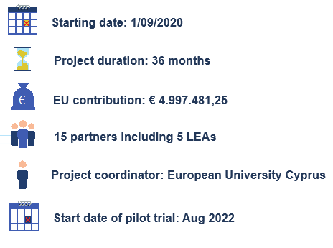
METICOS
This project has received funding from the European Union’s Horizon 2020 research and innovation programme under grant agreement no 883075.

Slide 3
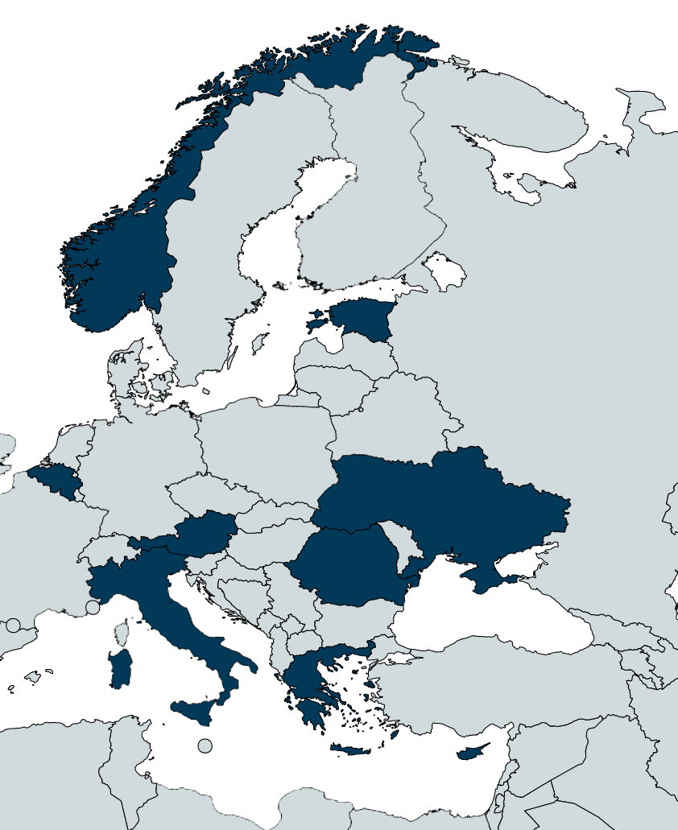


Consortium
This project has received funding from the European Union’s Horizon 2020 research and innovation programme under grant agreement no 883075.

Slide 4
Key Facts and Objectives
A Platform for Monitoring and Prediction of Social Impact and Acceptability of Modern Border Control Technology.
METICOS aims to:
► Introduce Big Data Analysis of cross border control validation methodologies and join the European initiative for Smart Borders
► Provide a step-change and a valuable tool for more modern and efficient border management and for gaining societal and political acceptance of technologies for “no gate crossing point solutions”
► Develop a platform able to simulate the technology acceptance and to estimate the perception of no gate crossing point solutions’ users (travelers and border authorities)
This project has received funding from the European Union’s Horizon 2020 research and innovation programme under grant agreement no 883075.

Slide 5
How to?
METICOS will develop a technological solution and metrics evaluating:
the effectiveness and efficiency of smart borders technologies
the travelers' satisfaction and acceptability on the use of these technologies and
the extend that both the efficiency and the acceptance of these technologies is improved with the introduction of new data sources e.g. from EES/ETIAS
METICOS knowledge base will create a Technology and Societal Acceptance Toolkit with multiple utilizations in favor of law enforcement and border authorities for a better and more efficient Entry/Exit System
This project has received funding from the European Union’s Horizon 2020 research and innovation programme under grant agreement no 883075.

Slide 6



Overall Aim
→ To join the European initiative for Smart Borders.
→ Provide a step-change for more modern and efficient border management and for gaining societal and political acceptance of technologies for “no gate solutions”.
→ Develop an ecosystem able to integrate information systems and networks of sensors as data sources in order to validate the efficiency of Smart Border technologies and to simulate users’ acceptance, empowering and providing a valuable tool to three major sub-divisions of the wider border control sector.
border control authorities
Service providers
travelers
This project has received funding from the European Union’s Horizon 2020 research and innovation programme under grant agreement no 883075.

Slide 7
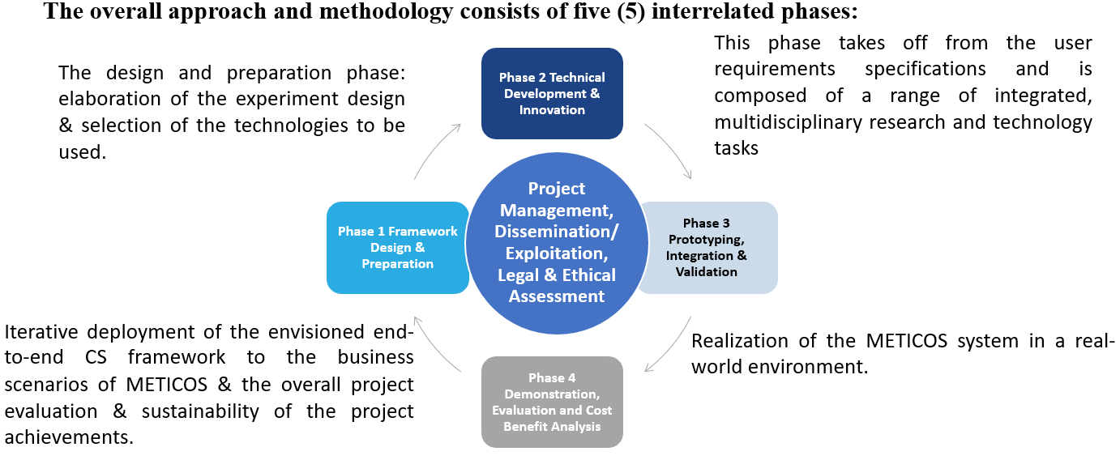
Methodology
This project has received funding from the European Union’s Horizon 2020 research and innovation programme under grant agreement no 883075.

Slide 8
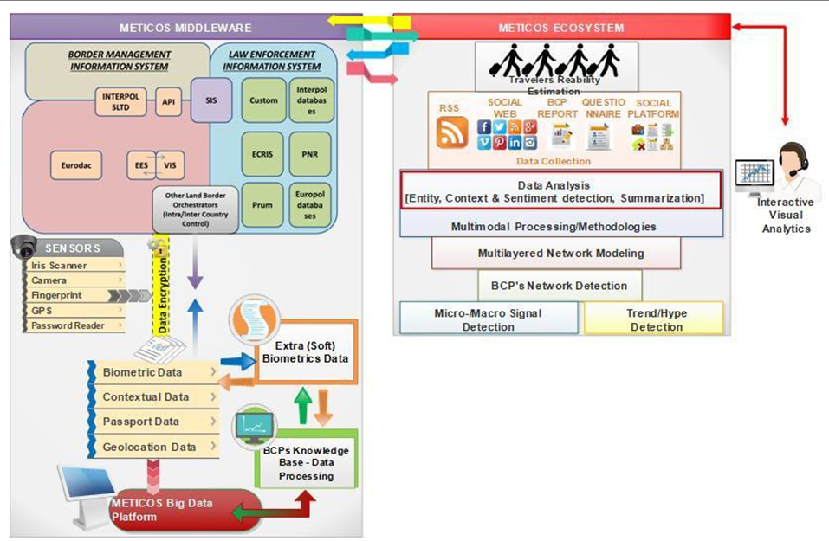
The Platform
Technology acceptance - primary factors influencing an individual’s intention to use new technology is whether the technology is perceived ease of use and perceived usefulness. METICOS aims to develop technology that will be easy to use on existing EEA systems by both the end users and beneficiaries.
Social Acceptance – the aim of METICOS is to create social acceptance by creating trust to the traveler’s that the technology created will facilitate their traveling and crossing borders rather than create a tool that will limit their freedom to travel across borders.
Maximise border control efficiency - The basic purpose of the METICOS technologies is to improve the effectiveness and efficiency of border controls by evaluating the operation of modern entry and exit systems
Three Challenges on collection of data:
Data complexity and heterogeneity
Data Interpretability
Data Heterogeneity
This project has received funding from the European Union’s Horizon 2020 research and innovation programme under grant agreement no 883075.

Slide 9


Pilots
Pilot Use Case 1: Border line validation: Border Authorities application trials and Pilot#1 Workshop
Location: Romania, Estonia, Greece and Cyprus.
Objectives:
- evaluate the no gate crossing processes (applied on the air/ land/ sea borders)
- evaluate the acceptance of border & custom authorities of no gate crossing
technology
- evaluate the social acceptance of no gate crossing technology from travellers point of view
- demonstrate that could provide enough data flow and services/tools for analysis
Pilot Use Case 2: Validation of EU BCP risk assessment platforms: Traveller application trials and Pilot#2 Workshop
Objectives:
- evaluate the provided enhanced situational awareness in terms of the timely and proper identification of potentially dangerous people and goods, and of prevention smuggling and human trafficking
- evaluate the risk-management coordination and cooperation between border control (passport/persons), customs (baggage/goods) and security in transport (pre-boarding security checks on persons and baggage)
- evaluate the improvement of proposed solutions for remote detection of abnormal behaviours
- evaluate the improvement and the acceptance of border automated screening systems
This project has received funding from the European Union’s Horizon 2020 research and innovation programme under grant agreement no 883075.

Slide 10
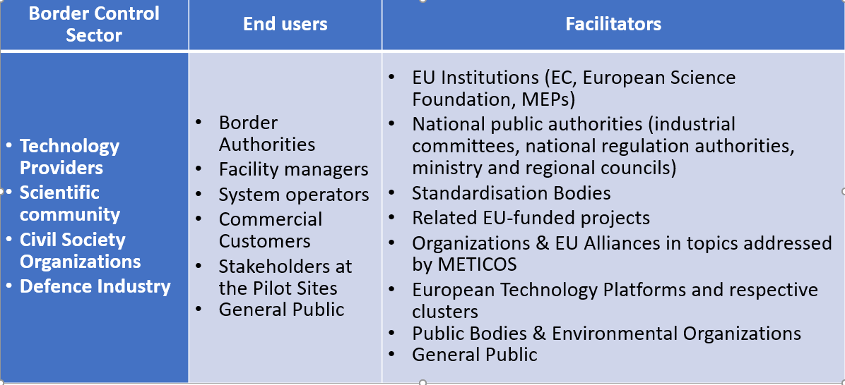
Stakeholders
This project has received funding from the European Union’s Horizon 2020 research and innovation programme under grant agreement no 883075.

Slide 11
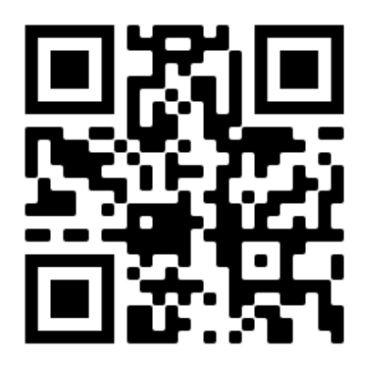




Contact Us
Online presence
METICOS e-mail:
info@meticos-project.eu
Project Coordinator:
Pantelis Velanas, PhD
e-mail: p.velanas@research.euc.ac.cy
Dissemination Manager:
Mpampis Chatzimallis
e-mail: chatzimallis@vilabs.eu
https://meticos-project.eu/ https://twitter.com/MeticosEU https://www.facebook.com/meticos.eu/
https://www.linkedin.com/company/meticos-eu/
Visit our website

Slide 12

This project has received funding from the European Union’s Horizon 2020 Research and Innovation programme under Grant Agreement No 883075

