Slide 1

BRAND STYLE GUIDE

Slide 2
Brand Values
Gratitude
Appreciation
Intentional
Deliberative
Integrity
Justice
Trust
Freedom
Autonomy
Independence
Page 1

Slide 3
Brand Colors
#03667d
#652a3e
#cb6d2c
#b79355
#fee4cb
Page 3

Slide 4
Typography
ABCDEFGHIJKLMNOPQRSTUVWXYZ
Abcdefghijklmnopqrstuvwxyz
1234567890
Playfair Display 700
Maitree medium
ABCDEFGHIJKLMNOPQRSTUVWXYZ
abcdefghijklmnopqrstuvwxyz
1234567890
Roboto
ABCDEFGHIJKLMNOPQRSTUVWXYZ
abcdefghijklmnopqrstuvwxyz
1234567890
Page 4

Slide 5
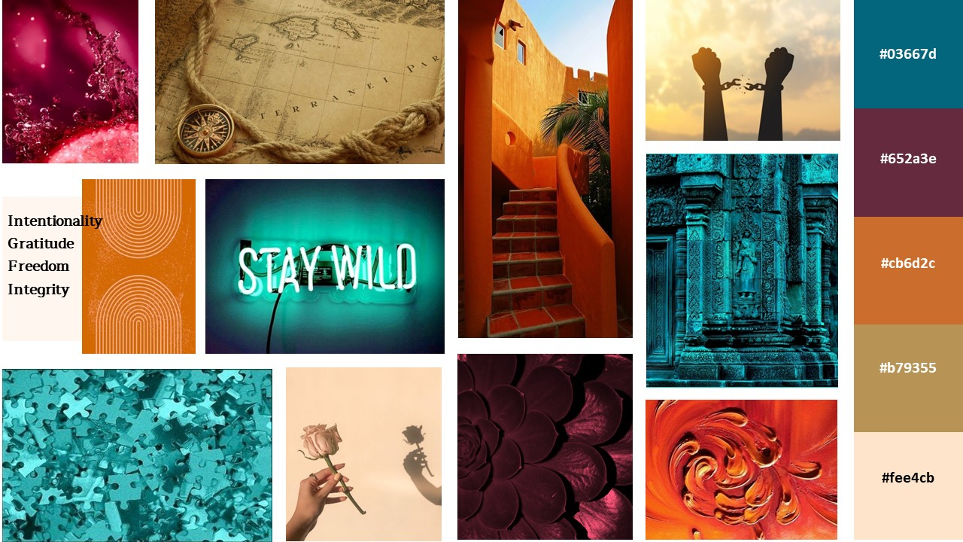
Mood Board
Page 5

