Slide 1


Spice up your golf LIFE – unique golf accessories for the passionate golfer.

Slide 2
BUSINESS IDEA
Golf is good for both body and soul - nature, togetherness and the game itself stimulates an active and positive lifestyle. Our starting point is all the good things about golf, and we have hand-picked the cool, unique equipment that makes golf extra fun.
Golf LIVING however, focuses exclusively on golf accessories - not irons, clubs or golf carts, but all the important details that make golf easier and more interesting! We offer the cool ”on-course” accessories, the smart training solutions, the practical travel equipment - but also the unique golf gifts that passionate golfers, would love to give or receive as a gift.
All products are a little out of the ordinary either in design, quality or functionality and not something the traditional golf shops have in the range today. The products combines functionality with a beautiful design, so you feel happy, confident and professional on the golf course, as well as inspired and motivated, when you practice.
We want to spice up your golf game!

Slide 3
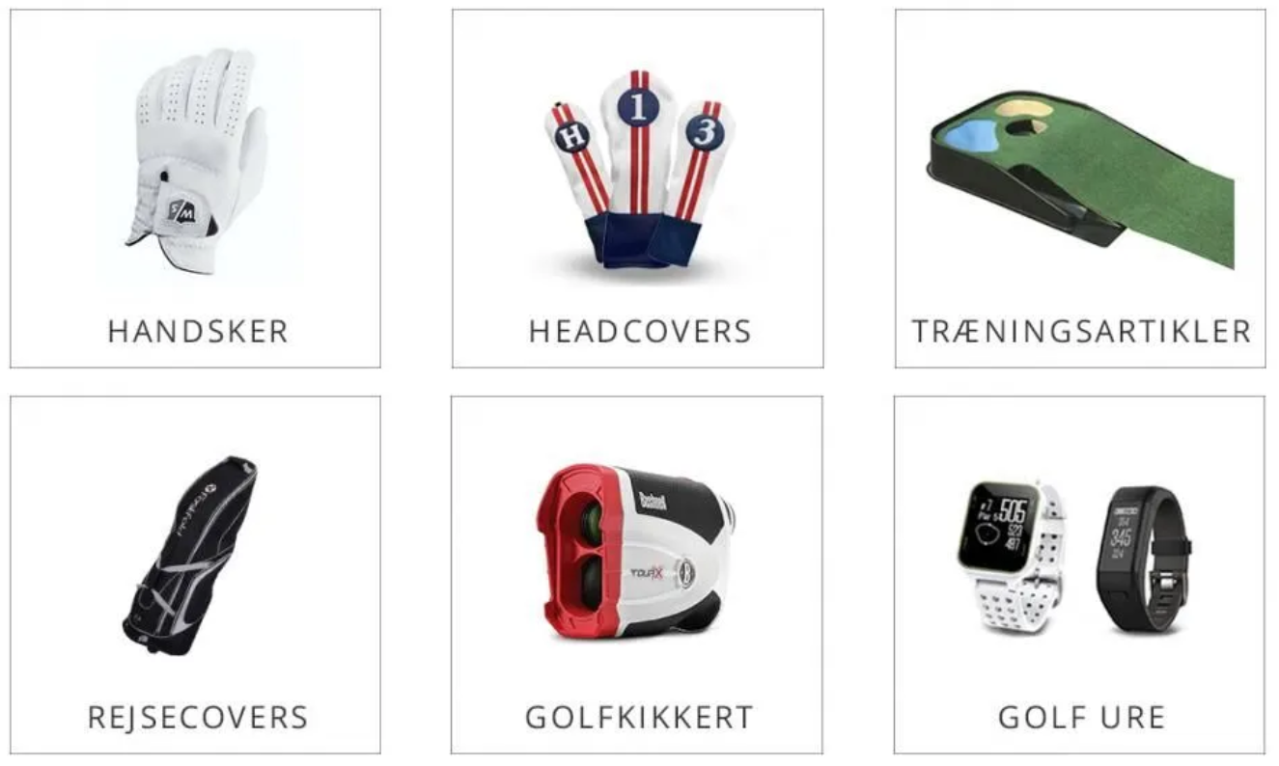
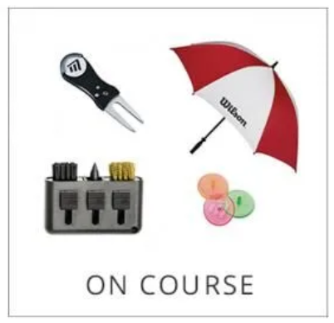
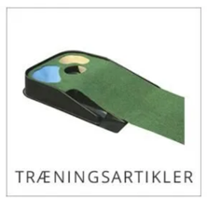
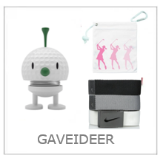
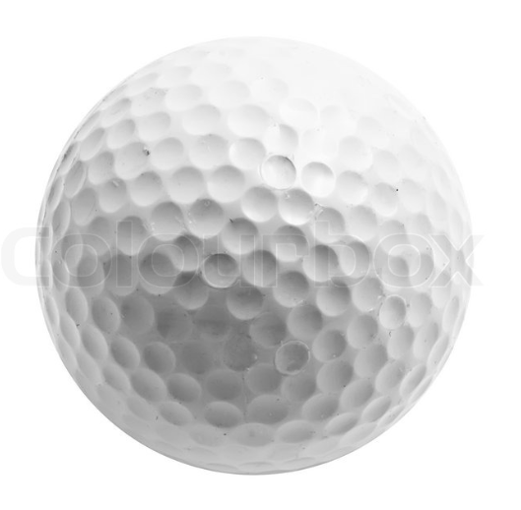

GolfLIVING focuses on golf accessories
Tees/balls
Ball markers
Umbrellas
Towels
Pitchforks
Clean&maintain
Ball pick-up
Water bottles
Unique golf gifts
Ball washers
Socks
Belts
REJSE ARTIKLER
AFSTANDSMÅLERE
BOLDE

Slide 4

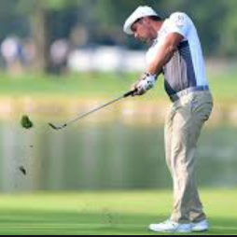

TARGET GROUP
We cater to golfers who are looking for a functional, stylish and quality-conscious expression and want to appear sporty and comfortable on the course. Golfers who want to add a little personality to their appearence and look sharp and trendy. We esspecially love and support women and beginners and try to reach these on social media, with personal and helpful ideas, tips & tricks to make their golfing life a little bit better!
We want you to to look great, so you can perform your best!

Slide 5

POSITIONING

Slide 6
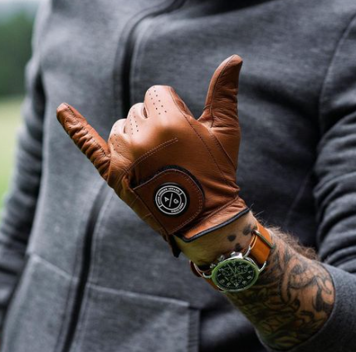
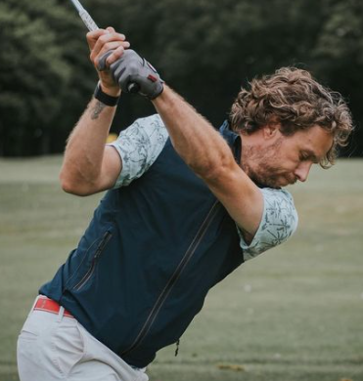



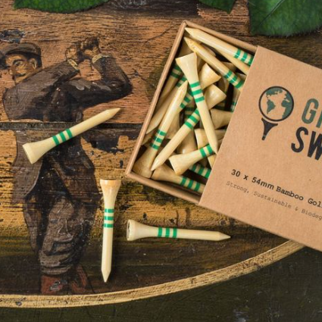

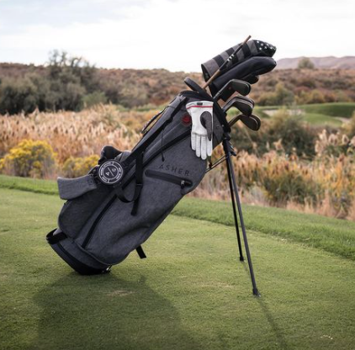
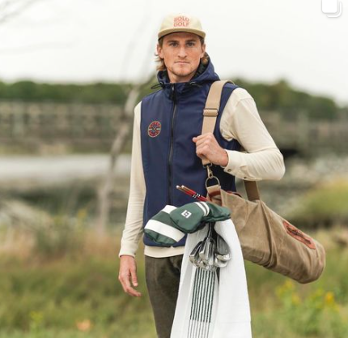
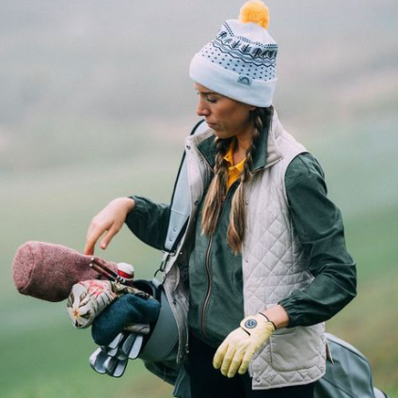
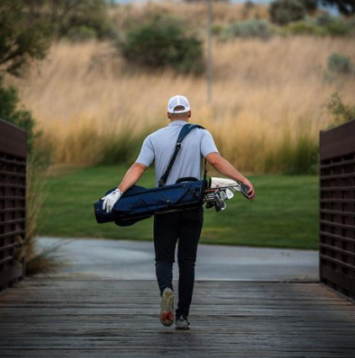
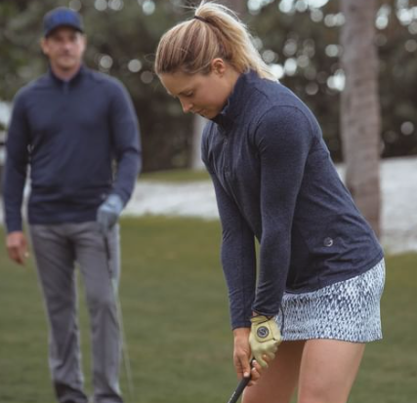

FOCUSED
MODERN
CLASSIC
NATURAL
STRONG
CONCIOUS
AUTHENTIC
RELAXED
SPORTY
UNDERSTATED LUXURY

Slide 7
WHAT DO WE WANT TO BE KNOWN FOR?
We want to be the alternative to “performance golf” – golf can be too formal and too traditional sometimes and we want to take a fresher approach and give golf a more relaxed face – allowing you to show your personality and style.
We love the golfing lifestyle, where people of all ages and skills - build, grow and bond over the game of golf. Our universe embrace the Scandinavian feel and find the right balance between functionality, coolness, and aesthetics. We like things which are clean, simple, and stylish - with a timeless expression with neutrals shades, natural materials, mixed with cozy textures and carefully selected colors.
We sell products which are functional and look great at the same time. We only have quality products that can withstand the game of golf and we don’t have anything in the range, that we would not use ourselves.
We want to make it easy to choose the right equipment - there are many sites that assume that you know everything in advance, but at GolfLIVING, we guide and help customers all the way and make sure, it’s clear and a pleasure to choose, buy and get it delivered.

Slide 8
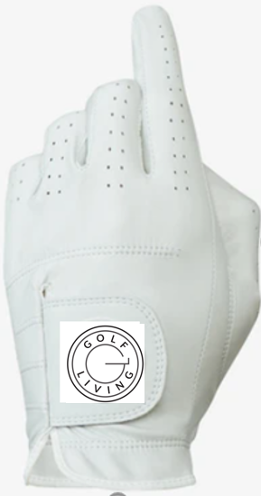
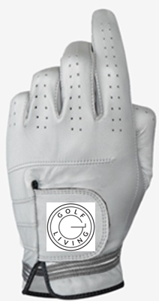
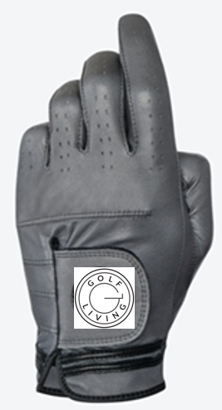
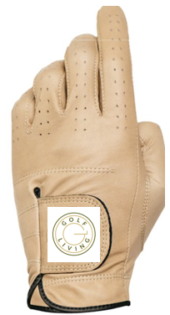
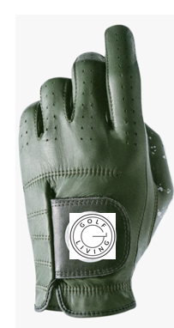
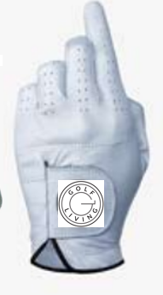
Task
A packaging design for our own golf gloves
Classic Collection
Scandinavian Collection

Slide 9
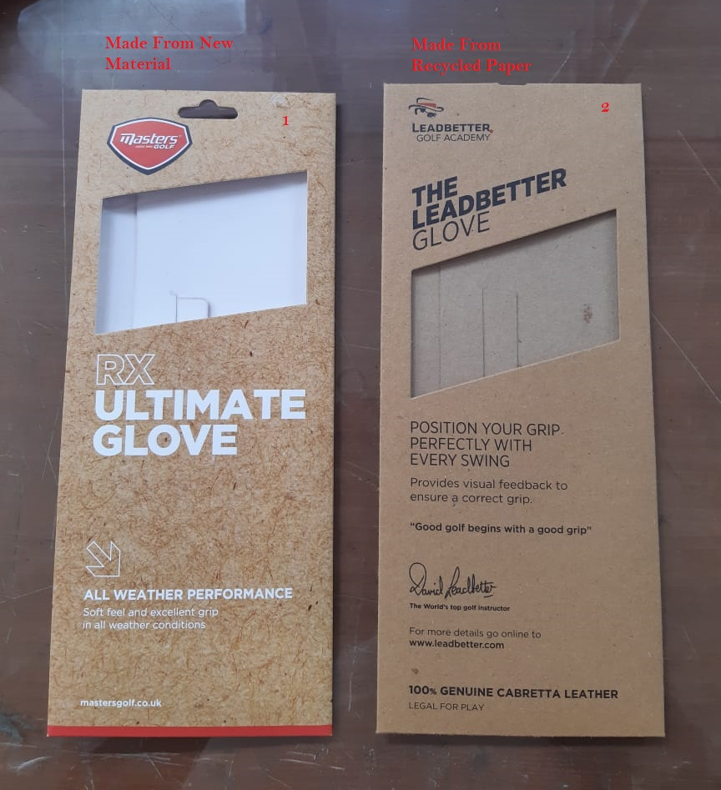
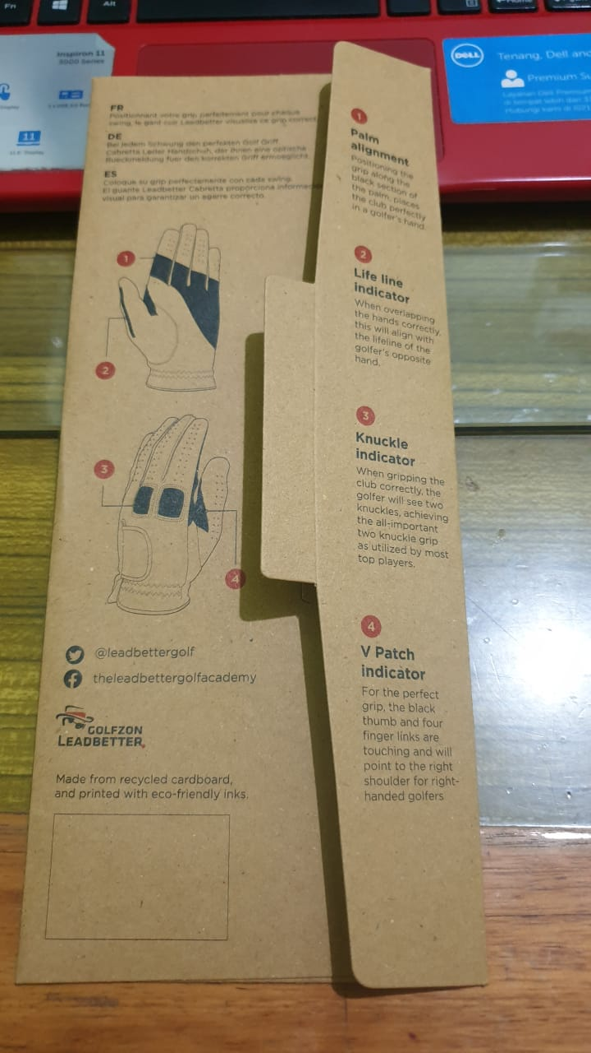
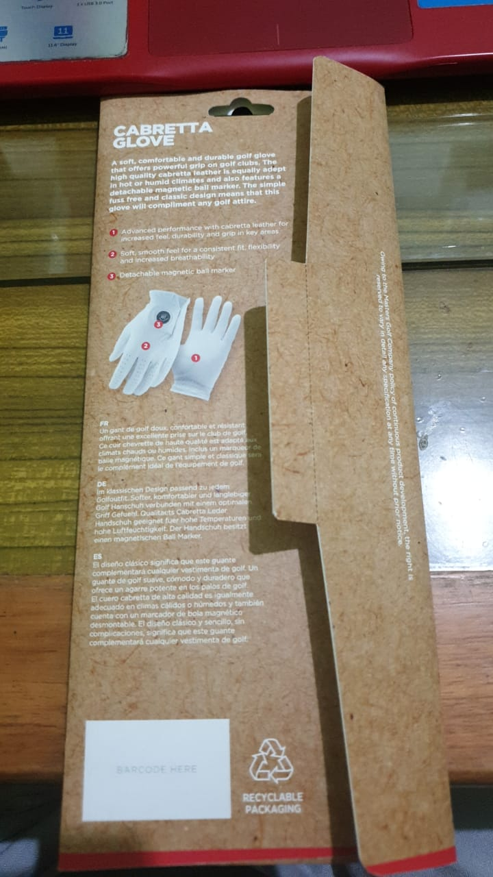
Our packaging template – how others have used it. In our design, we don’t need the cut out for hanging.

Slide 10
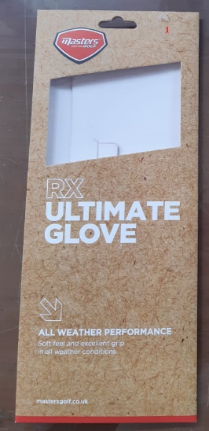





FRONT
Logo: round colored version on white background
Verdana/typo white tekst
Quality & style
100% AA Cabretta leather glove for ultimate grip and feeling.
100% style and performance
Look good play good - add some Scandinavian coolness to your game!
Red bottom line changes into dark green

Slide 11
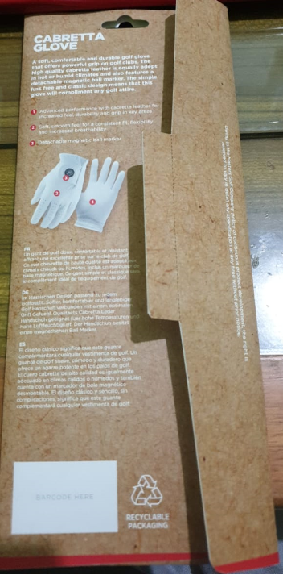

Verdana/typo white tekst
Go for quality
A glove is not just a glove. There’s a lot of different things to consider, when choosing a glove - but don’t worry, with your GolfLIVING glove, you get it all.
an extremely comfortable glove in 100% Cabretta leather
A perfect fit, that feels like a second skin
a good grip, which will feel stable throughout the swing
wonderful colors to match your style
All in all, a solid performing glove, which you can enjoy for rounds and rounds!
BACK
GolfLIVING
all rights reserved
Copenhagen 2021
E-mail info@golfliving.dk
www.golfliving.dk
GolfLIVING
Made from recycled carboard and printed with eco-friendly inks.
Made in Indonesia (+ recycling vignet) information on the flap vertically - like on the picture

Slide 12
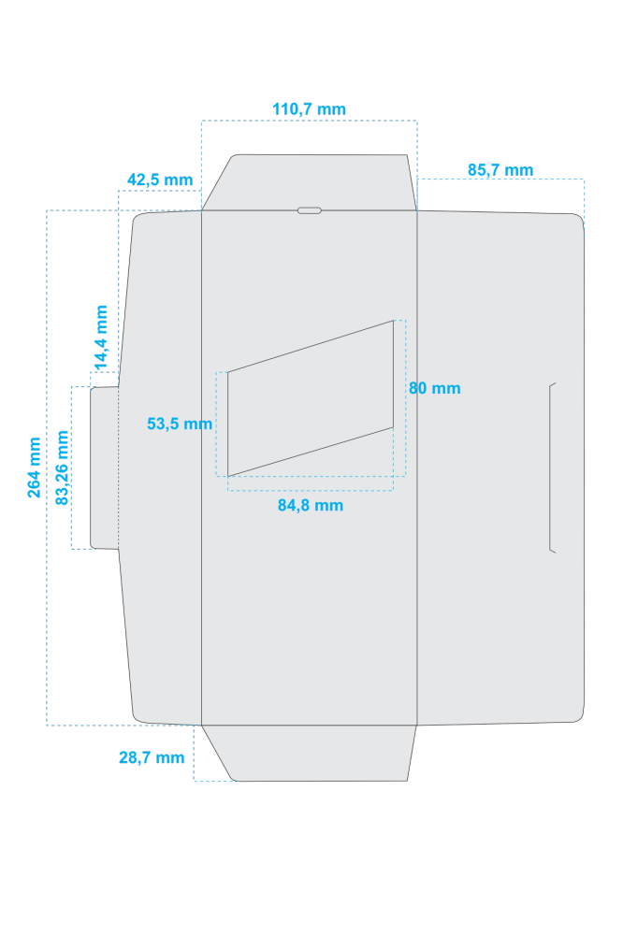
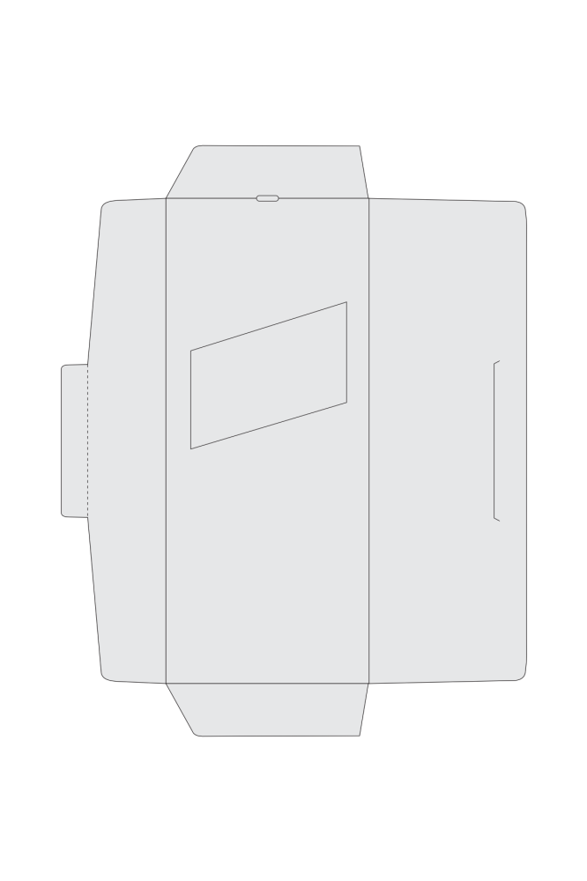

Slide 13


Pantone 7530C
CMYK 29-32-38-9
Pantone 418C
CMYK 59-48-58-44

Slide 14


Pantone 96999C
RGB 150 153 156
Pantone 7C
CMYK 63-60-64-65

