Slide 1
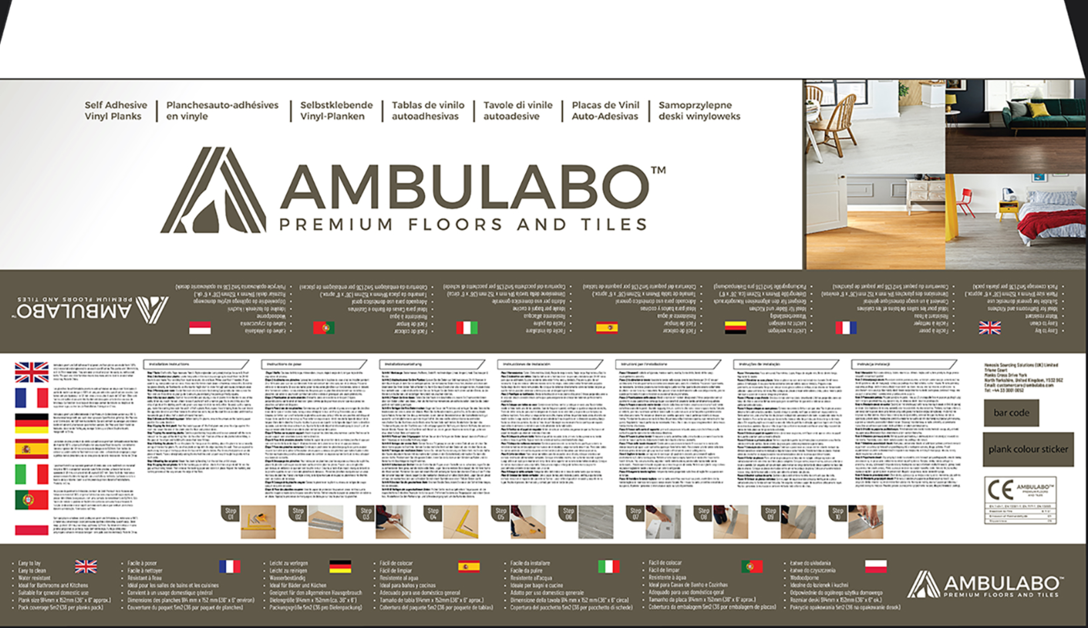
4
4
1
Move photos above text
3
Uniformly distributed
Uniformly distributed
2
5
4

Slide 2
#
1 | Remove frame around installation instructions text Place flag corresponding to the language
2 | Move photos above the text Ensure photos are uniformly distribute relative to the text placement Remove the word Step next to the photo – just the number is sufficient If possible, make the photos larger, or as large as possible without spoiling the aesthetic
3 | Remove the boxes you’ve added for barcode and plank colour stickers – just needed the area to be a blank white area. No box or text needed here.
4 | Remove the following text bullet points for features for all languages and place under the logo in the red box shown. You may move the logo placement up slightly to accommodate. Plank size 914mm x 152mm (36” x 6” approx.) Pack coverage 5m2 (36 per planks pack)
5 | By removing the bullet points above, there should be room at the top of the text to move the flags to position shown by the red arrow.

