Slide 1

7
4
1
3
6
2
7
# | Change required
1 | Remove the text outlining the features from where they are placed now and place features in different languages here in this space with a flag and on both sides. Make the logos smaller to accommodate if needed (see #7 below too)
2 | Move contact details to top right as indicated. Please include Tel: +44 33 0001 0052
3 | Make a bit smaller and rotate clockwise so it’s straight
4 | No need to mention the language (English, French, German etc…) and no need to mention Self Adhesive Planks. Just the flag and text to say installation instructions will suffice
5 | Photos are missing corresponding to the steps – please design so the photos corresponding to the 10 steps are shown – the photos for the 10 steps are in the brief
6 | Please leave some blank white space so barcode sticker and plank colour sticker can be added
7 | This text should read (no mention of 5m2 or 1m2 box): Easy to lay Easy to clean Water resistant Ideal for Bathrooms and Kitchens Suitable for general domestic use Plank size 914mm x 152mm (36” x 6” approx.) Pack coverage 5m2 (36 per planks pack)

Slide 2

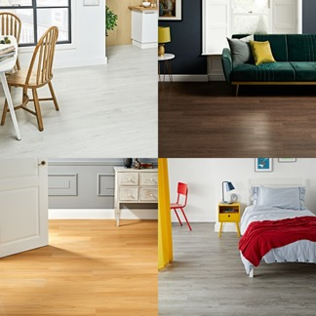
The photo does not look right. Can you match the original?

