Slide 1
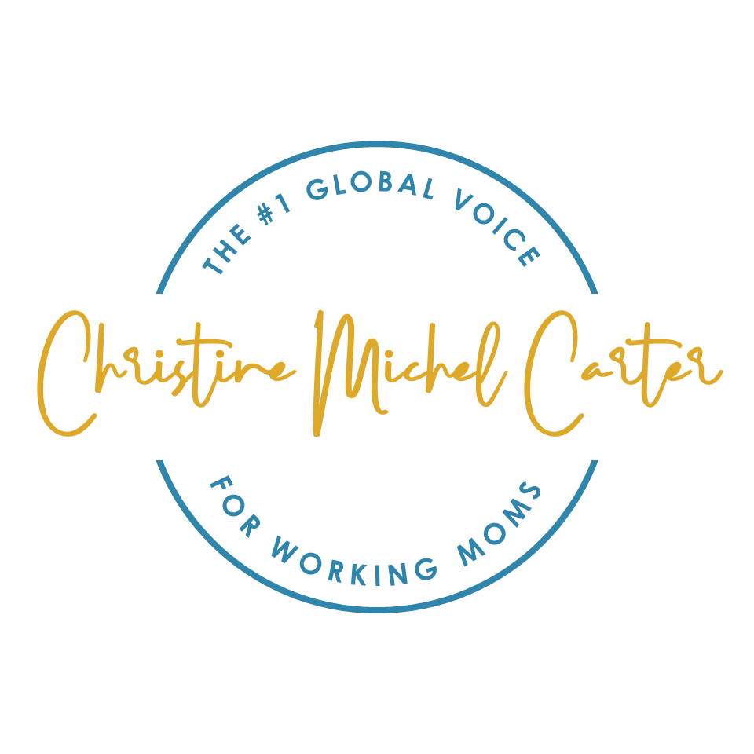
Brand Playbook

Slide 2
The Elevator Pitch
Christine is “the bridge.” She elevates the honest truths of working motherhood and provides these women with a space to share their honest stories and magnifies them, to inspire real social change.

Slide 3
Right to Win/Reason to Believe
Featured in The New York Times and The Washington Post, best-selling author Christine Michel Carter is the #1 global voice for working moms.
For over 15 years Christine has served as a consumer marketing expert, promoting products and services for organizations. She is also an expert in working parents, strengthening the relationship between companies and these hardworking professionals. Her Fortune 500 clients include Google, Walmart and McDonald’s.
Christine’s voice transpires across miles into the heart, mind, and soul of moms everywhere. She has written hundreds of articles with over one million views. Her writing has reached parents and working families in more than 150 countries.
Christine regularly contributes to ForbesWomen as a senior contributor, having written over 100 articles with 500K+ views. She has also written for a variety of publications, including TIME, Entrepreneur, HuffPost, Health, and Parents.
Most importantly, as a working mom herself, at home she’s Mommy to Maya and West- the two cutest damn kids on the planet.

Slide 4
Brand Strategy
Brand Goal: To become a mainstream global voice for moms.
Brand Value: Make women feel that they are not alone.
Brand Vision/Promise: Make working moms feel confident and understood.
Brand Mission: Change the narrative of what it means to be a mother.
Brand Positioning: Christine is “the bridge.” She uncovers the truth about why working moms struggle to climb the corporate ladder and why mom entrepreneurs (especially mom entrepreneurs of color) struggle to scale their small businesses. Christine provides a space for both of these groups to share their honest stories and magnifies them to inspire real social change.
COVID has changed the future of work. In hopes of reducing burnout, Christine teaches women pushed out of the workforce how to transition from the “traditional notion” of corporate America into a thriving virtual/office hybrid that works for them, their employer and their children. She is passionate about clearing up misconceptions and elevating the voice of women in different spaces.
The primary focus is on telling the stories of other moms (especially influencers and bloggers).
Brand Messaging: The #1 Global Voice For Working Moms

Slide 5
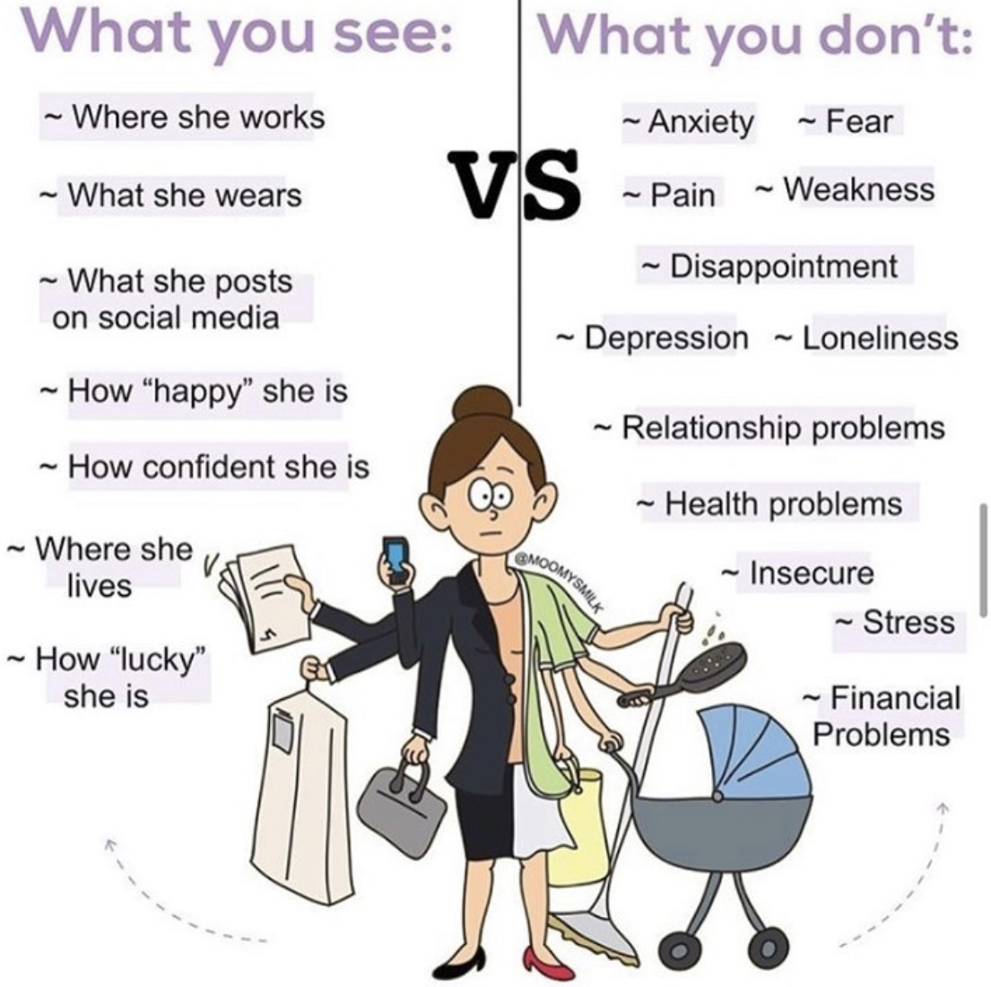
B2C Consumer Target
Who: 35-54 | Single | Mom w/ Two Kids at Home | Bachelor’s Degree or Higher | Annual Income of $70,000+ |Middle Class | Living in Texas, Florida, Georgia, North Carolina, Maryland, Louisiana, Virginia, South Carolina, Alabama and Mississippi
Prime Prospect: Black Moms
Need States:
  45% of single mothers are currently divorced or separated, 1.7% are widowed, 34% of single mothers never have been married.
  Into self-care and health and wellness. Looking for self-care, therapeutic spiritual moments. Enjoy gardening and working out. Want to reduce feelings of guilt, doubt, anxiety and depression, need a “sister circle”, “someone gets me” feeling.
  Independent (even if married), anxious and time-pressed. Often feels like an impostor in the office or at work, primary breadwinner for the multi-generational family. Restless, tense, anticipating and preparing for negative outcomes. Strong moms who place a high value on good parenting and are somewhat more likely than other generations to say being a parent is extremely important to identity.
  They’re passionate about their children, not feeling guilty for wanting to further their career. Ambitious and trying to change the world for their children. Vocal, outgoing, influential and involved nature. Don’t like when brands ignore the realities of today’s America.
  Put family first. Includes online and offline community, family and friends. Loving, with a reluctancy to trust brands.
  Spend a huge amount of time on social networking sites, more so than other races, and it’s because they engage with brands.

Slide 6
B2B Consumer Target
Who: 35-54 | HR Professional| Annual Revenue of $200M+ | Department Budget Of $30K+
Prime Prospect: Diversity & Inclusion Manager
Need States:
  Looking for a relevant, engaging facilitator. Christine understands the challenges of working moms and Black women and encourages them to have lively discussions. She is an open and honest Black mom keynote speaker who helps them be more assertive, confident and their own career champion. For those interested in achieving change within the organization and diversifying their corporate suppliers, Christine Michel Carter is a great choice.
  Need employee resource group programming/ Trying to create a culture of teamwork and respect. Multiple generations. Ethnic and cultural differences. These are just a few of the many factors that make workplace diversity a continual challenge for small businesses. The risk of lawsuits for failing to protect employees from harassment is real. Creating a culture of teamwork and respect will keep the work environment positive and productive. In addition, implementing a diversity training program is a must. Employers are responsible for setting standards of behavior in the workplace.
  Need a multicultural marketing strategy. Christine identifies opportunities to improve multicultural brand and enterprise health, and recommend specific initiatives that are market relevant to increase sales and contribute to brand equity. In addition, Christine develops marketing brand plan recommendations, ensuring that: marketing plans are strategically aligned (from a multicultural perspective), channel selections are planned, and an activation calendar has been carefully created by companies… with culturally accurate creative content.
  Need content marketing support. Christine Michel Carter has supported clients with the driving force behind high-quality SEO: content marketing. Many brands fail to pack a punch with black millennials and millennial moms. Christine is drafted in to breathe new life into them, improve them and help them evolve. She provides a fresh and impartial perspective on the pros and cons of a company’s brand. Therefore, she can suggest and implement effective branding solutions that transforms organizations.

Slide 7
Pain Point and Competitors
Consumer Target | Competitor | Pain Point/ Jobs To Be Done | Solution/Offering
B2C | Informal: Spouses, family, mom tribe, isolation (moms not looking for help, try to push through on their own) Formal: Rachel Hollis, Denise Albert, Scary Mommy, Mother Honestly, Motherly, Samantha Ettus, Eve Rodksy, Glennon Doyle | Feeling lost, alone, pressure of being primary caregiver, stress of balancing work and family Finding quality childcare and other resources Battling maternal mental health issues (anxiety, PPD) | Evaluate trends, data and companies to offer only the best recommendations Problem solves creatively, unafraid to change perspectives and break routine Teach women leaving due to the shecession and childcare crisis how to transition from a traditional notion of corporate America to a thriving virtual/office hybrid that works for them, their employer and their children Helping women prioritize, reduce stress, help them focus and ignore FOMO, improve productivity and time management, and even help with work-life balance as they create better boundaries for their workday Change the stigma and myth of single moms, ideas for others to support more single moms in healthier productive ways (helping with kid drop off and pick up), things not to say (who is the father), tax and federal laws that affect them
B2B | Kathy Buckworth Mary LoVerde Christine Carter Daisy Dowling | Retain working parents Ensure they’re addressing the needs of their workforce | Introduce resources, share government policies around paid family leave, childcare, etc. Encourage employers to be understanding and evaluate trends, data and companies to offer only the best recommendations

Slide 8
SWOT Analysis
Strengths: Unique brand positioning (embodies the personal brand) Strong emotional (empathy) and functional (data) benefit Great marketing and national press Communicate authentically w/audience Strong in social media and writing Seasoned managers and publicist | Weaknesses: Engagement decline Low brand awareness Training interns to transition social media Personal brand image (hair, makeup)
Opportunities: Obtain more global press Positioning as a thought leader and national/global media expert Increased referrals from existing customers COVID has changed the future of work. Teach women leaving due to the shecession and childcare crisis how to transition from a traditional notion of corporate America to a thriving virtual/office hybrid that works for them, their employer and their children | Threats: Competitors emerging as lifestyle influencers bleed into working mom and B2B space The rise of popular female CEOs having children and becoming thought leaders

Slide 9
Opportunities To Address
Brand Awareness
  Distribution expansion of MOM AF
  Sequel to MOM AF
  Short Form and Traditional Media
  Branded Digital Content (e.g. music, YouTube, podcast)
  TV/Film adaptation of MOM AF
Thought Leadership
  Media Analyst
  Purpose-driven
  TV Strategy (podcast or MOM AF into TV adaptation)
  State of Black Mothers in America
  Boutique/Popcorn products (automated and tripwire offers, merch, exclusive consumer subscription offering)
Strategic Partnerships and Business Development
  Product Development (execute design thinking with a major brand)
  Corporate Partnerships
Notes:
Short Form and Traditional Media
Short form content can be define as 1-15 minutes pieces of content mainly formatted for social media platforms such as YouTube, Facebook, etc. Most likely the short form format is ideally 2-5 minutes and hyper focused on a particular topic, e.g. day in the life of a working mom, helping children with new school homework, balancing love life with single parent hood, the realties of co-parenting, etc. Short form content can be used to pilot long form content ideas such as 22 min TV shows, featured documentaries, movies, etc.
Branded Digital Content or Podcast
Branded Digital Content refers to content created for, and in conjunction with corporate brand partners. The content can have multiple formats but serves as a method of selling a product, service or growing brand awareness for a corporate partners.
Lets review the deck and discuss:- How do we attach a solution or long term strategy? You know, the “to what end?” approach. A huge part of motherhood is affected by dads, marriage, partners…. should we make relationships part of our brand approach? 45% of single mom, that stat is daunting should we attempt to discuss and focus on this in an overt manner? -B2B slide, lets discuss-Need to understand your bandwidth and be a bit more clear about what we need to prioritize, develop and evaluate-Lets discuss product line -LOVE the tone slide … agree 100% the relatability is huge asset

Slide 10
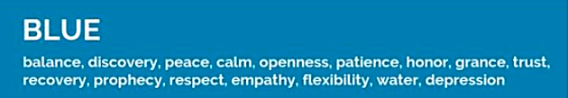
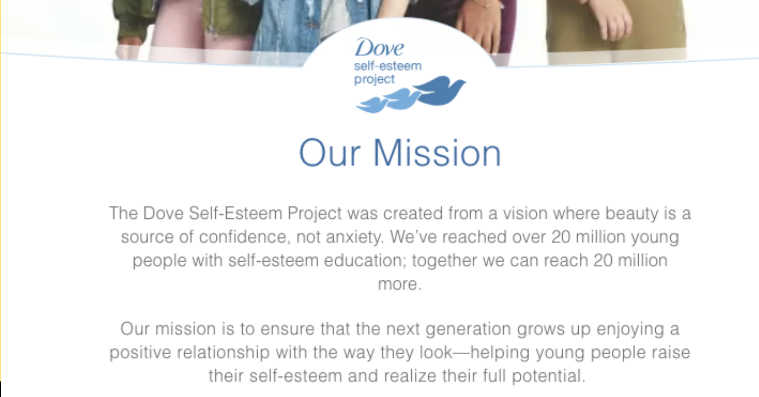
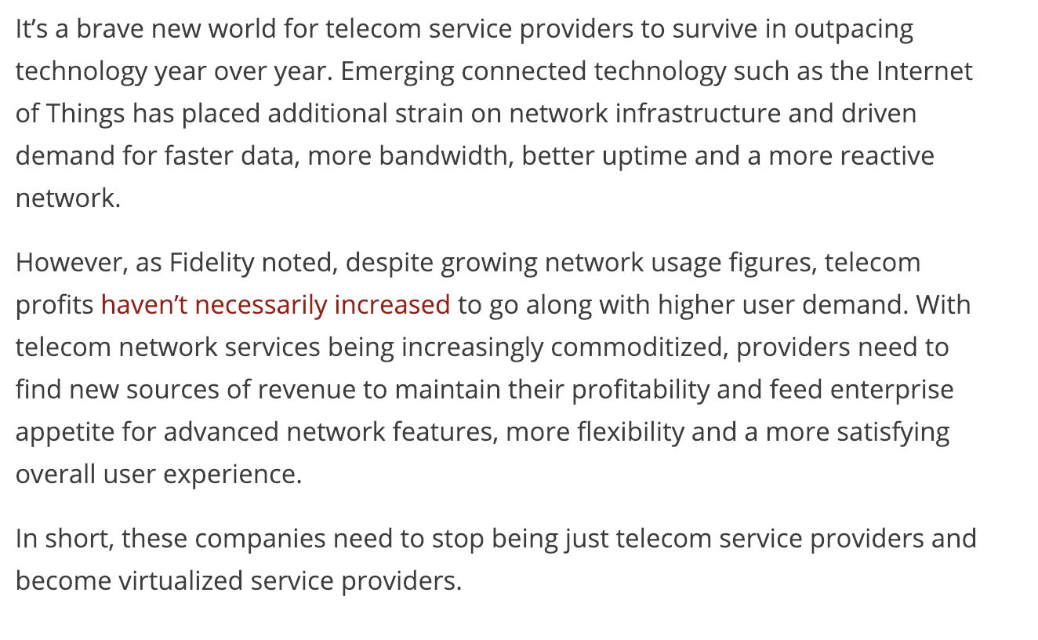
Tone Of Voice and Personality
Inspirational/motivational, connector, curator, savvy + edgy, fun, engaging, aggregator, elevating
Prophecy
  Smart, optimistic and looking for the most out of life
  Problem solves creatively, unafraid to change perspectives and break routine
  Innovates freely, willing to experiment with new ideas
  Evaluates trends, data and companies to offer only the best recommendations
  Trustworthy and principled
Balance
  Empowering, uplifting, and encouraging
  Promotes wellbeing to improve the lives of children
  Approachable; encourages two-way communication that demonstrates personality
  Aware of the depression, anxiety and mental health challenges of today’s working mother
  Conversationally concise without being flowery or complex
Empathy
  Not shy or afraid to be bold and go big
  Respectful of the many ways working mothers choose to run their homes
  Understanding and vocal about disproportionately affected, marginalized groups
  Inclusive, not intimidating or judgmental
  Easily improves and creates connections through available resources

Slide 11

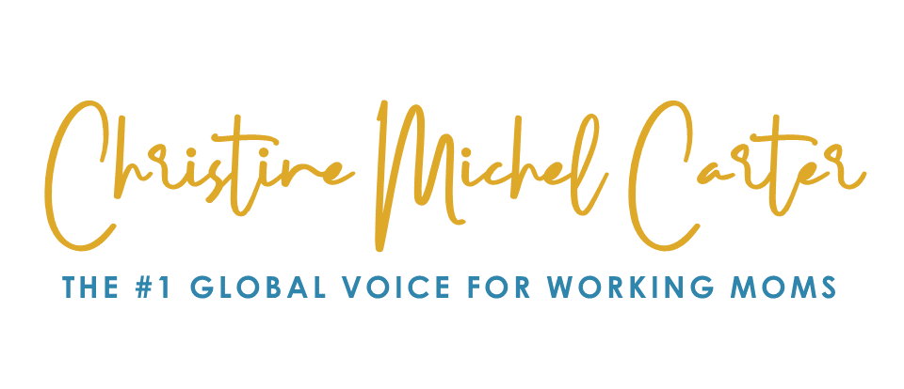
Design Guide
Typeface: Century Gothic for text. Tiara Black Demo for headlines.
Canva: Poppins Light or Poppins Medium. Oregano for handwriting.

Slide 12

Brand Colors
R: 6
G: 22
B: 74
R: 48
G: 133
B: 172
R: 222
G: 169
B: 41
R: 238
G: 212
B: 146
R: 245
G: 247
B: 246
R: 67
G: 67
B: 67

Slide 13

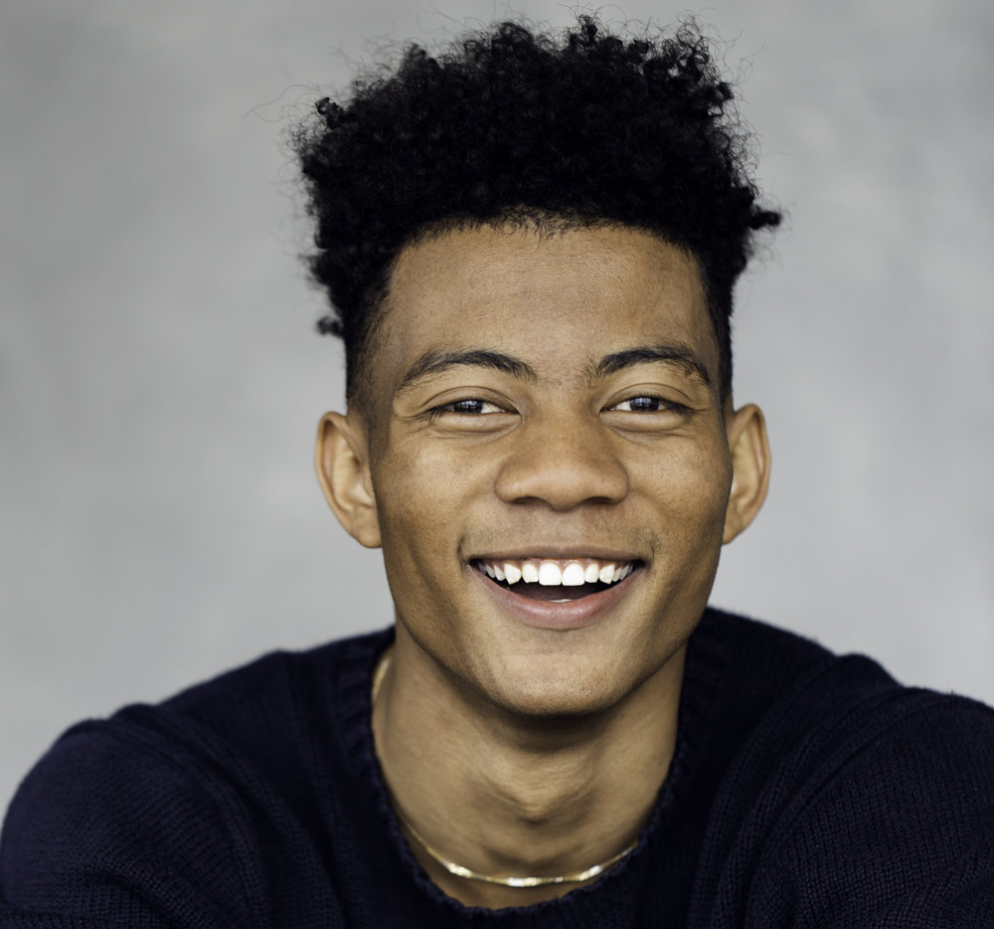

Content Marketing Images
Macro portrait or product photography
Very clear and sharp, saturated, vivid
Robust with color
Grouping of items
2/3 or closeup
Graphics should be the same
Diverse families also play a key role in our cultural photography
Our photography style is light, airy and natural. We use natural light whenever possible

Slide 14
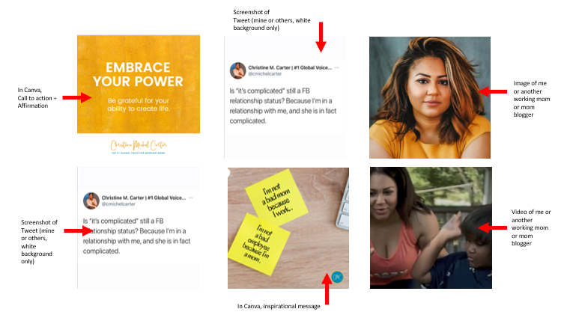
Social Puzzle
Notes:
IG: Screenshots of tweets, screenshots of other working mom’s tweets (and give them credit)
FB: CMC templates, share from other working moms and publications

