Slide 1


AdStash
Your Pathway to Programmatic DOOH
WWW.ADSTASH.COM
BUY ON ADSTASH
Info@AdStash.com
1-905-903-6766

Slide 2






DOOH NOW
DOOH is the “now” frontier of digital advertising, and your advertisers will soon be demanding it, if they aren’t already.
Consumers are ready to leave
their homes and spend.
Walking/driving behavior way up
Consumers plan to spend 25% of their lockdown-induced savings this summer
Screen fatigue, changing data privacy landscape driving budgets away from mobile/display
Brands are ready to
follow their consumers.
%
increase in DOOH spending in 2021
60
$
projected 2021 DOOH spend in the U.S. alone.
3B

Slide 3







DOOH NOW
But it’s not just lockdowns ending - this uptick has been driven by the unique effectiveness of DOOH ad exposure.
It’s special...
It’s powerful...
And it works.
Forced dwell time
100% viewability by
humans, not bots
Not Skippable
Brand-safe → brand loyal
Lends well to creative messaging
Vs. traditional OOH, DOOH 2x
more likely to be
seen, recalled,
2.5x
more impactful.
~100%
increase in reach if
added to
“OMNI-Channel”
campaigns

Slide 4




DOOH NOW
Despite this exploding interest in DOOH, several crucial issues persist for players trying to make use of this channel.
Premium pricing on the largest publisher networks makes adding this channel cost-prohibitive
Medium-sized publisher
networks either force advertisers to use their in-house DSP, or favor clients who use said DSP
Rare to find screen
networks with even basic analytics, optimization capabilities

Slide 5
AdStash’s platform unlocks DOOH for your brands and advertisers, programmatically, at scale.

Slide 6
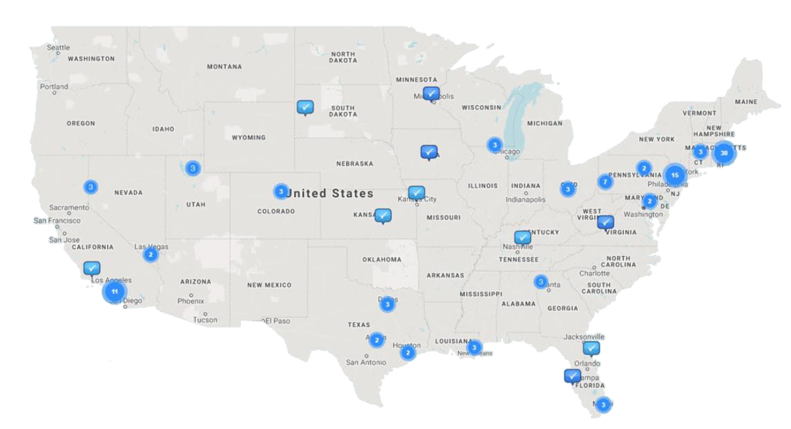
REACH
AdStash is your DOOH partner, connecting your partners and advertisers to a nation-wide network of place-based screens.
Our network, today
Our network, soon
23B+
251,000
203,000
Q4 2021
Impressions Annually
Today
181,000
Q3 2021
135,000
Q2 2021
50
70,000
106,000
Q1 2021
DMA’s
55,000
Q3 2020
Q4 2020
DIGITAL SIGNS
48,500
Q2 2020
55,105+
1,000
Q1 2020
800
Q4 2019
Venues
100
250
Q3 2019
Q1
2019
Q2 2019
61,410+
Screens
Q1
Q2
Q3
Q4
Q1
Q2
Q3
Q4
Q1
Q2
Q3
Q4
2019
2020
2021
2022

Slide 7













AUDIENCES
AdStash’s network exposes your advertisers’ messaging to a large, varied, unique set of audiences.
Audiences...
...you can buy anywhere...
...however you’d like.
High net worth
Open RTB
Sports Fans
Programmatic Guaranteed
High dwell time
Private Marketplace
And many more

Slide 8



TECHNOLOGY
AdStash superior technology and seamless integration delivers class-leading campaign performance.
For exchanges
Fast, functional integration
Reliable, High Performing Inventory
Robust
Analytics
Lower CPM’s
Have our inventory available to your clients in 4 weeks, in time for end of Covid
3 integration paths:
- openRTB
- VAST tags
- or a Custom API
100% fill rate
Quality controlled
Honest viewability reporting
$6 avg. on AdStash
$9-32 elsewhere
...often for the same screens
X screens with Linkett technology
Rest have x type of analytics
Up and running
in no time!
Budgets
will spend!
Budgets will
go further!
More data!

Slide 9








INVENTORY HIGHLIGHTS - MEDICAL
Point of Care Clinics
Medical Imaging Centers
Massive scale
Exclusive to AdStash
5000 screens
50 screens
3M impressions/month
400k impressions/month
Busy during lockdown
Nationwide
Northeast U.S.
College grads
high dwell time

Slide 10
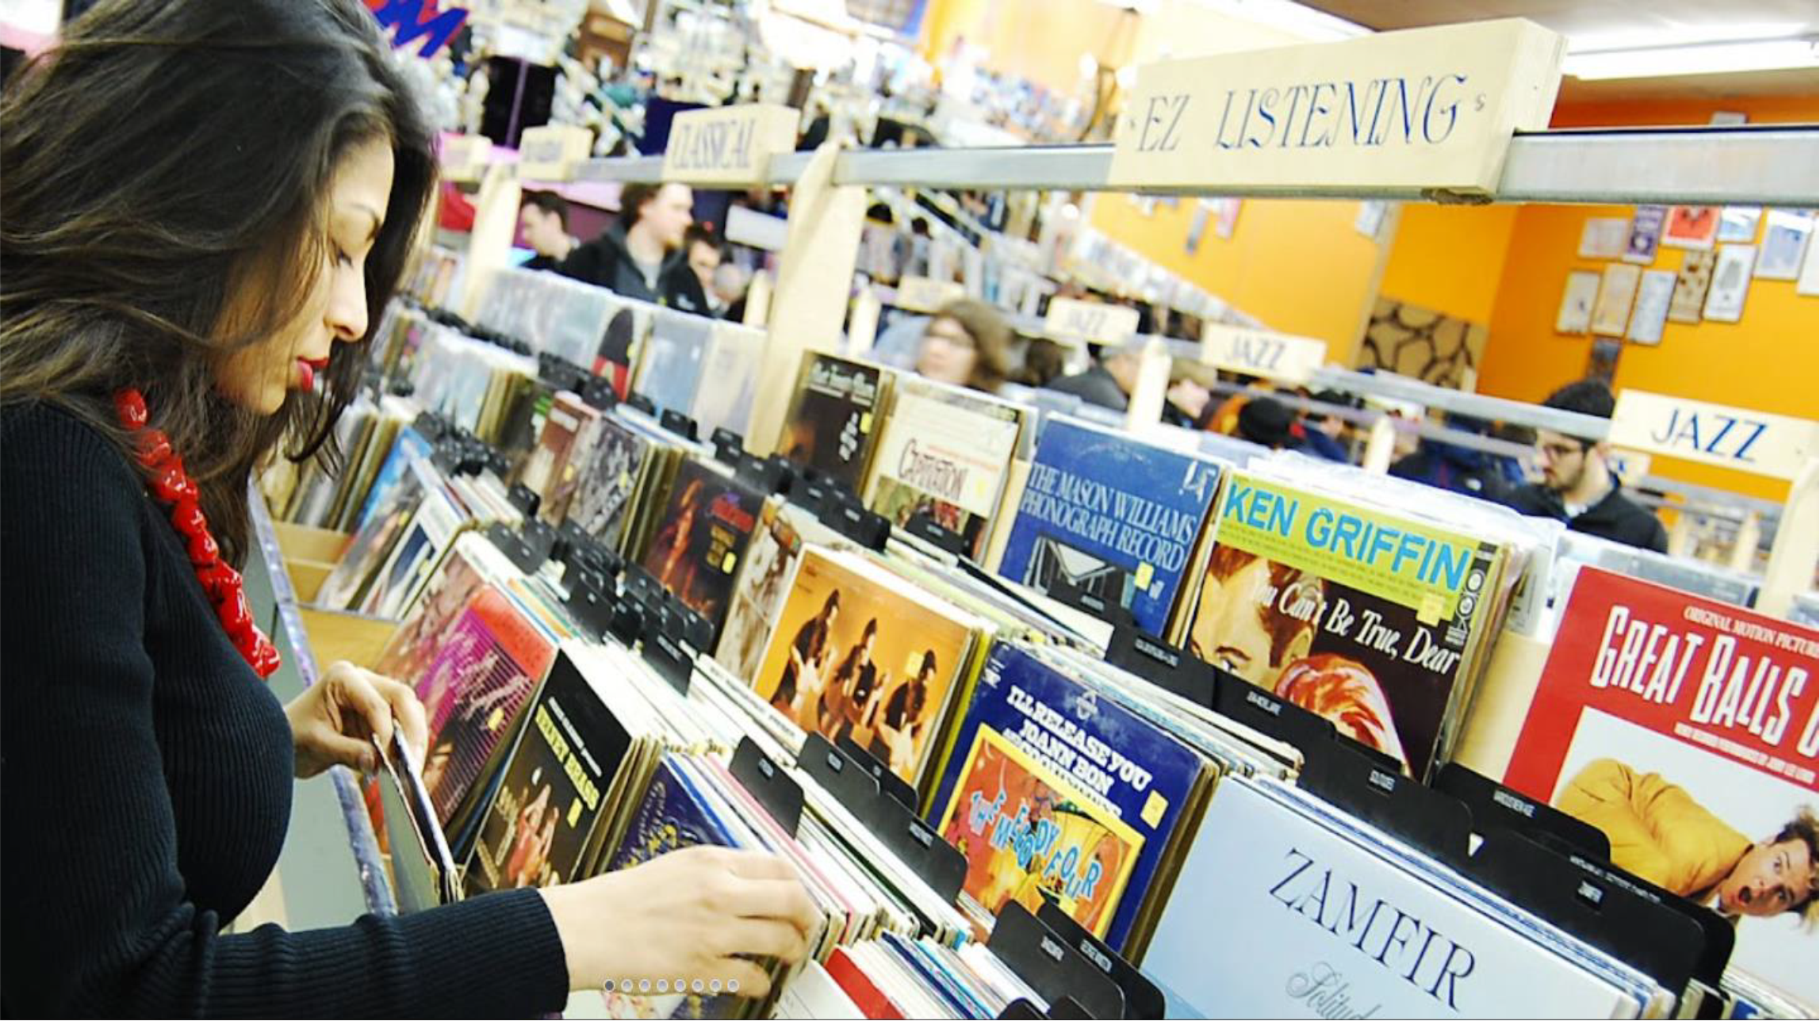
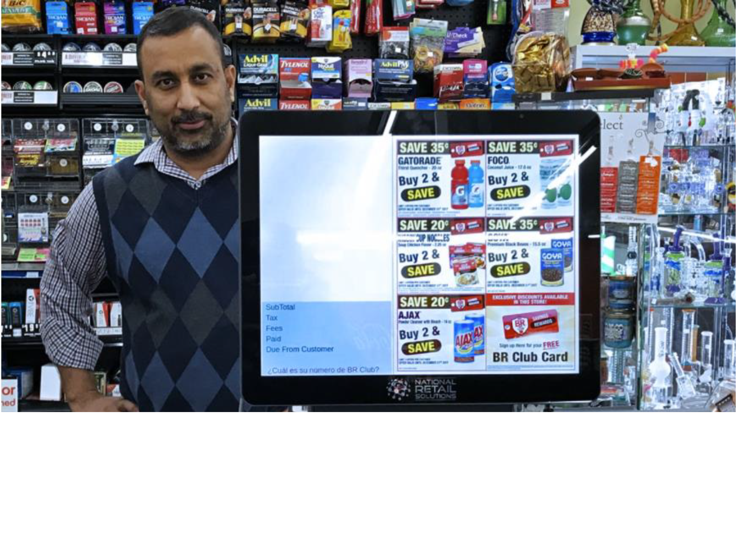


INVENTORY HIGHLIGHTS - RETAIL
Urban Record Stores
Grocery
Exclusive to AdStash
Exclusive to AdStash
Exclusive to AdStash
X screens
X screens
Close to point of purchase
X impressions per month
X impressions per month
Nationwide
Northeast U.S.
High income
Multiple visits/month

Slide 11
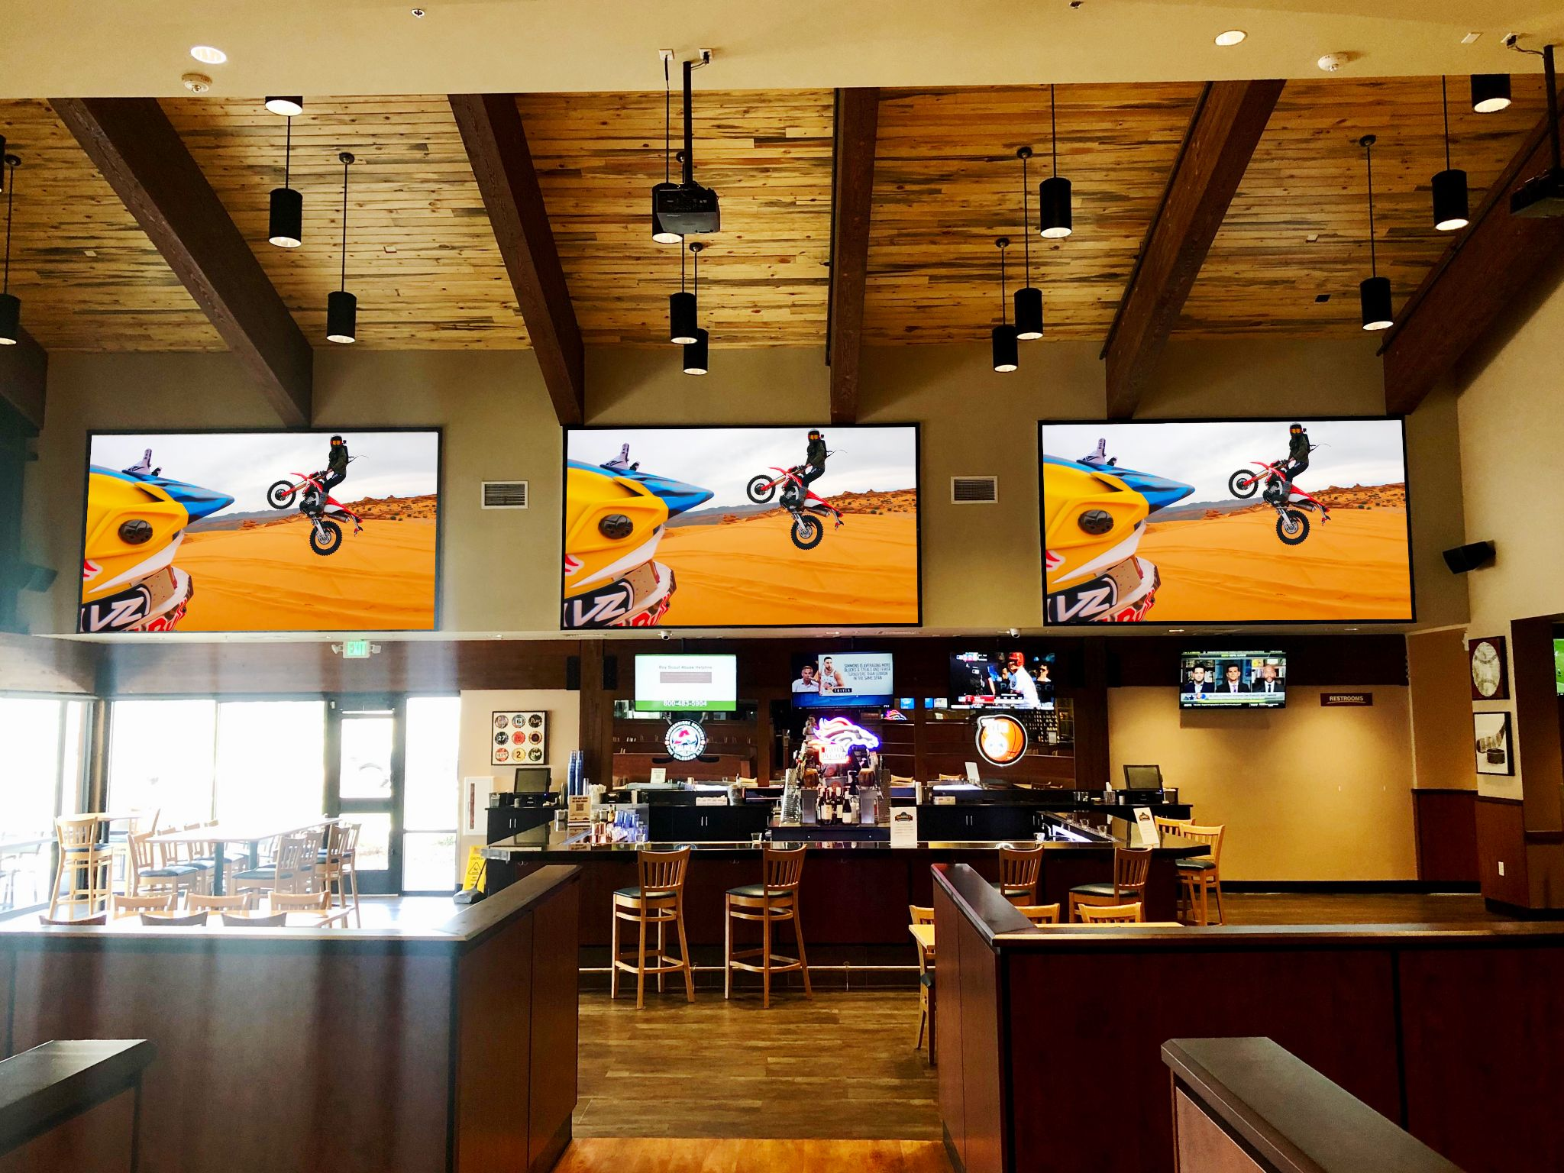
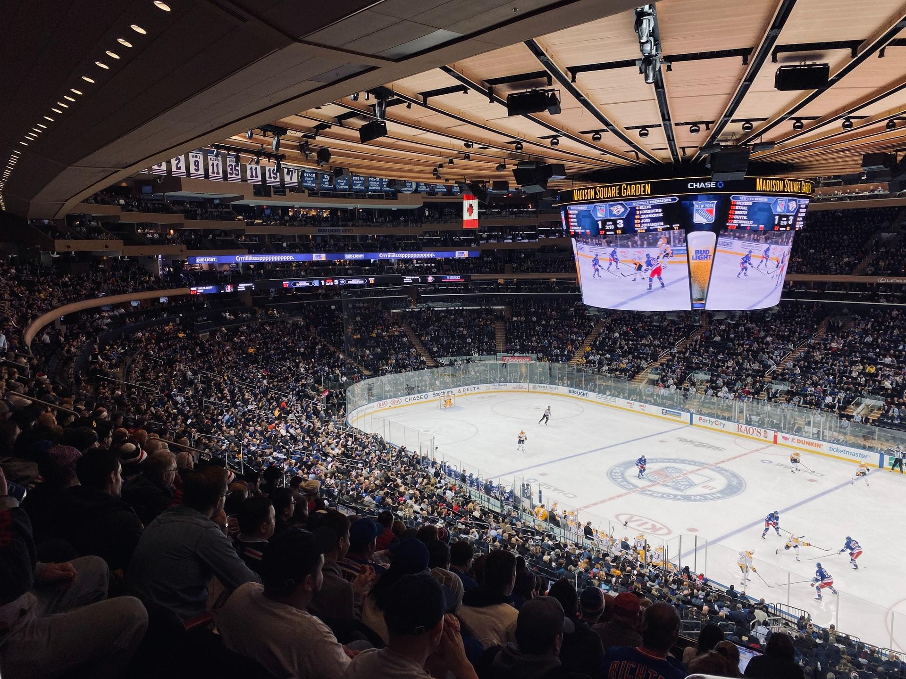

INVENTORY HIGHLIGHTS - ENTERTAINMENT
Bar/Restaurant
Sports Arenas
Massive scale
Exclusive to AdStash
X screens
X screens
X impressions per month
X impressions per month
Sports
Fans
Nationwide
Northeast U.S.

Slide 12
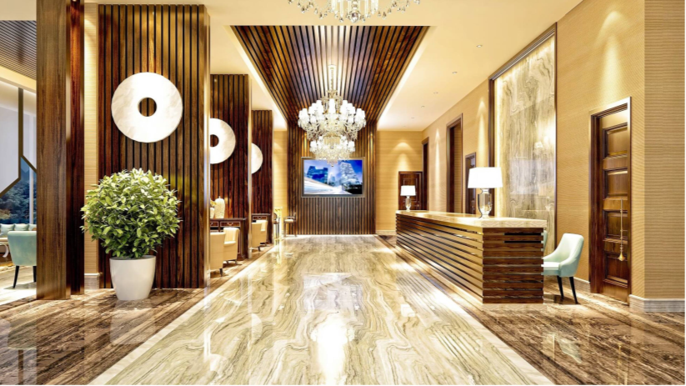
INVENTORY HIGHLIGHTS - HIGH NET WORTH
Private Airports
Exclusive to AdStash
X screens
X impressions per month
Nationwide

Slide 13






OUR PARTNERS
Our partners speak volumes
”
“Adstash powers our screen network within Wal-Mart pharmacies across Canada...we were able to serve 10M impressions through AdStash last year, which is huge for us...Adstash’s technology is so seamless, we just sit back and watch the revenue roll in.”
- Leo Virgone, GM
DOOH Publishers love us
”
“As we have grown our network to nearly 300 digital displays in over 100 sports arenas; AdStash has been a tremendous business partner. I highly recommend AdStash as the solution for anyone looking to build a screen network.”
- Brian Fitzgibbons, Co-founder and CEO
Brands we’ve worked with

Slide 14
YOUR COMPETITORS
Us
Our competitors are trash, emphasize own inventory
 | Feature 1 | Feature 1 | Feature 3 | Feature 4
AdStash | ✔ | ✔ | ✔ | ✔
Competitor 1 | ✔ | ✔
Competitor 2 |  | ✔ | ✔
Competitor 3 | ✔ | ✔ | ✔
DIAGRAM OF OUR SYSTEM
DIAGRAM OF THEIR SYSTEM

Slide 15
Digital Media Formats
Network
Indoor , 32” – 73” Screens
Full Screen Take Over
50% loop reservation for ads
Exclusively sold programmaticly
No Blacklisted Advertisers
Approval Upon Venue Review
Static ($5.5 CPM) & Video ($6.5 CPM)
The Right Time.
The Right Message.
The Right Audience.
Content Specifications
1920 pixels (w) x 1080 pixels (h) 16:9
1080 pixels (w) x 1920 pixels (h) 9:16
Static: PNG, RGB, encoded. JPG or H.264
Video: .MP$ / encoded .MOV
Ad Content Play Suggestions
15 second
30 second
60 second

Slide 16
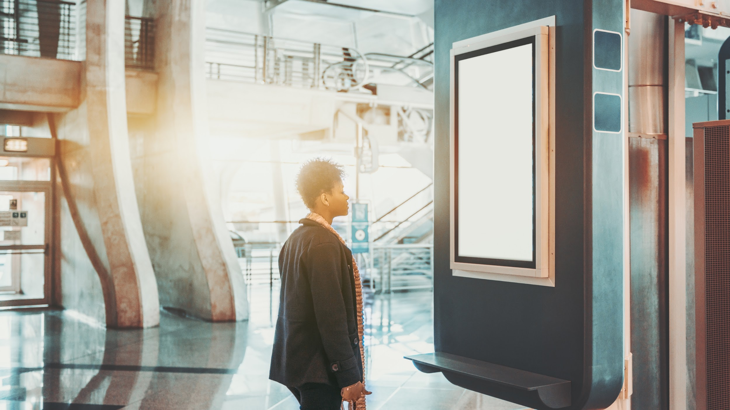
THANK
YOU
WWW.ADSTASH.COM
WORK WITH US!
david@adstash.com
1-905-903-6766

