Slide 1



Negative Impact
Contact Center Agents
Availability, Time, CSAT, Data Protection, CLV, Sales Conversion
Improvement
Informational
20%
Informational
>95%
Support
45%
Support
>95%
Availability
Availability
Sales
>98%
Sales
70%
Emergency
Catastrophic
Emergency
>99%
Informational
5%
Informational
5%
Support
35%
Support
5%
Wait Time
Wait Time
Sales
85%
Sales
10%
Traditional Security
Seqoria Advantage
80-85% Improvement Across the board
Emergency
10%
Emergency
90%
Informational
35%
Informational
0%
Support
65%
Support
10%
CSAT Impact
CSAT Impact
Sales
70%
Sales
10%
Emergency
80%
Emergency
5%

Slide 2
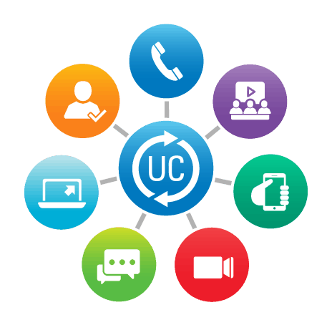
Negative Impact
Collaboration/Back Office User
Security, Adoption, Productivity,
Improvement
Internal
10%
Sales
40%
Security
Over 95%
Security
Regulated
90%
Non-Regulated
30%
Internal
60%
Sales
70%
Productivity
Productivity
Over 80%
Regulated
100%
Traditional Security
Seqoria Advantage
Non-regulated
65%
Internal
80%
Adoption
Retain Over 90%
Adoption
Customer Facing
10%

Slide 3
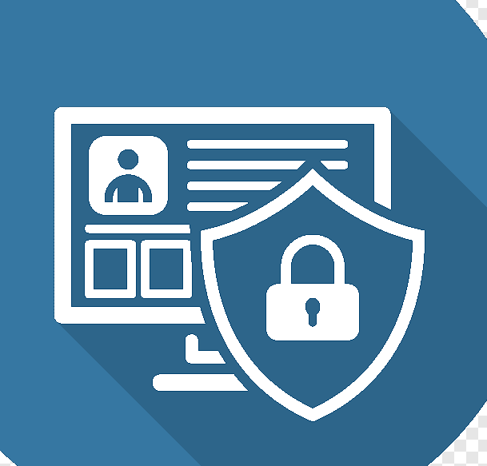
IT/Infosec
Security, Availability, Compliance, Operations, IR/DR, GRC
Time Spent
Time Saved
25%
Security
Security
Efficiency gain of 75%
30%
Availability
(IR/DR)
Availability
(IR/DR)
Efficiency gain of 50%
15%
Compliance
Traditional Security
Seqoria Advantage
Efficiency gain of 82%
Compliance
30%
Operations
Operations
Efficiency gain of 50%

Slide 4
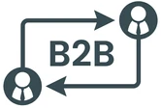
B2B Customers/Client
CSAT, Revenue, Retention, Adoption
Negative Impact
Improvement
Information
25%
Support
75%
CSAT
CSAT
Over 85% Improvement
Sales
90%
Information
10%
Support
45%
Revenue
Revenue
Over 80% Protection
Sales
85%
Traditional Security
Seqoria Advantage
Information
45%
Support
80%
Retention
Retention
Retain Over 90%
Sales
100%

Slide 5
Secured CX ROI – Transactional
Professional Security Services vs Seqoria SaaS
(for up to 10,000 Users Example)
 | Traditional Transactional Professional Services | Seqoria SaaS + Professional Services
Secured CX Assessment/Audit & Compliance | $190,000 | $124,500
Remediation & Integrated SOC workflows | $150,000 | $ 65,500
Robocalls, Communications Fraud, Secured CX Routing | $120,000 | Included
Total | $460,000 | $170,000 (63% Saving)
(for up to 5,000 Users Example)
 | Traditional Transactional Professional Services | Seqoria SaaS + Professional Services
Secured CX Assessment/Audit & Compliance | $120,000 | $69,500
Remediation & Integrated SOC workflows | $ 86,000 | $29,000
Robocalls, Communications Fraud, Secured CX Routing | $ 80,000 | Included
Total | $286,000 | $99,500 (65% Saving)
Projected Secured CX OPEX Savings (10,000 User Base)
First Year Savings : $290,000
Third Year Savings*: $870,000
Fifth Year Savings*: $1,450,000
Projected Secured CX OPEX Savings (5,000 User Base)
First Year Savings: $186,500
Third Year Savings*: $559,500
Fifth Year Savings*: $934,365
* Assuming growth in size, customer base, and upgrades over time

Slide 6
Secured CX ROI – Subscription
Professional Security Services vs Seqoria SaaS
(for up to 10,000 Users Example)
 | Traditional Subscription Services | Seqoria SaaS (Always on Security & Compliance) | Security/CX OPEX Savings
Secured CX Assessment/Audit & Compliance – 5K Users | $250,000 | $117,000 | $133,000 (53%)
Secured CX Assessment/Audit & Compliance – 10K Users | $370,000 | $162,000 | $208,000 (56%)
Robocalls, Communications Fraud, Secured CX Routing | $150,000 | Included | $150,000 (100%)
Projected Savings (5,000 User Base)
First Year Savings: $133,000
Third Year Savings*: $399,000
Fifth Year Savings*: $665,000
Projected Savings (10,000 User Base)
First Year Savings: $208,000
Third Year Savings*: $840,000
Fifth Year Savings*: $1,400,000
* Assuming growth in size, customer base, and upgrades over time

