Slide 1
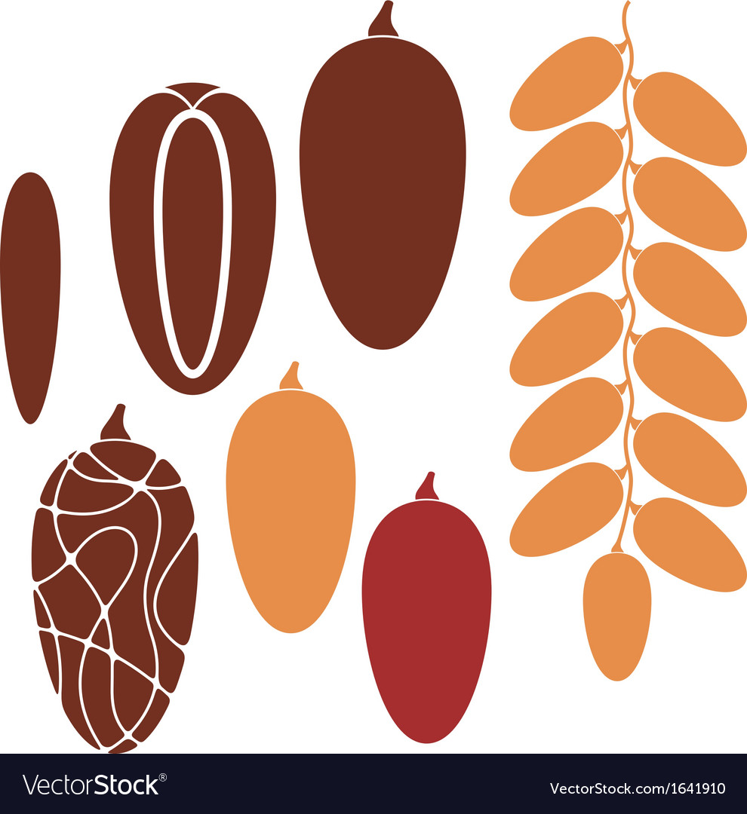

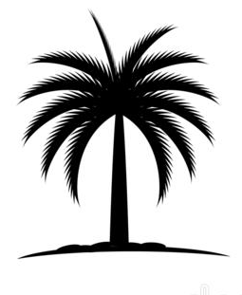
Design elements
Short Name
Dates
Fronds
Palm
ATC
Or
Or
Full Name
Arabian Tammary Trading Co.

