Slide 1
Independent financial advisory services tailored to your goals
ABC, XYZ – April 2021

Slide 2
ABC, XYZ – Growth of $1,000 vs Benchmark*
Benchmark = 45% xxxxxxxx, 15% yyyyyyyyy, 40% zzzzzzzzz

Slide 3
ABC, XYZ – Annual Returns vs Benchmark*
 | LECOM
 | 60/40 | Hudson | DE Shaw | 50/50
 | Benchmark | Bay | Composite | Hedge Funds
2011 | 0.6% | 4.6% | 4.8% | 4.7%
2012 | 11.3% | 10.5% | 14.5% | 12.5%
2013 | 16.0% | 8.2% | 12.3% | 10.2%
2014 | 6.1% | -2.5% | 15.5% | 6.5%
2015 | -0.1% | -1.7% | 14.6% | 6.5%
2016 | 7.2% | 4.6% | 5.7% | 5.2%
2017 | 13.9% | 9.2% | 10.4% | 9.8%
2018 | -3.8% | 6.6% | 11.3% | 9.0%
2019 | 19.3% | 7.7% | 10.7% | 9.2%
2020 | 12.1% | 15.8% | 19.6% | 17.7%
YTD 2021 | 2.5% | 8.2% | 5.1% | 6.7%
Benchmark = 45% xxxxxxxx, 15% yyyyyyyyy, 40% zzzzzzzzz

Slide 4
ABC, XYZ – Risk / Return vs Benchmark*
Return
Standard Deviation
Benchmark = 45% xxxxxxxx, 15% yyyyyyyyy, 40% zzzzzzzzz

Slide 5
ABC, XYZ – analytical data vs Benchmark*
 | 50/50 Hedge Funds | Benchmark
Annualized Return | 9.5% | 8.1%
Standard Deviation | 2.9% | 8.3%
Average monthly return | 0.8% | 0.7%
Largest monthly gain | 9.6% | 7.7%
Largest monthly loss | -2.5% | -8.6%
Max drawdown (consecutive negative months) | -2.5% | -12.5%
% months of positive returns | 86% | 72%
max # of months of consecutive loss | 2 (twice) | 5 (once)
Monthly standard deviation | 0.8% | 2.4%
Min annual return with 99% probability | 3.7% | -8.5%
% years outperformed 60/40 benchmark | 60%
% months outperformed 60/40 benchmark | 65%
R Square against benchmark | 8% | 100%
Benchmark = 45% xxxxxxxx, 15% yyyyyyyyy, 40% zzzzzzzzz

Slide 6
ABC, XYZ vs Benchmark* – monthly volatility
Benchmark = 45% xxxxxxxx, 15% yyyyyyyyy, 40% zzzzzzzzz

Slide 7
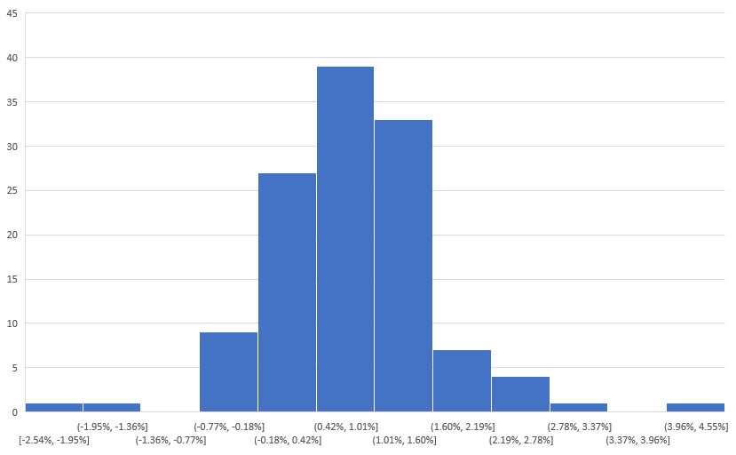
ABC, XYZ – Return distribution

Slide 8
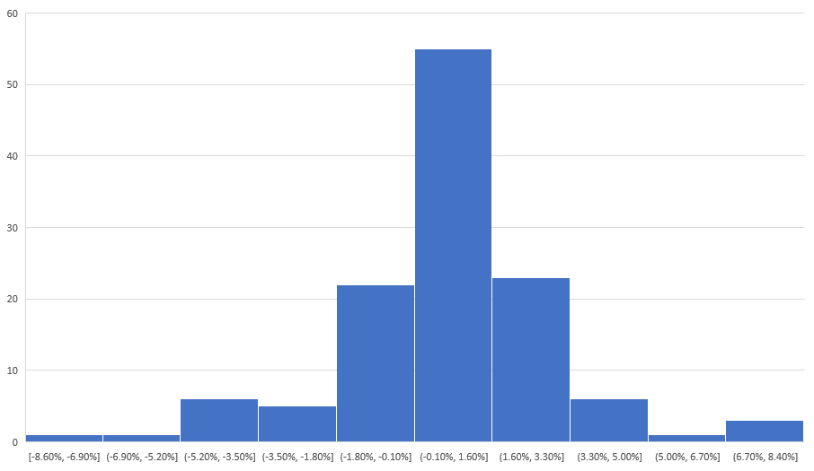
Benchmark* – Return distribution
Benchmark = 45% xxxxxxxx, 15% yyyyyyyyy, 40% zzzzzzzzz

Slide 9
Disclaimer
Disclaimer: this document is a general communication being provided for informational purposes only. It is educational in nature and not designed to be as advice or a recommendation for any specific investment product, strategy, plan feature or other purpose in any jurisdiction. Any examples used are generic, hypothetical and for illustration purposes only. This material does not contain sufficient information to support an investment decision and it should not be relied upon by you in evaluating the merits of investing in any securities or products. In addition, users should make an independent assessment of the legal, regulatory, tax, credit, and accounting implications and determine, together with their own professional advisers, if any investment mentioned herein is believed to be suitable to their personal goals. Investors should ensure that they obtain all available relevant information before making any investment. Any forecasts, figures, opinions or investment techniques and strategies set out are for information purposes only, based on certain assumptions and current market conditions and are subject to change without prior notice. All information presented herein is considered to be accurate at the time of production, but no warranty of accuracy is given and no liability in respect of any error or omission is accepted. It should be noted that investment involves risks, the value of investments and the income from them may fluctuate in accordance with market conditions and taxation agreements and investors may not get back the full amount invested. Both past performance and yields are not reliable indicators of current and future results.

