Slide 1
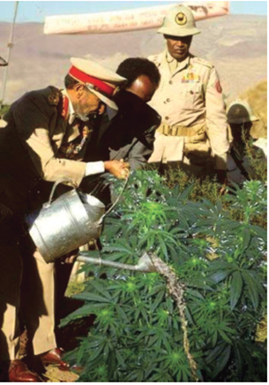
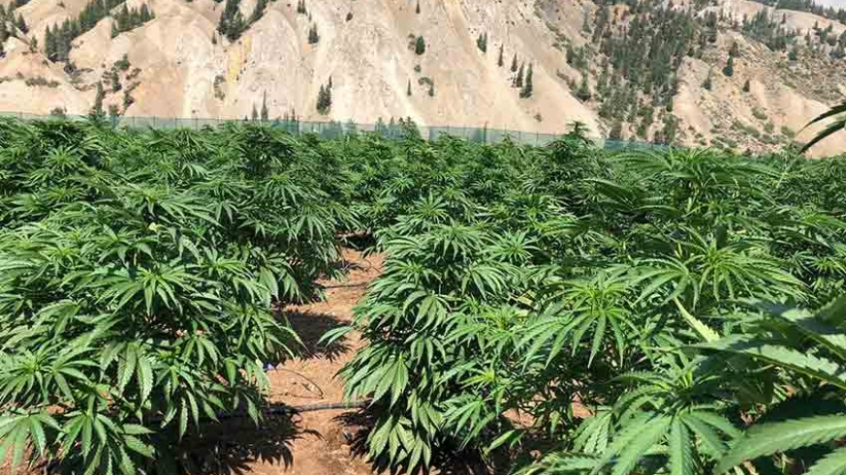
Change the background, make it a weed field or farm, as the following image below.
Remove personnel in uniform and add a worker/farmer
Put the following Quote at the bottom or top. “Our youth must be steadfast and take advantage of the benefits of modern civilization. Do not fall prey to idleness for it shall be a curse to you and to succeeding generations. You must set yourselves us as examples of determination and hard work. Plan your time and use both your physical and mental powers purposefully and productively”. Haile Selassie

