Slide 1




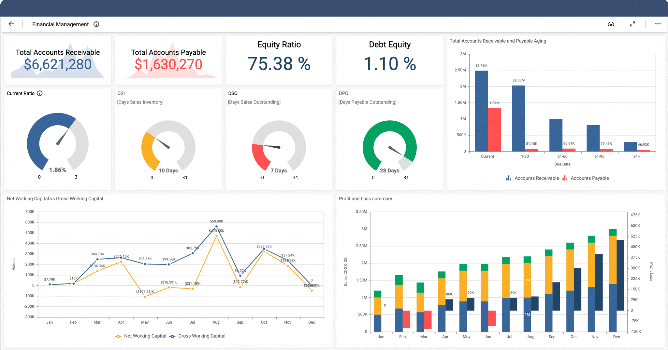





FYI – OpsTrakker is the software name
where as eDatasheet is a module inside of the software. Both logos should be somewhere on the flyer
Manual Data Entry into an OSIsoft PI System
Need graphic representing handwritten entry of data on a paper form
Dashboard with charts and graphics on where data goes.
Would like to visually capture how information on left is turning digital on right (data/bits). We don’t like arrow above hopefully gives you an idea
Must Include OSIsoft partner logo on the right side. Does not have to be really big.
Text to include:
Enable Manual Data Entry into an OSIsoft PI System with the following features:
Intuitive User Interface
Enter Free form comments
Select preconfigured text (e.g. Reason Codes)
Edit values once written to PI (Optional based on Security)
Configurable security model
Web Based Design for Desktop or Mobile devices
Save data directly to PI tags or AF attributes
Integrated with PI Vision
Example footer:
Enhanced Information Solutions Inc. (EIS)
North America Headquarters · 1725 Tower Drive, Suite 100 · Stillwater, MN 55082
European Headquarters (E.I.S. · GmbH Besselstrasse 25 · 68219 Mannheim, Germany
Telephone +1.651.351.9227 | +49.621.8455.235 | info@eisinc.com

