Slide 1
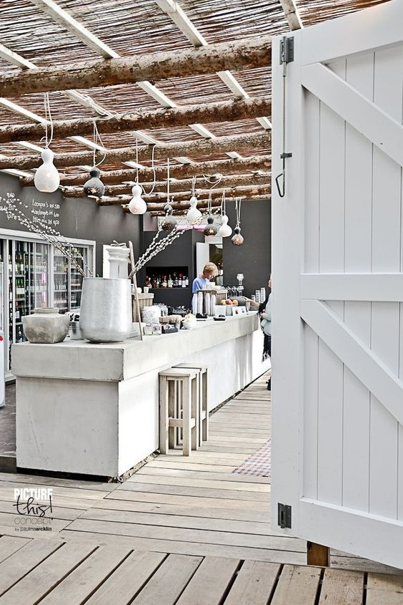
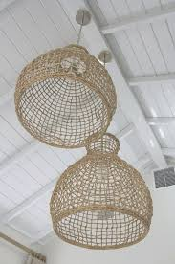
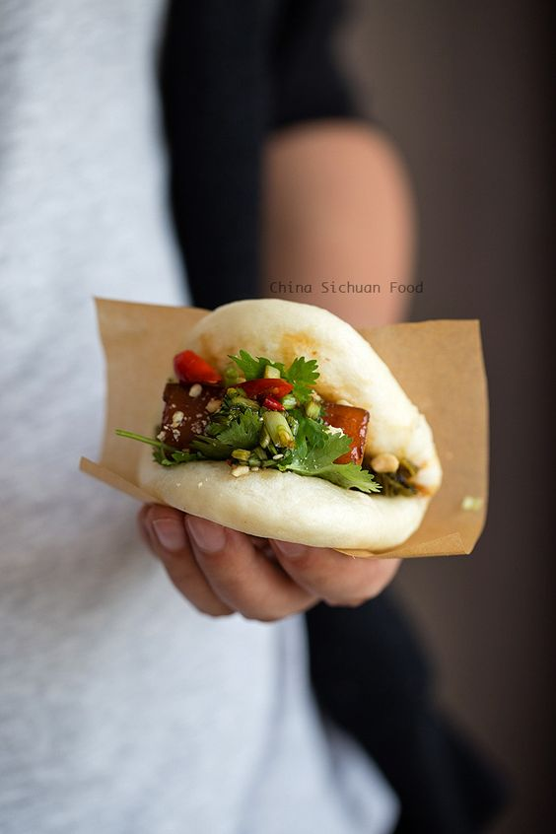
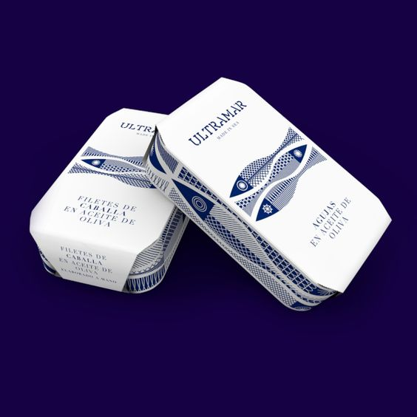
Seaview Restaurant New Seaside Experience
New exciting street food seafood options to takeaway
New stylish deli counter selling in house seafood products

Slide 2
Executive Summary
The ambition of the Seaview Restaurant is to create a new sensational and unrivalled seaside experience.
This new stylish space will showcase an innovative and fresh design to offer visitors a seafood destination like no other.
Creativity and quality will be evident as soon as the customer steps into this new venture making this an unforgettable
memory that will bring a whole new customer and attention to Saltburn and surrounding area.
We will offer the visitor something that is unmatched in this area attracting a totally new customer.
Our famous traditional takeaway menu will still be available, as well as an exciting quality street food menu for those
foodies looking for that more creative seafood offering.
An exciting new bespoke seafood retail delicatessen area will allow customers to choose from and enjoy a variation of
prepared items.
A newly appointed executive chef will look after the operation, providing in house products such as oak smoked salmon,
dressed crab, mackerel pate, prepared local lobster to take home.
A redesign of the ice cream counter will again focus on originality in design and products, providing the
customer with an unmatched unforgettable encounter when visiting the new venture.
We have appointed a new corporate branding company to provide a new ambitious identity for the Seaview
which will support our business in gaining national recognition for an outstanding creative seaside experience.

