Slide 1
Overview of the task
The following schematics of different printing techniques are to be included in my doctoral thesis in pharmaceutics and it is therefore of importance that the techniques are described accurately.
I am looking for a modern look and that all figures are having the same colors/color scheme to have a harmonized look throughout the thesis. I am not sure what colors I am looking for, but no super bright colors, I am thinking maybe blue/grey, but I am open for suggestions ☺
The printed object should always represent a printed round tablet and never a table etc. that now are shown in some of the example schematics.
If possible the schematics should be 3D schematics/pictures rather than 2D.
5 different figures should be made in total, 1/slide (slide 2, 3, 4, 5, and 6). I have on the different slides described the different techniques (some techniques are visualized with more than one picture, but only one schematic per technique should be made).

Slide 2
2D
Contact methods
Flexographic printing
Stencil printing
Non-contact methods
Inkjet printing (IJP)
Continuous
Drop-on-demand (DoD)
Thermal (TIJ)
Piezoelectric (PIJ)
Electrostatic
Acoustic
Solenoid valve
3D
Extrusion-based 3D printing
Fused deposition modeling (FDM)
Semisolid extrusion 3D printing (EXT)
Powder solidification 3D printing
Drop on solid deposition (DOS)
Selective laser sintering (SLS)
Liquid solidification 3D printing
Drop-on-drop deposition (DOD)
Stereolithography (SLA)
4D
3D printing + time
Inkjet printing
I would need an easy readable, but professional looking, overview table/figure of all of the printing techniques in the same color scheme as the rest of the figures. The three techniques that I now have bolded (piezoelectric inkjet printing, fused deposition modeling and semisolid extrusion 3D printing) are the techniques that I have used in the thesis so I would like for them to stand out/be highlighted in some way. I am not sure how to best make it easy for the reader to see the different main techniques (2D, 3D and 4D), maybe all of these should have a different color or can be separated in a different way?

Slide 3
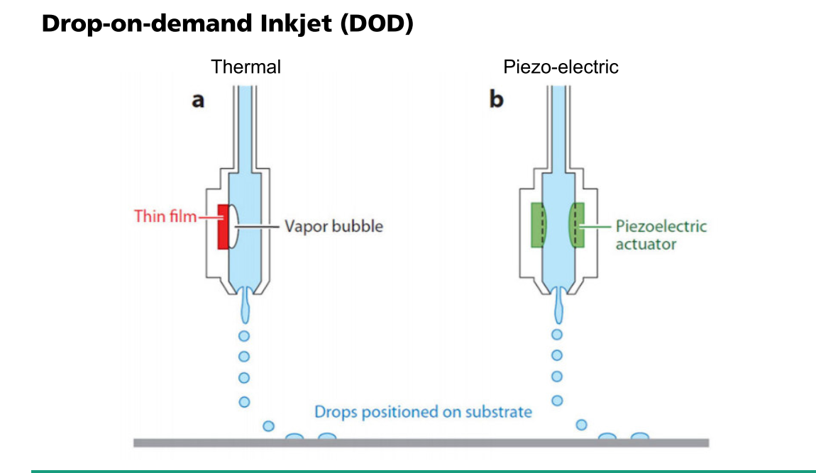
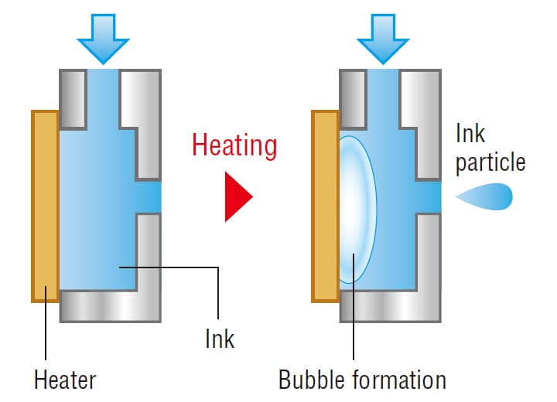
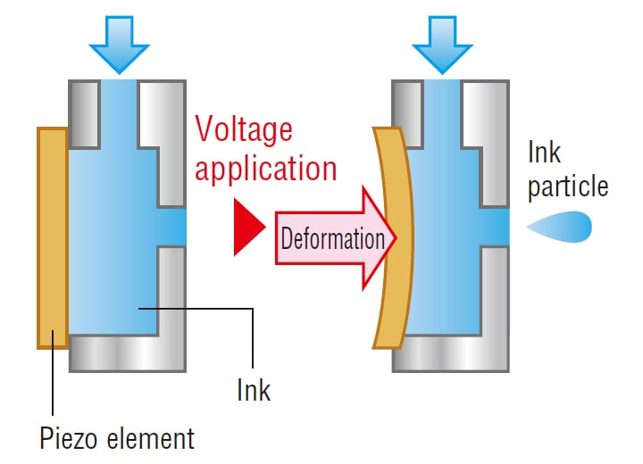
Thermal
Please use “ink droplet” or “droplet”, not “drop” or “particle”
Piezoelectric
Please use “vapor bubble formation”
piezoelectric element (please use this term not “piezo element”)
Piezoelectric
Please use the term “droplets” instead of “drops”
The grey is to be called “substrate”
General info: Please make a figure similar to the one above, but more “professional” looking. The two techniques are described in more detail to the left. However, I would like for the droplets to be ejected downwards, i.e. the nozzle is pointed down (as in the pictures above and not to the right side as in the pictures to the left.

Slide 4
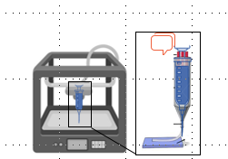
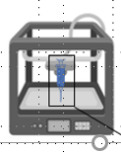
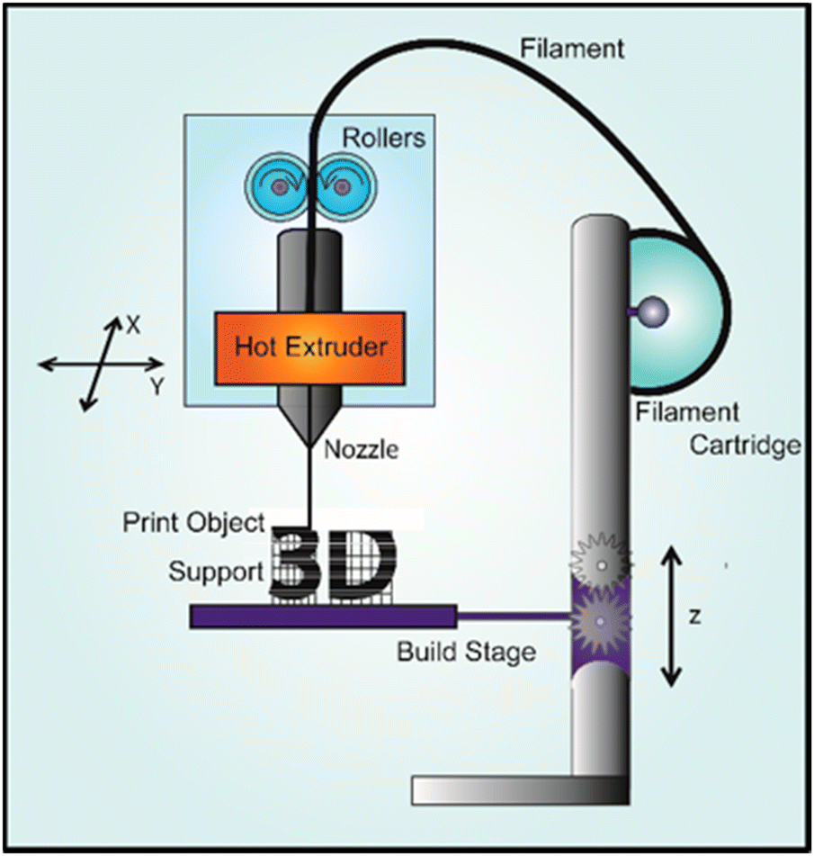
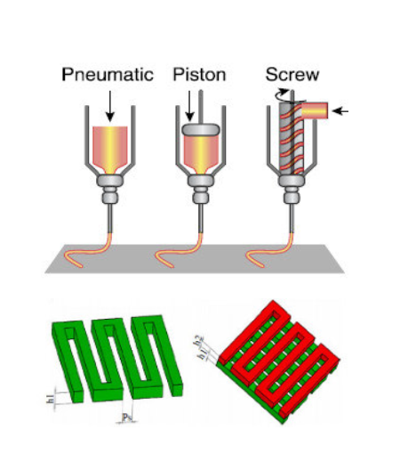
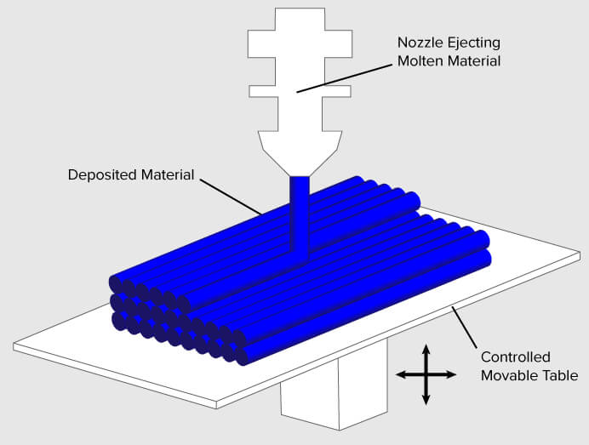
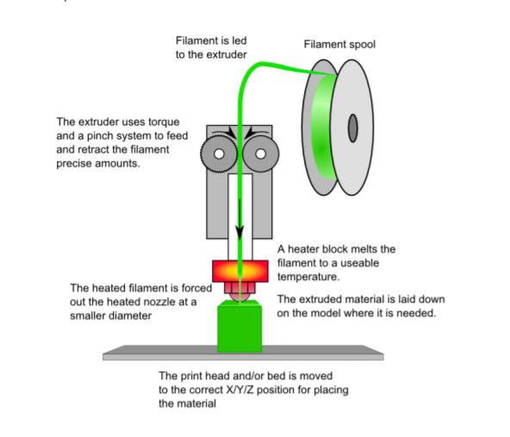

Two different techniques, but I would like them to be presented side by side in the same figure, the line in the middle is just here to make clear which picture belongs where and should not be included in the final figure.
This is how the printer could look like
This is how the printer could look like
Fused deposition modeling
Extrusion-based 3D printing
This is zoomed on how the technique works (3 different ways, but still all classified as the same technique).
This is zoomed on how the technique works
Please make the printed object a circle to imitate a round tablet being printed instead of a square. The printed object should visualize that the object is printed in a layer-by-layer manner as in the blue object to the right.
Filament spool
Please make the printed object a circle to imitate a round tablet being printed instead of a square.
Build plate
Insert round printed tablets here
This infill in a round shape, h1, h2 etc. do not need to be included
Another schematic of the same process to get a better understanding, (the lengthy descriptions are not needed)
This is just zoomed from here

Slide 5
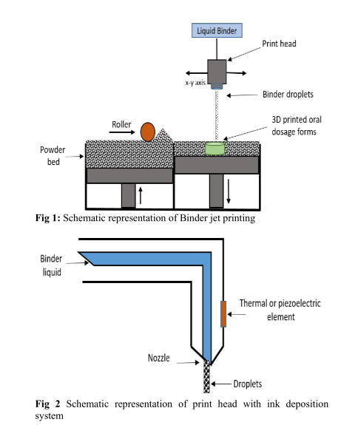
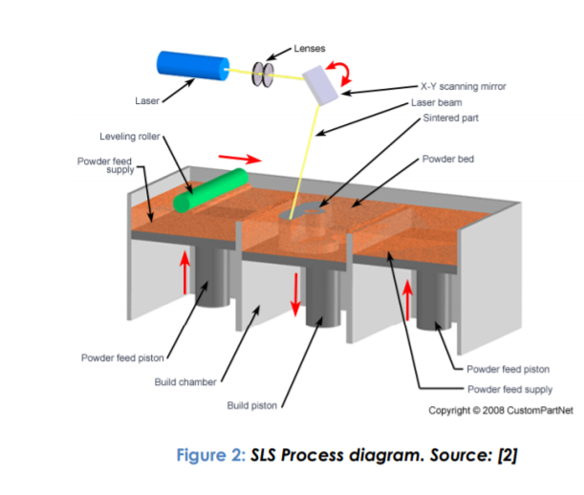
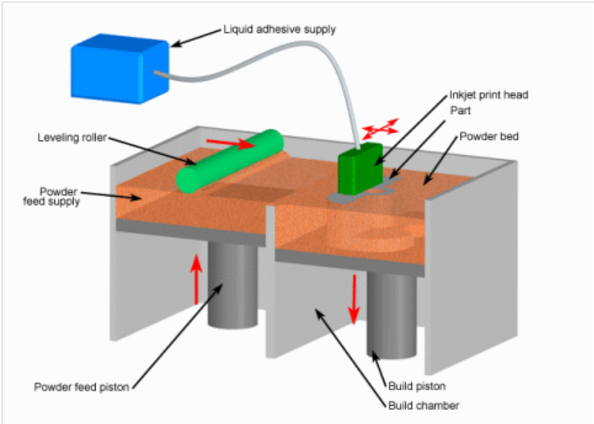
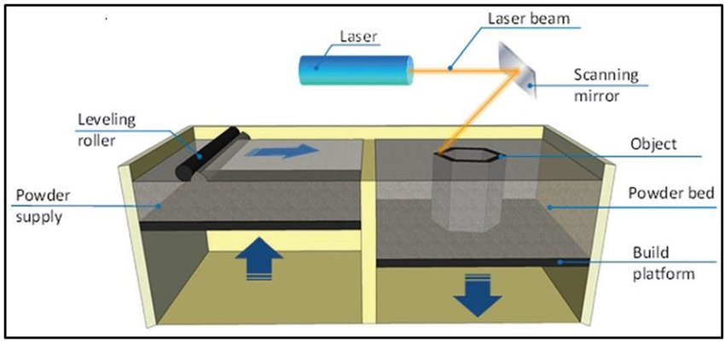
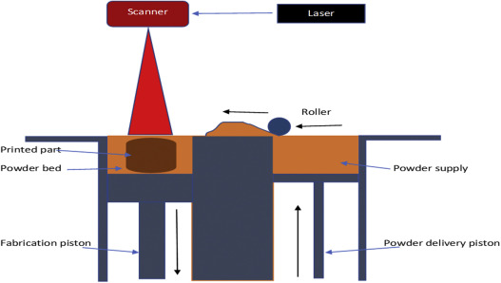
DOS
DOS and SLS and should be shown in the same picture.
SLS
Insert info that build plate moves in Z-direction (both DOS and SLS)
(DOS)
powder
This is zoomed in of the print head
This third section can be left out to look more similar as in DOS where only two sections are shown.
(SLS)
This utilizes the same technique as inkjet printing techniques, so similar representation of the nozzle can be used, but instead of “ink” please use “binder liquid” and please move the nozzle up and not below in a different picture as here. Text from Fig 1 and Fig 2 should be left out!

Slide 6
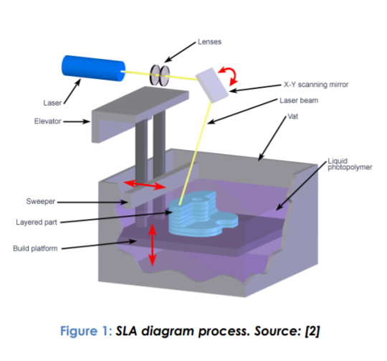
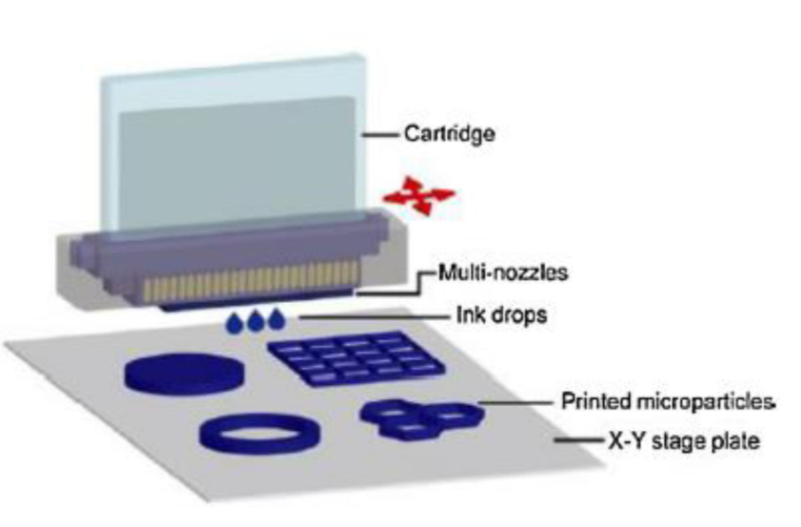
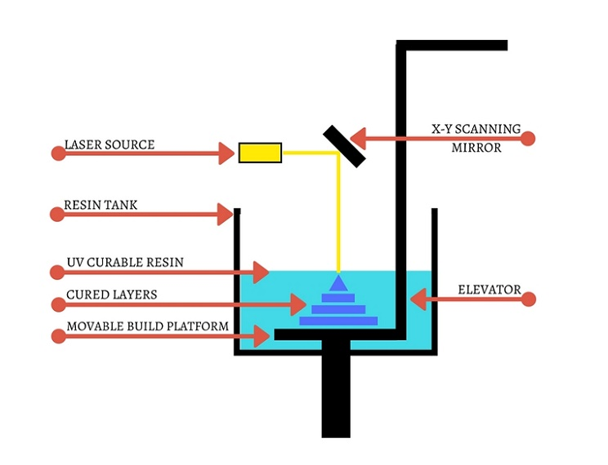
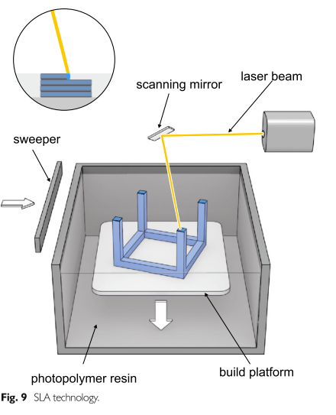
DOD
SLA
Ink droplets
X-Y build plate
Show only one nozzle (not the whole print head) similar as on slide 3 for inkjet printing, but instead here showing a solid printed object (tablet) instead of just deposited droplets. Again please use “droplets” instead of “drops”
Insert info that build plate moves in Z-direction
Use: build plate

