Slide 1
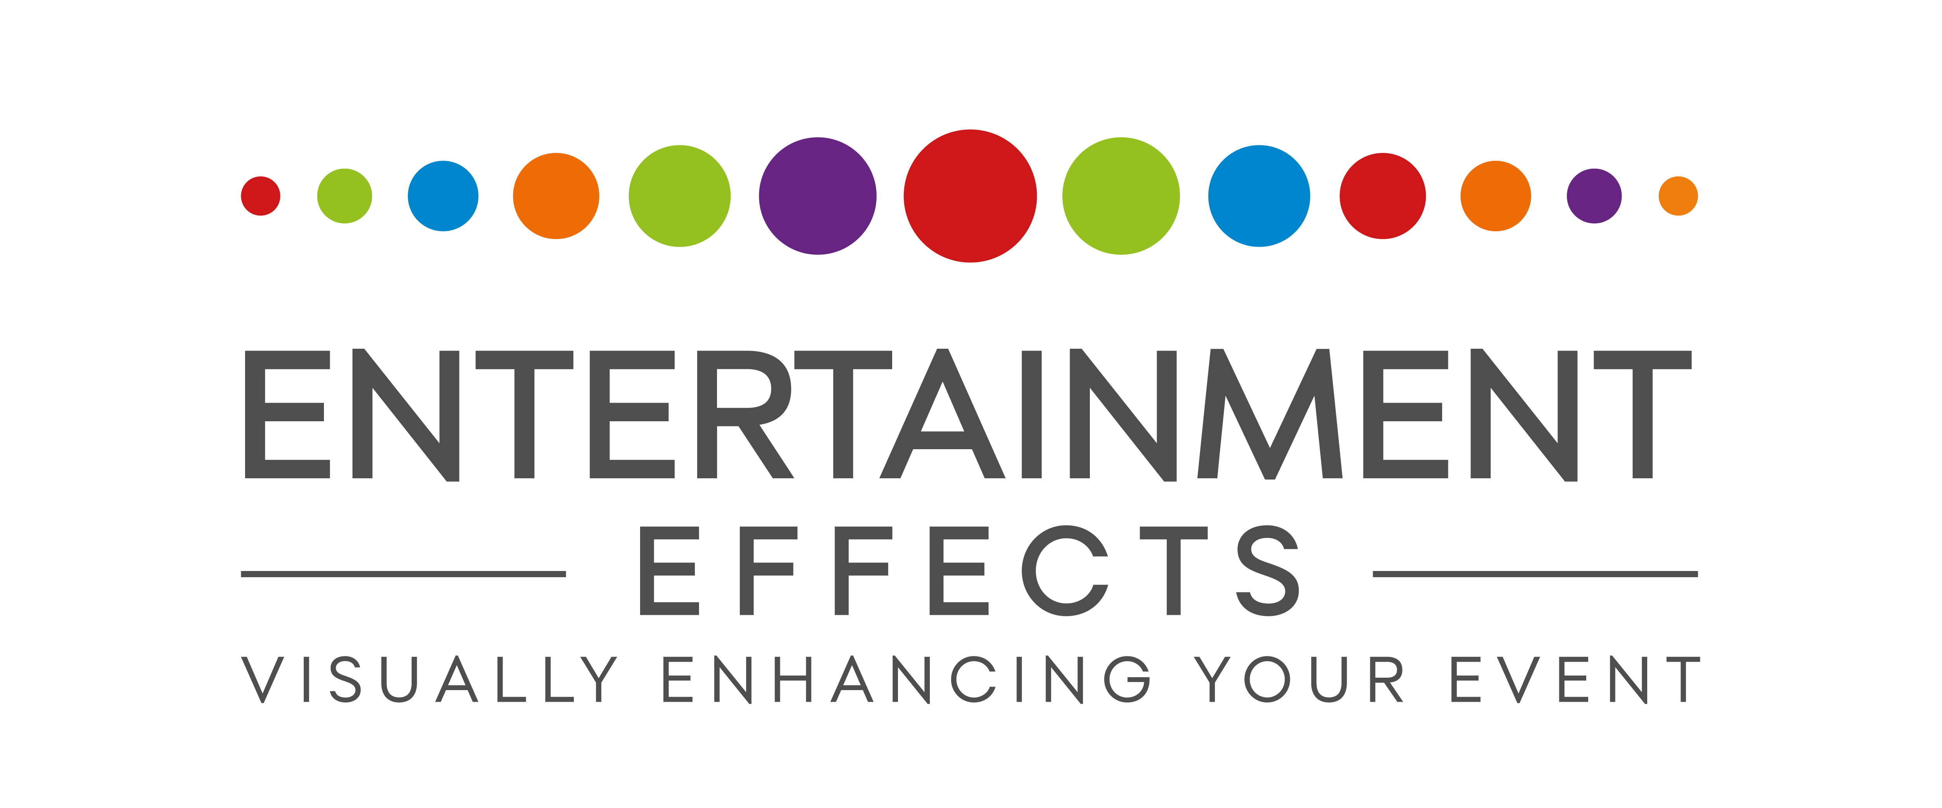

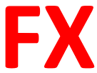
This is my current logo.
I’m looking to
Reduce the ENTERTAINMENT and replace it with ENT
Change the EFFECTS to FX
I think I would like to keep the strap line – VISUALLY ENHANCING YOUR EVENT
Or we can just add that in text under any logo design.
Preferred shape – Wide and rectangular
Something square like this doesn’t really work
ENT FX

Slide 2
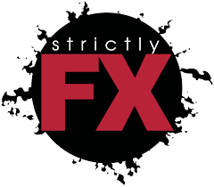




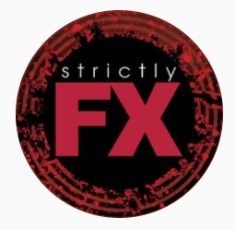
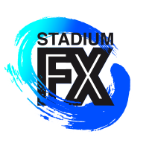
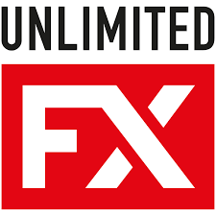
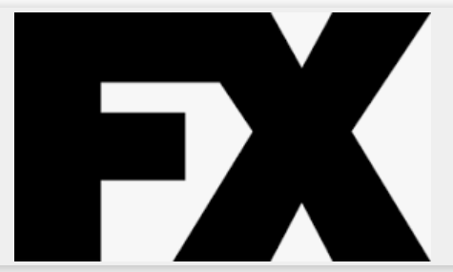
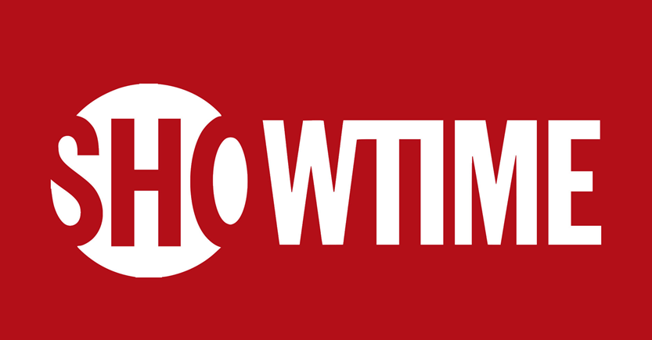
Here are some examples of other logo’s in the industry which are popular, and I like.

Slide 3
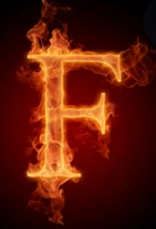
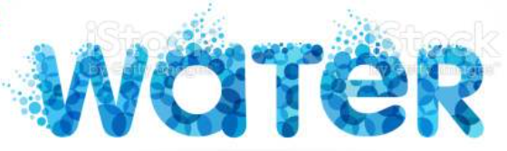


Something I’d like to see is the same logo but in 2/3 colours. A Red / Orange one I can use on the Pyro pages of my website and a Blue one for the water products. We’ve also just become carbon netural, so I’d like a Green version to promote that.
Or possibly a combined logo with the 2 FX letters in 2 different colours. One to represent the Water and the Other Pyro / Fire. Maybe using a textured lettering. The two letters would have to be aligned and look the same style.
I worry this could look a bit tacky with too much going on. Ultimately, I want a clean / smart logo.

