Slide 1
PSN Overview 2021
Prepared for
Petite Gateau

Slide 2

PSN At-A-Glance
Founded and Based in Austin, TX in 2017
Veteran Owned and Operated
Technology, Construction, and Managed Operations Services Company Focused On the Restaurant Industry
Experienced Teams of Restaurant Operators
Nearshore Technology Solution Center Offering 24/7 Support
Successfully Delivered Over 200 Projects Nationally (TX, OH, MI, OK, KS) Since 2017
Portion Of All Profits To Benefit Veteran Charities

Slide 3
What we stand for
“Our desire to improve the quality and standards of our industry, for our clients, while making a difference in people’s lives, is our mission statement. This is PSN!” – Elliott Garofalo, PSN CEO

Slide 4
WHAT WE DO
Leveraging an end-to-end integrated services portfolio offering, ranging from technology, construction, and restaurant managed operation services, PSN delivers results that move the needle!

Slide 5
Moving the Needle with PSN360
Operational Efficiency
Evaluate existing business processes for best practice adoption, automation, and shared services enablement
Assess technology landscape, integration, and support
New and Increased Revenue Streams
Brand refresh for capture of new demographics
Remodel and train existing network
New territory construction expansion
Increasing Company Value
Identify and remediate under performing locations
Implement managed operations for company store or franchise location
Increase system-wide AUV, and increase company’s market cap

Slide 6
How we do it
PSN360 is an end-to-end integrated services offering that takes a wholistic view of your company to improve operational efficiencies, identify new revenue streams, and increase overall profitability

Slide 7
PSN ValueID

Slide 8
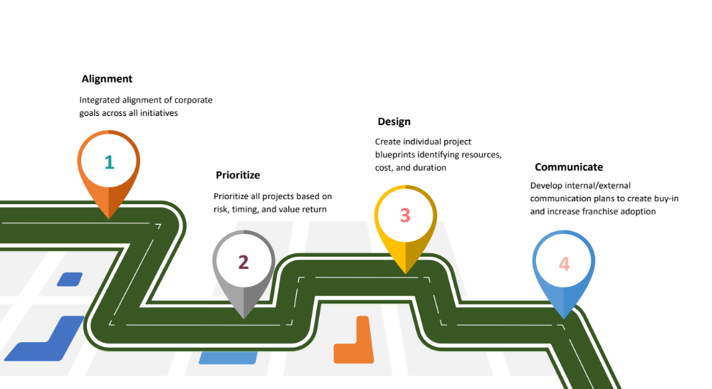
PSN ValueMap

Slide 9
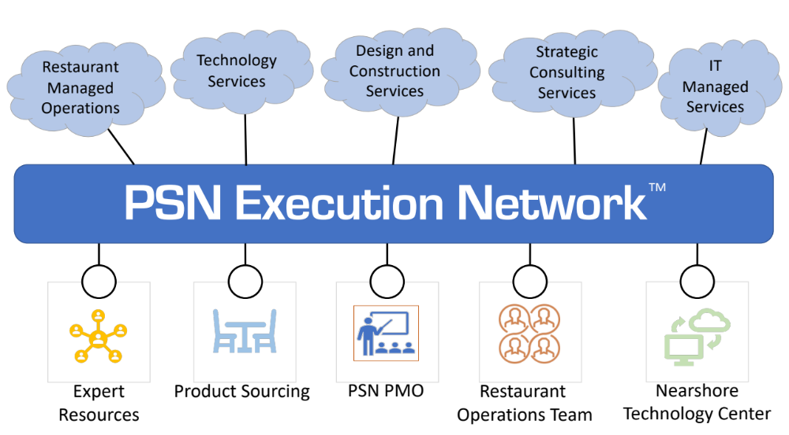

Slide 10
Detailed Service offerings
“PSN’s portfolio of service offerings, created for the restaurant industry, provides unmatched value and clarity to your business!”
– George Schaefer, PSN COO

Slide 11
Technology Services
Software Implementations
  Back-office software selection and implementation services (SAP, Oracle, JDE, Salesforce, NetSuite, etc)
  Hardware and software upgrades
  Cloud strategies and deployments
Application Development
  Mobile application development
  Business analytics dashboard development
  Disparate systems integration (3rd party delivery, etc)
Application Management Support
  Complete 24/7 IT remote support from PSN’s nearshore Technology Solution Centers
  IT Managed services for hardware, software, and databases
  Restaurant experienced technologists

Slide 12
Construction Services
New Restaurant Construction
  Site selection assistance, architectural blueprint creation, and designer services
  Ground up construction and multi-unit national rollouts
  Focused services from fine dining to quick serve restaurants
Existing Restaurant Construction
  “Front” and “back” of the house remodeling
  Exterior renovations, repairs, and expansions
  Full-service sourcing consolidation (graphics, millwork, signage, etc)
PSN’s Proprietary Delivery Methodology
  Real time project status analytics available to our clients
  Fully transparent project delivery schedules
  Fix fee priced engagements

Slide 13
Restaurant Services
New Restaurant Consulting
  Concept Development
  Site Development Consulting
  Startup Consulting
  Corporate Contract Staffing (Marketing, FBC’s, Operations, and Training)
Existing Restaurant Consulting
  Operational Analysis
  Quality Assurance and Audit Services
  GM Operations Training
  Corporate Contract Staffing (Marketing, FBC’s, Operations, and Training)
Outsourced Restaurant Management
  Operational Takeover of Existing Underperforming Restaurant Locations
  Corporate Owned or Franchisee Models
  Multiple Deal Structures Available (Royalties, Profit Sharing, Rent+, etc)

Slide 14
Don’t Take Our Word For It…
“By utilizing PSN’s different services offerings, Schlotzsky’s identified numerous aspects of our business that significantly impacted profitability”— Kelly Roddy, President of Schlotzsky's Restaurants
“PSN assessed our environment, developed a strategic roadmap, and implemented solutions that changed our forecasted profitability. We then utilized PSN’s support services to protect those gains! – Brad Wilton, CIO Valley Proteins
“Fantastic work George, Elliott, Chuck and the whole team at Patriot Services Network. Professionalism, honesty and class throughout. Can’t wait to work with PSN on my 9 other locations!” – JJ Ramsey, Schlotzsky’s Franchisee
“PSN handled everything with my store conversion! They far exceeded our expectations, and the results are amazing!” – Michele Webb, Restaurant Owner
“I chose PSN because it was obvious my best interests came first and foremost. They make every effort to minimize store disruption” – Janet Tavernier, Restaurant Owner

Slide 15
Next Steps
Determine which PSN services need to be utilized
Confirm scope and locations for 2020/2021 remodels
Develop pricing and contract agreements
Develop prioritized rollout plan
Q&A

Slide 16

Contact Us
Toll-free : 800-264-7879
Website : www.patriotservicesnetwork.com
Email : elliott@patriotservicesnetwork.com
george@patriotservicesnetwork.com
Facebook : @PatriotServicesNetwork
1213 W Slaughter Ln, #170
Austin, TX 78748

