Slide 1
2020 Candler Cup

Slide 2
1-2 minute video of who we are Bottler History

Slide 3

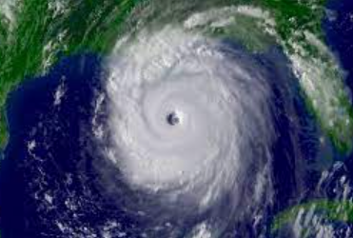
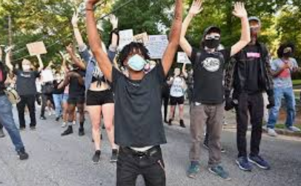
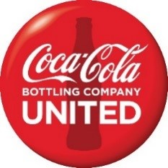
2020 was the year of turmoil
Notes:
Constant challenges that tested our brands, our people, and our communities.
Covid
Hurricanes (unique to United)
Social injustice (given nearly 50% of our workforce is black, this was a very emotional and stressful event)

Slide 4
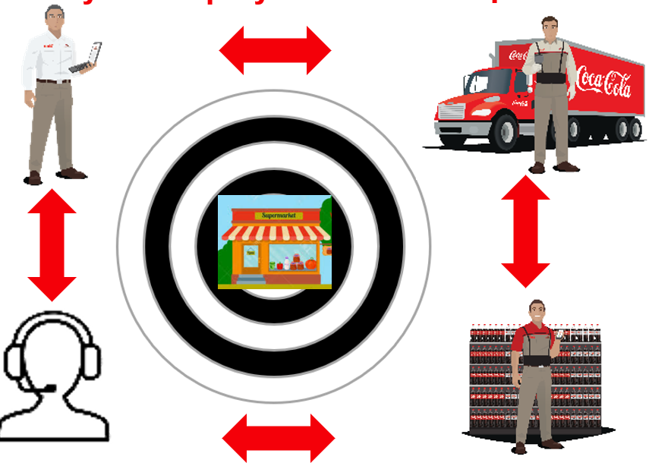
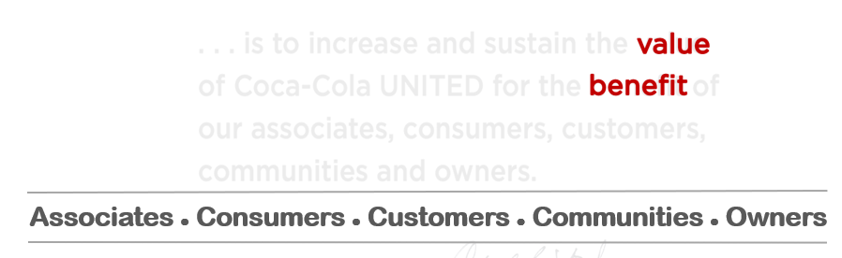
AND resilience!
An Operating Model Built on
Local Relationships
Notes:
Continued and accelerated commitment, rather than an about face, to our purpose statement, operating model and culture! Our operating model and investment strategy got us through the challenging times.
Purpose statement
Culture
Customer service focused operating model

Slide 5
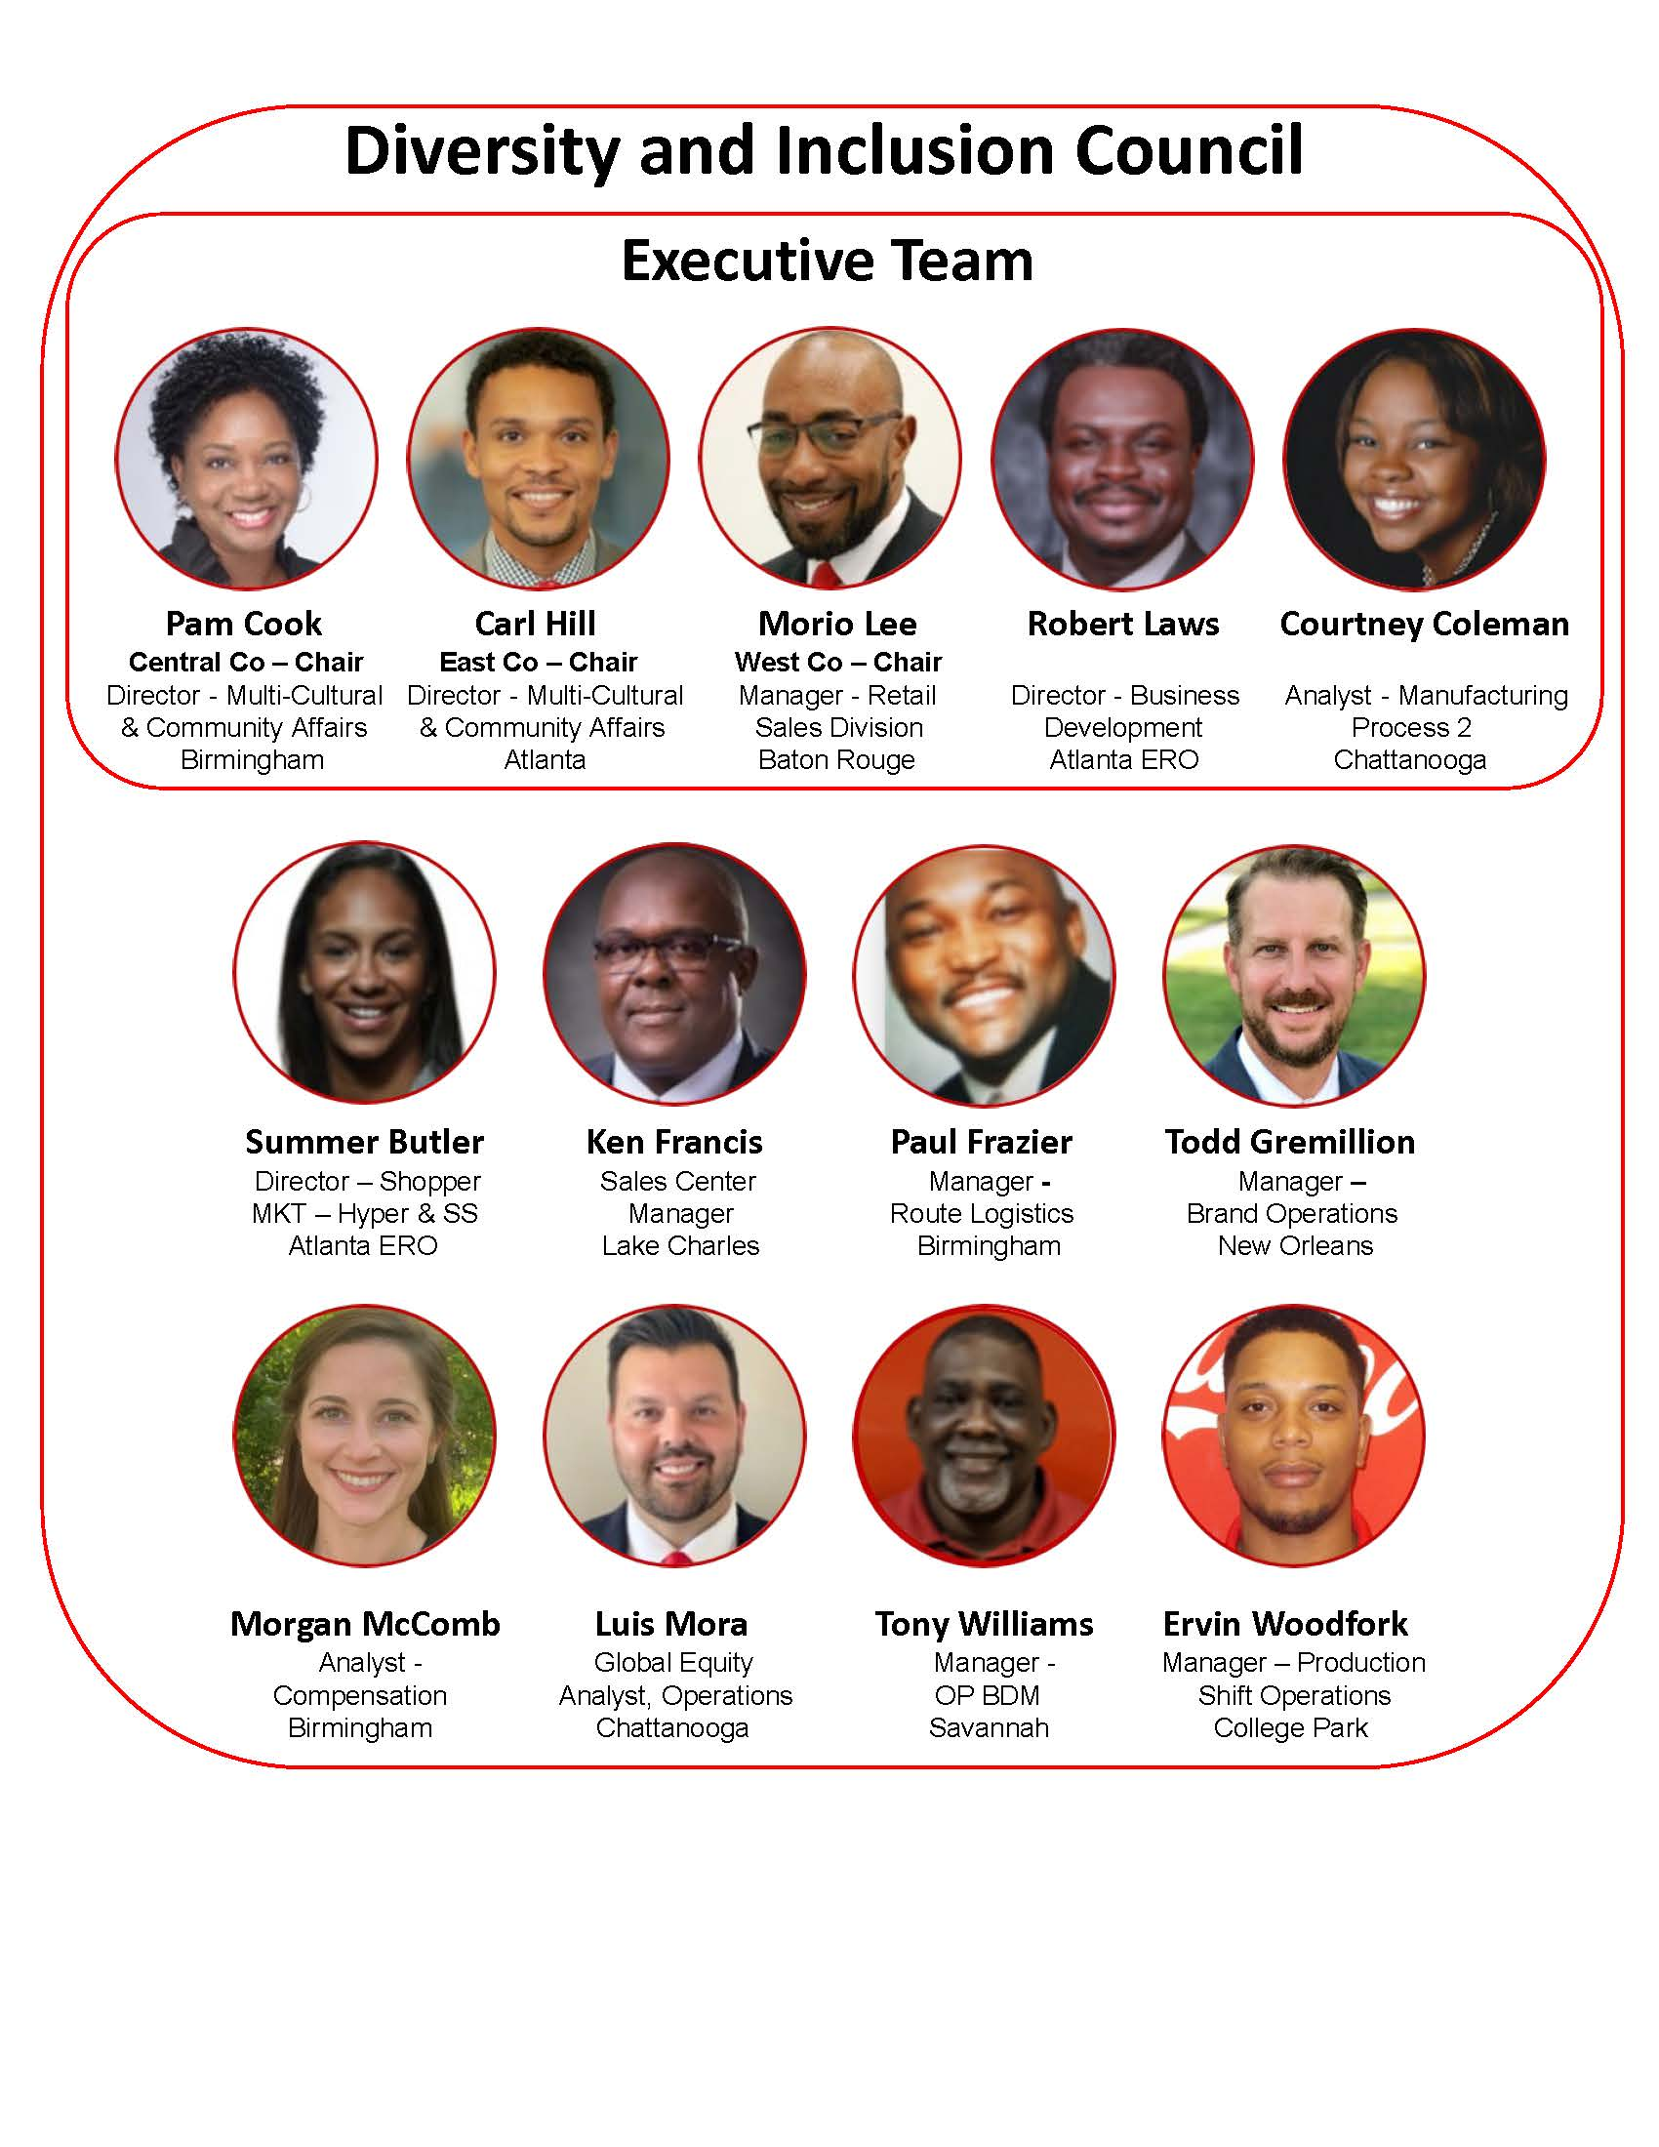
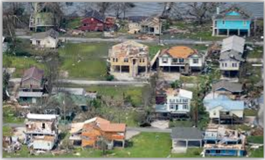


Investing in People
Inclusion
Education
Relief
Hiring for growth!
742 jobs added over 5 years
Notes:
Inclusion
D&I council
Woman’s Leadership conference
Education
Over 40,000 hours of skills training as continue to build out our culture of training workstreams
Scholarship/Tuition Reimbursement support of $80k
Employee relief fund
XXXX
Hiring for growth

Slide 6

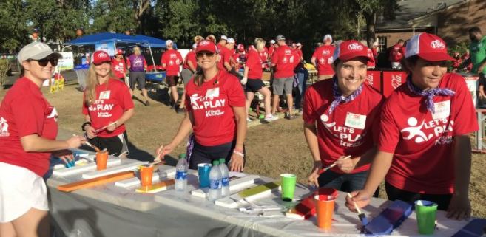
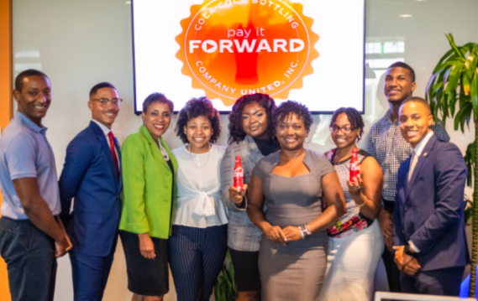
Investing in Communities
Partnerships
Philanthropy
Sponsorships
Notes:
Partnering
Working locally with organizations to advance world without waste initiatives
with our HBCU community to educate our future leaders providing 32 internships through our Pay It Forward program
$11m in strategic philanthropic donations
$20.5 million in Sponsorships

Slide 7
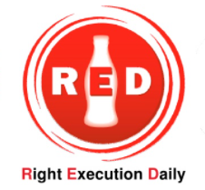
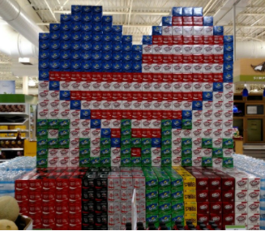
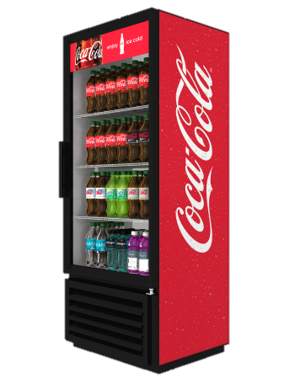
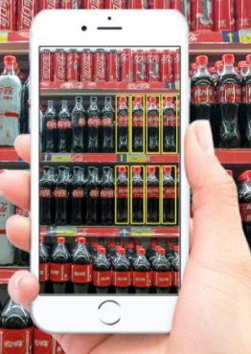
Investing in Customers
+14% RED execution
+6.5% promotion execution
17,000+ cooler placements
+5% space growth
Notes:
Execution against our strategic execution initiatives have improved +14%
We have also expanded efforts to measure execution of our promotional activities seeing an improvement of 6.5%
Placing 17k incremental coolers has helped us grow our space by 5%

Slide 8
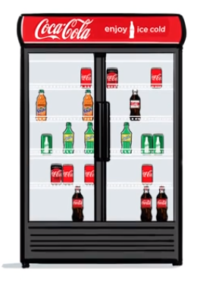
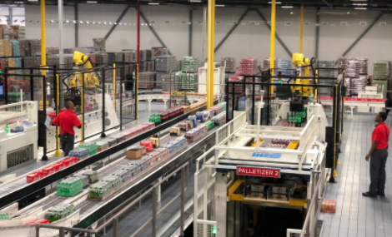
Investing in Capabilities
Infrastructure
Predictive Analytics
$568m capital plans
Notes:
Warehouse Automation
Distribution system for future growth for an ever growing portfolio
85% of our DSD volume will flow through automation investments
Predictive Algorithms for assortment and replenishment
Predictive product performance: Ensuring we have the right brands in the right locations.
Predictive order: Currently we cover 30% of our channel business with predictive orders, with plans to expand this year into nearly 80% or our customers.
All intended to improve our customer/consumer commitments and prepare for continued portfolio expansion. We know we have to use capabilities and technology to deliver on commitments.

Slide 9
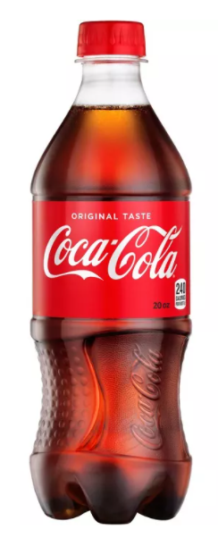
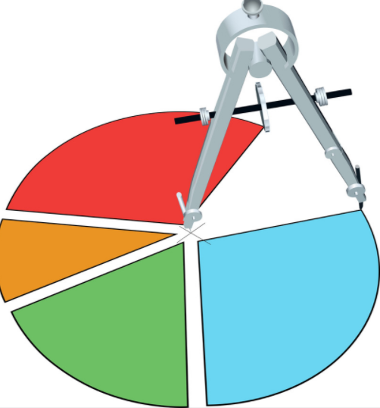
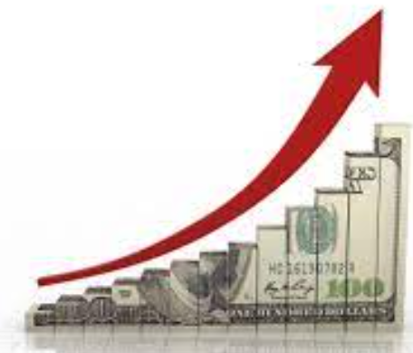
Topline Results
+4.4% sales volume
+9% or $260m retail growth
+4.6% revenue growth

Slide 10
Hold “look to future” sizzle video

Slide 11
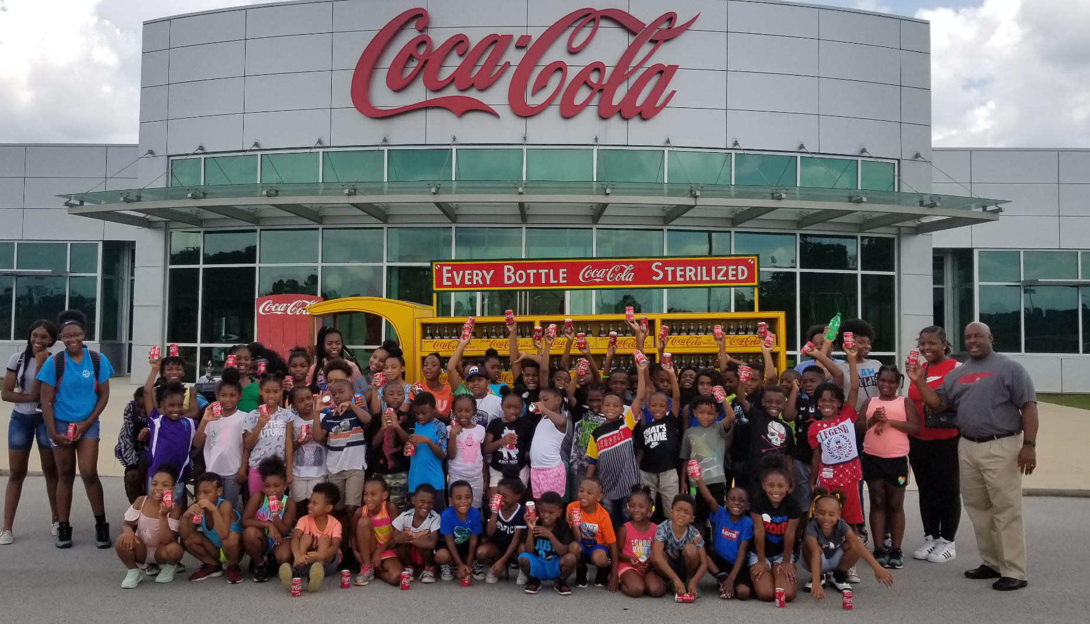
We are Market Street
Coca-Cola Bottling Company, UNITED

