Slide 1
G.a.S.
Modern fuel for scale-ups
www.GiveaSh-t.com
Logo design brief

Slide 2

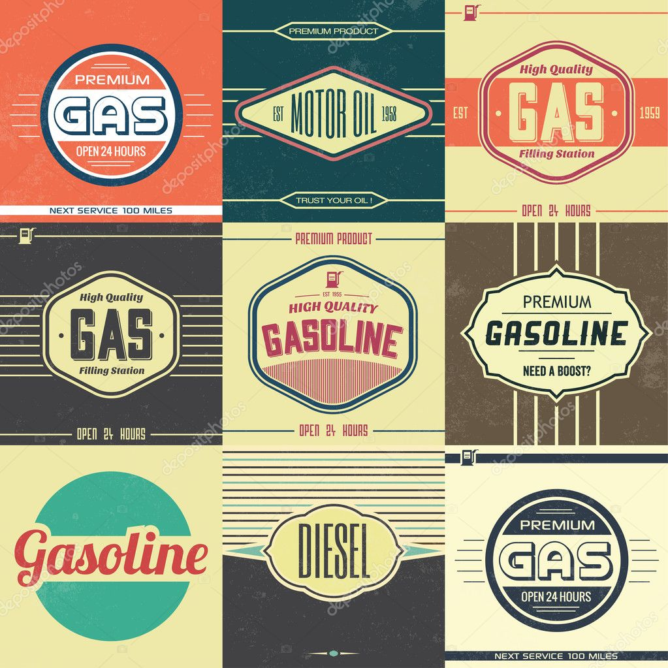
Logo inspiration
Modern day vintage, inspired by old gas station logos
I like this style font

Slide 3

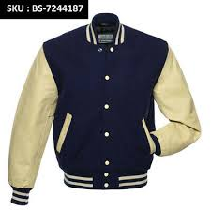

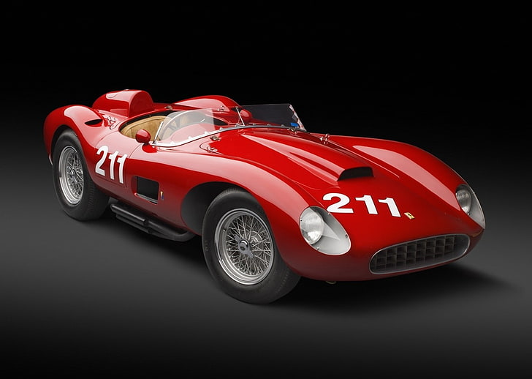
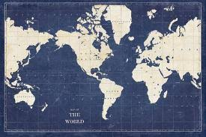

Colors
Base colors
Highlight color
Navy blue & Cream (vintage)
Ferrari red (Rosso corsa)

Slide 4
Brand values
We operate with Respect, Honesty and Transparency
We value and balance our resources...planet and human
We care about Family, the planet, our partners and fun

