Slide 1



« Parfait pour toute
la famille »
fff
« Parfait pour toute
la famille »

Slide 2
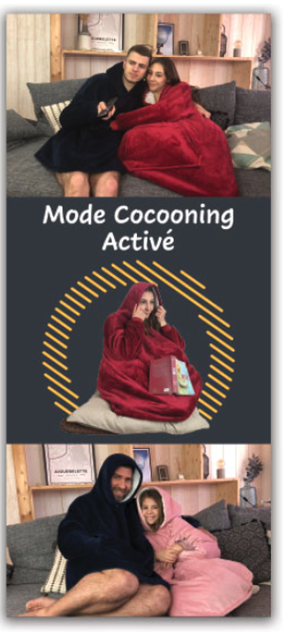

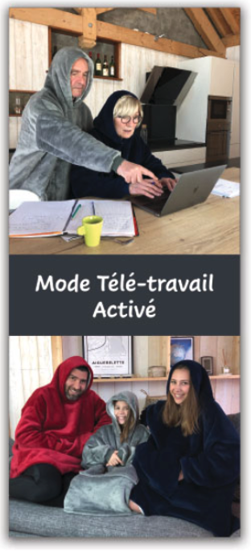
This 3 faces are OK
For this face, I will need to have 6 differents colors for the back ground. I will produce 6 colors of sweater : NAVY .DARK GREY . PINK . RED
LIGTH GREY. ALMOST WHITE. So, I will print different face according color inside.
This 3 as close as the photos on box
Keep the same as your work
Change the photo by new one downloaded just now

