Slide 1

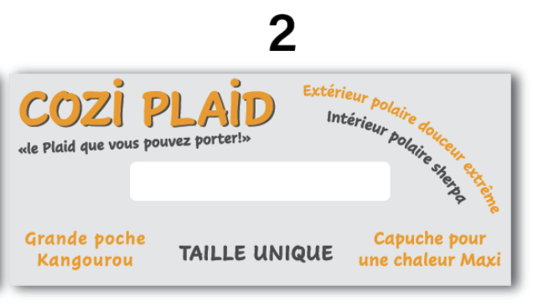
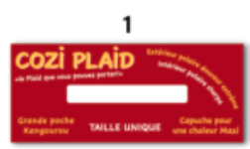

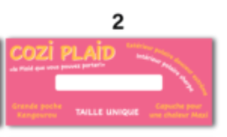


YES
COLOR LITTLE MORE DARK
Maybe Black to replace white behind COSI PLAID
COLOR MORE PASTEL
Maybe Black to replace white behind COSI PLAID + BLACK FOR WHITE WRITTING
COLOR MORE NAVY
THIS ONE OK

