Slide 1
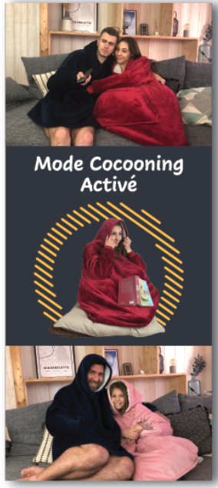

Ok or little bigger
Take out the picture
Write the words in center
Keep remaining background plain
Ok or little bigger

