Slide 1


MS602 CARTRIDGE ARTWORK CONCEPTS
TRADE RANGE

Slide 2
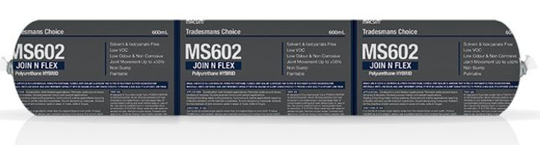
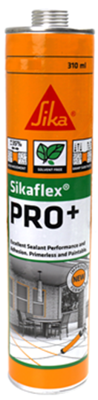
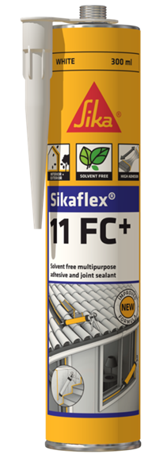
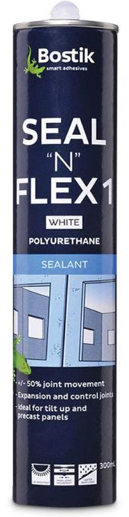
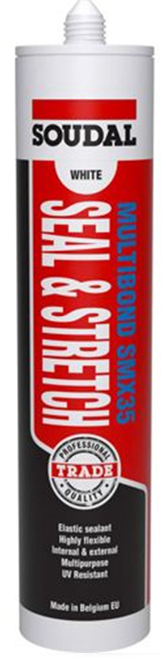
MS 602 CARTRIDGE
TRADE RANGE
COMPETITION

Slide 3
MS 602 CARTRIDGE
TRADE RANGE
MARKET SEGMENT
TARGET END USERS
Commercial / Industrial
Domestic construction
Light manufacturing
Waterproofing
Builders / Developers
Glaziers
Plumbing
Electrical
Landscape
DIY

Slide 4

MS 602 CARTRIDGE
TRADE RANGE
HEADLINE DESCRIPTION
ARTWORK THEME
High performance Hybrid PU Joint Sealant/ Adhesive
Technical
Professional
Trustworthy
Reliable
Not for DIY
Not Selleys
Not Soudal
KEY SELLING FEATURES
Solvent & Isocyanate Free
Non-Carcinogenic
Low VOC
Low odour
Joint movement +/-25%
Non slump
Paintable

Slide 5
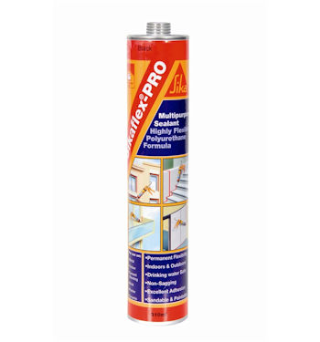
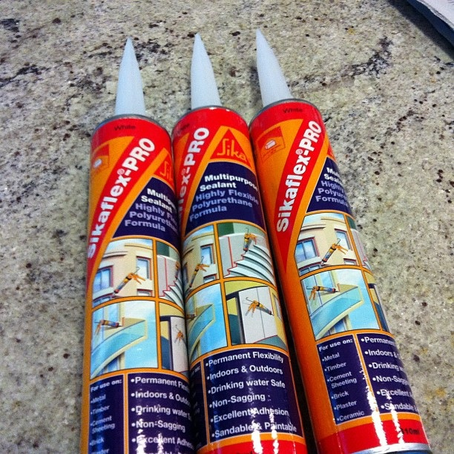
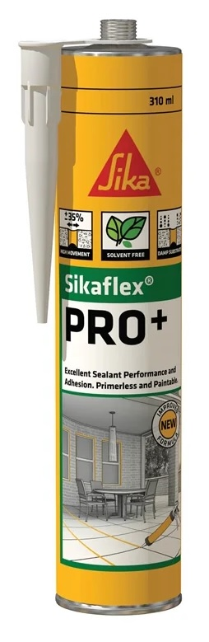
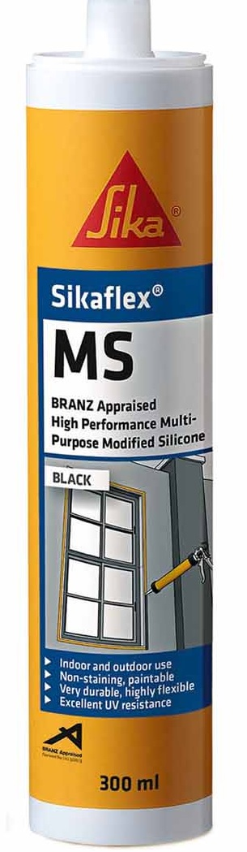
MS 602 CARTRIDGE
TRADE RANGE
APPLICATIONS IMAGES / DRAWINGS
Under Waterproofing seal
Window Reveal / Sub-Sil
Concrete Precast
Sealing Brickwork

Slide 6
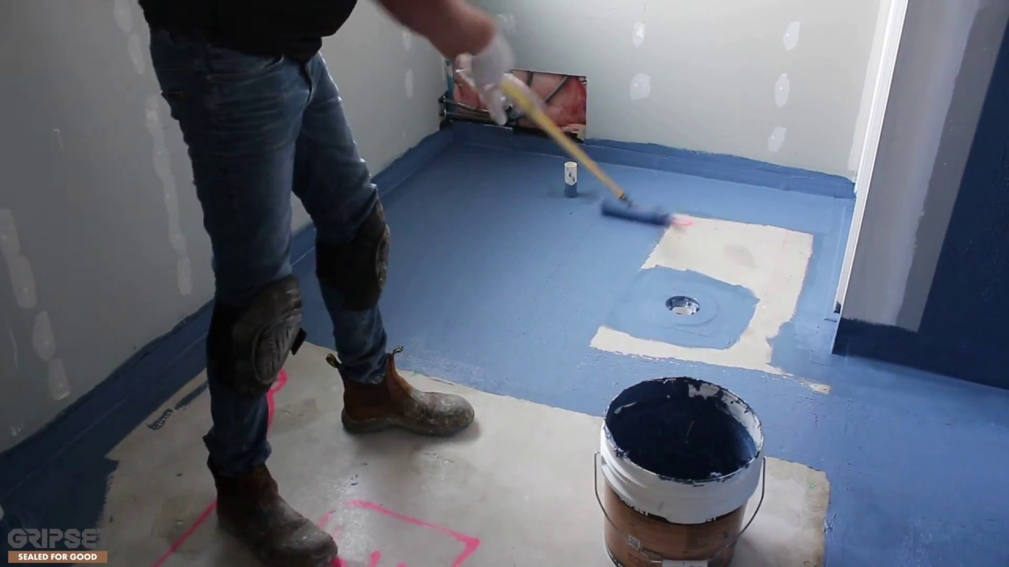
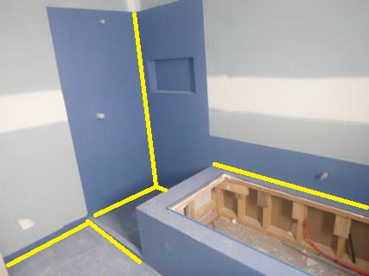
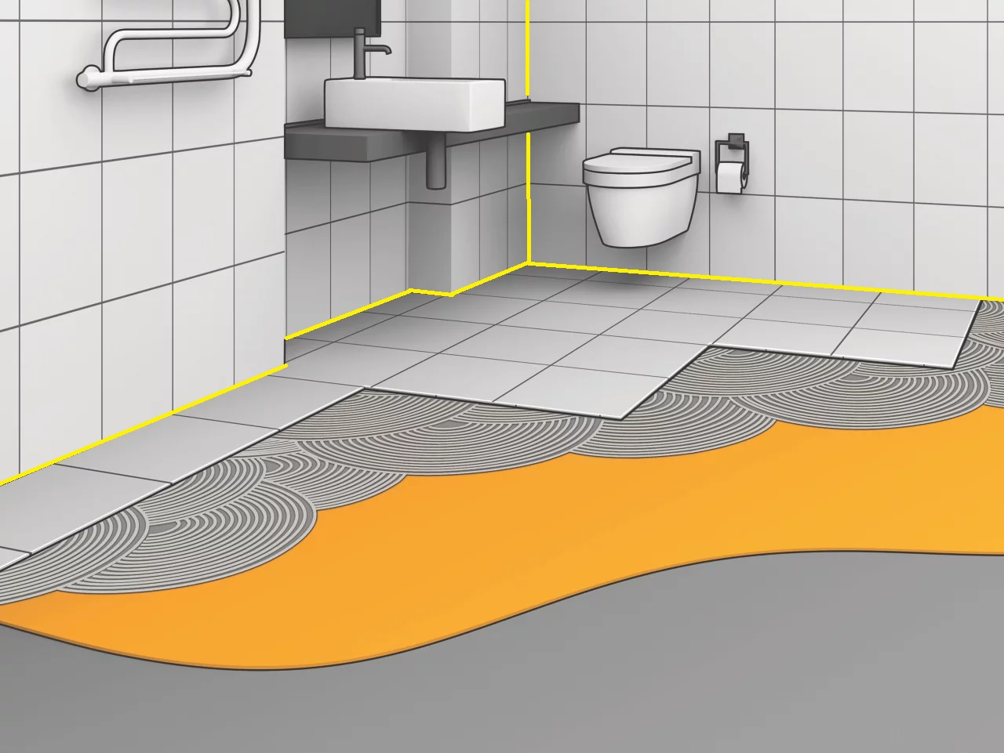
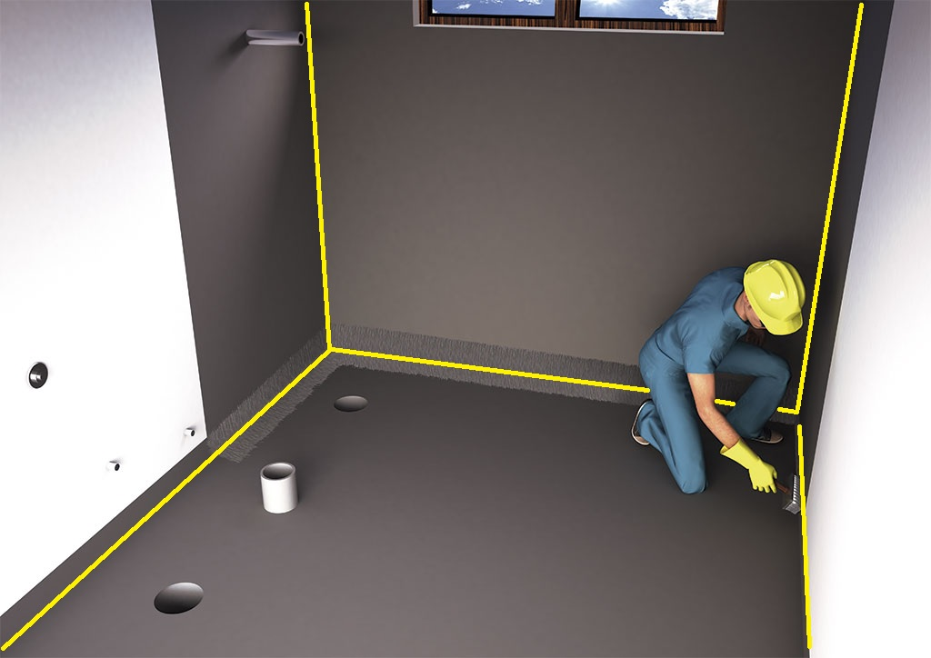
MS 602 CARTRIDGE
TRADE RANGE
WATERPROOFING
Under Waterproofing Fillet / Joint Seal
Before a waterproofing membrane is applied, all joints between plaster, shower bases, cement sheet and risers are sealed using MS602 Hybrid PU.

Slide 7
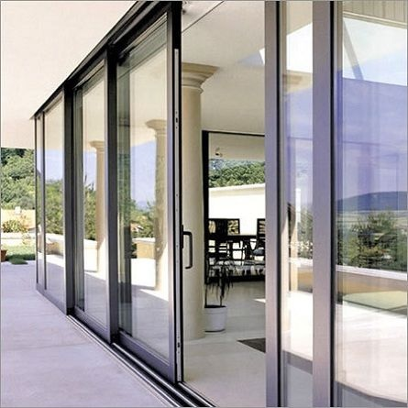
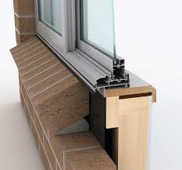
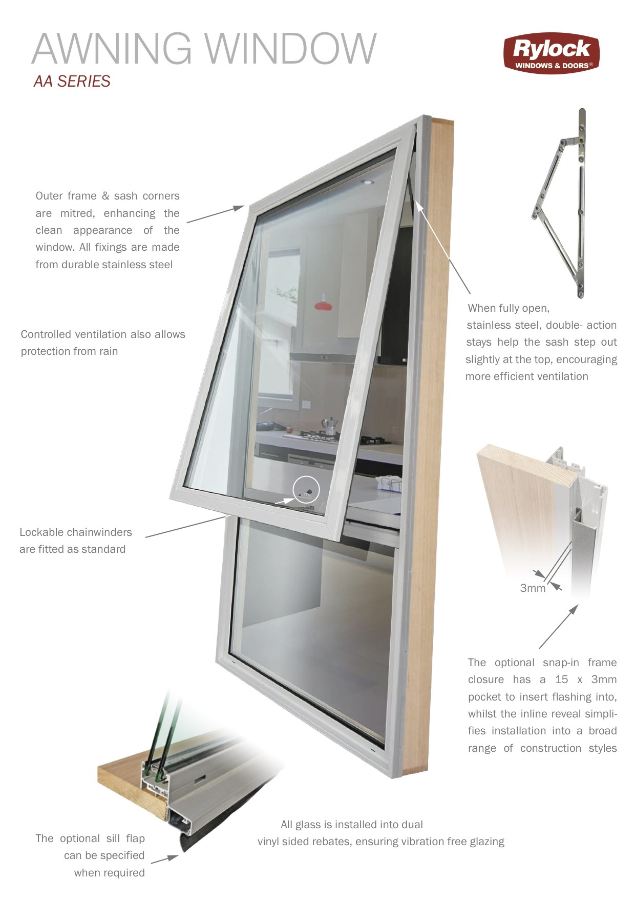
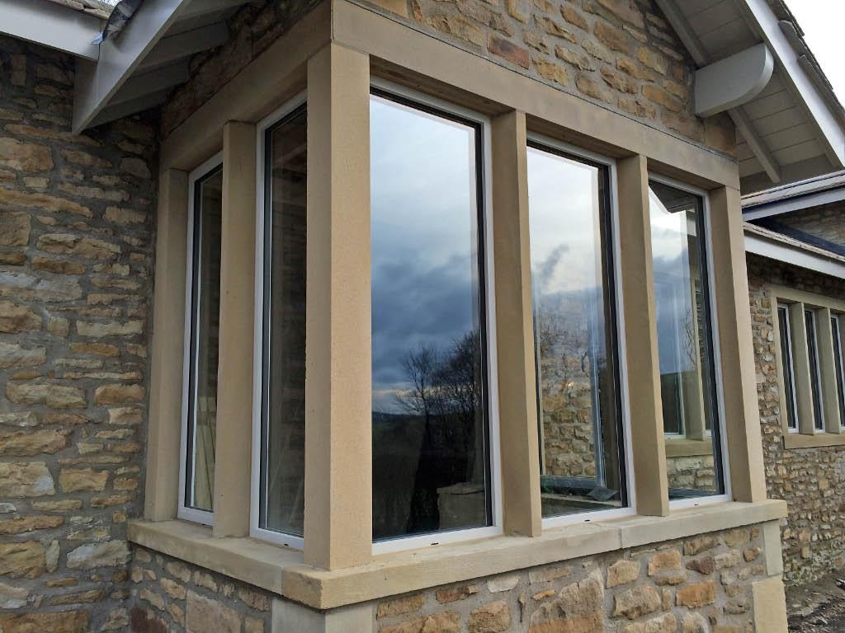
MS 602 CARTRIDGE
TRADE RANGE
WINDOW INSTALLATION
Sub-Sill Window Sealing application
When windows are installed, the top, sides and bottom of the window frame itself needs to be sealed to prevent moister ingress, as well as create a draft seal.

Slide 8
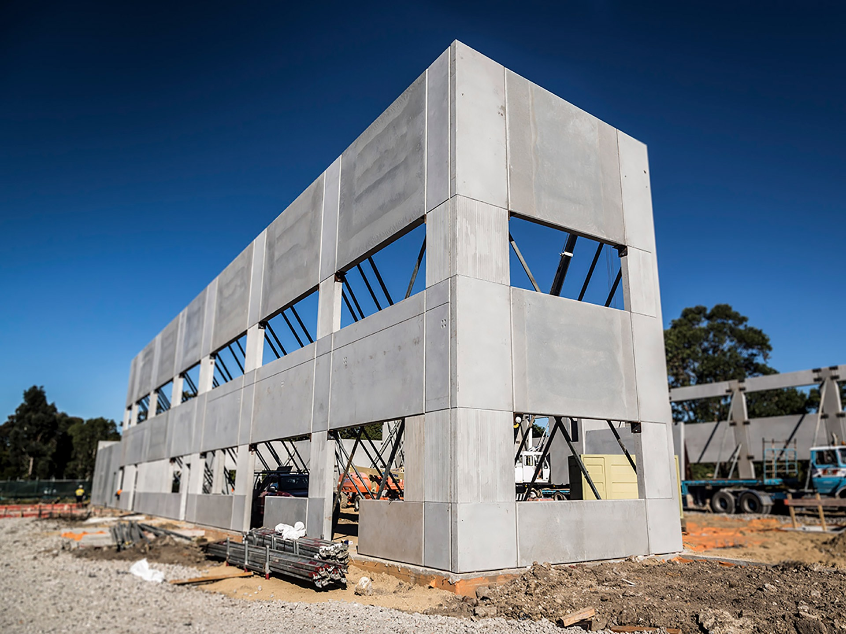
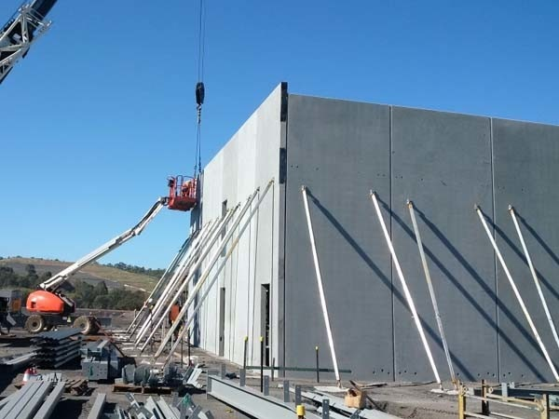
MS 602 CARTRIDGE
TRADE RANGE
PRECAST CONCRETE CONSTRUCTION
All joints (vertical and horizontal) in-between concrete precast panels are sealed to prevent moisture migration and is usually sealed on both sides of the joint.

Slide 9
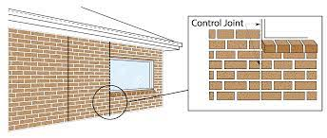
MS 602 CARTRIDGE
TRADE RANGE
GENERAL DOMESTIC JOINT SEALANT
All

