Slide 1
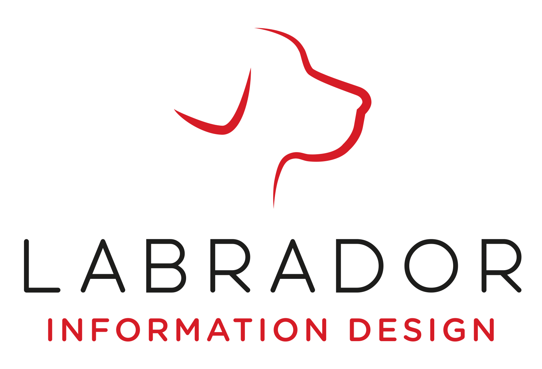
Brief logo « Investor Relations Lab’ »

Slide 2
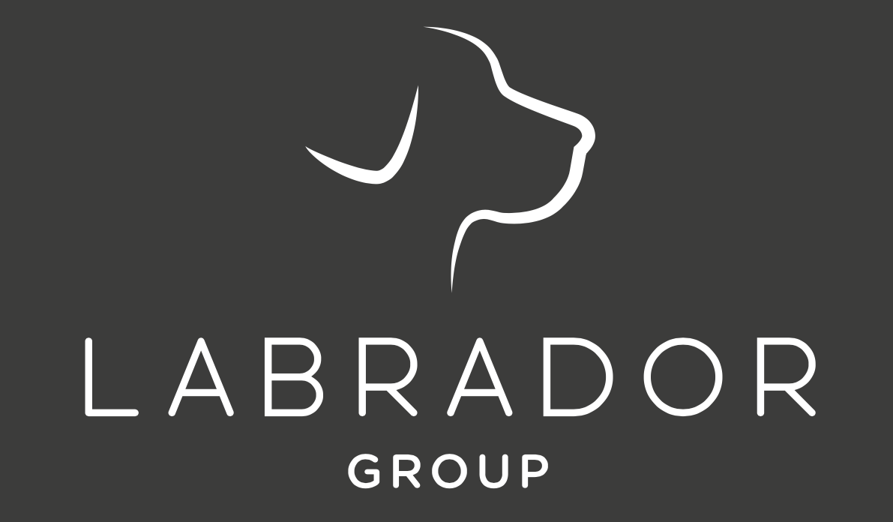
Who are we ?
Losam Agency, marketing agency specializing in the creation and animation of communities.
Losam Agency created “ Investor Relations Lab’ ” for the company Labrador, the first think tank dedicated to the future of regulated information
The “ Investor Relations Lab’ ” what is it ?
(5 meetings a year (1 dinner + 4 breakfasts meeting)
1 stategic committee composed of 8/10 leaders which will define the themes of the different meetings.

Slide 3
Who is Labrador ?
Labrador is a consulting, writing, design, ergonomics and translation agency.
The mission of the Labrador Group is to make companies love by inventing trusted corporate information that creates value for its clients and preference for their audiences.
Labrador brings together more than 40 business expertises, structured around a research laboratory and two agencies:
Labrador Maverick, Corporate Information Research Laboratory.
Labrador Information Design, Consulting agency in regulated communication and reading ergonomics
Labrador Language Services, Clear Language and Translation Agency.
The Labrador Group offers a unique and turnkey range of expertise across the entire information science business chain: regulated communication consulting, reading ergonomics, illustrations and educational graphics, writing and translation in clear language, secure constitution and production platform, publishing, printing and digital versions.

Slide 4
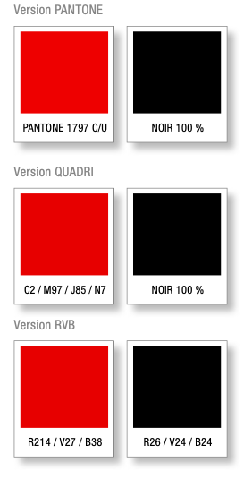
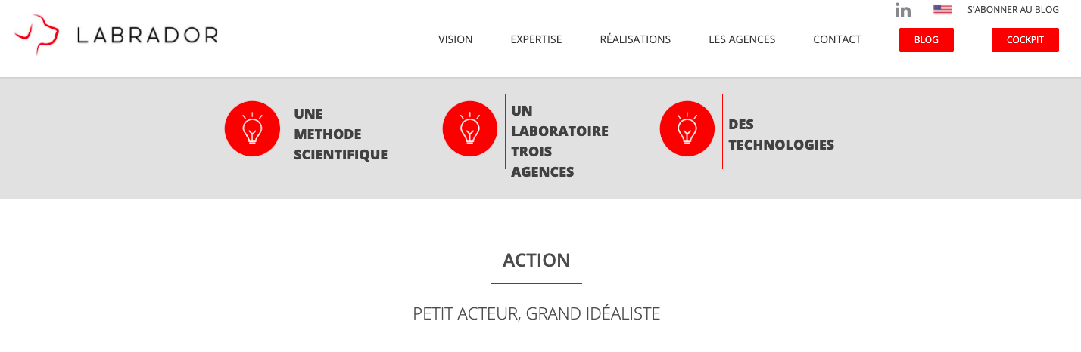
LABRADOR’S BRAND GUIDELINE

Slide 5
INVESTOR RELATIONS LAB
Target :
Director of Investor Relations and Director of Financial Communications
Positioning :
Under the impulse of Labrador and a dozen major clients, the Lab' aims to bring together issuers who wish to reflect collectively on the new challenges of regulated information.
The principle is to create a laboratory for experimentation based on the sharing of experiences, visions and convictions.
Baseline:
« Think-Tank dedicated to the new dimensions of regulated information. »

Slide 6
BRIEF
What : Creating a logo
Sector : Marketing
Logo text : Investor Relations Lab’
« A SOBER AND CHIC UNIVERSE »
Elégant
Amusant
Traditionnel
Personnel
Féminin
Coloré
Bas de gamme
Audacieux
Sérieux
Moderne
Professionnel
Masculin
Noir et Blanc
Haut de Gamme

Slide 7
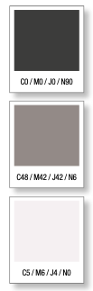
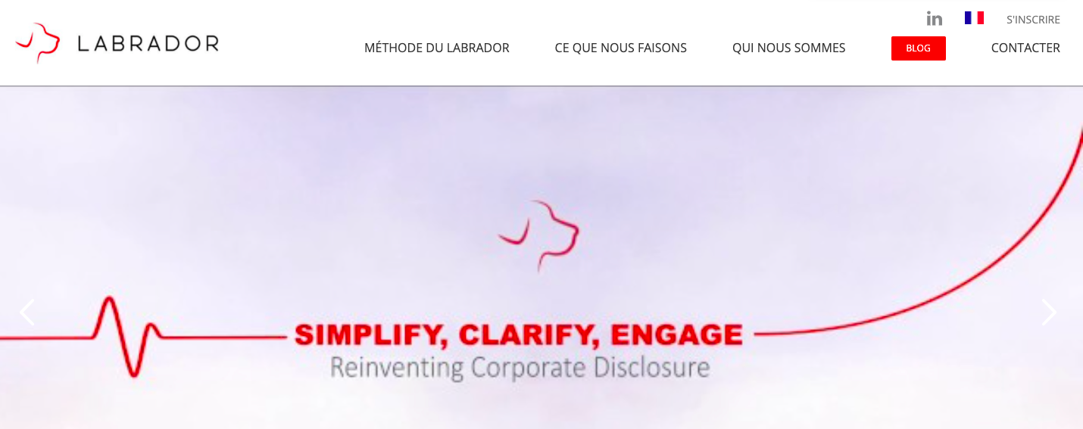
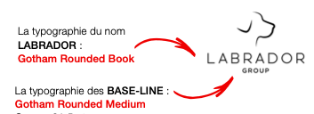
DNA OF LABRADOR
We want to keep the DNA of our partner

Slide 8

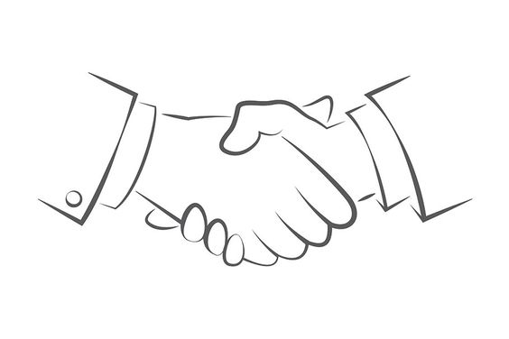
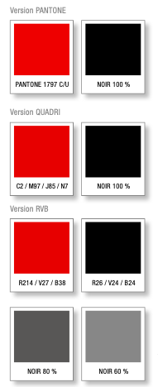

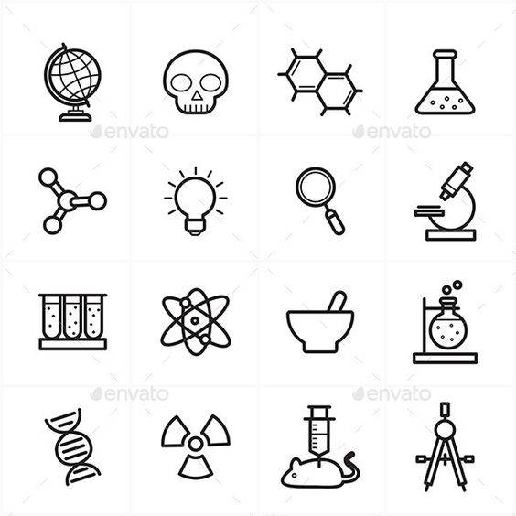
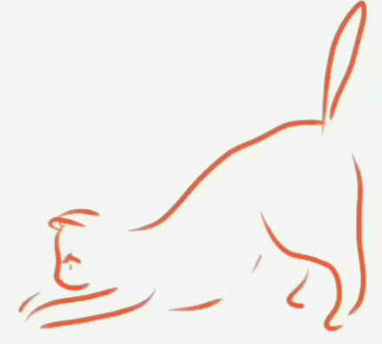
INSPIRATION
A minimalist logo, seems drawn
Use inspiration from the word « relations », « Lab »
Use the colors of Labrador

